Slide 1
BEBC_Hw
File created on: 3/20/20 3:51:31 PM PDT

Slide 2
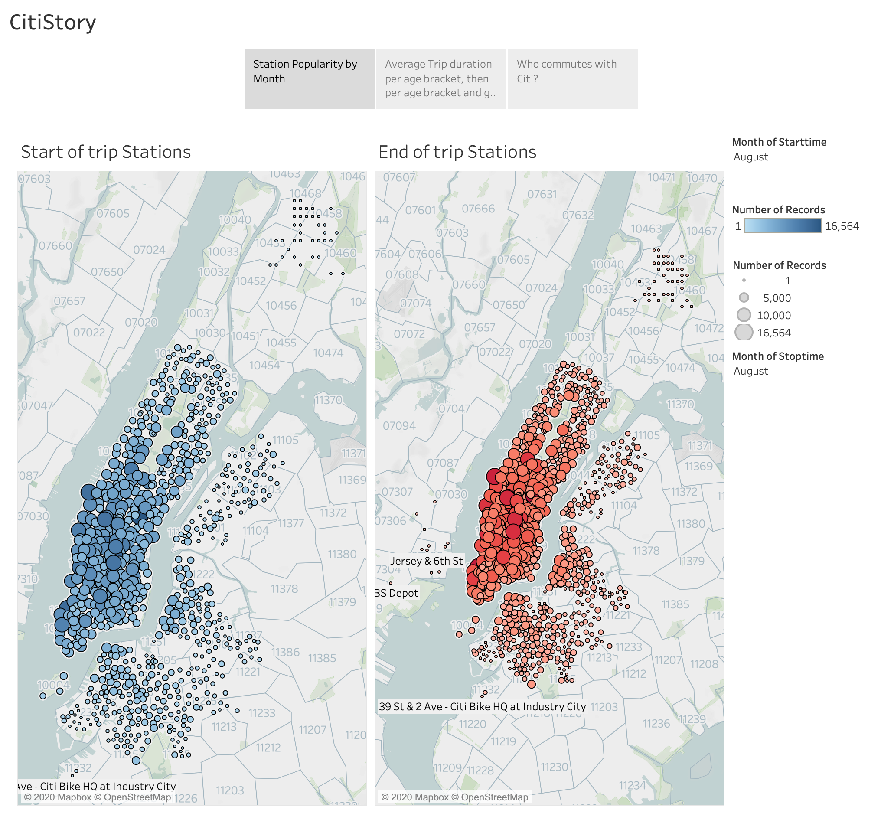

Slide 3
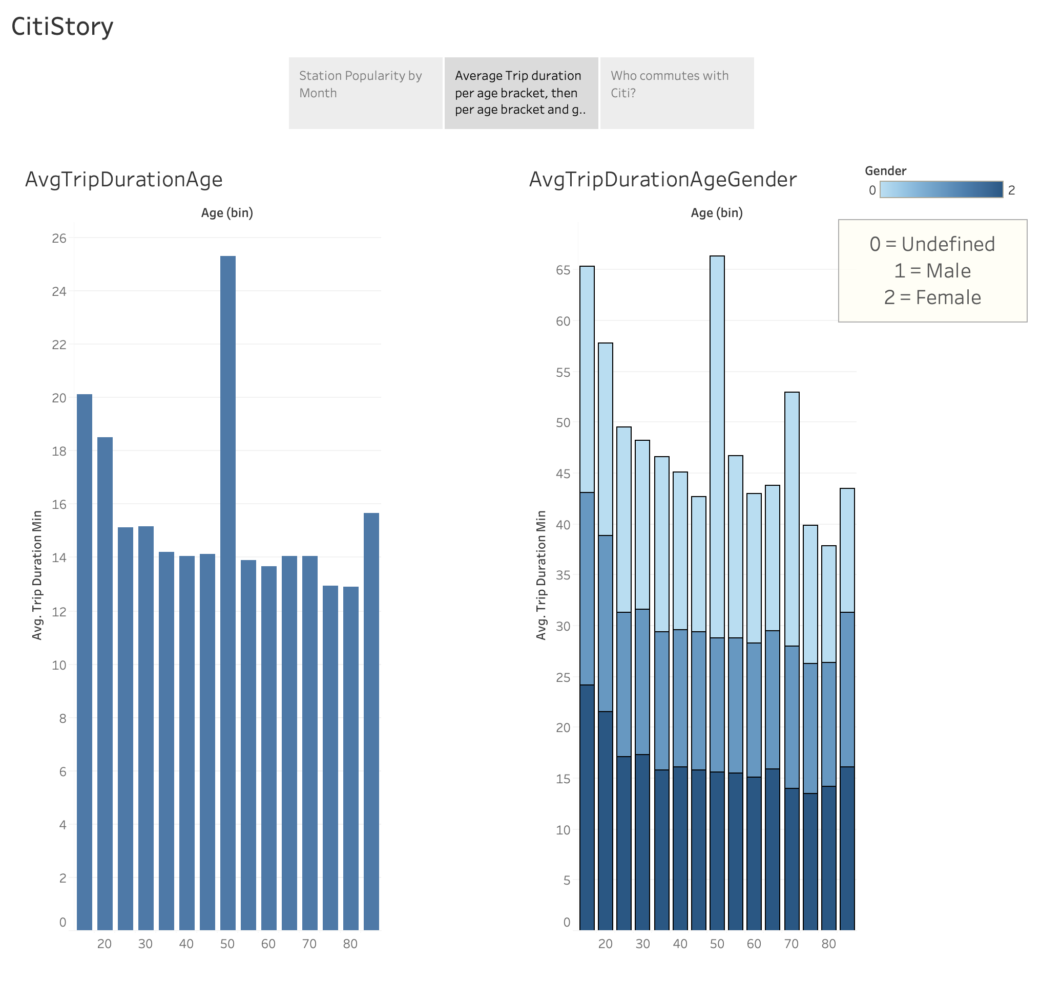

Slide 4
