Slide 1
Healthcare Providers' Strategies and Challenges in Managing Medication Errors in Eastern Region, Ghana;
A Qualitative Study on Interventions, Communication, and Safety Improvements
Title
JOSEPHINE OSEI
ERHD
AJ HEALTH & RESEARCH CONSULT

Slide 2
Outline
  Background
  Objectives
  Methods
  Results
  Conclusion
  Recommendations
  Acknowledgements

Slide 3
Background
Global Context:
  Medication errors (MEs) cause preventable harm to 1 in 20 patients (WHO, 2019).
  LMICs face higher risks: 83% of MEs are preventable, 30% result in death.
Ghana’s Challenge:
  Limited data but a burden trends that mirrors other LMIC countries (i.e. weak reporting systems).
  Eastern Region: 3.3M population, 1,226 health facilities, hybrid digital-manual workflows.
Research Gap:
  Scanty studies on Ghana-specific challenges, especially in Eastern Region.

Slide 4
Objectives
General Objective:
  To explore providers’ experiences, strategies, and challenges in managing MEs.
Specific Objectives:
  Examine processes for identifying/resolving MEs (time spent, methods).
  Assess institutional resources and communication strategies.
  Identify root causes and innovations for prevention.

Slide 5
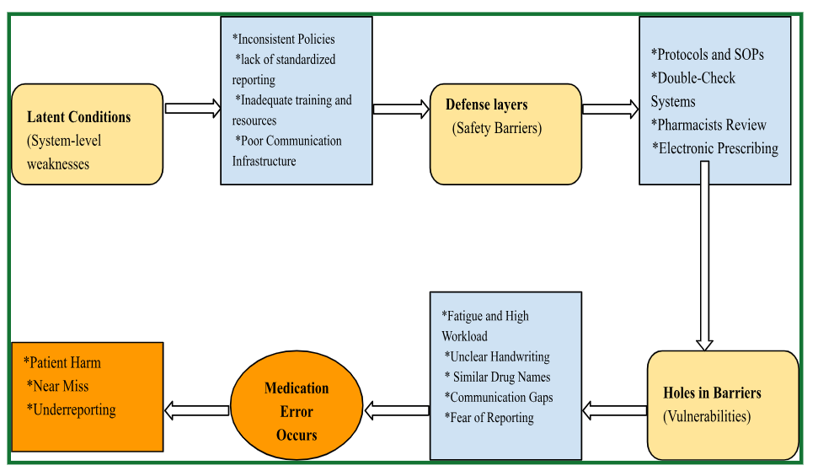
The Reason’s Swiss-Cheese model framework

Slide 6
Methods
Design: Qualitative, in-depth interviews.
Setting: 9 districts (3 zones) in Eastern Region; 27 participants (Prescribers, Nurses, Pharmacists and Pharmacy Technicians).
Sampling: Random selection of District Hospitals and Purposive selection of participants from district hospitals.
Data Collection: Audio-recorded interviews, thematic analysis based on key themes.
Ethics: Confidentiality ensured, Regional permissions obtained from ERHD.

Slide 7
Questionnaire Pre-Test Site
Facility Name | Districts | Zones | No. of Interviewees per facility
Atua Government Hospital | Manya-Krobo | Northern | 3

Slide 8
Sampled Districts
Facility Name | Districts | Zones | No. of Interviewees per facility
Eastern Regional Hospital, Koforidua | New Juaben South | Southern | 3
Nsawam Government Hospital | Nsawam-Adoagyiri | Southern | 3
Oda Government Hospital | Birim Central | Southern | 3
Asesewa Government Hospital | Upper Manya-Krobo | Northern | 3
Kwahu Government Hospital | Kwahu South | Northern | 3
Enyiresi Government Hospital | Atiwa East | Northern | 3
Kibi Government Hospital | Abuakwa South | Middle | 3
Yilo Krobo Municipal Hospital(Somanya) | Yilo-Krobo | Middle | 3
Kade Government Hospital | Kwaebibirem | Middle | 3
Total | 9 |  | 27

Slide 9
RESULTS
PROCESS MEASURES
Hybrid Error Detection
SYSTEMS MEASURES
Service Delivery: Workloads and Staffing Shortages
Underreporting Culture
Health Information Systems: Hybrid Digital-Manual workflows
Leadership: Punitive Cultures
Health Commodities: look-alike drugs and poor labeling

Slide 10
Results – Process Measures 1
Hybrid Error Detection
  LHIMS (digital) + manual checks
  "Using electronic prescribing has significantly reduced handwriting errors, but we still manually verify each order before dispensing" (P21).
  Introduces inefficiencies into the error resolution process (2-hour resolution time per error).
  “We usually detect errors when preparing to issue medications. The entire process from the doctor writing the prescription to the correction can take one to two hours, depending on the pharmacy workflow." (P6)

Slide 11
Results - Process Measures 2
Underreporting Culture
  Fear of blame
  "My supervisor still asks 'who messed up?' rather than 'what failed?'" (P18).
  Hinderance by hierarchical communication barriers
  "There is fear that reporting errors might affect performance evaluations, so some staff choose to remain silent."(P22).
  Informal resolution
  “We do not have a standardized reporting system. Sometimes, minor errors are corrected immediately, but only life-threatening ones are documented.”(P14)
  Lack of patient-friendly reporting mechanisms.
  “Patients sometimes notice errors, like incorrect dosages, but they don’t know how to report them.”(P14),

Slide 12
Results- Systems Measures 1
Root Causes
Service Delivery: Workloads and Staffing Shortages
"When the workload is too high, we tend to rush through prescriptions, and that’s where mistakes happen." (P7).
"With 100+ patients daily, thorough checks become impossible by afternoon" (P7).
2. Health Commodities: look-alike drugs and poor labeling
"Some medication names resemble each other, and if you're not vigilant, you could mistakenly dispense the wrong one, especially when you're under pressure" (P4, Pharmacist, 8 years).

Slide 13
Results- Systems Measures 2
3. Health Information Systems: Hybrid Digital-Manual Workflows
Introduces significant bottlenecks when technical failures occur.
Adaptive tech use (paper backups).
“A medical officer remarked, "When LHIMS crashes, we revert to paper, and errors spike" (P19).
4. Leadership: Punitive Cultures
The absence of safety in error reporting(peer safeguarding) prevents organizational learning from near-misses and minor errors.
Routinely address errors informally rather than through formal channels

Slide 14
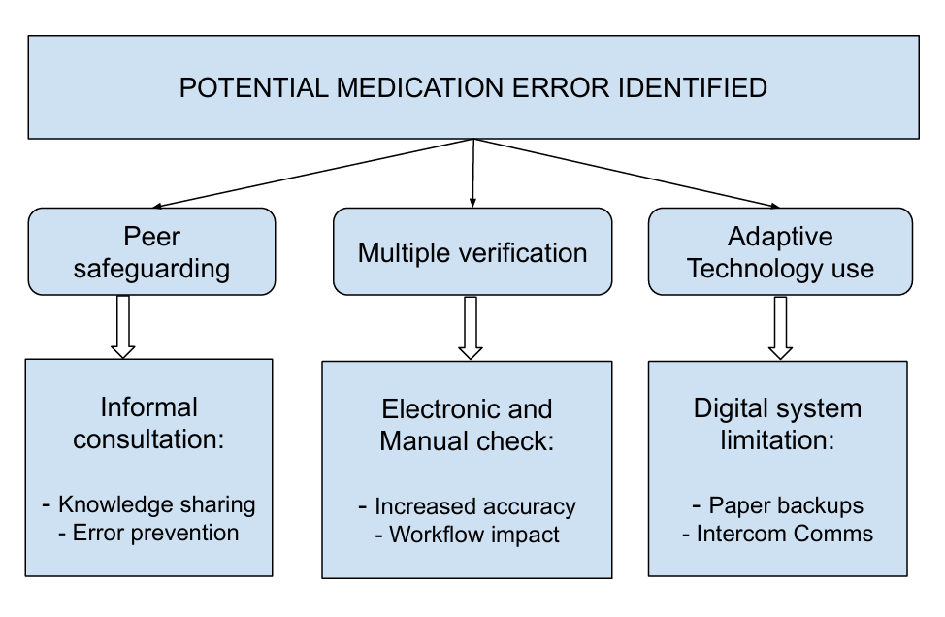
Current Medication Safety Interventions & Strategies in the Eastern Region

Slide 15
Recommendations
Immediate (0–6 months):
Strengthen SBAR (Situation, Background, Assessment, Recommendation) communication protocols
Incorporate peer validation and structured checklists to reduce dispensing errors ( high-risk medications).
Use Tall-man lettering for Look-Alike/Sound-Alike Drug Names. e.g. predniSONE vs. prednisoLONE
Short-Term (6–18 months):
Train facility leadership in Just Culture principles to foster a blame-free environment that encourages error reporting and learning.
Strengthen and scale up anonymous, mobile-based error reporting systems to encourage incident documentation without fear of punitive repercussions.
Develop and implement context-appropriate medication reconciliation protocols
Long-Term (18–36 months):
Expand the clinical roles of pharmacists in error detection, reporting, and patient safety leadership across all healthcare levels.
Pilot barcode-assisted medication administration (BCMA) in selected tertiary facilities.

Slide 16
Conclusion
  Hybrid systems improved legibility but introduced delays making the error detection reactive rather than preventive.
  Fear of blame and weak reporting structures discourage open communication and learning from errors.
  High workloads and similar-looking medications increase error risks, highlighting the need for staffing support and better labelling.

Slide 17


Acknowledgements
Participants (Interviewed Healthcare staff)
Eastern Regional Health Directorate.
AJ HEALTH & RESEARCH CONSULT

