Slide 1
BIG MOUNTAIN RESORT PROJECT
October, 2020

Slide 2
Problem Identification
Big Mountain Resort
Access to 105 trails by 11 lifts, 2 T-bars and 1 magic carpet
Current Adult Ticket Price: $81.00
Installation of an additional chair lift which increases the operational costs by $1,540,000
Needs the best premium ticket pricing model for offsetting the additional cost and reflecting the value of facilities.

Slide 3
Recommendations
Model predicted ticket price: $94.22
2nd Scenario; Increasing the vertical drop by adding a run and installing additional chair lift increases the ticket price by $1.99 and revenue by USD3.5M.
No ticket price change by closing the least used 1 run.

Slide 4
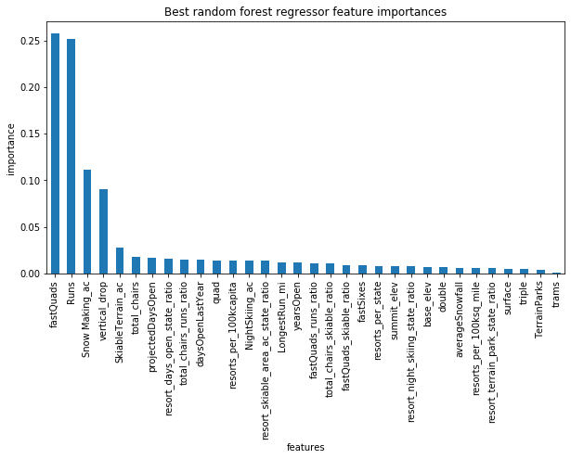
Modeling Results and Analysis
The top 4 features correlated with ticket pricing:
FastQuads
Runs
SnowMaking_ac
Vertical_drop

Slide 5
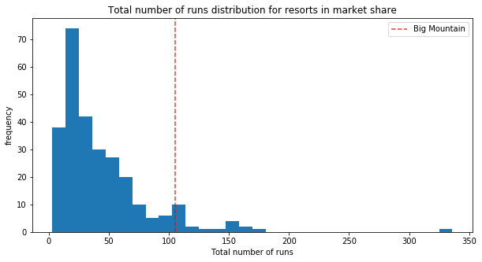
BMR Position Among the competitors
Although BMR’s current ticket prices are higher In Montana and among other states, due to its position in these features, our model predicts ticket prices can be increased up to $94.22.
RUNS

Slide 6
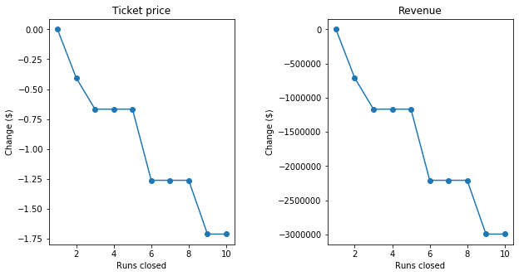
Closing Least Used Runs
Closing 1 run makes no difference
Closing 2 reduces ticket price by ~$0.41
Closing 3-4-5 reduces ticket price by ~$0.67
Closing 6 or more leads to a large drop

Slide 7
Conclusion
By the 2nd Scenario, revenue will be twice the expenses which offsets the installation and operational costs.
To compensate the cost of 2nd scenarios additional run, closing least used 1 run would be recommended.
To improve the model performance, knowing the operational costs of snowmaking, staff, electricity and maintenance would be useful.

