Slide 1
NamasteYogi
Tera Brown
Latuanja Carson
Jessica Ferguson
Desiree Stout

Slide 2
Elevator Pitch
Let us tell you why you need this app!

Slide 3
Concept
Description: NamasteYogi offers yoga and meditation breaks for the busiest yogi
Search for yoga poses
Click saved poses to practice again later
Finds a studio near you
Meditation with sound therapy
User Story:
As a overwhelmed human
I want a quick way to add zen to my day
So that I can recenter
Motivation for Development:
Offer a consolidated space to cultivate an at home yoga and meditation practice
Easy access to local studio info

Slide 4
Process
Technologies Used:
Basic Package
APIs
BULMA
JSON
Tasks/Roles:
Project Scope
APIs Search
Layout
Pseudocode
Teamwork
Challenges:
Viable APIs
API daily limit
VSC live share
File size repo freeze
Successes:
Teamwork
Adaptability
Planning

Slide 5
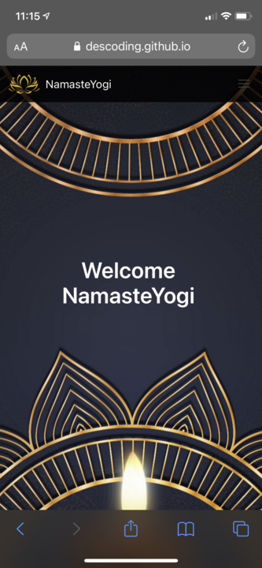
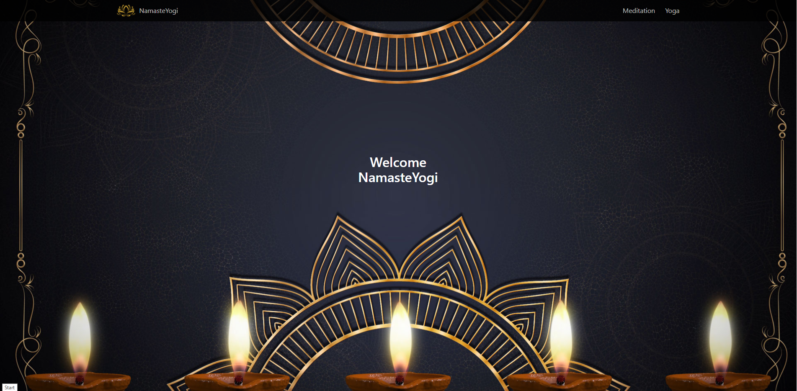
Demo

Slide 6
Directions for Future Development
Anatomical model with clickable body parts
Users target problem areas
Each body section linked to specific poses
Upon click, series of poses are offered
Music library for mediation practice
Music linked to specific poses
Visual breath queues
Essential Oil & Candle Scent Pairing
Yoga Studio Search – yield more than one option to pick from
Saving pose videos to “My Studio” page
User guide link on home page

Slide 7
Check Us Out
Deployed Site - https://descoding.github.io/NamasteYogi2.0/
GitHub Repo - https://github.com/DesCoding/NamasteYogi2.0

