Slide 1
NamasteYogi
Tera Brown
Latuanja Carson
Jessica Ferguson
Desiree Stout

Slide 2
Elevator Pitch
Let us tell you why you need this app!

Slide 3
Concept
Description: NamasteYogi offers yoga and meditation breaks for the busiest yogi
Search for yoga poses
Click saved poses to practice again later
Finds a studio near you
Meditation with sound therapy
User Story:
As a overwhelmed human
I want a quick way to add zen to my day
So that I can recenter
Motivation for Development:
Offer a consolidated space to cultivate an at home yoga and meditation practice
Easy access to local studio info

Slide 4
Process
Challenges:
Viable APIs
Last FM and Spotify would not play songs
Lack of Yoga APIs available
youTube maxed out in plays per day
API daily limit expended for calls
Live sharing VSC did not work
File size caused issue with pushing to GitHub repo
Successes:
Great team work
Adaptability
Realigned our vision because original scope was not realistic for our timeline
Adjusted implementation based on current skillsets
Assigned ideas for future development
Technologies Used:
HTML, jQuery, JavaScript, CSS
Two server side APIs
BULMA CSS framework
Client-Side Storage
w/ Mobile first UI
Tasks/Roles:
Identified project scope
Searched for viable APIs
Outlined the layout of the app
Pseudocode ideas and functionality
Worked together to discuss and research as a group during class time

Slide 5
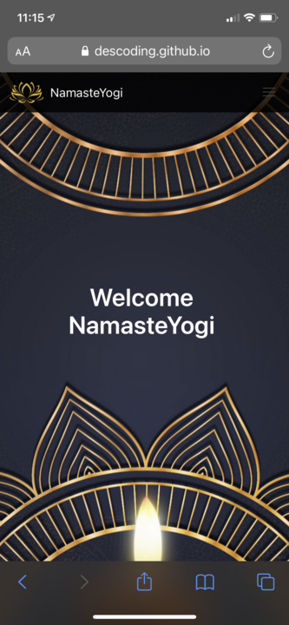
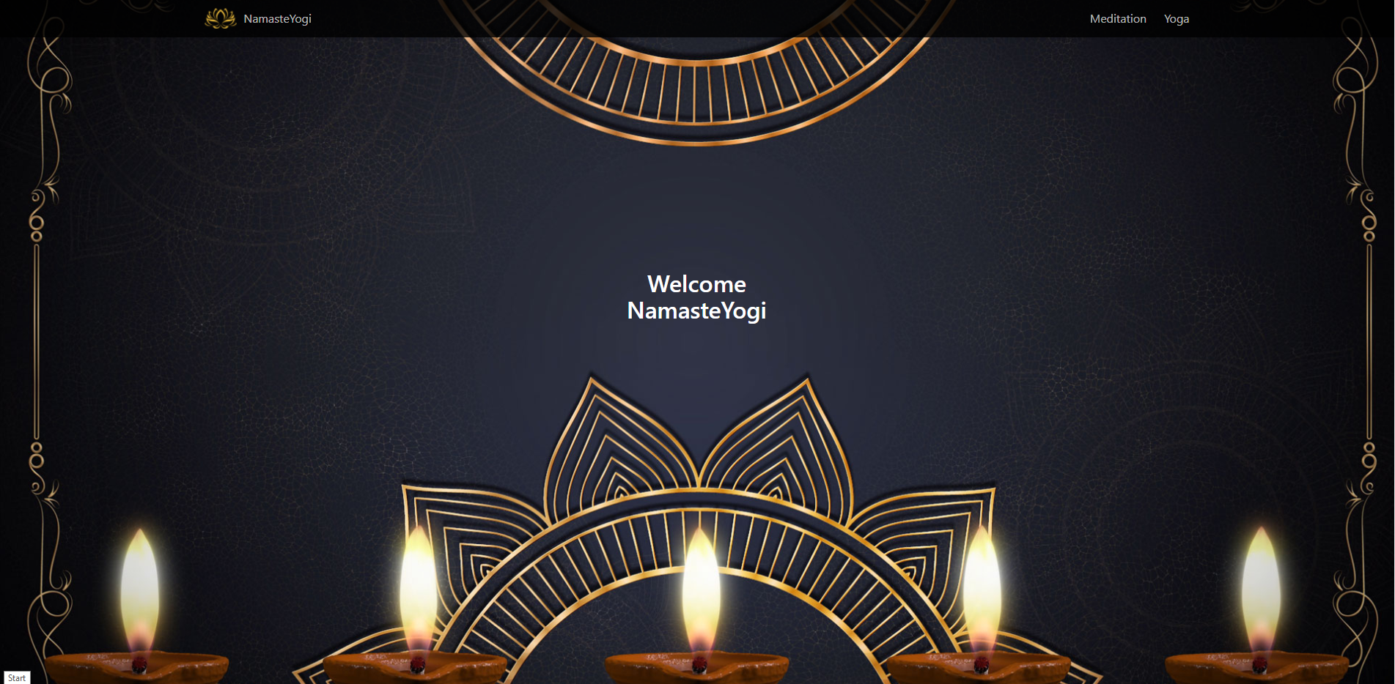
Demo

Slide 6
Directions for Future Development
Anatomical model with clickable body parts
Users target problem areas
Each body section linked to specific poses
Upon click, series of poses are offered
Music library for mediation practice
Music linked to specific poses
Visual breath queues
Essential Oil & Candle Scent Pairing
Yoga Search – yield more than one option to pick from

Slide 7
Check Us Out
Deployed Site - https://descoding.github.io/NamasteYogi2.0/
GitHub Repo - https://github.com/DesCoding/NamasteYogi2.0

