Slide 1
NamasteYogi
Tera Brown
Latuanja Carson
Jessica Ferguson
Desiree Stout

Slide 2
Elevator Pitch
* Elevator pitch: a one minute description of your application

Slide 3
Concept
Description - NamasteYogi offers yoga and meditation breaks for the busiest yogi
Search for yoga poses
Finds a studio near you
Meditation with sound therapy
User Story - NamasteYogi is for the yogi who has just a little too much on thier to do list. Clients input problem areas or share how they are feeling, the app offers yoga postures, meditation, and/or breath work easily incorporated into each day.
Motivation for development – balancing it all is not easy, I think we’re all feeling the crunch. We wanted to be solution oriented and offer something we could all use…

Slide 4
Process
Technologies Used
Two serverside APIs
BULMA CSS framework
Client-Side Storage
w/ Mobile first UI
Breakdown of tasks and roles
Challenges we encountered – APIs…………………..
Successes – great team work, we learned from eachother….

Slide 5
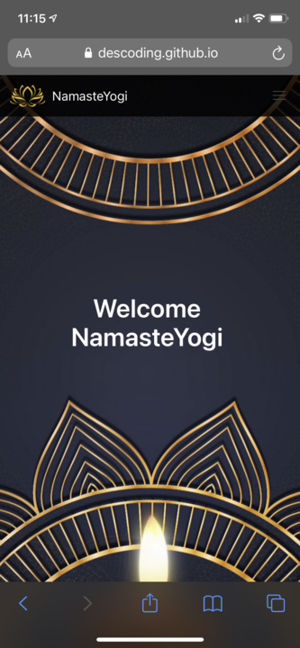
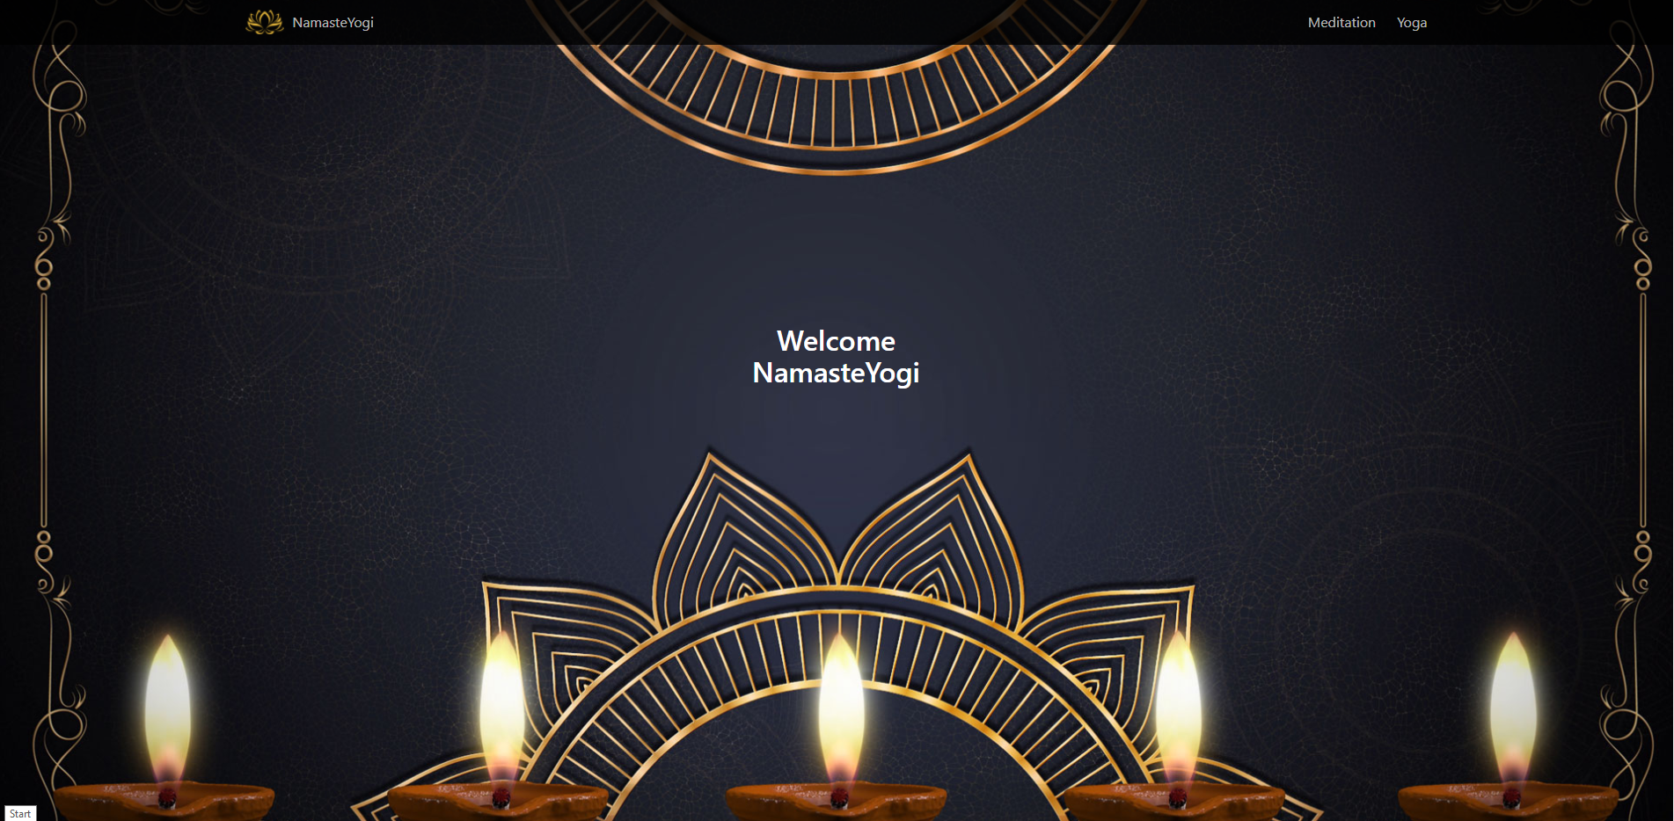
Demo

Slide 6
Directions for Future Development
Anatomical model with clickable body parts
Users target problem areas
Each body section linked to specific poses
Upon click, series of poses are offered
Music library for mediation practice
Visual breath queues
Essential Oil & Candle Scent Pairin

Slide 7
Links
Deployed Site - https://descoding.github.io/NamasteYogi2.0/
GitHub Repo - https://github.com/DesCoding/NamasteYogi2.0

