Slide 1
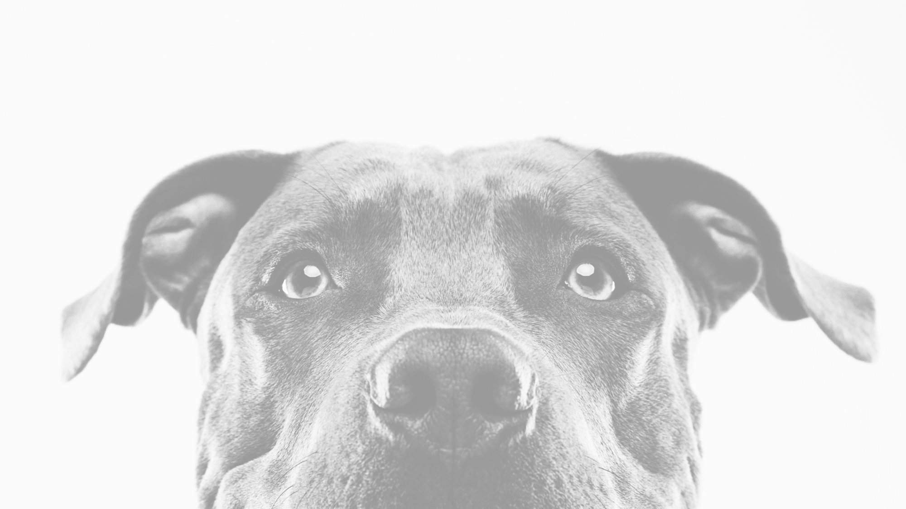
Puppy Love
Tera Brown
Latuanja Carson
Jessica Ferguson
Desiree Stout

Slide 2
Elevator Pitch
As a group of paw loving people, we thought "what better way to join two of peoples favorite pastimes: looking at pictures of furry friends and swiping"! Whether you are trying to determine what types of dogs you would be interested in adding to your family or just want to relax by looking through dog photos, this app is for you! With our App you can swipe right to save the image and left to not. You never have to worry about rejection like SOME OTHER apps, these furry friends love everyone!

Slide 3
Concept
Description: An app that matches pups to their people.
Motivation for Development: A fun way for people to see what breeds/dogs they want to adopt.
User Story:
As a soon to be dog-parent
I want a find cute pics of pups
So that I know what breed to adopt

Slide 4
Process
Technologies Used:
node
API
Bootstrap
JSON
Sequelize, SQL Workbench
Passport
Handlebars
Hammer.js (new technology)
Tasks/Roles:
Teamwork
Pseudocode
Layout
Challenges:
ESLint
Branching
Successes:
Teamwork
Adaptability
Planning

Slide 5
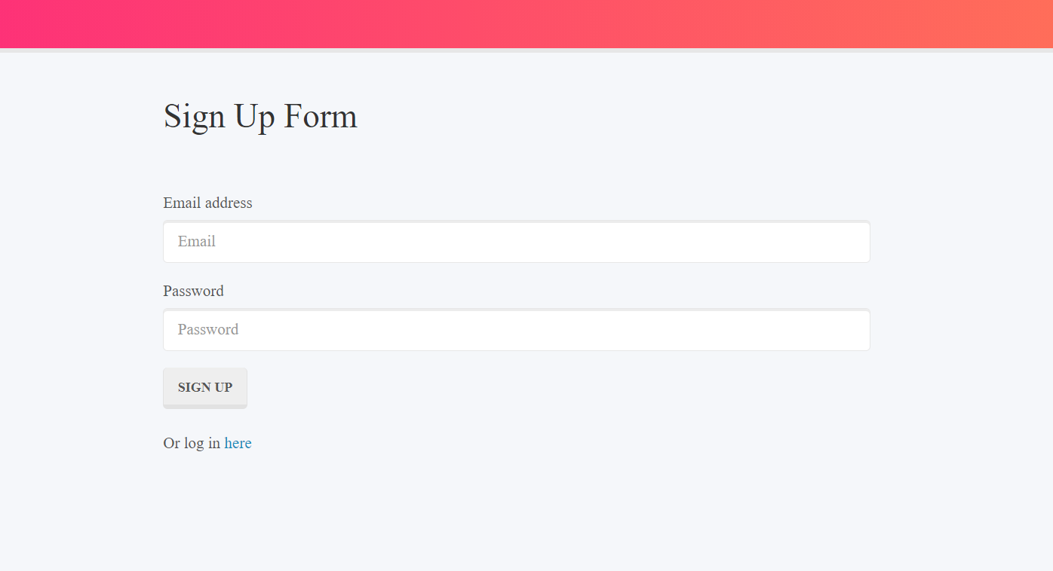
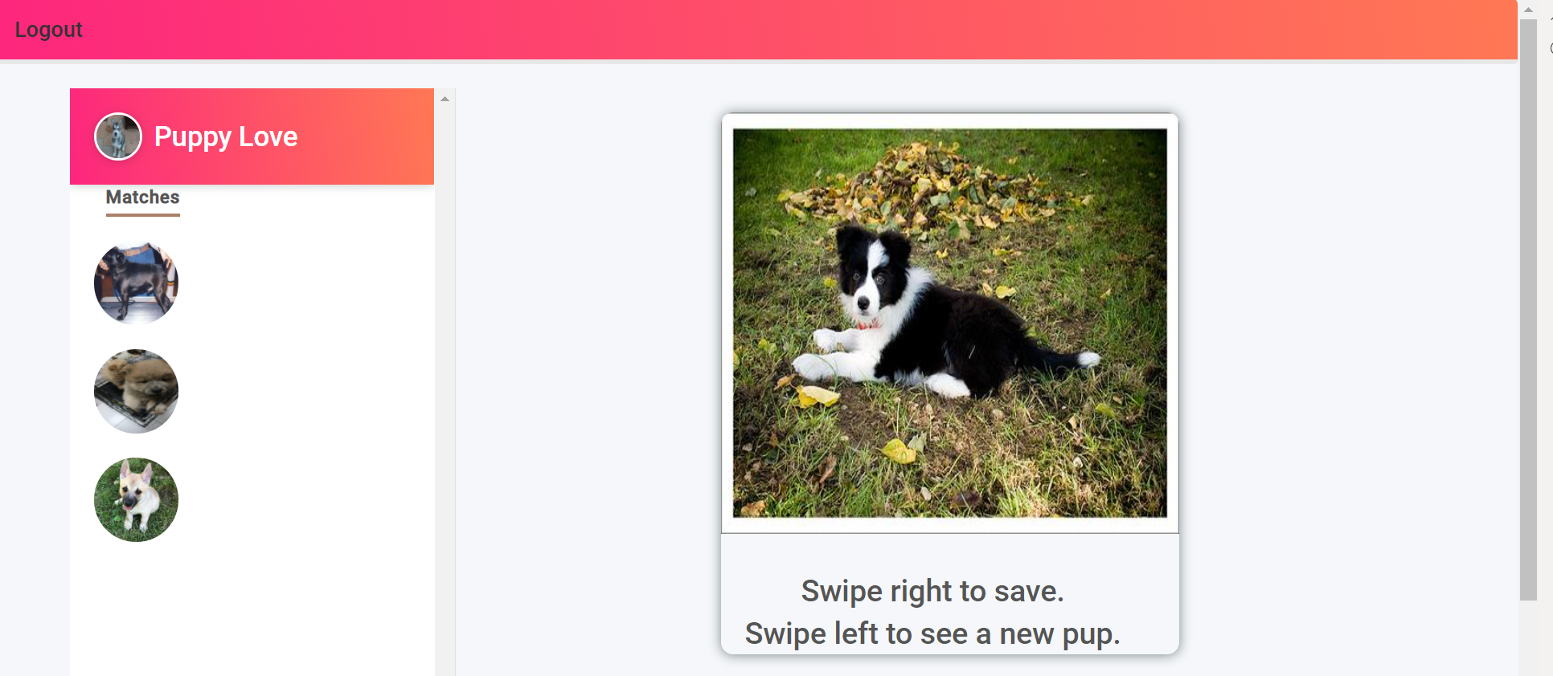
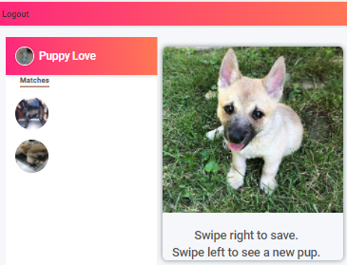
Demo

Slide 6
Directions for Future Development
YouTube results for recommended breed
Link to nearby rescue shelters if matching breeds are available
Aggression or breed filter
Recommended care instructions for each breed
Customizable user preferences after initial setting
Save user posts/notes
Delete/Edit saved matches
Expand usage of API

Slide 7
Links to Find Puppy Love
Deployed Site - https://descoding.github.io/PuppyLove
GitHub Repo - https://github.com/DesCoding/PuppyLove

