Slide 1
Deliverables 1: Plan, Design, and Research
Overview of the intended application and WHY you feel it’s valuable.
Our application is intended to give users a great experience when looking for dogs to adopt.
This application is valuable because it gives users an opportunity to search for and apply for dog adoptions. The user experience will provide them with swiping capabilities when matches are found for their new furry family members.
A set of DETAILED screen-by-screen design layouts with annotations describing all UI/UX components and all data relevant to the screen.

Slide 2
Landing page
Overview of the site features
Navbar w/ links to features and logo
User login
User create account
User login
Member page with saved data
User preferences for type of dog
Aggression or breed filter
Customizable user preferences after initial account setup
Saved Matches/liked pets
Delete/Edit saved matches
Create account
Match Page
Users see available dogs
Select/save matches
Add animation for card swipes
Link to shelter to adopt selected pet
Resources
YouTube results for recommended breed
Link to nearby rescue shelters if matching breeds are available
Search by zip code to find nearest shelter
Recommended care instructions for each breed

Slide 3
Logo
contrasting colors from our nav bar
Heart shape
Paw and home in heart
Features
Notifications via text or e-mail when a pet matching your preferences is added
Buffering graphic – dog chasing tail
Error page load with scene or graphic
Sound effects

Slide 4
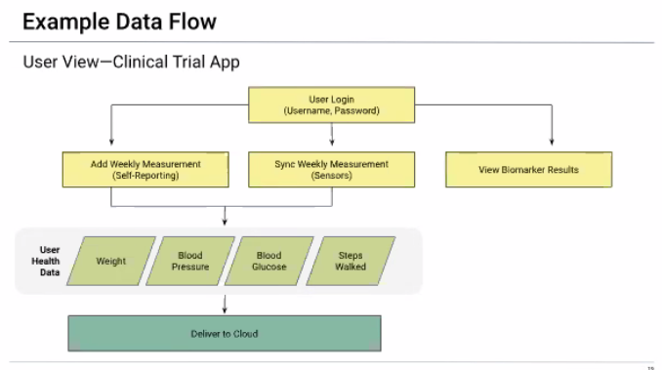

Slide 5
Deliverables 1: Plan, Design, and Research
1. Overview of the intended application and WHY you feel it’s valuable
a. Our application is intended to give users a great experience
when looking for dogs to adopt.
b.This application is valuable because it gives users an opportunity
to search for and apply for dog adoptions. The user experience
will provide them with swiping capabilities when matches are
found for their new furry family members.
2. A set of DETAILED screen-by-screen design layouts with annotations
describing all UI/UX components and all data relevant to the screen.
3. A breakdown of roles by group member.
a. Latuanja: Branding
i.Logo
ii.Color scheme
iii.Images
b. Louis: Animations
i. Sound effects
ii. Animated card swipes
c.Tera: API implementation with filters
i. Puppy finder
ii.
User able to filter by preferences
iii.
Pull in shelter/agency contact info
iv.
More sophisticated matching/filtering system
d.
Jessica: React Packages
i.
Swipe functions (
https://www.framer.com/motion/
)
ii.
Buttons for swipe choices
e. Desiree: Authentication
i.
Landing Page
ii.
Save matches
iv.
Recall matches found
4.
A schedule for completion of various tasks.
5.
Download some of the packages we’re interested in using
a.
Be sure to use the quick start guides
6.
A screenshot of your project management board that shows
breakdown of tasks, assigned to group members with a schedule.

Slide 6
Our Why
Our Why
Puppy Love is intended to give users a convenient and fun experience when looking for dogs to adopt.
This application is valuable because it gives users an opportunity to search for adoptable dog in the St. Louis region. [number of dogs needing homes, health benefits of pet ownership….]
The user experience will include swiping, animation, capabilities to save matches new furry family members.

Slide 7
Here are each weeks deliverables:
Week 1: A detailed plan of action with the following:
An overview of the intended application and WHY you feel it’s valuable.
A breakdown of roles by group member.
A schedule for completion of various tasks.
A screenshot of your Jira, Trello, or Project Management Board that shows breakdown of tasks assigned to group members with a schedule.
A set of DETAILED screen-by-screen design layouts with annotations describing all UI/UX components and all data relevant to the screen.
On this note, show Slides 26-27 as an example of a UI/UX and Data Flow layout. Tell the class that you’ll expect something akin to these drafts.
Week 2: A functioning minimal viable product (i.e., a prototype version of your app that shows the intended function). This should be as close to a working app as possible and include:
A 5-7 minute presentation that discusses what your app is, what it does, and how it works. You will be presenting to instructors and TAs during class.
A screenshot of your Jira, Trello, or Project Management Board that shows breakdown of tasks assigned to group members with a schedule. This should be updated to reflect remaining priorities and completed tasks.
Week 3: A significantly more polished version of the app.
This should literally seem like an app that you would submit.
Include a summary of significant issues faced to date and their resolution.
Provide a detailed description of each person’s contributions.
Submit a detailed plan that describes remaining efforts. This should describe remaining issues like:
Stretch Features
Bugs
Enhancements
UI Polishing
Week 4: The Presentation!
A 7-10 minute demonstration of your app.
More on this as we near closer to the end.

Slide 8
Send to Brandon
Please by sometime the end of this week send me the following:
What the app will do.
What technologies they expect their app to implement.
Who will be responsible for each part of the app.
Who will be responsible for each part of deliverable #1.

