Slide 1

CmpE 281 Team Tech-Phantoms Airbnb
Presenters:
Darshil Kapadia (013007280)
Kavina Desai (013784017)
Shreyam Kela (013775411)
Vinay Kovuri (013710684) Guided by: Prof. Paul Nguyen

Slide 2
Architechture Overview
Airbnb as the name suggests is the clone of Airbnb application.
The frontend of Airbnb made in react is deployed on Heroku with a CI/CD pipeline.
The frontend communicates with the four microservices named Login, Property, Booking and Dashboard.
The microservices are hosted on each team members’ own AWS VPC with sharded mongo clusters handling the data.
These microservices are dockerized and are running on either Amazon Elastic Container Service(ECS) or Amazon Elastic Kubernetes Service(EKS) clusters, again integrated with CI/CD pipeline for continuous deployment.
The dockerized microservices are exposed to frontend using Amazon’s API Gateway which on getting the request proxies it to the respective load balancers.

Slide 3
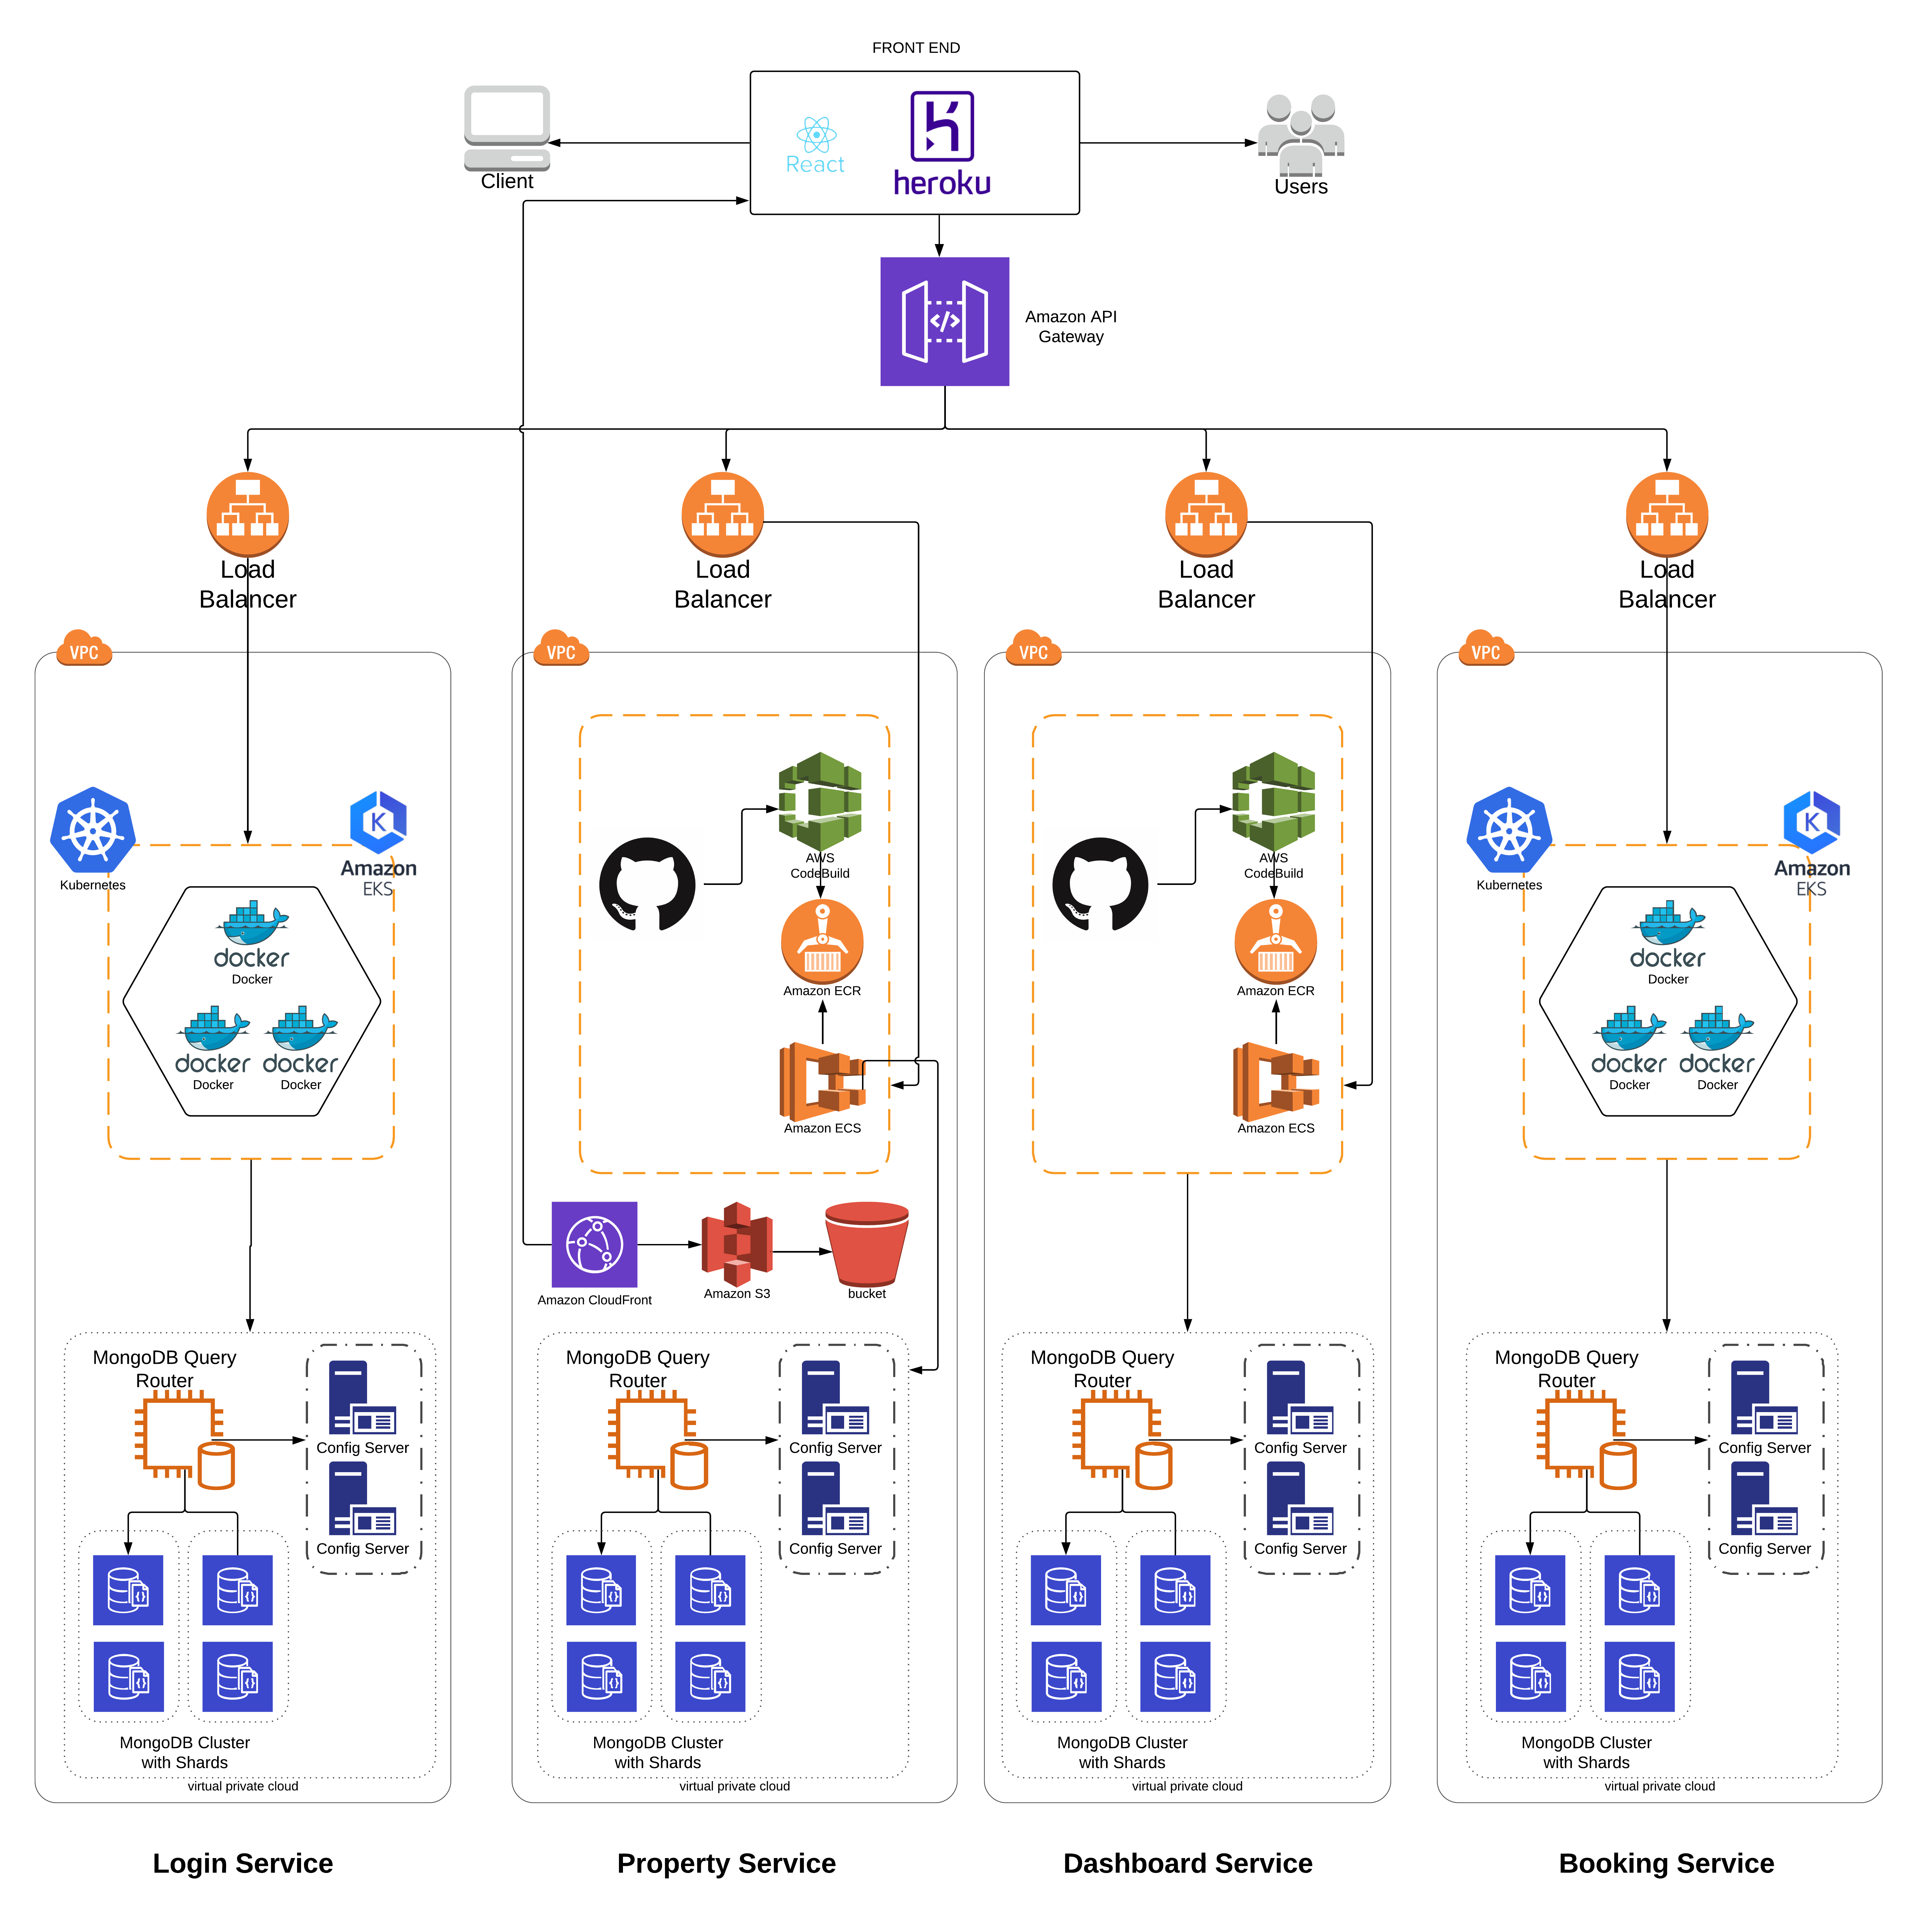
Architechture Diagram.
Link

Slide 4
AKF Scaling Cube
X-axis Scaling:
The X-axis Scale has been addressed by replicating each microservice across multiple instances which increases the throughput and helps in avoiding failures.
Y-axis Scaling:
By dividing each service based on their functions and deploying it to separate AWS accounts, our application also addresses the Y-axis scaling.
Z-axis Scaling:
The NoSql database i.e MongoDB has been sharded to address the Z-axis Scale.

Slide 5
Demo
Frontend URL : https://airbnb-project-cmpe281.herokuapp.com/homepage

