Slide 1



IIP Presentation
Kasegaon Education Society’s
Rajarambapu Institute of Technology, Rajaramnagar
(An Autonomous Institute)
(Approved by AICTE, affiliated to Shivaji University Kolhapur)
Project Name: “Face Mask Detection Using Machine Learning”
Name – Aditya Arvind Desai. Roll No.- 1908058. Class- Final Year B. Tech. Company Name- Softron.
Under guidance of-
prof. Y.N. Bhosale
Industry Supervisor- Mr. Rohan Suryawanshi

Slide 2
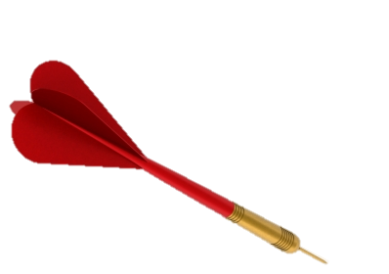
Introduction
IMPORTANCE OF WEARING MASK
CHALLENGES IN
MANUAL MONITORING
NEED
PROBLEM ?

Slide 3
Objectives
1
Enhance public safety
2
Automate monitoring process
3
Accuracy and reliability
4
Scalability and adaptability

Slide 4
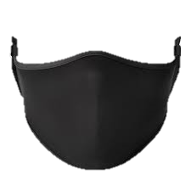
Problem Statement
Project Name: “Face Mask Detection Using Machine Learning”
Traditional methods of manual monitoring are resource-intensive, time-consuming, and prone to human error. Ensuring compliance with mask-wearing guidelines is crucial to prevent the spread of infectious diseases, such as COVID-19, and protect public health.
Therefore, there is a pressing need for a robust and accurate face mask detection system that can automate the process, provide monitoring, and contribute to creating safer environments for individuals and communities.

Slide 5

Methodology
Create a training dataset
Importing necessary libraries
Image pre-processing
Train an image classification model
creating the CNN architecture
training the model
Make predictions
reading in a sample image
Processing it
Giving output

Slide 6

Methodology
A) Create a training dataset
Importing necessary libraries
Name | Usercase | Command
numpy | numerical computing | import numpy as np
pandas | data manipulation and analysis | import pandas as pd
matplotlib | data visualization | import matplotlib.pyplot as plt
cv2 | provides a wide range of functions and algorithms for image and video processing | import cv2
scikit-learn | encoding categorical variables into numerical labels. | from sklearn.preprocessing import LabelEncoder
tensorflow | provides a comprehensive set of tools and libraries for building and deploying machine learning models | from tensorflow.keras.utils import to_categorical, normalize
mtcnn | face detection algorithm | from mtcnn.mtcnn import MTCNN

Slide 7

Methodology
2. Preprocessing
Reading the CSV file
A) Create a training dataset
Filtering the dataset
Exploring the labels distribution
Fetching image filenames
Visualizing an image with bounding boxes
Preparing the training data

Slide 8
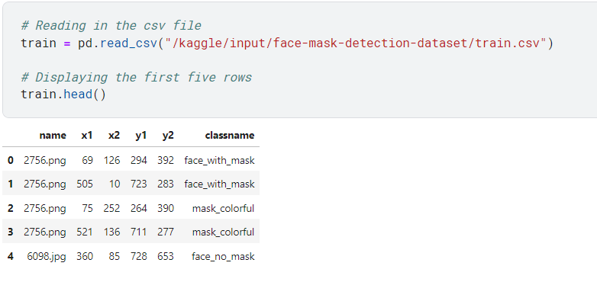
Methodology : Creating a training dataset
Reading the CSV file
Filtering the dataset
Face with mask
Face no mask

Slide 9
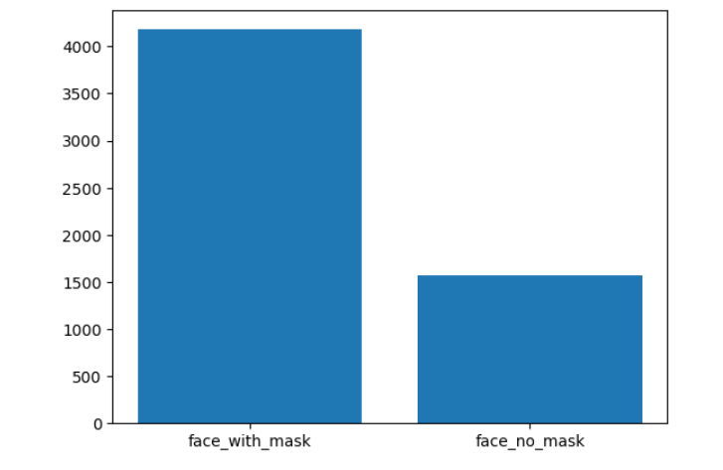
Methodology : Creating a training dataset
Exploring the labels distribution
Fetching image filenames:
The code retrieves the filenames of the corresponding images from the respective folder

Slide 10
Methodology : Creating a training dataset
Exploring the labels distribution
Fetching image filenames:
The code retrieves the filenames of the corresponding images from the respective folder
A bar plot is created to visualize the distribution of the selected class labels

Slide 11
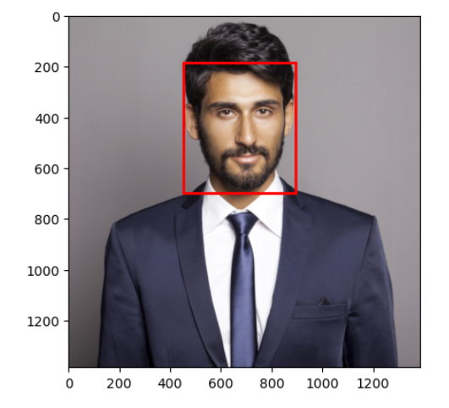
Methodology : Creating a training dataset
Visualizing an image with bounding boxes
Preparing the training data
The images in the dataset are processed to make them suitable for training a machine learning model
Whose steps are :
converting the images to grayscale
cropping them based on the bounding box coordinates to focus on the faces
resizing them to a fixed size
The processed images, along with their corresponding class labels, are stored in a list called "data."
helps verify if the bounding box coordinates in the dataset align with the actual faces in the images.

Slide 12
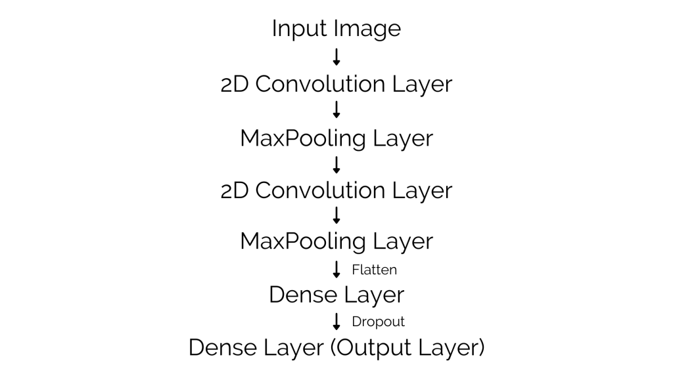
Methodology
B) Train an image classification model
Architecture of Computational neural network we Created

Slide 13

Methodology : Train an image classification model…
Step 1 :Defining the input shape
The input shape of the images (height, width, and color depth) is extracted from the processed image data
This information is necessary for
defining the architecture of the convolutional neural network (CNN) model.
KERAS
Step 2 : Building the CNN architecture
Sequential model from TensorFlow
several layers
layers work together to extract meaningful features from the input images and classify them into the two target classes: "face_with_mask" and "face_no_mask.

Slide 14
Methodology : Train an image classification model…
Step 3 :Compiling the model -
Adam optimizer
performance evaluation – considering accuracy as the metric
Step 4 :Training the model
The model is trained on the preprocessed image data (stored in variable "x") and the corresponding class labels (stored in variable "y"). Training occurs over a specified number of epochs

Slide 15
Methodology
Part 3 : Make predictions
Reading a sample image
Face detection using MTCNN: The MTCNN
Pre-processing the image:

Slide 16
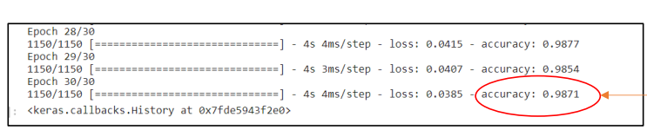
Results
Accuracy :
The developed face mask detection system achieved impressive results in terms of accuracy and efficiency.
During testing, the model consistently detected and classified individuals' mask-wearing status with high precision and recall rates. The F1-score, which combines precision and recall, exceeded 0.98, indicating excellent overall performance.

Slide 17
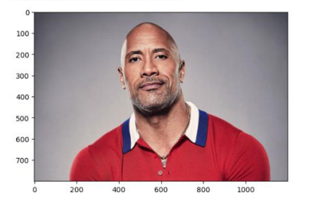
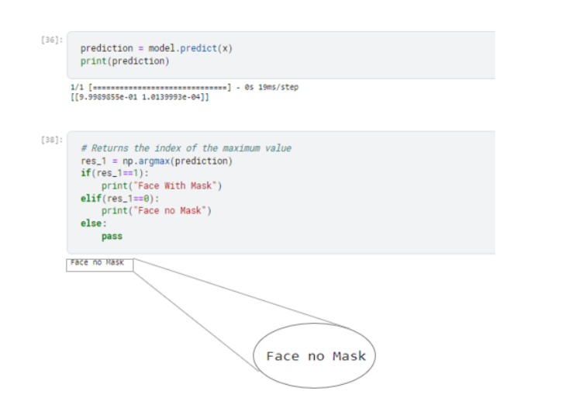
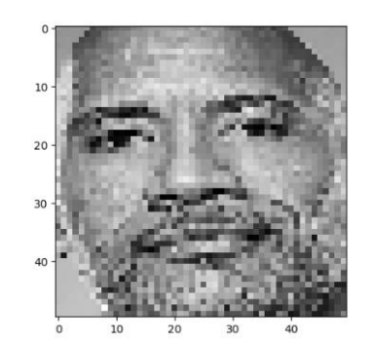
Results : Input 1
Input Image 1
Output
Processed Image 1

Slide 18
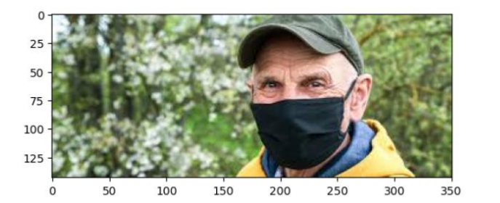
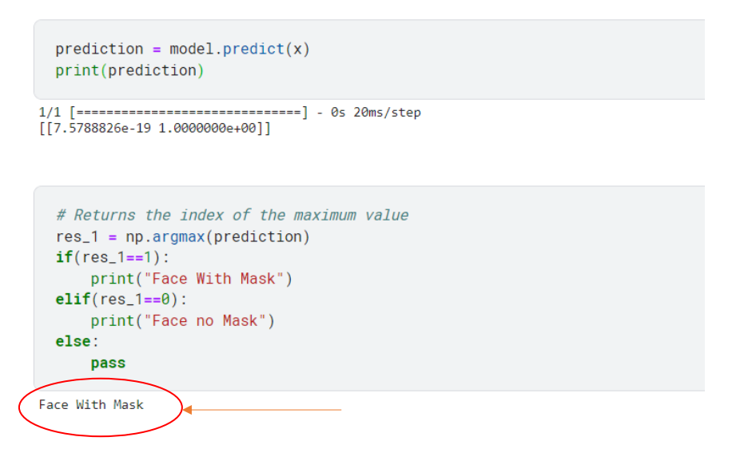
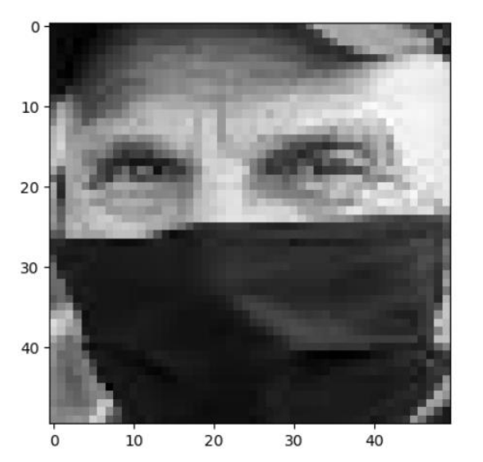
Results : Input 1
Input Image 2
Output for Image 2
Processed Image 1

Slide 19
Conclusion
he face mask detection project has successfully developed a system that accurately detects the presence or absence of face masks in images. By utilizing computer vision techniques, the system identifies individuals wearing masks and those without.
The tested system achieved high accuracy rates, indicating its practicality and potential for real-world implementation. Overall, the project offers a valuable solution for promoting public health and safety in various settings.

Slide 20
THANK YOU…

