Slide 1
Sales-DashBoard-V1
File created on: 1/20/25 5:00:02 PM EST

Slide 2
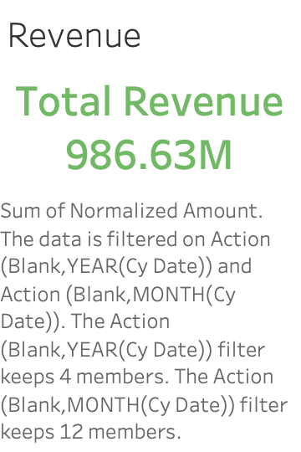

Slide 3
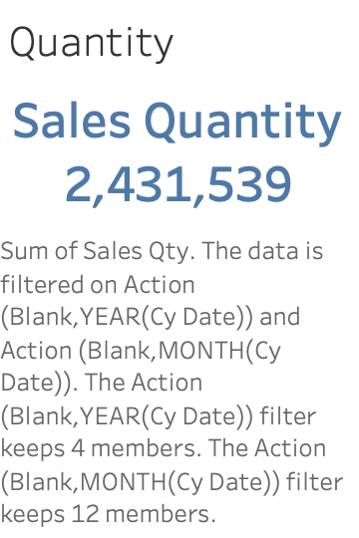

Slide 4
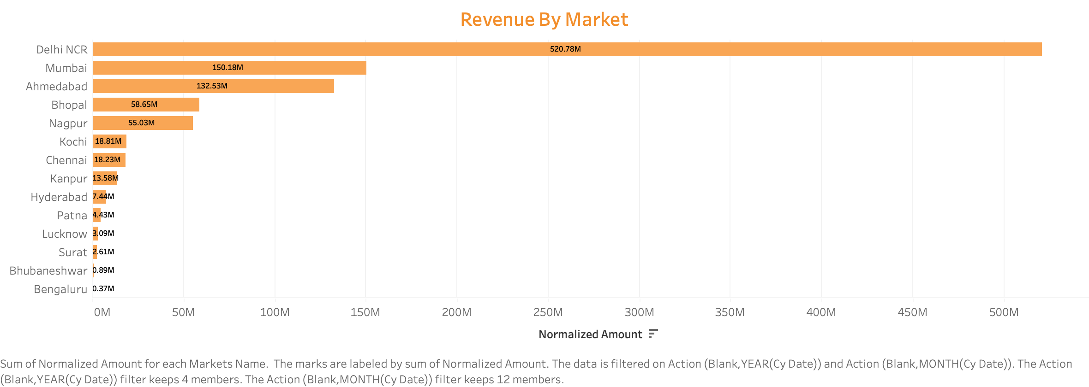

Slide 5
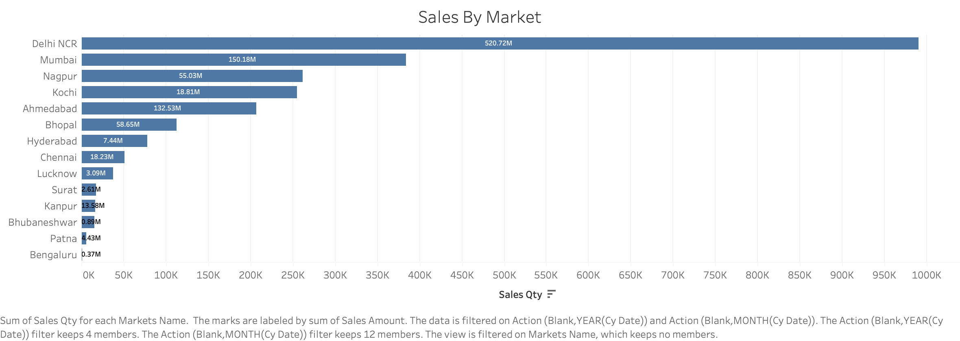

Slide 6


Slide 7


Slide 8
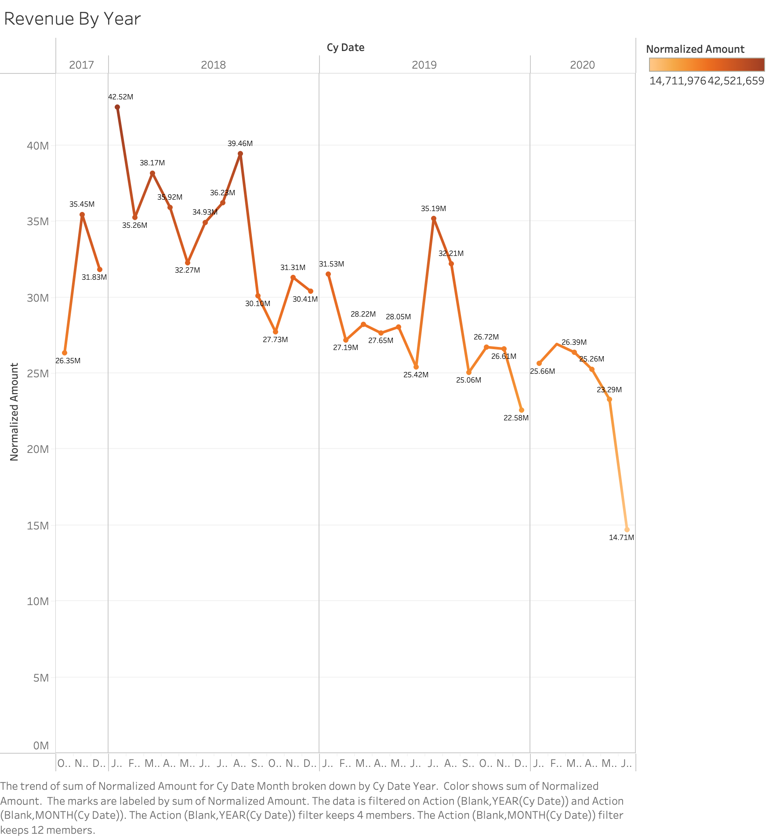

Slide 9


Slide 10
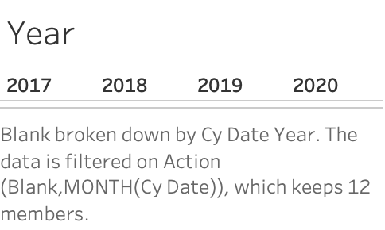

Slide 11
