Slide 1
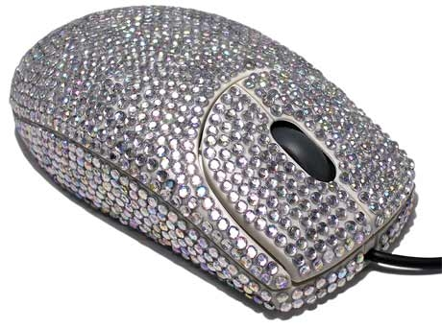
Polish
Game Design 2
Hogeschool van Amsterdam

Slide 2

Today we will
-Discover Juiciness in diverse casual games
Recognize elements of juiciness
Find elements of juiciness online
Advise each other on making their games more bling bling.

Slide 3
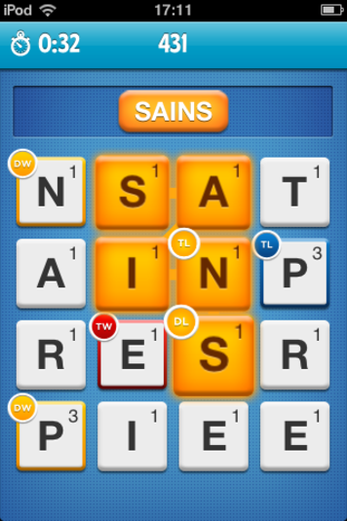
What is juicy about this?
Ruzzle
Play it.
Write down as many elements as you can

Slide 4
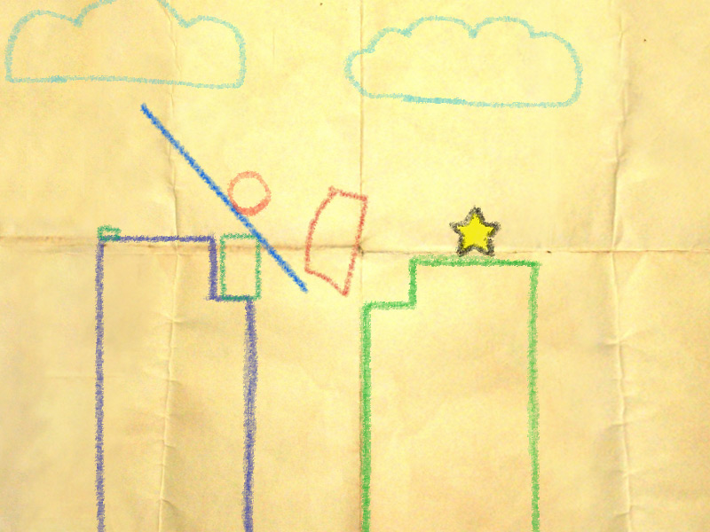
And this?
Crayon Physics.
Play it
Write down as many elements as you can

Slide 5
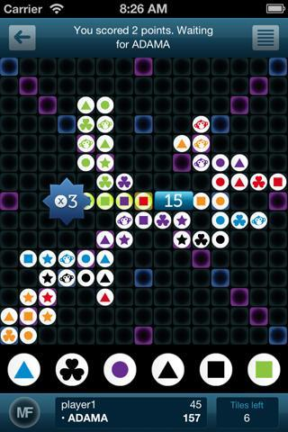
And this?
Mindfeud
Play it
Write down as many elements as you can.

Slide 6
For the last game
What could be improved??

Slide 7
JUICE IT OR LOOSE IT
http://www.youtube.com/watch?v=Fy0aCDmgnxg

Slide 8
ESSENCE OF GAME
HAS STRONG FEEDBACK
BOIL YOUR GAME DOWN TO ITS ESSENCE:
Matching (Bejeweled)
Sorting (Solitaire)
Seeking (Azada)
Managing (Diner Dash)
Hitting (Wii Tennis)
Chaining (Diner Dash)
Constructing (Crayon Physics)
Bouncing, Tossing , Rolling and Stacking (Bow Man 2)
Socializing (Rock Band)
Jumping, dodging (Mario)

Slide 9
Essence of game
Look at examples that have same essence of game.
Write down feedback in these games.

Slide 10
Playtesting helps in getting the right juiciness
- Juiciness is about game feel.
- Game feel has to do with play testing.
- Playtest with a GOAL in mind…..

Slide 11
COST OF FAILURE
Read: http://www.jesperjuul.net/text/losttime/
Play Braid. Write down how cost of failure is reduced.
Play VVVVVV or Super Meat Boy Write down how cost of failure is reduced.

Slide 12
COST OF FAILURE
Have your game played. Timpe playtime till failure with stopwatch in at least one section/level for at least 10 different players. Have amount of tries of success ready. Count total time to success.
Improve on your findings and write about them in your review.

Slide 13
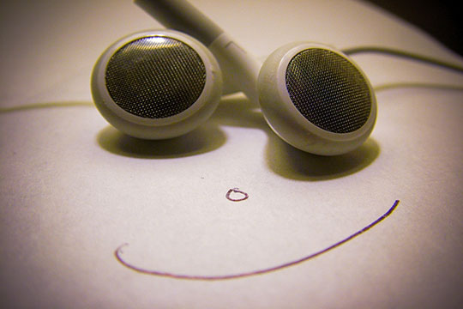
Set the mood
Imitate, but do not copy
Graphic style
License music

Slide 14
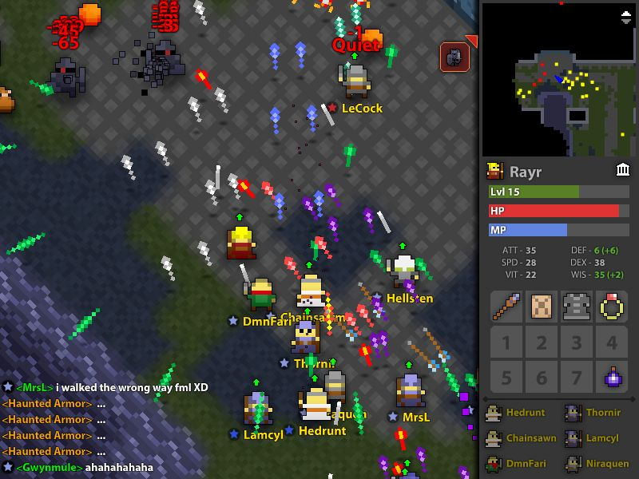
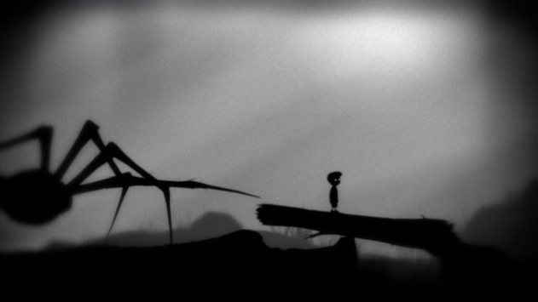
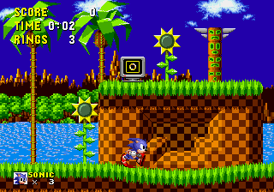
Imitate a graphic style
Something easy
Something abstract
Old-school?
Imitate the color palette
Imitate the lines and shapes

Slide 15
License music
Music sets the mood
  Crayon Physics
    http://www.youtube.com/watch?v=QsTqspnvAaI
Describe your mood and find free music
  http://www.kloonigames.com/blog/crayonphysics/day-2-music-of-crayon-physics-deluxe
Double check the license and credit where you got the music from
  http://www.archive.org/details/opensource_audio

Slide 16
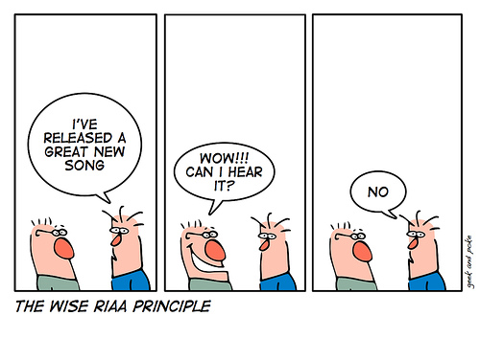
License
Double check that you have written permission to use anything that you did not make yourself:
  Code
  Images
  Sounds
  Writing

Slide 17
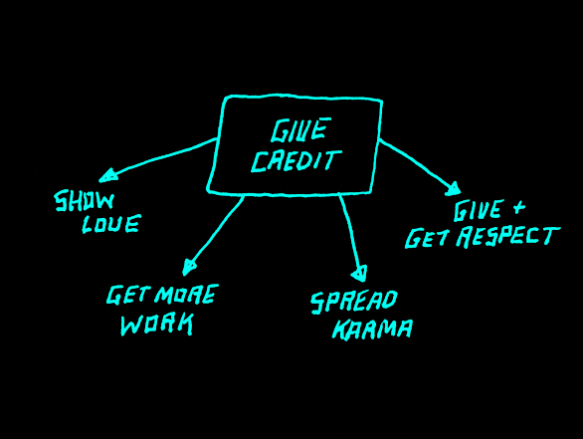
Credits
Use industry standard roles
Just state the facts
Cite everything that you did not make
Be generous to others
Be brief
Be humble

Slide 18
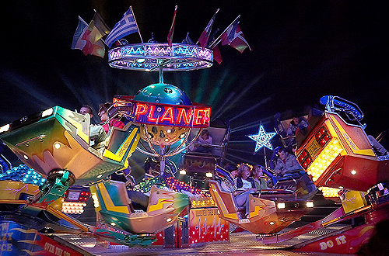
Exaggerate
Dutch people are too humble

Slide 19
Play your game on the web
How do you start? Restart?
REPLAYABILITY????
Play from web browser
Does your app have focus?
What happens when your app loses focus?
Example
  Droplets
  Twin Shot 2

Slide 20
Make a list of ten elements to juice up your game
Use playtests
Use prior art
Try to implement as many as possible, you can always go back if it doesn’t work.
Go CRAZY!
Tips: Tutorial on Gamefeel, from Jan Willem Nijman (Vlambeer) in Gamemaker
https://www.dropbox.com/s/c0i6jidrvk6r2io/controlconf.rar

Slide 21
PORTFOLIO PRESENTATION
Name your game!
DO NOT MAKE US SEARCH FOR YOUR GAMES.
Communicate the experience you want to convey, do not mention genre.
PICTURE OF GAME.
Description: Brief, to the point. 25 words or less.
For example: http://www.jayvanhutten.com/
Maybe also: Screenshot, video.
Playable demo in HTML.
Review on gamepage, not in seperate downloadable text files!

Slide 22
Portfolio
Examples of good portfolio’s:
http://venbrux.com/work/
http://www.calanpayne.com/games.html
http://www.stefander.nl/
http://jdifrancisco.com/?page_id=800
http://www.samkaplangamedesign.com/portfolio.html
http://www.senntient.com/hire/game.html

Slide 23
More help to promote your game
http://mochiland.com/articles/marketing-flash-games-the-other-half-of-the-battle
http://mochiland.com/articles/promoting-your-game-lessons-learned
http://mochiland.com/articles/thumbnail-design-a-picture-is-worth-a-thousand-plays

Slide 24
Complete your portfolio
Upload your games,
Make your games accessible: Do not make me search for your games and postmortems!
E-mail me a link
Questions?

