Slide 1
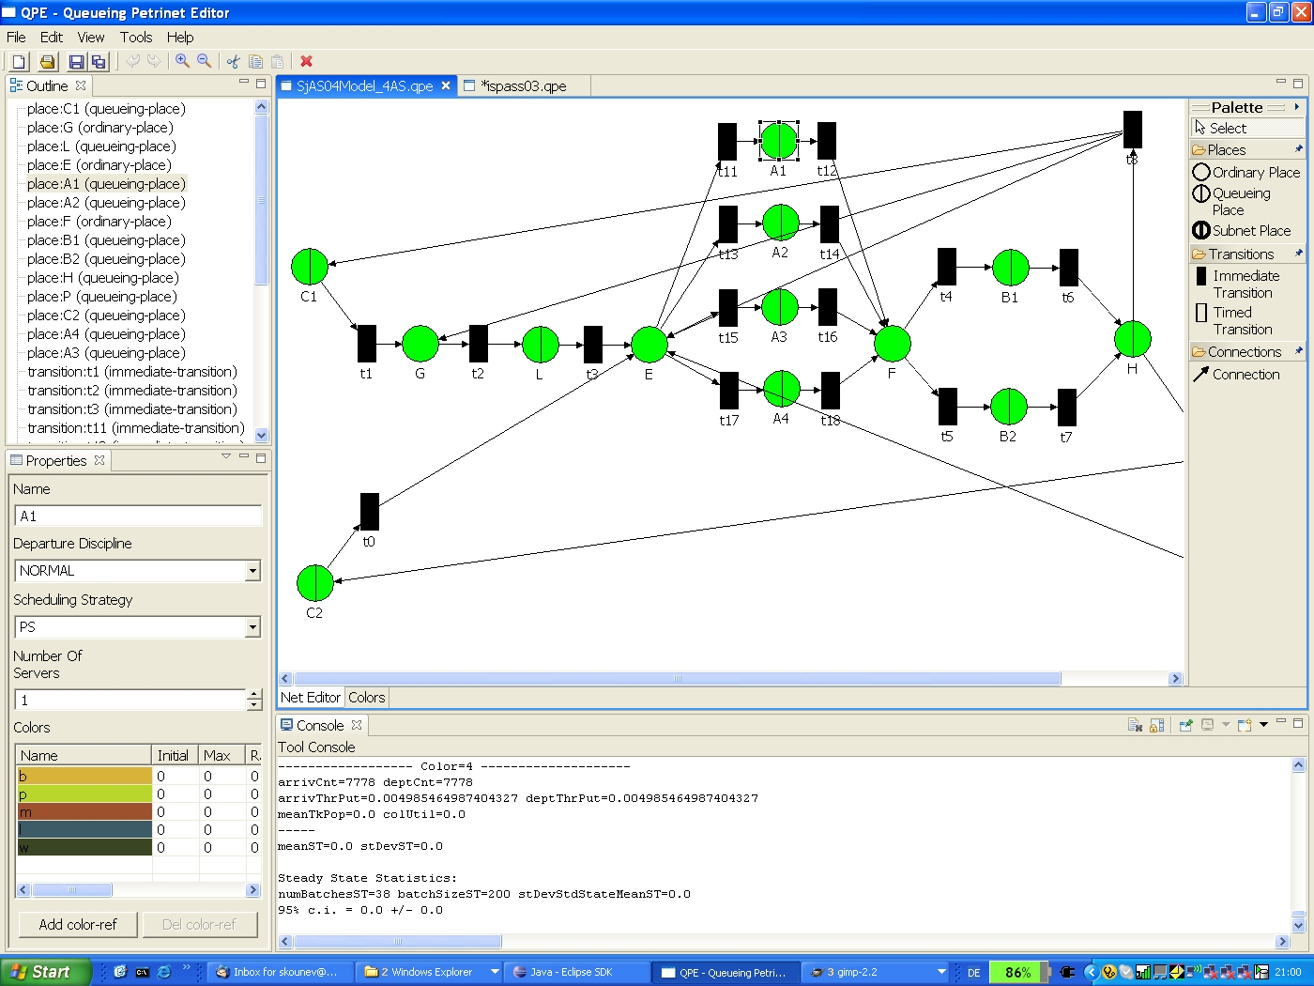
QPME - Queueing Petri net
Modeling Environment
A performance modeling tool based on the Queueing Petri Net (QPN) modeling formalism.
Made of 2 components: QPN Editor (QPE) and Simulator (SimQPN).
Based on Eclipse/GEF.
Provides a user-friendly graphical user interface.
Runs on all platforms supported by Eclipse including Windows, Linux, Solaris, HP-UX, IBM AIX and Apple Mac OS among others.
For further information contact
QPME-Website: http://www.dvs1.informatik.tu-darmstadt.de/staff/skounev/QPME
  Dr. Samuel Kounev
  University of Cambridge - Computer Laboratory
  Tel: +44 (1223) 7 67014
  Email: skounev@acm.org or Samuel.Kounev@cl.cam.ac.uk
  Web: http://www.cl.cam.ac.uk/~sk507/
© S. Kounev and C. Dutz

Slide 2

QPME - Queueing Petri net
Modeling Environment
Advantages of the Modeling Approach
QPN models combine the modeling power and expressiveness of queueing networks and generalized stochastic Petri nets (see [4] below).
QPN models allow the integration of hardware and software aspects of system behavior and lend themselves very well to modeling distributed systems (see [2] and [5] below).
The knowledge of the structure and behavior of QPNs can be exploited for fast and efficient analysis using simulation. This makes it possible to analyze models of large and complex systems ensuring that the approach scales to realistic systems (see [1] below).
Many efficient qualitative analysis techniques from Petri net theory can be extended to QPNs and used to combine qualitative and quantitative system analysis.
Last but not least, QPN models have an intuitive graphical representation that facilitates model development.
Publications Related to QPME/SimQPN
S. Kounev and A. Buchmann, “SimQPN - a tool and methodology for analyzing queueing Petri net models by means of simulation”, Performance Evaluation, Vol. 63, No. 4-5, pp. 364–394, May 2006.
S. Kounev, “Performance Modeling and Evaluation of Distributed Component-Based Systems Using Queueing Petri Nets”, IEEE Transactions on Software Engineering, Vol. 32, No. 7, pp. 486-502, July 2006.
C. Dutz, “QPE - A Graphical Editor for Modeling using Queueing Petri Nets”, Master Thesis, Technical University of Darmstadt, Apr. 2006.
S. Kounev, “Performance Engineering of Distributed Component-Based Systems - Benchmarking, Modeling and Performance Prediction”, Shaker Verlag, Dec. 2005, ISBN: 3832247130.
S. Kounev and A. Buchmann, “Performance Modeling of Distributed E-Business Applications using Queueing Petri Nets”, In Proc. of the 2003 IEEE Intl. Symposium on Performance Analysis of Systems and Software, Austin, Texas, March 6-8, 2003.
SimQPN
© S. Kounev and C. Dutz

