Slide 1


Darmstadt University of Technology
QPME - Queueing Petri net
Modeling Environment
Samuel Kounev and Christofer Dutz
Databases and Distributed Systems Group
Department of Computer Science
Darmstadt University of Technology
QEST’06, September 12, 2006

Slide 2
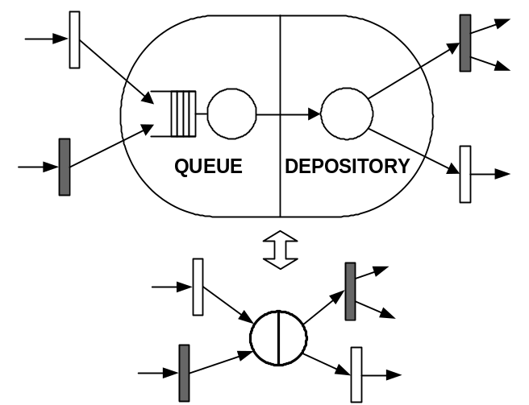
Queueing Petri Nets (QN + PN = QPN)
- Introduced by Falko Bause in 1993
- Combine Queueing Networks and Petri Nets
- Allow integration of queues into places of PNs
- Ordinary vs. Queueing Places
- Queueing Place = Queue + Depository
Advantages:
Combine the modeling power and expressiveness of QNs and PNs
Enable the integration of hardware and software aspects of system behavior into the same model
Lend themselves very well to modeling distributed component system.
© S. Kounev and C. Dutz <number>

Slide 3
QPN Modeling Tools
Currently, only one tool available
HiQPN-Tool
  Developed at the University of Dortmund
  Supports analytical analysis techniques only
  Suffers from the state space explosion problem
  Models of realistic systems not analyzable
  Only available on Sun-OS 5.5.x / Solaris 2
© S. Kounev and C. Dutz <number>
Notes:
Darauf hinweisen, dass es an dem State Space Explosion Problem leidet und das es nur auf einer veralteteten Sun Version lauffähig ist.

Slide 4

QPME = QPN Modeling Environment
Made of 2 components: Editor (QPE) and Simulator (SimQPN)
Based on Eclipse/GEF
Implemented in Java for maximum portability
Provides a user-friendly graphical user interface
Widely accessible - runs on all platforms supported by Eclipse incl. Windows, Linux, Solaris, HP-UX, IBM AIX and Mac OS among others.
Uses XML as storage format - XML schema based on PNML with some changes and extensions
© S. Kounev and C. Dutz <number>
Notes:
Kurz die zwei Bausteine (QPE + SImQPN) erwähnen, Dass auf maximale Portabilität geachtet wurde und Kurz erwähnen, das PNML als Basis gewählt und um einige Features für QPNs erweitert wurde.

Slide 5
QPME – SimQPN Features
Simulation routine based on the event-scheduling approach
Exploits the knowledge of the structure and behavior of the underlying models for efficient simulation:
  The locality principle of CPNs adapted to QPNs is exploited
  Optimized algorithm for keeping track of transition enabling status
  Efficient scheduling of service completion events at PS queues
Supports a wide range of service time distributions
Modes of data collection minimize the overhead of collecting data
SimQPN
© S. Kounev and C. Dutz <number>
Notes:
Darauf hinweisen, dass hier genaues Wissen über QPNs genutzt wurden, um die Simulation zu optimieren. (Backup-Folie 13: Why not use a general purpose Generator) (Stats-level können verwendet werden um den Overhead zu minimieren)

Slide 6
Steady State Analysis
Output data analysis methods:
  Method of independent replications
  Method of non-overlapping batch means
  More sophisticated methods (e.g. ASAP) could be used
Elimination of initialization bias
  Method of Welch
© S. Kounev and C. Dutz <number>
Notes:
Zu „More sophisticated methods could be used“ → Wenn StatsLevel = 4 werden alle Messdaten in Dateien abgelegt und stehen komplexeren Analysen zur Verfügung
Zu „Elimination of initialisation bias“ → benötigt keine Angabe der Warmup-Period

Slide 7
Method of Batch Means
Stopping criteria supported
  Fixed sample size procedure
  Sequential procedure
    Absolute precision
    Relative precision
Batch size increased until successive batch means approximately uncorrelated
Jackknife estimators of the autocorrelation coefficients used to measure correlation between batch means
For FCFS, indirect estimation of the steady state token residence times supported (variance-reduction technique).
© S. Kounev and C. Dutz <number>
Notes:
Zu “Fixed sample size procedure” → Fixed Length
Zu “Sequential procedure” → Sequential Absolute/Relative

Slide 8
Further Information
QPME-Website: http://www.dvs1.informatik.tu-darmstadt.de/staff/skounev/QPME
S. Kounev, “Performance Engineering of Distributed Component-Based Systems - Benchmarking, Modeling and Performance Prediction”, Shaker Verlag, Dec. 2005, ISBN: 3832247130.
S. Kounev and A. Buchmann, “SimQPN - a tool and methodology for analyzing queueing Petri net models by means of simulation”, Performance Evaluation, Vol. 63, No. 4-5, pp. 364–394, May 2006.
S. Kounev, “Performance Modeling and Evaluation of Distributed Component-Based Systems Using Queueing Petri Nets”, IEEE Transactions on Software Engineering, Vol. 32, No. 7, pp. 486-502, July 2006.
C. Dutz, “QPE - A Graphical Editor for Modeling using Queueing Petri Nets”, Master Thesis, Technical University of Darmstadt, Apr. 2006.
A public version of QPME will soon be made available to research organizations for non-profit use. For more information contact Samuel Kounev at skounev@acm.org or Samuel.Kounev@cl.cam.ac.uk
© S. Kounev and C. Dutz <number>

Slide 9
That Was It…
Thank You for your Attention!
© S. Kounev and C. Dutz <number>

Slide 10
Backup Slides
© S. Kounev and C. Dutz <number>

Slide 11
SimQPN Features
Portability (implemented 100% in Java)
Extremely light-weight (< 1 MB)
Supported scheduling strategies: FCFS, PS, IS
Supported service time distributions: Beta, BreitWigner, ChiSquare, Gamma, Hyperbolic, Exponential, ExponentialPower, Logarithmic, Normal, StudentT, Uniform, VonMises and Empirical.
Timed transitions and immediate queueing places are currently not supported, however, they can be approximated.
© S. Kounev and C. Dutz <number>

Slide 12
Random Number Generation
The Colt open-source library developed at CERN was used
Mersenne Twister random number generator employed
  One of the strongest uniform pseudo-random number generators known with astronomically large period and 623-dimensional equidistribution with up to 32-bit accuracy.
Alternative medium quality uniform random number generator available that is a bit faster
Colt’s random seed generator employed
© S. Kounev and C. Dutz <number>

Slide 13
Analysis of QPN models by DES
Why not use a general-purpose simulator?
  QPN constructs cannot be represented directly.
  Model must be mapped to a description using a simulation language – complex, time-consuming and error-prone task!
  Some simplifications might be required.
  Poor efficiency of the simulation! Knowledge of the structure and behavior of the underlying models cannot be exploited.
© S. Kounev and C. Dutz <number>

Slide 14
Optimizations
Simulation routine based on the event-scheduling approach
  Event defined as completion of service at queueing place
Scheduling of service completion events of PS queues deferred until after all enabled transitions have fired. This avoids having to reschedule the events after each change in the token population.
Optimized algorithm for keeping track of transition enabling status.
Modes of data collection minimize the overhead of collecting data.
Object data accessed directly bypassing accessor methods.
© S. Kounev and C. Dutz <number>

Slide 15
Optimizations (2)
The locality principle of CPNs adapted to QPNs is exploited:
  A transition’s enabling status needs to be checked only after
    change of population of an ordinary input place
        tokens added → check for newly enabled modes
        tokens removed → check for newly disabled modes
    service completion event at a queueing input place
        check for newly enabled modes
© S. Kounev and C. Dutz <number>

