Slide 1
QPE
A Graphical Editor for Modeling using Queueing Petri Nets
Christofer Dutz

Slide 2
Agenda
Motivation
XML Format
Approaches to Java GUI development
QPE Design & Architecture
Demo
Conclusion
Future Work

Slide 3
Motivation
Benefits of QPNs over ordinary PNs
Problems analyzing QPNs
How SimQPN solves these problems
HiQPN as editor and its disadvantages
QPE closing the gap

Slide 4
Benefits of QPNs over ordinary PNs
Motivation
Enables to model both software and hardware aspects
Ideal for modeling distributed systems
  E-commerce systems
Combines the modeling power of queueing networks and Petri nets

Slide 5
Problems analyzing QPNs
Motivation
State space explosion problems
Analytical analysis techniques not scalable
Models of realistic systems can not be solved

Slide 6
SimQPN simulator
Motivation
Scales much better
Allows simulation of far more complex nets
Unfortunately no GUI

Slide 7
HiQPN
Motivation
Currently the only GUI tool for QPNs
Runs only on one specific platform
  Based on Solaris (Sun-OS 5.5.x / Solaris 2)
  Very limited accessibility
Does not support simulation
  State space explosion problem
Problematic integration with SimQPN
  C ←→ Java
  Platform obsolete
Screenshots

Slide 8
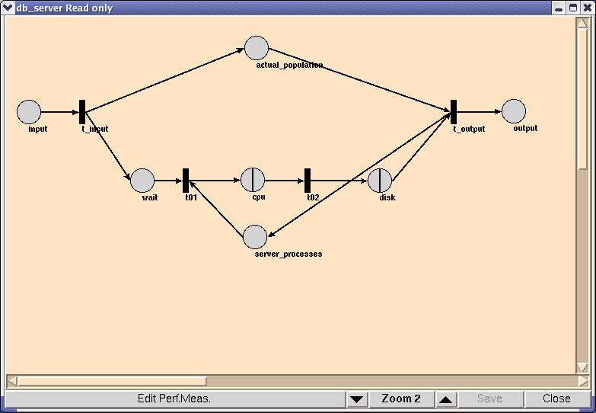
HiQPN net editor
Motivation

Slide 9
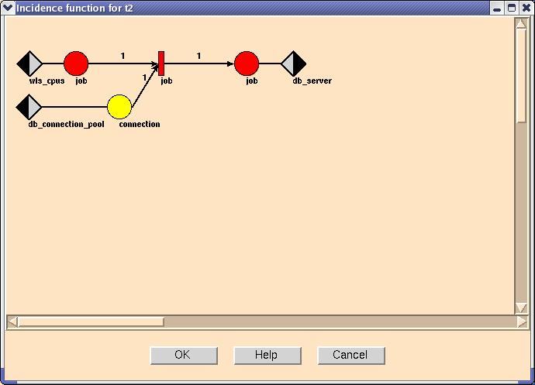
HiQPN incidence function editor
Motivation

Slide 10
QPE
Motivation
Pure Java
Developed directly for QPN support
Available on all major platforms
Integrates perfectly with SimQPN
Screenshots

Slide 11
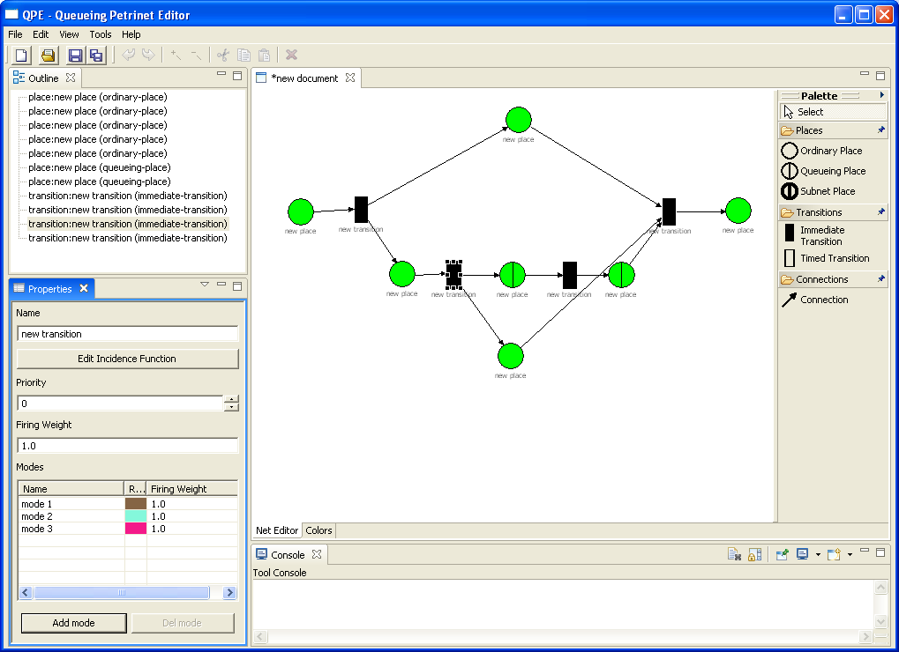
QPE net editor
Motivation

Slide 12
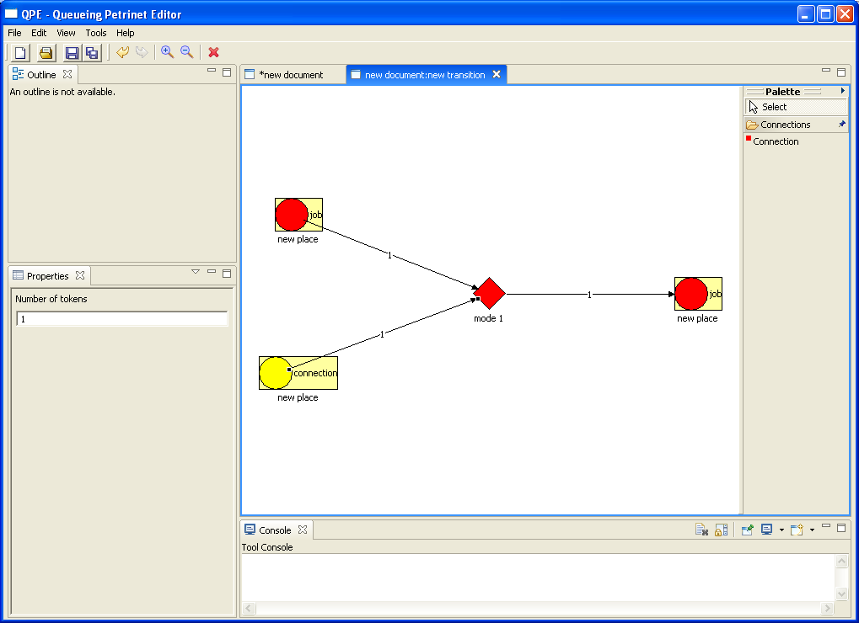
QPE incidence function editor
Motivation

Slide 13
XML Format
Why XML?
Format extension vs. new definition
Demo
Schema definition

Slide 14
Why XML?
XML Format
Portable
Human readable
Transformable
Self describing

Slide 15
Format extension vs. new definition
XML Format
PNML
  Filled with unnecessary features
  Unable to integrate global color definitions
QPE format
  Lightweight
  Optimized for QPNs
Conversion PNML ←→ QPE using XSL

Slide 16
Format Demo
XML Format
..\test-data\test2.xml

Slide 17
Schema definition
XML Format
W3C XML Schema
  Good tool support
  widely spread
  No support for type definition based on name and attribute
RelaxNG
  Easy format
  Able to define QPE format

Slide 18
Schema Demo
XML Format
..\qpn.rng

Slide 19
Approaches to Java GUI development
SWING & AWT
Extending existing tools
  PIPE
Graphic frameworks and libraries
  Touchgraph
  Eclipse & GEF

Slide 20
SWING & AWT
Approaches to Java GUI development
AWT fast but very limited
SWING slow
Implement Framework for QPN visualization by myself
Reinventing the wheel is no solution
→ dropped

Slide 21
PIPE
Approaches to Java GUI development
High level code object oriented
Low level code procedural
Class names had nothing to do with their function
Hacking against my understanding of software quality
Reimplementation more time-consuming than reimplementing from scratch using visualization framework
→ dropped

Slide 22
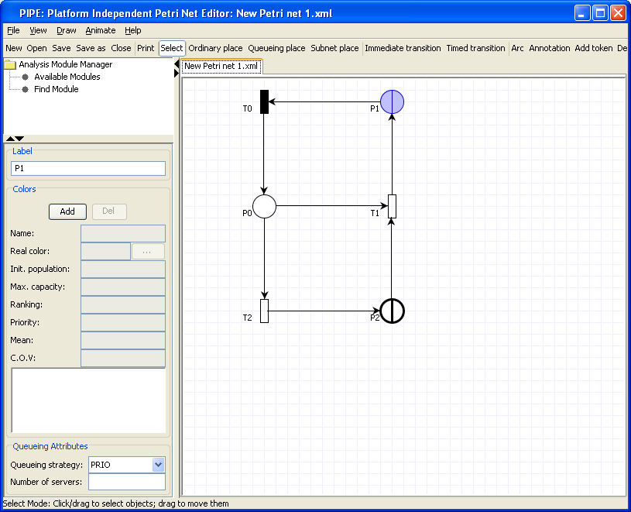
PIPE based QPN editor
Approaches to Java GUI development

Slide 23
Touchgraph
Approaches to Java GUI development
Library for visualizing net structures
Amazing visualization
Homogeneous elements
  No constraints
  No attribute types bound to certain node types
→ dropped because of GEF

Slide 24
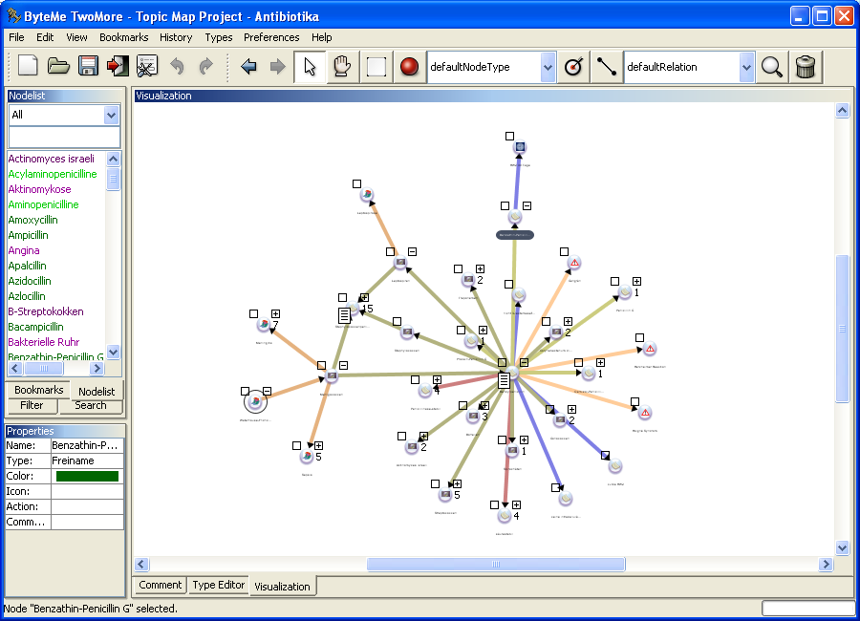
Touchgraph application
Approaches to Java GUI development

Slide 25
Eclipse & GEF
Approaches to Java GUI development
RCP (Rich Client Platform)
  Minimal Eclipse
  Usage of all Eclipse plug-ins
  Application generally usable as standalone application or plug-in
GEF = Graphical Editing Framework
  Visualization framework for building graphical editors

Slide 26
QPE Design & Architecture
RCP Perspective
Problems
Main patterns
Model
Controller
View

Slide 27
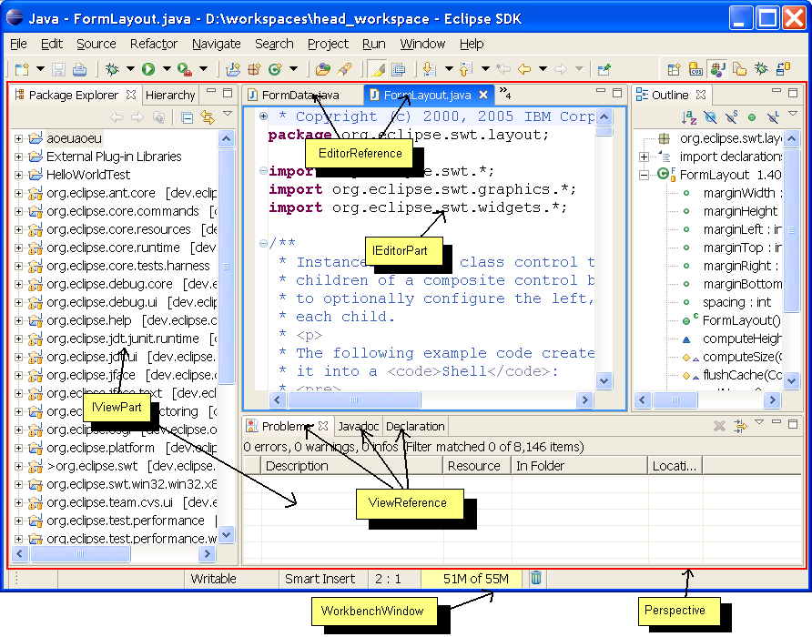
RCP Perspective
QPE Design & Architecture

Slide 28
Problems
QPE Design & Architecture
Change from 3.0 to 3.1
  Major changes in plug-in mechanism
  Samples and how-to's for 3.1 hard to find
  Google not yet indexed a lot of 3.1 content
No Architecture Map
How-to's mainly show samples without explanation

Slide 29
Main patterns
QPE Design & Architecture
MVC
  Model Model
  View Controller
Observer
  PropertyChangeListener
Reflection
  Parameters of type Object
  Implementing additional interface results in entirely different behavior

Slide 30
Model
QPE Design & Architecture
XML (Dom4J and XPath for navigation)
Write access wrapped to enable event-listeners
Screenshots of sample actions
  Registering a new document
  Registering as event listener for an element
  Modify an element

Slide 31
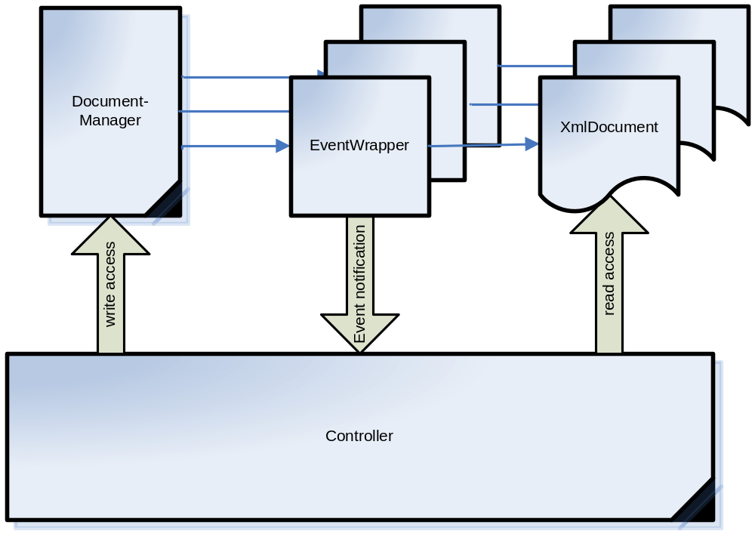
General structure
QPE Design & Architecture

Slide 32
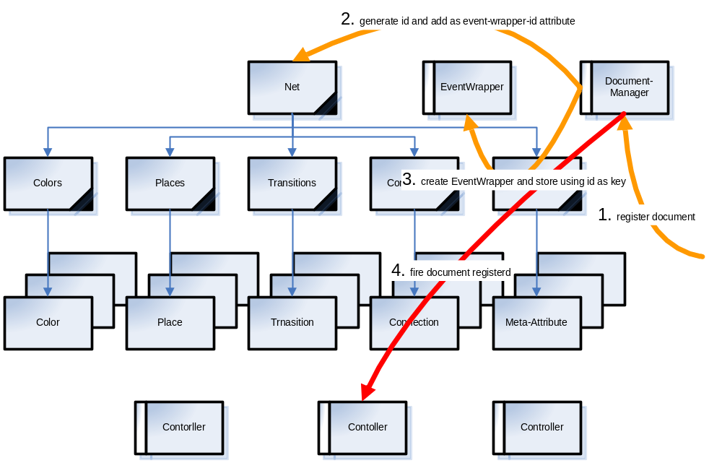
Registering a new document
QPE Design & Architecture

Slide 33
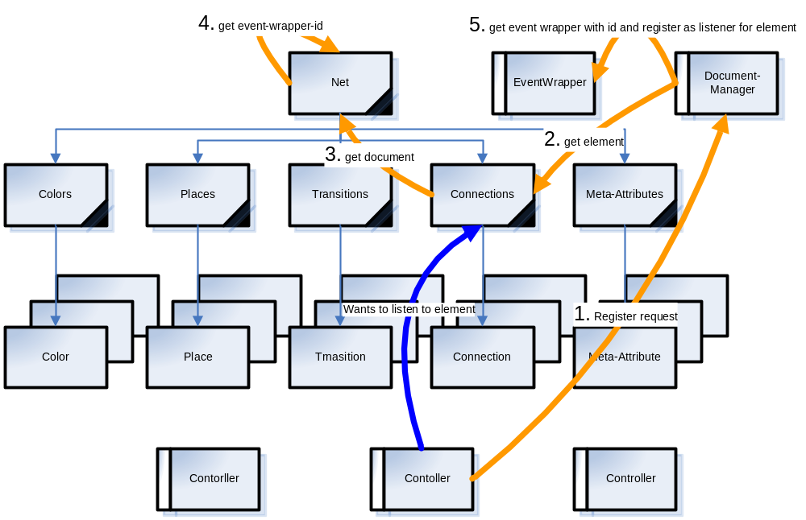
Registering as event listener
QPE Design & Architecture

Slide 34
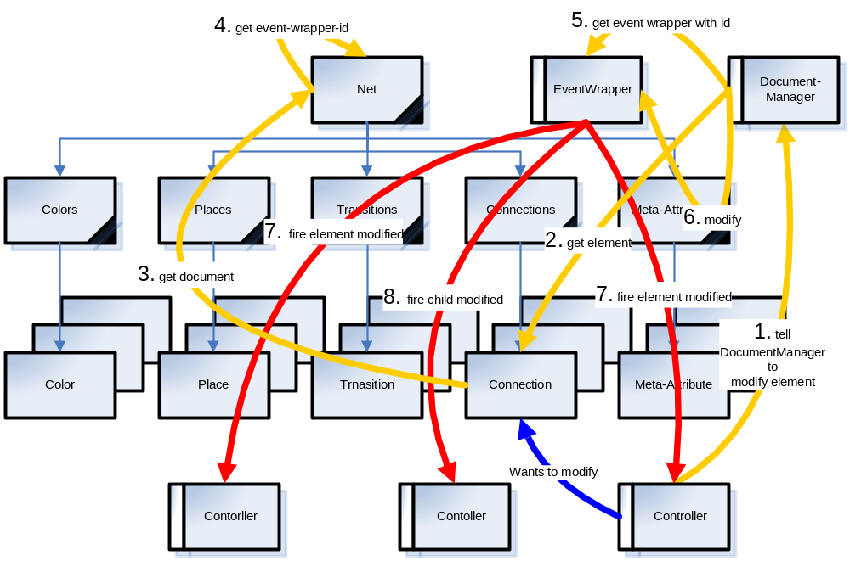
Modify an element
QPE Design & Architecture

Slide 35
Controller
QPE Design & Architecture
EditParts
  interacting with Platform
  Keeping model and view in sync
  Register as event listeners to platform and model events
Screenshot of EditPart structure

Slide 36
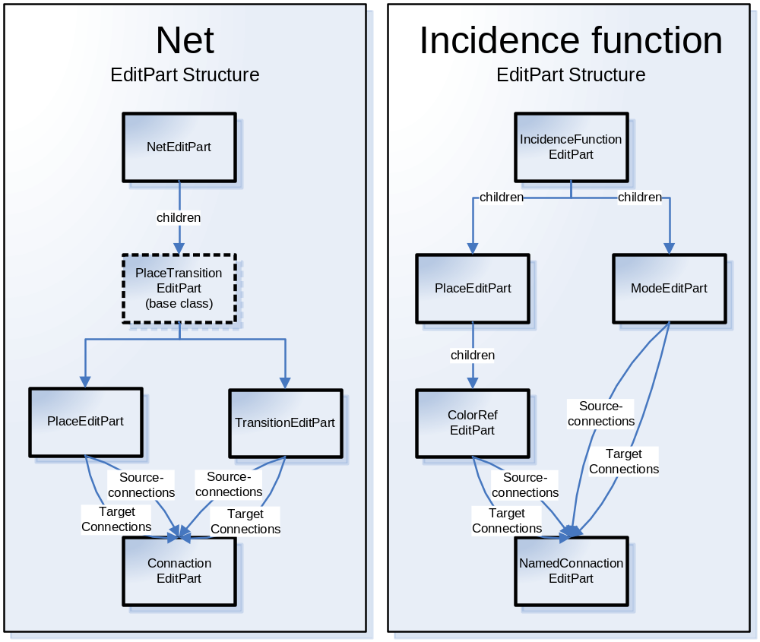
EditPart stucture
QPE Design & Architecture

Slide 37
View
QPE Design & Architecture
Figures = Visual components
Problem
  Lists in Java only allow one reference to a single Object
  How to distinguish between input and output place?
Solution: Wrapping in wrapper objects
Screenshot of I.F. editor figures

Slide 38
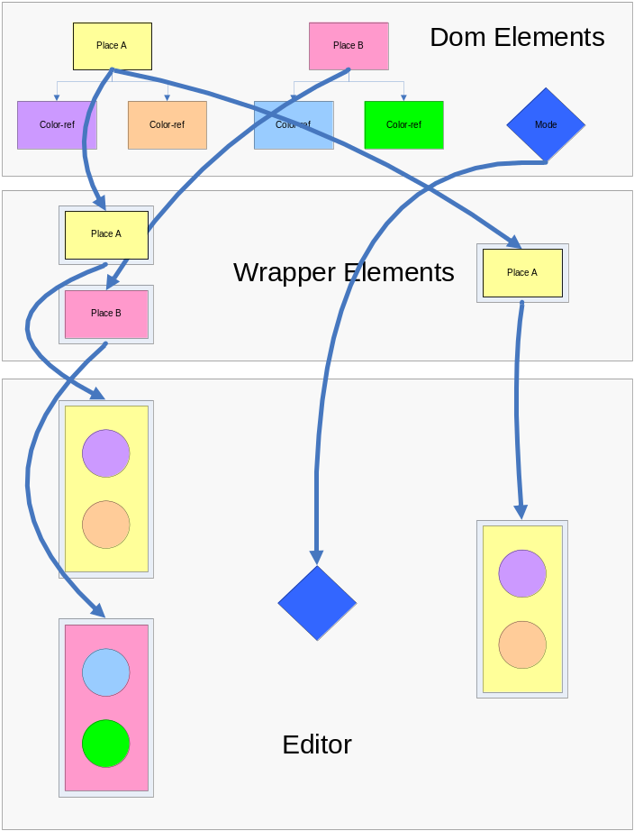
Incidence function view structure

Slide 39
Demo
QPE Design & Architecture
QPE
  Show everything
SimQPN plug-in
  Show wizard

Slide 40
Conclusion
Multiplatform QPN editor
Integration of SimQPN simulator
Together form QPME:
  Queueing Petri Net Modeling Environment
Able to be widely spread
Because of simulator performance will be highly accepted by users

Slide 41
Future work
Implementation of subnet editor
  QPN → HQPN editor
Final adjustments in simulator integration.
Validation of simulator integration
Branding to make executable binary package for each supported platform

Slide 42
End

