Slide 1
Introduction to Homomorphic Cryptosystems
<Author>
08/07/2025

Slide 2
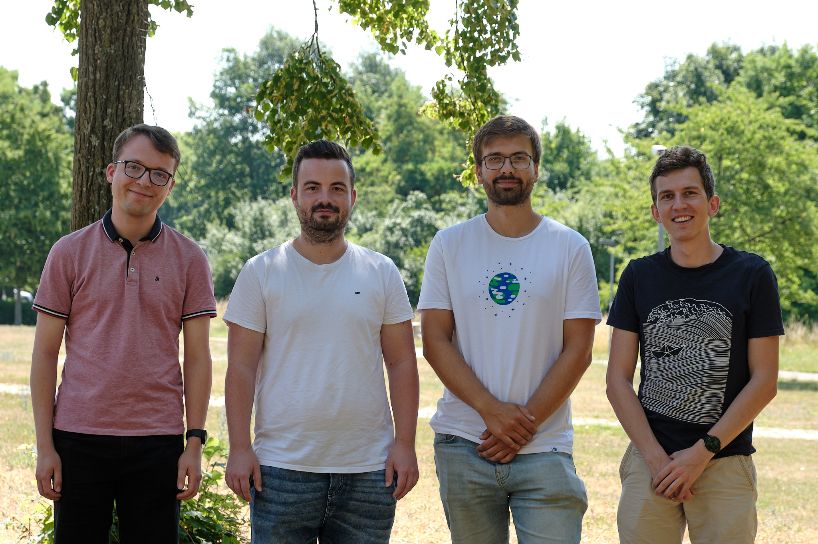
Original Lecture Team
From left to right:
Lukas Horn, M.Sc. Dr. Thomas Prantl Tobias Schneider, B.Sc. Simon Engel, M.Sc.
Chair of Software Engineering (Informatik II) Department of Computer Science University of Würzburg

Slide 3
Cloud Computing
Global cloud computing revenue from 2010 to 2022 and forecast to 2024 by segment (in billions of US dollars)
Here should be the graphic https://de.statista.com/statistik/daten/studie/195760/umfrage/umsatz-mit-cloud-computing-weltweit/, which we unfortunately cannot place here directly for licensing reasons. Lecturers would therefore have to download the graphic themselves.

Slide 4
What’s a Limiting Factor of Cloud Computing?
Which of the following security controls would most increase your confidence in adopting public clouds?
Here should be the graphic https://www.statista.com/statistics/1319167/global-security-tools-to-increase-public-cloud-adoption/, which we unfortunately cannot place here directly for licensing reasons. Lecturers would therefore have to download the graphic themselves.

Slide 5
Motivation
Cloud computing has grown over the last decade and is expected to become more important in the future.
The number of digital crimes is increasing and causing ever greater losses.
Cloud Computing
Data privacy
The AI market size is projected to rise from 241.8 billion U.S. dollars in 2023 to almost 740 billion U.S. dollars in 2030, accounting for a compound annual growth rate of 17.3%. [1]
In the E.U., 57% of large enterprises using the cloud reported the risk of a security breach as the main limiting factor in the use of cloud computing services. [2]
[1] https://www.statista.com/statistics/941835/artificial-intelligence-market-size-revenue-comparisons/
[2] Josep Domingo-Ferrer, et Al.; ”Privacy-preserving cloud computing on sensitive data: A survey of methods, products and challenges”
https://doi.org/10.1016/j.comcom.2019.04.011.

Slide 6
Data Privacy vs. Confidentiality vs. Data Integrity vs. Access Control
Data privacy
The claim of individuals, groups or institutions to determine for themselves when, how, and to what extent information about them is communicated to others
Confidentiality
The protection of sensitive information from unauthorized access or disclosure.
Data integrity
Ensuring the accuracy, completeness, consistency, and validity of the data.
Access Control
The selective restriction of access to a place or other resource (data).

Slide 7


Motivation – Basic Idea
End User
Cloud
Message
Message
“Add five to the encoded message”
“Divide the message by two”
“Take the square root of the message”
Message + x
Message + x
We can do calculations on encrypted numbers
The party doing calculations does not know the outcome

Slide 8
Motivation - History
Idea and name was first introduced by Rivest et al. in 1978
Assumption that cryptosystems with the homomorphic property are possible
But: no solution
No fully homomorphic solution was found over the next 30 years
Breakthrough in 2009 by Gentry et al.
First real homomorphic cryptosystem
Possible to do unlimited number of operations on the ciphertext
Homomorphic Encryption (HE) is a new and interesting topic, which is expected to undergo more breakthroughs in the future

Slide 9
Goals
The idea and importance of Homomorphic Encryption
Mathematical background and differences of multiple HE cryptosystems
How to implement important functions with limited operations
What do we want to learn in this lecture?

Slide 10
Storyline of the Lecture
Homomorphism Definition
Overview over homomorphic cryptosystems
CKKS Cryptosystem
Extension of homomorphic cryptosystems by basic mathematical functions
Evaluation of Homomorphic Application

Slide 11
Mathematical Background

Slide 12
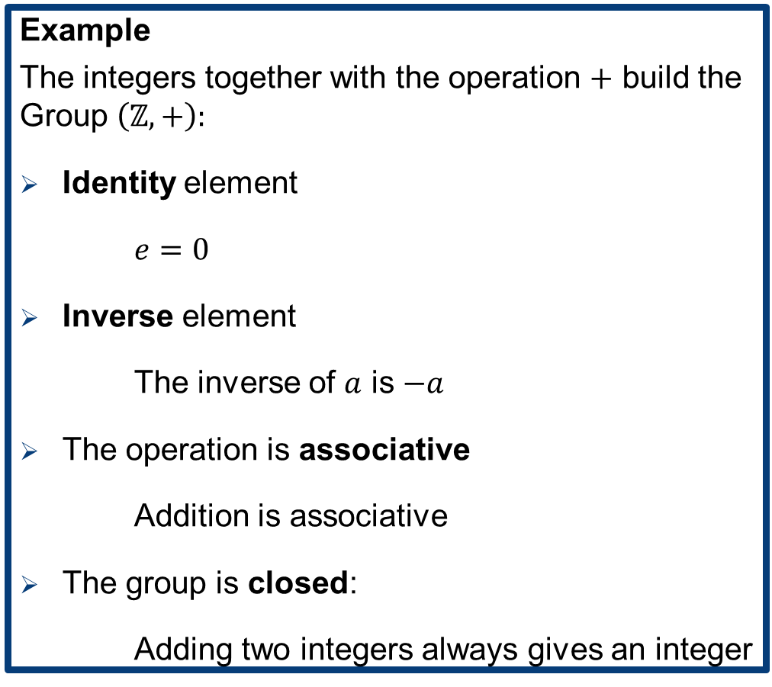
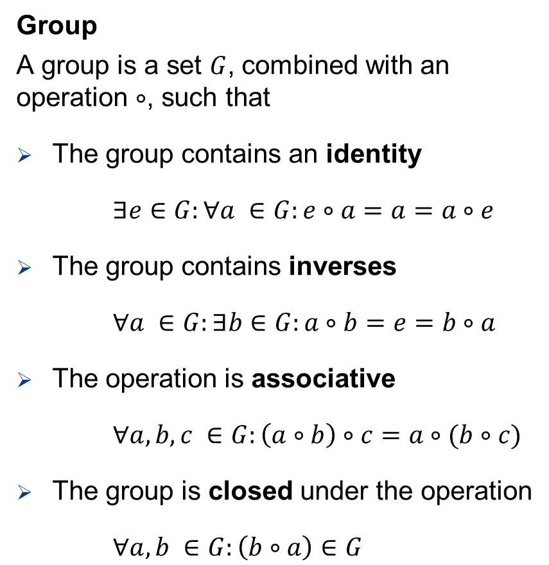
Mathematical Background
Group
A group is a set $G$, combined with an operation $∘$, such that
The group contains an identity
$∃e∈G:∀a ∈G:e∘a=a=a∘e$
The group contains inverses
$∀a ∈G:∃b∈G:a∘b=e=b∘a$
The operation is associative
$∀a,b,c ∈G:\left(a∘b\right)∘c=a∘(b∘c)$
The group is closed under the operation
$∀a,b ∈G:\left(b∘a\right)∈G$
Example
The integers together with the operation $+$ build the Group $\left(ℤ,+\right):$
Identity element
$e=0$
Inverse element
The inverse of $a$ is $−a$
The operation is associative
Addition is associative
The group is closed:
Adding two integers always gives an integer

Slide 13
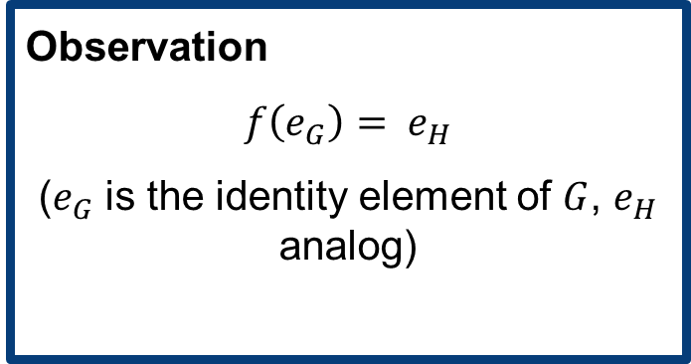
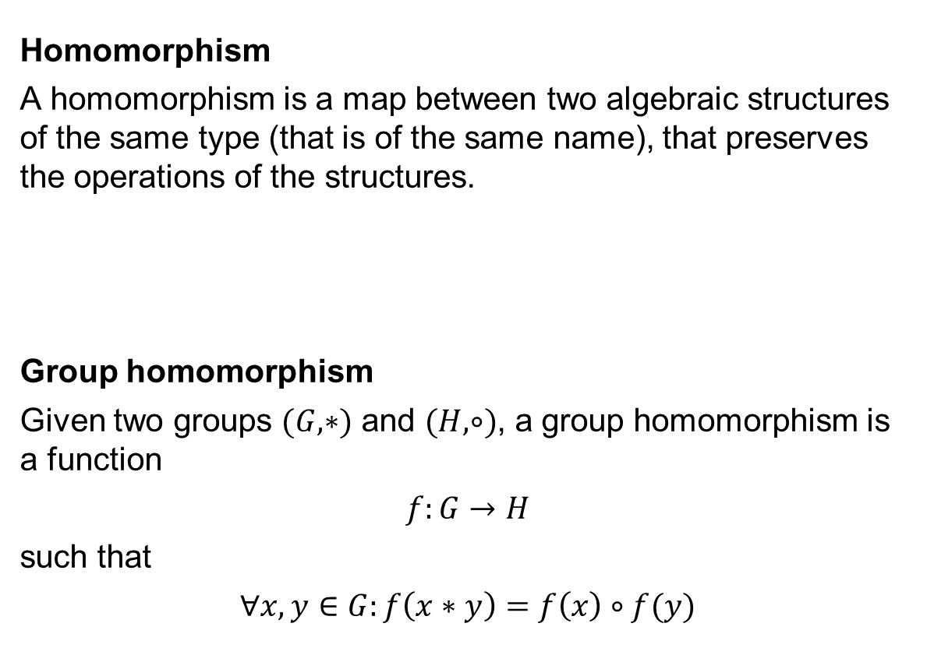
Mathematical Background
Homomorphism
A homomorphism is a map between two algebraic structures of the same type (that is of the same name), that preserves the operations of the structures.
Group homomorphism
Given two groups $(G,∗)$ and $(H,∘)$, a group homomorphism is a function
$$f:G→H$$
such that
$$∀x,y∈G:f\left(x∗y\right)=f\left(x\right)∘f(y)$$
Group
Monoid
Ring
Vector space
Modul
…
Observation
$f\left(e_{G}\right)= e_{H}$
($e_{G}$ is the identity element of $G$, $e_{H}$ analog)

Slide 14
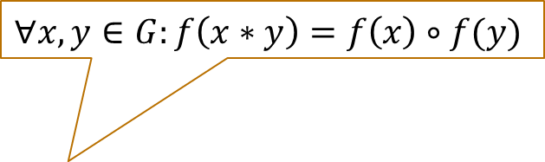

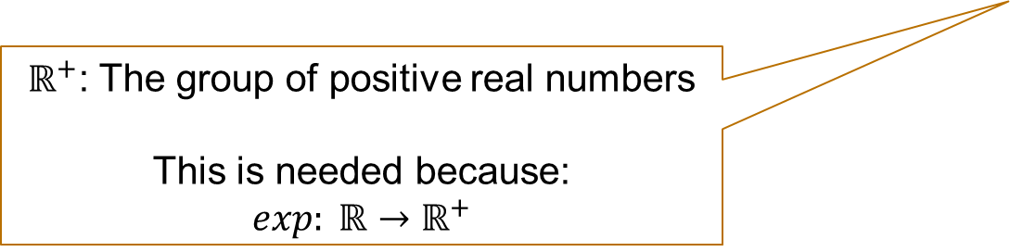
Group Homomorphism Example
$f\left(x\right)=\exp\left(x\right)=e^{x}$ yields a group homomorphism from the group $(ℝ,+)$ to the group $(ℝ^{+}, ∙)$.
Proof
Trivial because of the rules of exponents:
$z^{m}⋅z^{n}=z^{m+n}$
So for all $x,y∈ℝ$the exponential function fulfills the homomorphic property:
$$f\left(x+y\right)=e^{x+y}=e^{x}⋅e^{y}=f(x)⋅f(y)$$
$ℝ^{+}$: The group of positive real numbers
This is needed because:
$$exp: ℝ→ℝ^{+}$$
$$∀x,y∈G:f\left(x∗y\right)=f\left(x\right)∘f(y)$$

Slide 15
Homomorphic property of rsa

Slide 16
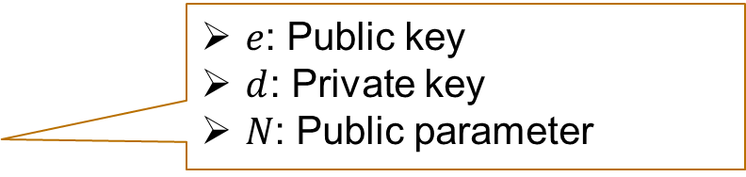

Homomorphic property of RSA
The (textbook) RSA cryptosystem
Encryption of $m$: $E\left(m\right)=m^{e} \text{mod} N=c$
Decryption of $c$: $D\left(c\right)=c^{d} \text{mod} N=m$
RSA is homomorph with respect to multiplication
$$E\left(m_{1}\right)⋅E\left(m_{2}\right)= m_{1}^{e}m_{2}^{e} \text{mod} n$$
$$={\left(m_{1}m_{2}\right)}^{e} \text{mod} n$$
$$=E(m_{1}∙m_{2})$$
$e$: Public key
$d$: Private key
$N$: Public parameter
Short task
Does this cryptosystem fulfil homomorphic properties?
And if so: Which mathematical operation preserves the structure?

Slide 17
Homomorphic property of RSA
The (textbook) RSA cryptosystem
Encryption of $m$: $E\left(m\right)=m^{e} \text{mod} N=c$
Decryption of $c$: $D\left(c\right)=c^{d} \text{mod} N=m$
RSA is homomorph with respect to multiplication
$$E\left(m_{1}\right)⋅E\left(m_{2}\right)= m_{1}^{e}m_{2}^{e} \text{mod} n$$
$$={\left(m_{1}m_{2}\right)}^{e} \text{mod} n$$
$$=E(m_{1}∙m_{2})$$
$e$: Public key
$d$: Private key
$N$: Public parameter

Slide 18
Overview over homomoprhic cryptosystems

Slide 19
Homomorphic cryptosystems
We distinguish between three different homomorphic encryption approaches:
Partially Homomorphic Encryption (PHE)
Allows only one type of operation with an unlimited number of times
Somewhat Homomorphic Encryption (SWHE)
Allows some types of operations a limited number of times
Fully Homomorphic Encryption (FHE)
Allows an unlimited number of operations for an unlimited number of times
Additive
or
Multiplicative
Additive
and
Multiplicative
Additive
and
Multiplicative
RSA
Unlevelled
Encryption does not add an error to the message
Levelled
Encryption adds a (small) error to the message
We don’t know an unlevelled FHE scheme!

Slide 20
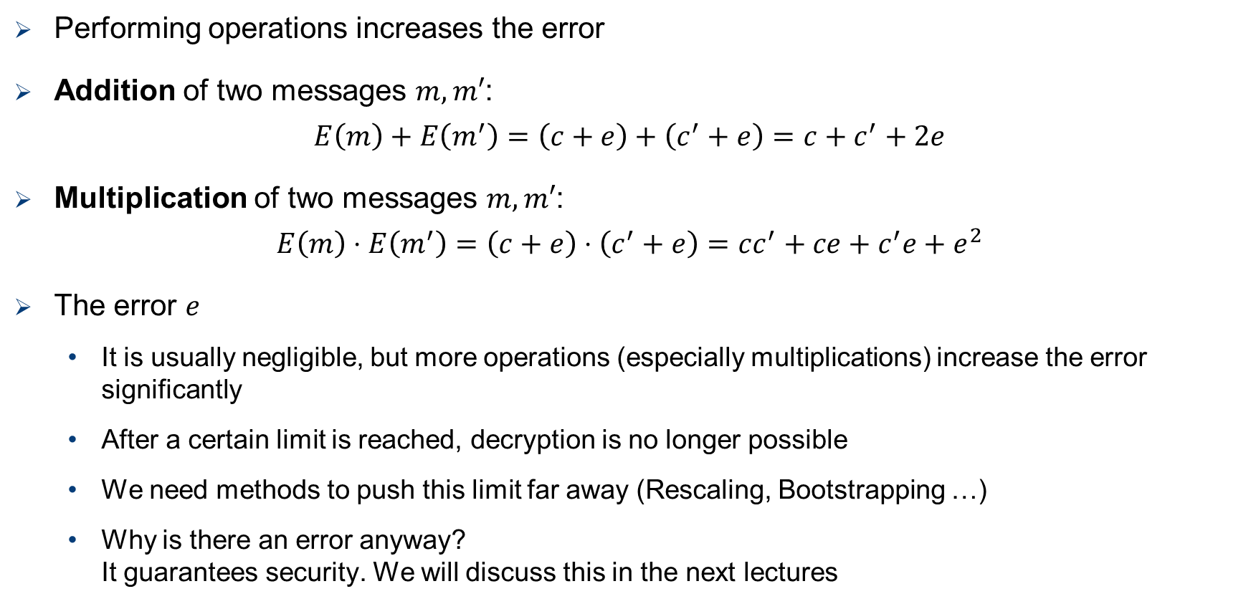
Levelled Homomorphic Encryption
Levelled
Encryption adds a (small) error to the message
Performing operations increases the error
Addition of two messages $m,m′$:
$$E\left(m\right)+E\left(m^{′}\right)=\left(c+e\right)+\left(c^{′}+e\right)=c+c^{′}+2e$$
Multiplication of two messages $m,m′$:
$$E\left(m\right)⋅E\left(m^{′}\right)=\left(c+e\right)⋅\left(c^{′}+e\right)=cc^{′}+ce+c^{′}e+e^{2}$$
The error $e$
It is usually negligible, but more operations (especially multiplications) increase the error significantly
After a certain limit is reached, decryption is no longer possible
We need methods to push this limit far away (Rescaling, Bootstrapping …)
Why is there an error anyway? It guarantees security. We will discuss this in the next lectures

Slide 21
Homomorphic Cryptosystems
Domains:
Integer → Only Integer arithmetics
Boolean → Represents boolean circuits with typical gates (AND, OR, NOT)
Real numbers → Floating-point arithmetics
Name | Year | Domain
BGV | 2011 | Integer
BFV | 2012 | Integer
FHEW | 2014 | Boolean
TFHE | 2016 | Boolean
CKKS | 2017 | Real number

Slide 22
Homomorphic Encryption – The solution for everything?
Homomorphic Encryption provides interesting new approaches in the IT security domain
However, it’s not a solution for everything:
Performance
Calculations on the (mostly) larger ciphertexts take much longer, then doing the same operation on the plaintext.
No verifiable computing
There is no way of verifying that the correct computations were executed in the cloud.
Malleability
An attacker could transform a ciphertext into another ciphertext which decrypts to a related plaintext.
Multiple parties
How can multiple parties privately input values for the computation?

Slide 23
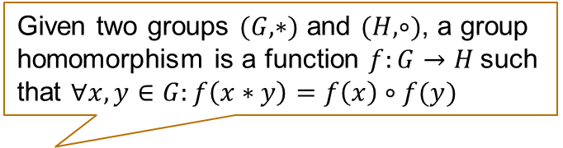
Summary – What did we learn today?
A group is a set 𝐺, combined with an operation ∘. There are four requirements to fulfill.
Mathematical Background
What is a group?
What is the definition of “Homomorphism”?
Given two groups $(G,∗)$ and $(H,∘)$, a group homomorphism is a function $f:G→H$such that $∀x,y∈G:f\left(x∗y\right)=f\left(x\right)∘f(y)$
Overview over homomorphic cryptosystems
PHE vs. SWHE vs FHE
Levelled vs. unlevelled
We need methods like rescaling or bootstrapping to implement FHE schemes.
Homomorphic property of RSA
RSA is homomorph with respect to multiplication

