Slide 1
Learning With Errors
<Author>
08/07/2025

Slide 2

Learning Without Errors
Solve for $x_{1},…, x_{4}$:
$$34x_{1}+2x_{2}+4x_{3}+67x_{4}=5297$$
$$6x_{1}+25x_{2}+71x_{3}+33x_{4}=6439$$
$$42x_{1}+88x_{2}+64x_{3}+52x_{4}=8790$$
$$13x_{1}+9x_{2}+93x_{3}+49x_{4}=8454$$
No problem using the tools of linear algebra:
$$x=\left(\begin{matrix}\begin{matrix}5 \\ 18\end{matrix} \\ 50 \\ 73\end{matrix}\right)$$

Slide 3
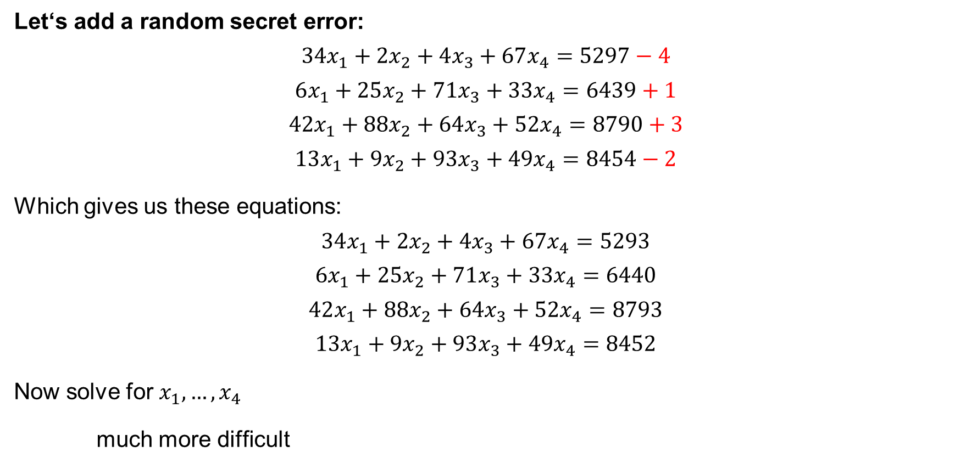
Adding Error
Let‘s add a random secret error:
$$34x_{1}+2x_{2}+4x_{3}+67x_{4}=5297−4$$
$$6x_{1}+25x_{2}+71x_{3}+33x_{4}=6439+1$$
$$42x_{1}+88x_{2}+64x_{3}+52x_{4}=8790+3$$
$$13x_{1}+9x_{2}+93x_{3}+49x_{4}=8454−2$$
Which gives us these equations:
$$34x_{1}+2x_{2}+4x_{3}+67x_{4}=5293$$
$$6x_{1}+25x_{2}+71x_{3}+33x_{4}=6440$$
$$42x_{1}+88x_{2}+64x_{3}+52x_{4}=8793$$
$$13x_{1}+9x_{2}+93x_{3}+49x_{4}=8452$$
Now solve for $x_{1},…, x_{4}$
much more difficult

Slide 4
Modular Arithmetic

Slide 5
Modular Arithmetic
Modular arithmetic is a system of arithmetic for integers. The numbers “wrap around” when reaching a certain value, called modulus.
Example: 12-hour clock
0
11
1
10
2
9
3
8
4
7
5
6

Slide 6
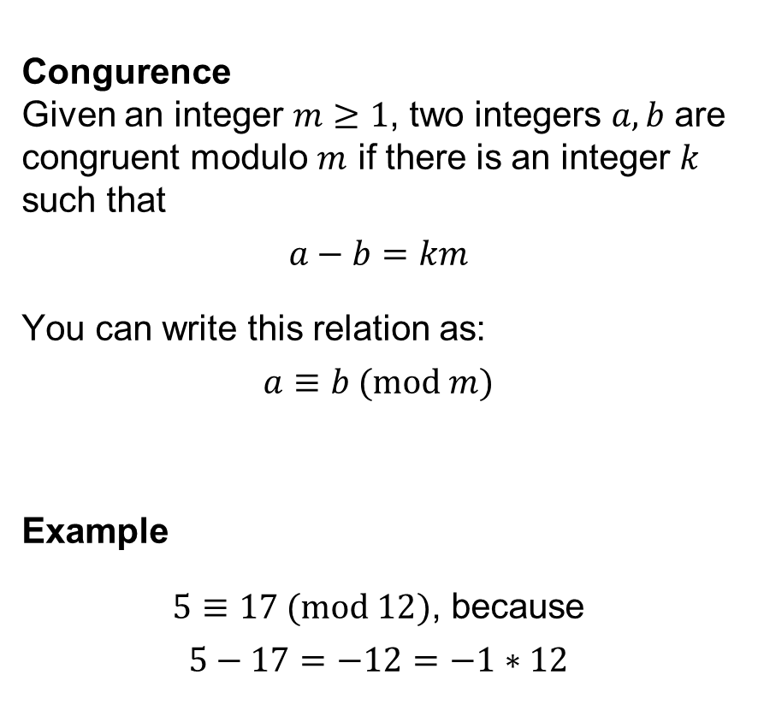
Modular Arithmetic
Congurence Given an integer $m≥1$, two integers $a,b$ are congruent modulo $m$ if there is an integer $k$ such that
$$a−b=km$$
You can write this relation as:
$$a≡b (\text{mod} m)$$
Example
$5≡17 (\text{mod} 12)$, because
$$5−17=−12=−1∗12$$
0
11
1
10
2
9
3
8
4
7
5
6

Slide 7
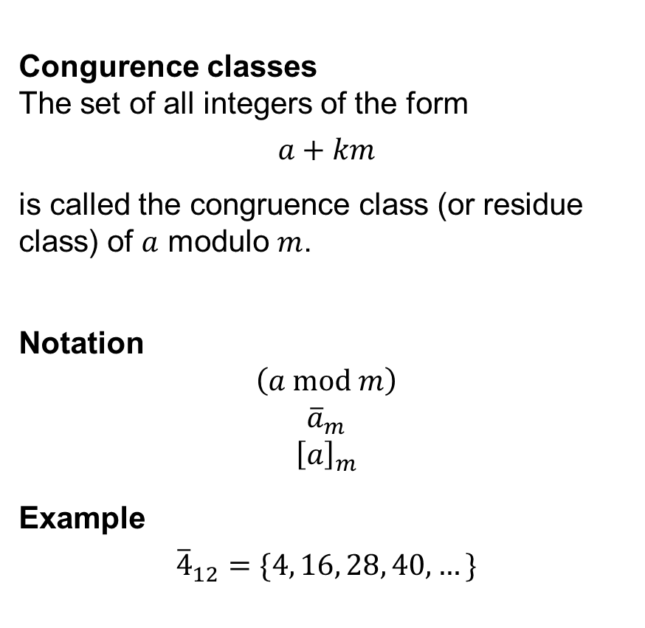
Modular Arithmetic
Congurence classes The set of all integers of the form
$$a+km$$ is called the congruence class (or residue class) of $a$ modulo $m$.
Notation $$\left(a \text{mod} m\right) \\ {\overline{a}}_{m} \\ {\left[a\right]}_{m}$$
Example
$${\overline{4}}_{12}=\{4, 16, 28, 40, …\}$$
0
11
1
10
2
9
3
8
4
7
5
6

Slide 8
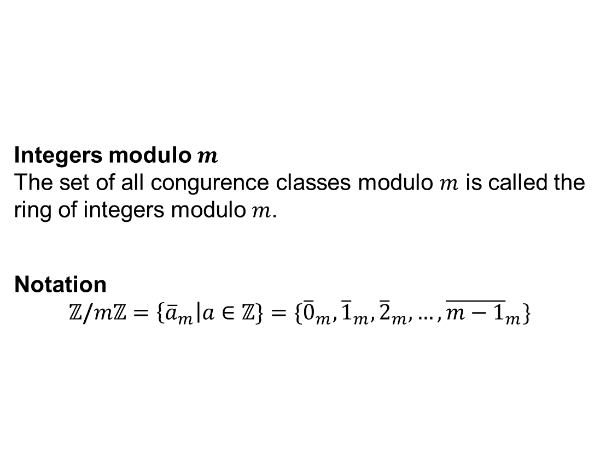
Modular Arithmetic
Integers modulo $m$ The set of all congurence classes modulo $m$ is called the ring of integers modulo $m$.
Notation $$ℤ\text{/}mℤ=\left\{{\overline{a}}_{m}\right|a∈ℤ\}=\{{\overline{0}}_{m}, {\overline{1}}_{m},{\overline{2}}_{m},…,{\overline{m−1}}_{m}\}$$
More on that in future lectures!
Notes:
Restklassenring

Slide 9
LWE Definition

Slide 10

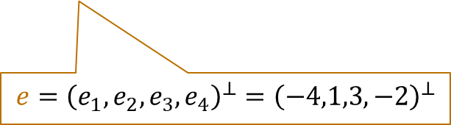
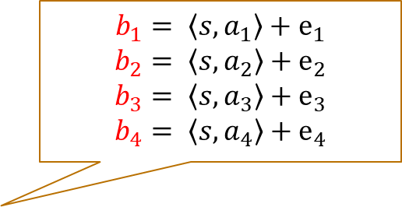
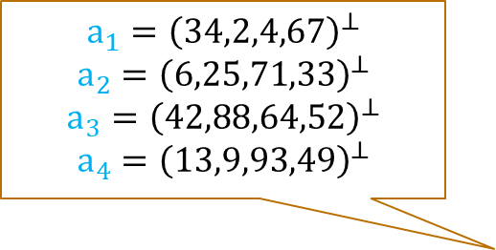
Learning with Errors
$$34x_{1}+2x_{2}+4x_{3}+67x_{4}=5297−4$$
$$6x_{1}+25x_{2}+71x_{3}+33x_{4}=6439+1$$
$$42x_{1}+88x_{2}+64x_{3}+52x_{4}=8790+3$$
$$13x_{1}+9x_{2}+93x_{3}+49x_{4}=8454−2$$
$$a_{1}={\left(34,2,4,67\right)}^{⊥}$$
$$a_{2}={\left(6,25,71,33\right)}^{⊥}$$
$$a_{3}={\left(42,88,64,52\right)}^{⊥}$$
$$a_{4}={\left(13,9,93,49\right)}^{⊥}$$
$$b_{1}= \left\langle s, a_{1}\right\rangle +e_{1}$$
$$b_{2}= \left\langle s, a_{2}\right\rangle +e_{2}$$
$$b_{3}= \left\langle s, a_{3}\right\rangle +e_{3}$$
$$b_{4}= \left\langle s, a_{4}\right\rangle +e_{4}$$
$$e={\left(e_{1},e_{2},e_{3},e_{4}\right)}^{⊥}={\left(−4,1,3,−2\right)}^{⊥}$$
Notes:
Hier kann man schonmal die Bestanteile der Definition anhand des Beispiels vom Anfang definieren.

Slide 11
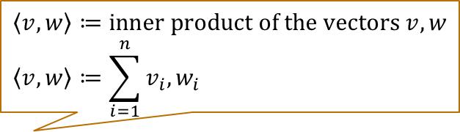
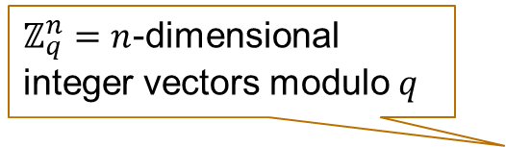

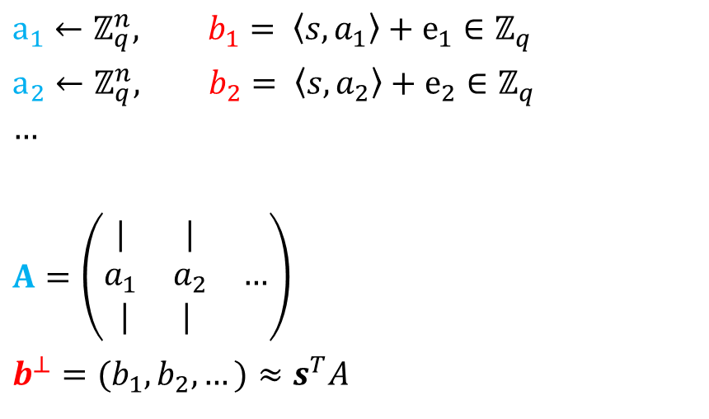
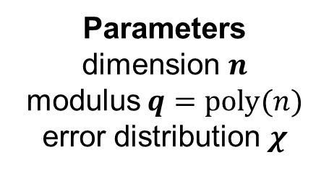

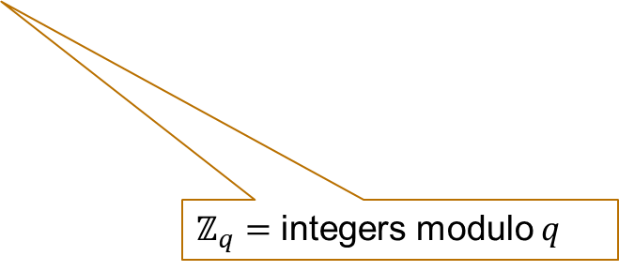
Learning with Errors
$$\left\langle v,w\right\rangle ≔\text{inner} \text{product} \text{of} \text{the} \text{vectors} v,w \\ \left\langle v,w\right\rangle ≔\sum_{i=1}^{n}{v_{i},w_{i}}$$
$ℤ_{q}^{n}=n$-dimensional integer vectors modulo $q$
Parameters dimension $n$ modulus$q=poly(n)$ error distribution $χ$
$$a_{1}←ℤ_{q}^{n}, b_{1}= \left\langle s, a_{1}\right\rangle +e_{1}∈ℤ_{q}$$
$$a_{2}←ℤ_{q}^{n}, b_{2}= \left\langle s, a_{2}\right\rangle +e_{2}∈ℤ_{q} \\ …$$
$A=\left(\begin{matrix}| & | & \\ a_{1} & a_{2} & … \\ | & | & \end{matrix}\right)$
$$b^{⊥}=(b_{1},b_{2},…)≈s^{T}A$$
uniform random
$ℤ_{q}=$ integers modulo $q$
Search Problem Find secret $s∈ℤ_{q}^{n}$ given $A$ and $b^{⊥}≈s^{⊥}A$
Decision Problem Distinguish $(A,b)$ from uniform $(A, b)$

Slide 12
Build A Cryptosystem from the LWE Problem

Slide 13
Symmetric vs Antisymmetric Cryptosystem
Symmetric cryptosystem
There is one key shared with both parties. The key is used to encrypt the data.
Advantages
Simple, easy to implement and calculate
Disadvantages
Key has to be shared between the parties
Antisymmetric cryptosystem
Every party has two keys (public and private key). Messages encrypted with the public key can be decrypted with the private key.
Advantages
The public key can be shared without a problem as it can be only used for encryption
Disadvantages
More complex calculations.
Security comes from the assumption, that it is hard to get the private key from the public key

Slide 14
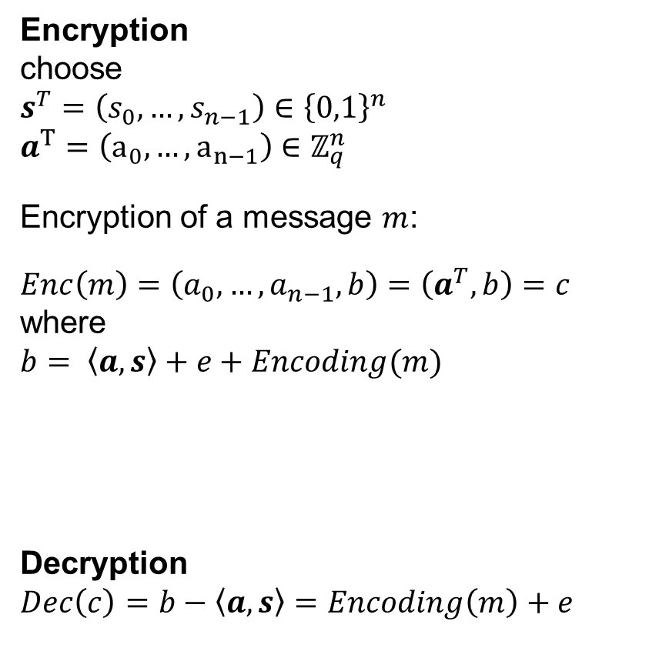
A Symmetric LWE Cryptosystem
Encryption choose $$s^{T}=\left(s_{0},…, s_{n−1}\right)∈{\left\{0,1\right\}}^{n} \\ a^{T}=\left(a_{0}, …, a_{n−1}\right)∈ℤ_{q}^{n}$$
Encryption of a message $m$:
$Enc\left(m\right)=\left(a_{0}, …, a_{n−1}, b\right)=\left(a^{T},b\right)=c$ where $$b= \left\langle a, s\right\rangle +e+Encoding(m)$$
Decryption $$Dec\left(c\right)=b−\left\langle a, s\right\rangle =Encoding\left(m\right)+e$$
bit
modular integer
real in an interval
0
11
1
10
2
9
3
drawn from error distribution.
This the LWE definition and provides security
8
4
7
5
6
https://www.zama.ai/post/tfhe-deep-dive-part-1

Slide 15

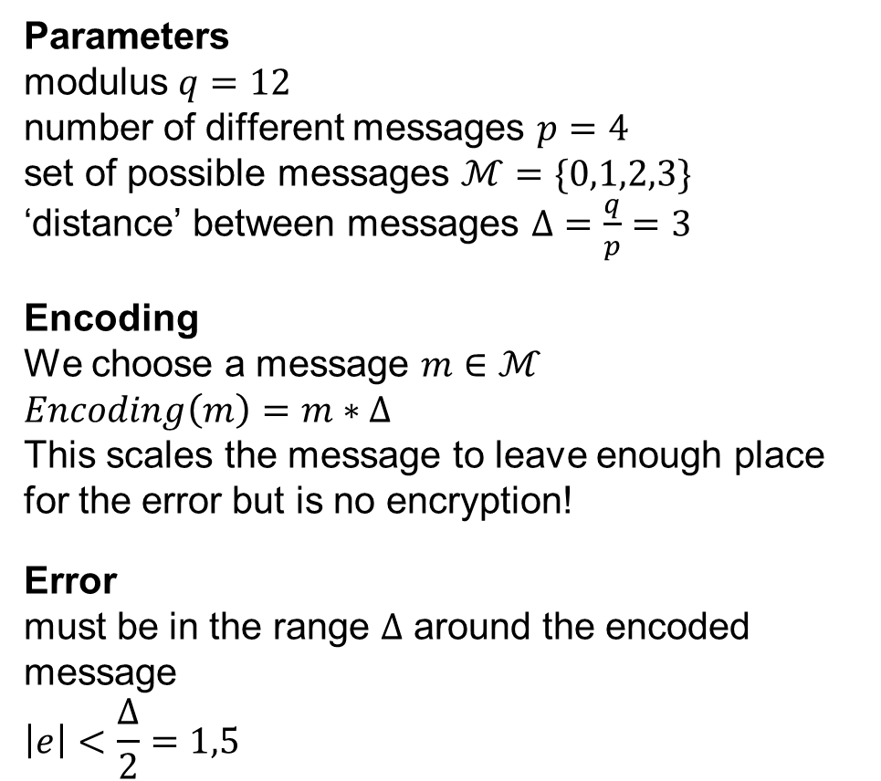
Encoding and Error
Parameters modulus $q=12$ number of different messages $p=4$ set of possible messages $ℳ=\{0,1,2,3\}$ ‘distance’ between messages $Δ=\frac{q}{p}=3$
Encoding We choose a message $m∈ℳ$ $$Encoding\left(m\right)=m∗Δ$$ This scales the message to leave enough place for the error but is no encryption!
Error must be in the range $Δ$ around the encoded message $$\left|e\right|<\frac{Δ}{2}=1,5$$
$Δ$
0
11
1
10
2
9
3
8
4
7
5
6
https://www.zama.ai/post/tfhe-deep-dive-part-1

Slide 16

Encoding and Error: Example
Example We want to send the message $m=3$
$$Encoding\left(m\right)=9$$
We draw the error $e=−1$
$$Encoding\left(m\right)+e=8$$
$Δ$
0
11
1
10
2
9
3
8
4
7
5
6
https://www.zama.ai/post/tfhe-deep-dive-part-1

Slide 17

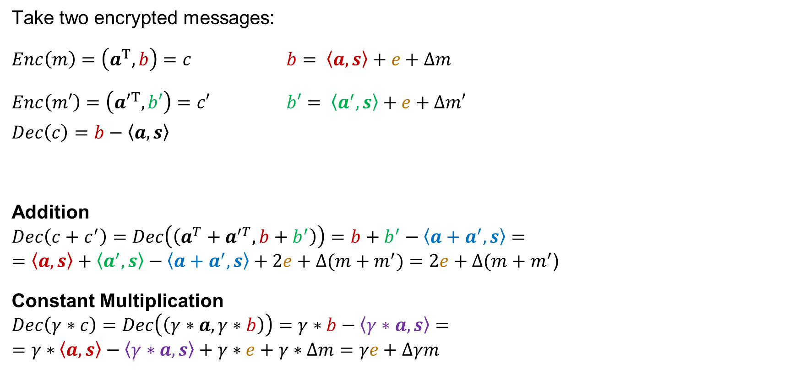
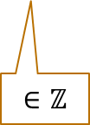
Homomorphic Properties of the Symmetric Cryptosystem
Take two encrypted messages:
$Enc\left(m\right)=\left(a^{T},b\right)=c$ $b= \left\langle a, s\right\rangle +e+Δm$
$Enc\left(m′\right)=\left({a′}^{T},b′\right)=c′$ $b′= \left\langle a^{′}, s\right\rangle +e+Δm′$
$$Dec\left(c\right)=b−\left\langle a, s\right\rangle$$
Addition $$Dec\left(c+c^{′}\right)=Dec\left(\left(a^{T}+a^{′T},b+b^{′}\right)\right)=b+b^{′}−\left\langle {a+a}^{′}, s\right\rangle =$$ $=\left\langle a, s\right\rangle +\left\langle a^{′}, s\right\rangle −\left\langle {a+a}^{′}, s\right\rangle +2e+Δ(m+m^{′})=2e+Δ(m+m^{′}$)
Constant Multiplication $$Dec\left(γ∗c\right)=Dec\left(\left(γ∗a,γ∗b\right)\right)=γ∗b−\left\langle γ∗a, s\right\rangle = \\ =γ∗\left\langle a, s\right\rangle −\left\langle γ∗a, s\right\rangle +γ∗e+γ∗Δm=γe+Δγm$$
The inner product is distributive over vector addition
$$\left\langle a+b, c\right\rangle =\left\langle a ,c\right\rangle +\left\langle b, c\right\rangle$$
The error increases!
The error increases!
$$∈ℤ$$

Slide 18
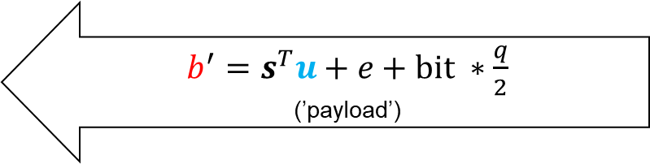


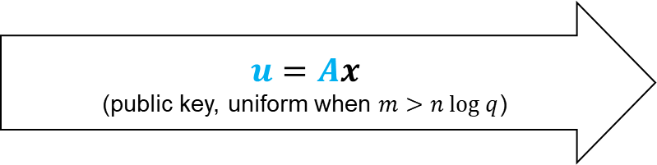
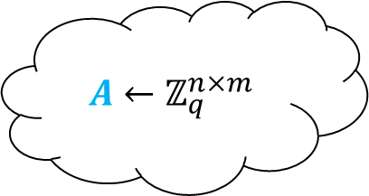

Public-Key Cryptosystem from LWE
public parameter
Alice chooses vector $x$
$$b^{′}−b^{T}x ≈bit∗\frac{q}{2}$$
$A$ $←ℤ_{q}^{n×m}$
Bob $$s←ℤ_{q}^{n}$$
secret key
$$u=Ax$$
(public key, uniform when $m>n \text{log} q$)
LWE problem, this provides security
When all parameters are set correctly
$$b^{T}=s^{T}A+e^{T}$$
(ciphertext ‘preamble’)
$b^{′}=s^{T}u+e+\text{bit} ∗\frac{q}{2}$
(’payload’)
Craig Gentry, Chris Peikert, and Vinod Vaikuntanathan. 2008. Trapdoors for hard lattices and new cryptographic constructions.
Notes:
b’-bx=(su+e+bit*q/2)-(sAx+ex)=su + e + bit * q/2 – su – ex = bit *q/2 +e-ex

Slide 19
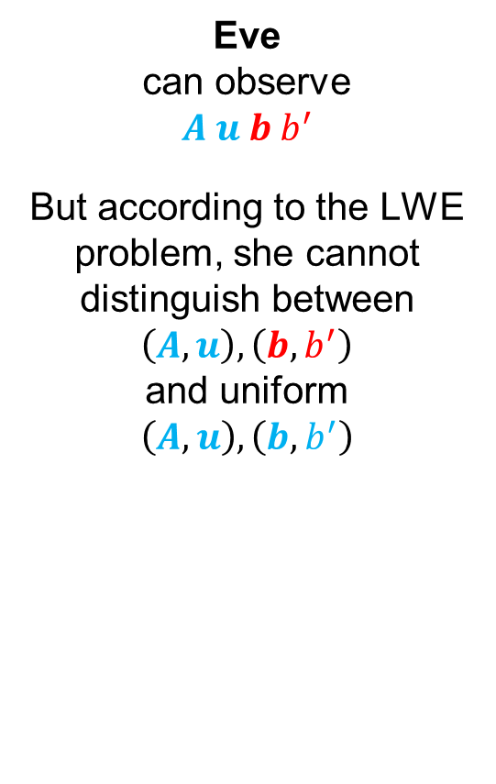
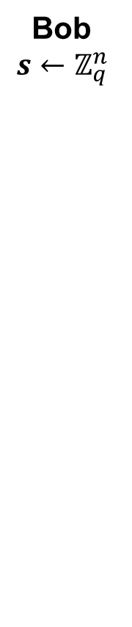





Public-Key Cryptosystem from LWE
Alice chooses vector $x$
$A$ $←ℤ_{q}^{n×m}$
Bob $$s←ℤ_{q}^{n}$$
Eve can observe $$A u b b^{′}$$
But according to the LWE problem, she cannot distinguish between $\left(A,u\right),\left(b,b^{′}\right)$ and uniform $$\left(A,u\right),\left(b,b^{′}\right)$$
$$u=Ax$$
(public key, uniform when $m>n \text{log} q$)
$$b^{T}=s^{T}A+e^{T}$$
(ciphertext ‘preamble’)
$b^{′}=s^{T}u+e+\text{bit} ∗\frac{q}{2}$
(’payload’)
Craig Gentry, Chris Peikert, and Vinod Vaikuntanathan. 2008. Trapdoors for hard lattices and new cryptographic constructions.

Slide 20
Lattice Problems

Slide 21

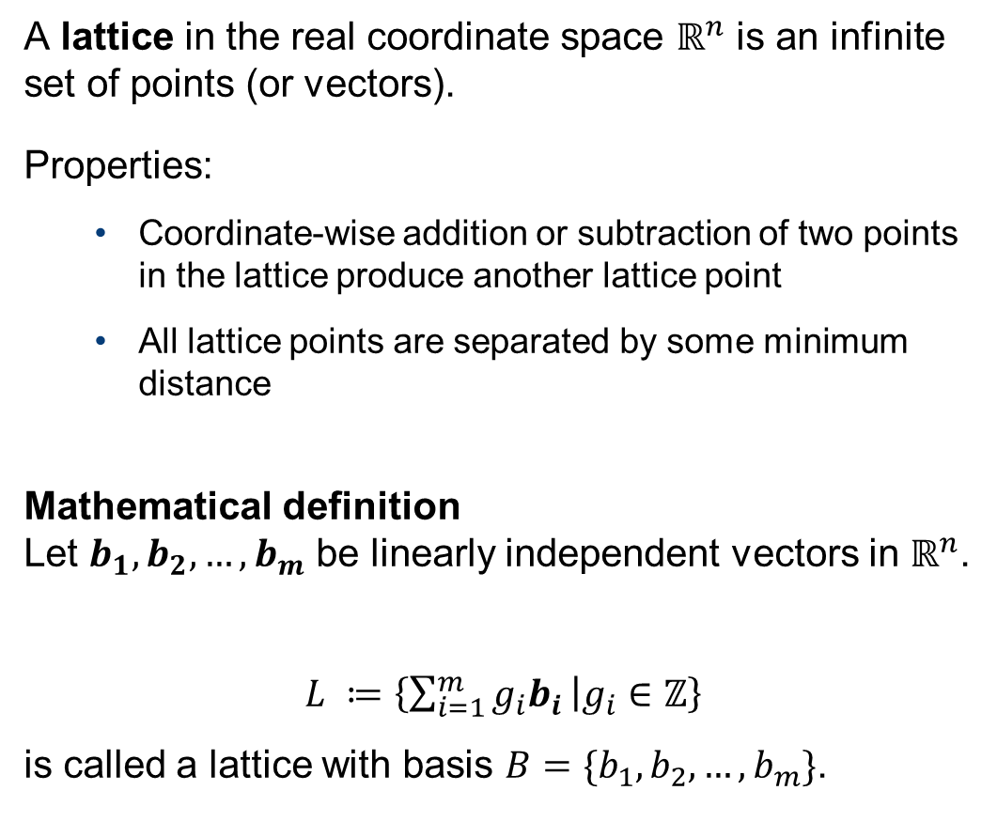
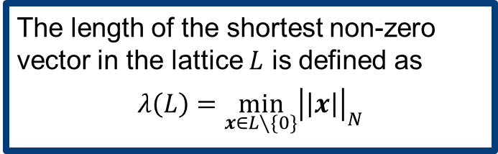

What is a Lattice?
A lattice in the real coordinate space $ℝ^{n}$ is an infinite set of points (or vectors).
Properties:
Coordinate-wise addition or subtraction of two points in the lattice produce another lattice point
All lattice points are separated by some minimum distance
Mathematical definition Let $b_{1}, b_{2}, …, b_{m}$ be linearly independent vectors in $ℝ^{n}$.
$$L ≔\left\{\sum_{i=1}^{m}{g_{i}b_{i}} | g_{i}∈ℤ\right\}$$ is called a lattice with basis $B=\{b_{1},b_{2},…,b_{m}\}$.
$$b_{1}$$
$$b_{2}$$
The length of the shortest non-zero vector in the lattice $L$ is defined as
$$λ\left(L\right)=\min_{x∈L∖\{0\}}{{\left|\left|x\right|\right|}_{N}}$$

Slide 22

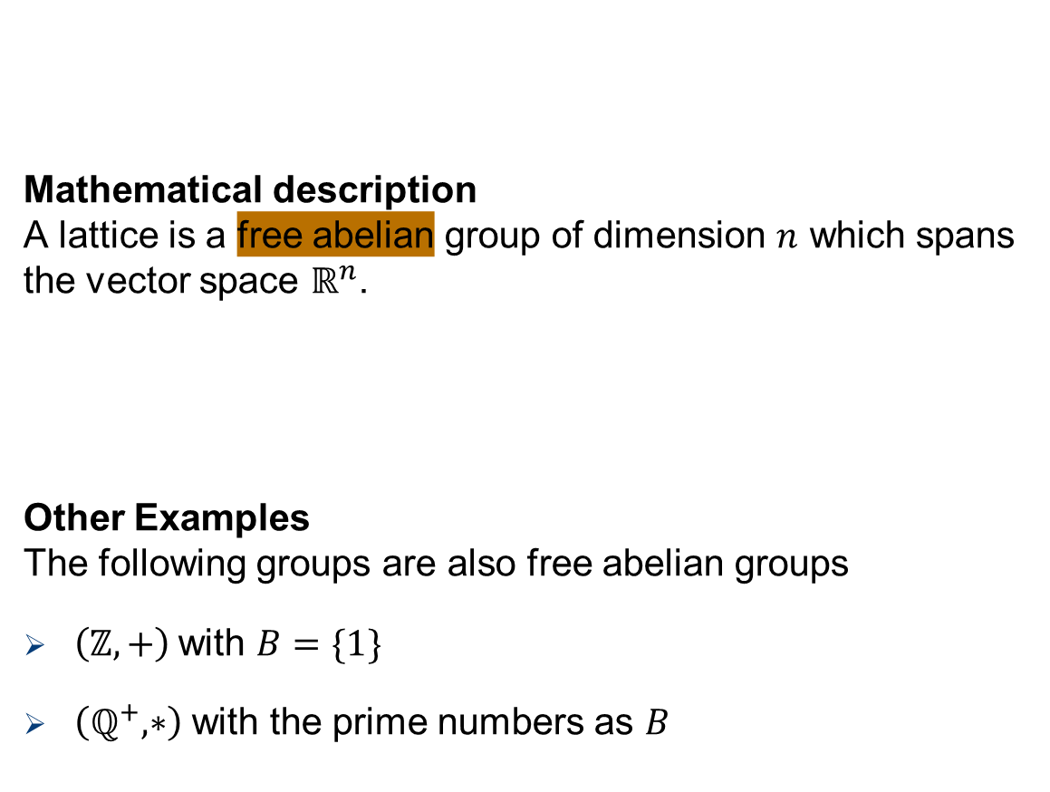
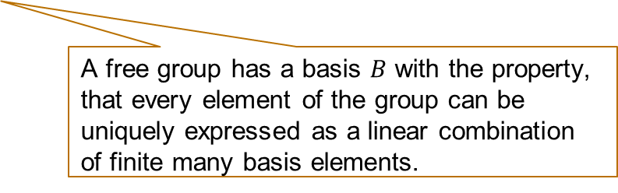
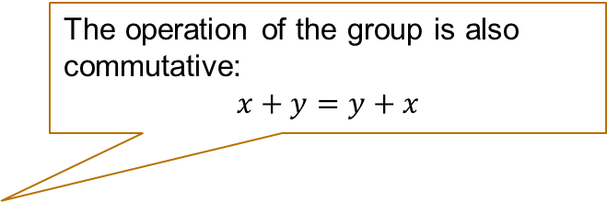

What is a Lattice?
Mathematical description A lattice is a free abelian group of dimension $n$ which spans the vector space $ℝ^{n}$.
Other Examples The following groups are also free abelian groups
$\left(ℤ,+\right)$with $B=\{1\}$
$\left(ℚ^{+},∗\right)$ with the prime numbers as $B$
The operation of the group is also commutative:
$$x+y=y+x$$
A free group has a basis $B$ with the property, that every element of the group can be uniquely expressed as a linear combination of finite many basis elements.
$$b_{1}$$
$$b_{2}$$
Positive rational numbers

Slide 23

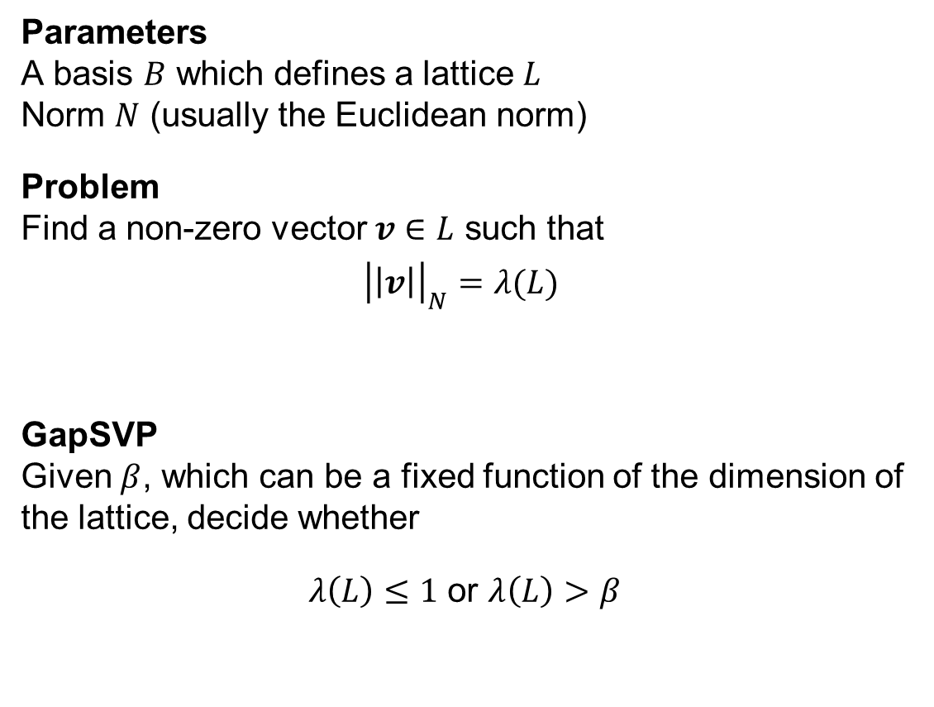

Shortest Vector Problem (SVP)
Parameters A basis $B$ which defines a lattice $L$ Norm $N$ (usually the Euclidean norm)
Problem Find a non-zero vector $v∈L$ such that
$${\left|\left|v\right|\right|}_{N}=λ(L)$$
GapSVP Given $β$, which can be a fixed function of the dimension of the lattice, decide whether
$λ\left(L\right)≤1$ or $λ\left(L\right)>β$
$$v$$
$$b_{2}$$
$$b_{1}$$

Slide 24

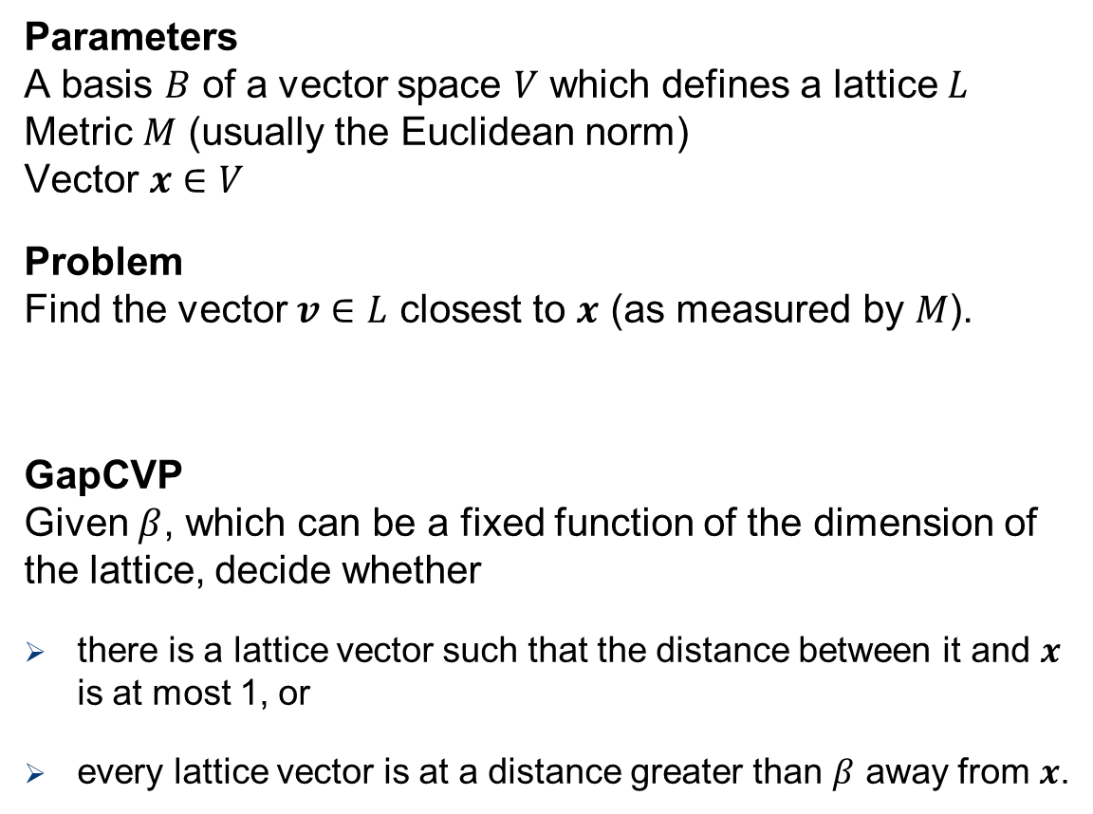



Closest Vector Problem (CVP)
Parameters A basis $B$ of a vector space $V$ which defines a lattice $L$ Metric $M$ (usually the Euclidean norm) Vector $x∈V$
Problem Find the vector $v∈L$ closest to $x$ (as measured by $M$).
GapCVP Given $β$, which can be a fixed function of the dimension of the lattice, decide whether
there is a lattice vector such that the distance between it and $x$ is at most 1, or
every lattice vector is at a distance greater than $β$ away from $x$.
$$v$$
$$x$$
$$b_{2}$$
$$b_{1}$$

Slide 25



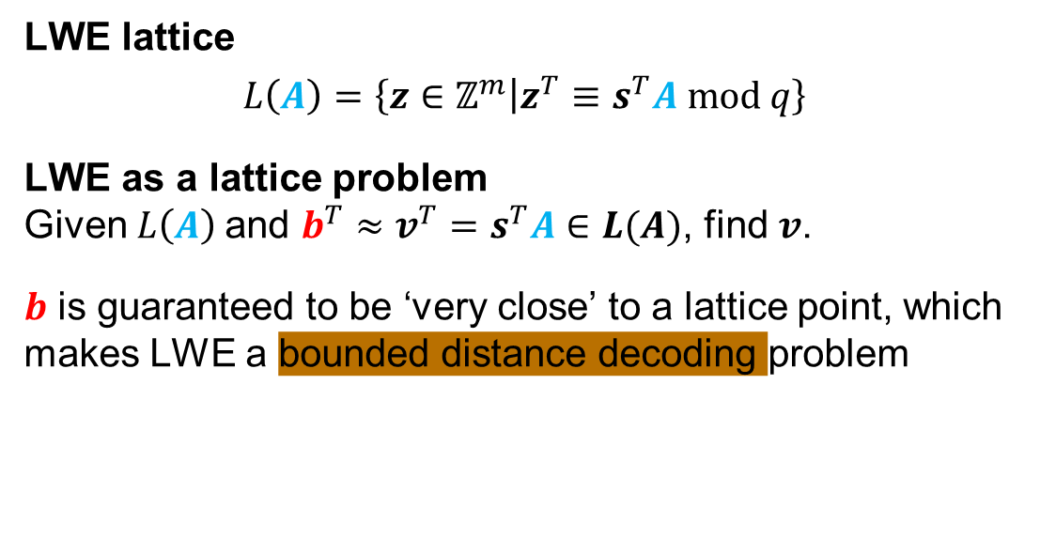
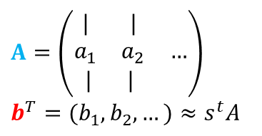
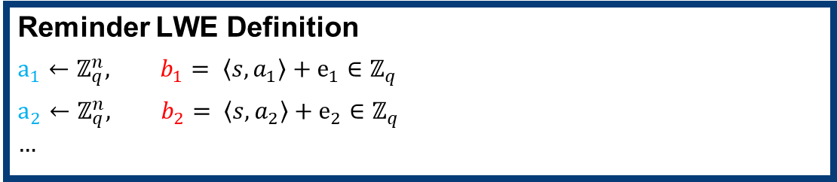

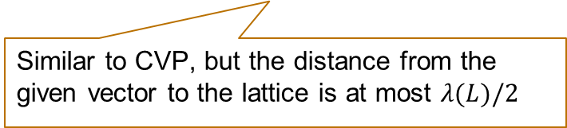
LWE is a Lattice Problem
Reminder LWE Definition
$$a_{1}←ℤ_{q}^{n}, b_{1}= \left\langle s, a_{1}\right\rangle +e_{1}∈ℤ_{q}$$
$$a_{2}←ℤ_{q}^{n}, b_{2}= \left\langle s, a_{2}\right\rangle +e_{2}∈ℤ_{q} \\ …$$
$A=\left(\begin{matrix}| & | & \\ a_{1} & a_{2} & … \\ | & | & \end{matrix}\right)$
$$b^{T}=(b_{1},b_{2},…)≈s^{t}A$$
$$(0,q)$$
LWE lattice
$$L\left(A\right)=\left\{z∈ℤ^{m} | z^{T}≡s^{T}A \text{mod} q\right\}$$
LWE as a lattice problem Given$L\left(A\right)$ and $b^{T}≈v^{T}=s^{T}A∈L(A)$, find $v$.
$b$ is guaranteed to be ‘very close’ to a lattice point, which makes LWE a bounded distance decoding problem
$$v$$
$$b$$
$$(q,0)$$
Similar to CVP, but the distance from the given vector to the lattice is at most $λ(L)/2$

Slide 26
Lattice Problems in Cryptography
SVP, CVP and LWE are all in the same category of hardness (NP-hard)
No efficient (quantum-) algorithms are known for lattice related problems
Lattice based cryptosystems are often algorithmically simple and highly parallelizable
Mainly linear operations on vectors
Matrices modulo small integers
Famous lattice-based schemes
NTRUEncrypt
Kyber
TFHE
LWE is the base problem for (almost) every HE cryptosystem!
Notes:
NTRU:
based on SVP
– public key cryptosystem
– fully accepted to IEEE
– fast
– low memory
Kyber:
key encapsulation mechanism
– LWE
– was the only key encapsulation mechanism selected by NIST during the selection process for a standard for quantum-safe crypto
TFHE: Fully hommorphic

Slide 27
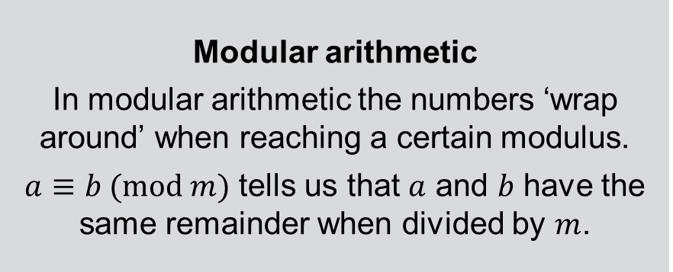
Summary – What did we learn today?
LWE
What is the learning with errors problem?
We can build symmetric and public key cryptosystems based on LWE.
The LWE problem is the challenge to find the solution to a linear system of equations, which is altered by a small error.
Lattice Problems
Shortest Vector Problem (SVP)
Closest Vector Problem (CVP)
LWE is also a lattice problem and therefore as hard to solve.
Lattice-based cryptography seems to be a solution for the post-quantum era.
Modular arithmetic
In modular arithmetic the numbers ‘wrap around’ when reaching a certain modulus.
$a≡b (\text{mod} m)$ tells us that $a$ and $b$ have the same remainder when divided by $m$.

