Slide 1
The CKKS Cryptosystem Part 1: Background
<Author>
08/07/2025

Slide 2
What is CKKS?
Full homomorphic encryption scheme
Introduced in 2017 by Cheon, Kim, Kim and Song
Supports fixed-point arithmetic
Currently the most capable and therefore best working FHE scheme
Many functions (square root, division, …) can be implemented using the CKKS basis

Slide 3
Polynomial Ring

Slide 4
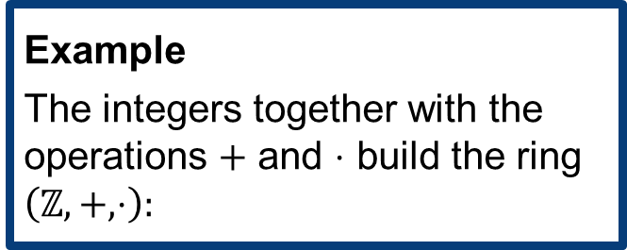
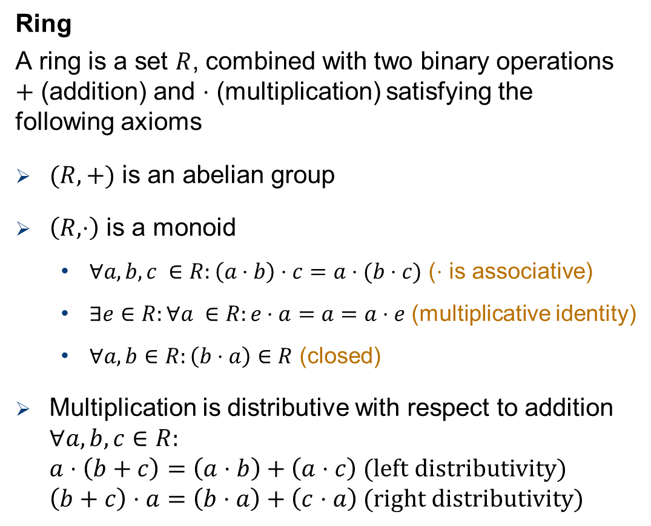
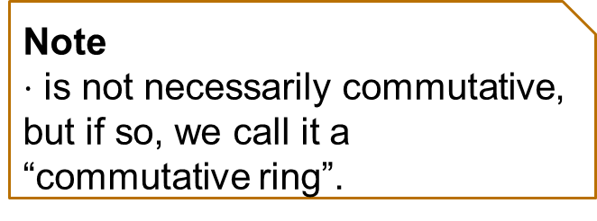
Polynomial Ring
Ring
A ring is a set $R$, combined with two binary operations $+$ (addition) and $⋅$ (multiplication) satisfying the following axioms
$(R,+)$ is an abelian group
$\left(R,⋅\right)$ is a monoid
$∀a,b,c ∈R:\left(a⋅b\right)⋅c=a⋅(b⋅c)$ ($⋅$ is associative)
$∃e∈R:∀a ∈R:e⋅a=a=a⋅e$ (multiplicative identity)
$∀a,b∈R:\left(b⋅a\right)∈R$ (closed)
Multiplication is distributive with respect to addition $∀a,b,c∈R:$ $a⋅\left(b+c\right)=\left(a⋅b\right)+\left(a⋅c\right) \text{(}\text{left} \text{distributivity}\text{)}$ $\left(b+c\right)⋅a=\left(b⋅a\right)+\left(c⋅a\right) \text{(}\text{right} \text{distributivity}\text{)}$
Reminder group:
identity
inverse
operation is associative
group is closed under the operation
abelian: operation is commutative
Example
The integers together with the operations $+$ and $⋅$ build the ring $\left(ℤ,+,⋅\right):$
Note $⋅$ is not necessarily commutative, but if so, we call it a “commutative ring”.

Slide 5
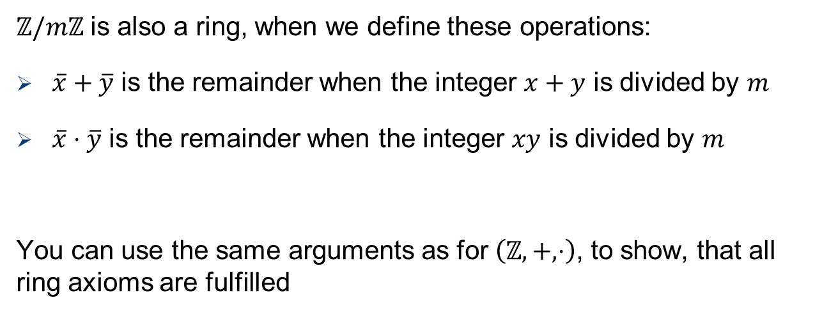
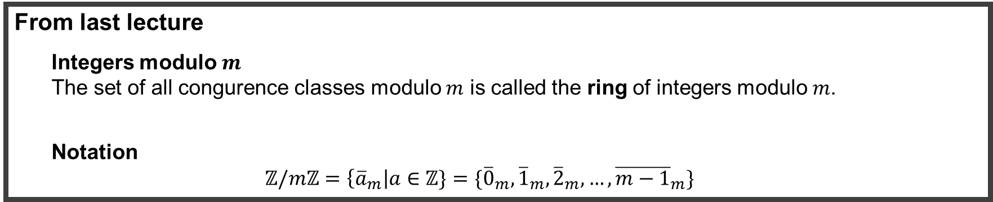


Polynomial Ring
From last lecture
Integers modulo $m$ The set of all congurence classes modulo $m$ is called the ring of integers modulo $m$.
Notation $$ℤ\text{/}mℤ=\left\{{\overline{a}}_{m}\right|a∈ℤ\}=\{{\overline{0}}_{m}, {\overline{1}}_{m},{\overline{2}}_{m},…,{\overline{m−1}}_{m}\}$$
$ℤ/mℤ$ is also a ring, when we define these operations:
$\overline{x}+\overline{y}$ is the remainder when the integer $x+y$ is divided by $m$
$\overline{x}⋅\overline{y}$ is the remainder when the integer $xy$ is divided by $m$
You can use the same arguments as for $\left(ℤ,+,⋅\right)$, to show, that all ring axioms are fulfilled
We also call $ℤ/mℤ$ a residue class ring or quotient ring
$\overline{x}$ and $\overline{y}$ are $∈ℤ/mℤ$

Slide 6

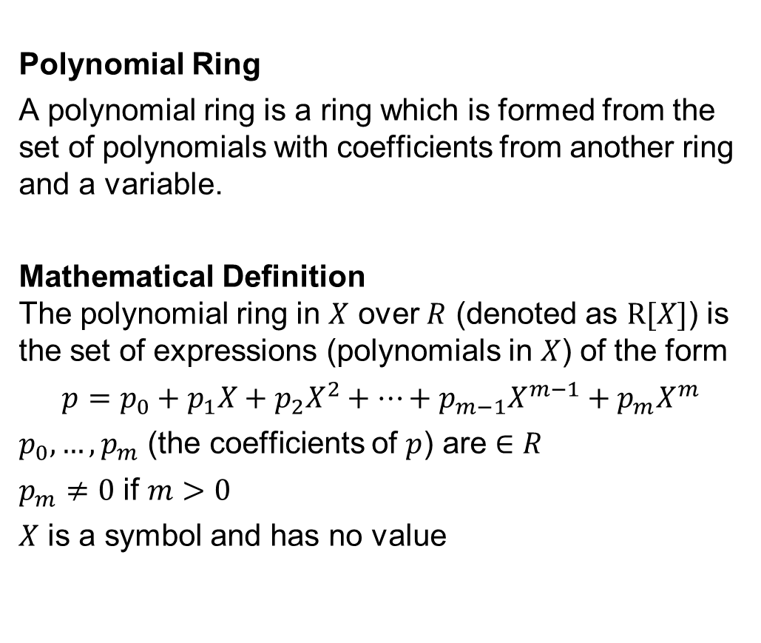
Polynomial Ring
Polynomial Ring
A polynomial ring is a ring which is formed from the set of polynomials with coefficients from another ring and a variable.
Mathematical Definition The polynomial ring in $X$ over $R$ (denoted as $R[X]$) is the set of expressions (polynomials in $X$) of the form
$$p=p_{0}+p_{1}X+p_{2}X^{2}+…+p_{m−1}X^{m−1}+p_{m}X^{m}$$
$p_{0},…,p_{m}$ (the coefficients of $p$) are $∈R$
$p_{m}≠0$ if $m>0$
$X$ is a symbol and has no value
To define a polynomial ring, we need:
ring $R$
variable $X$

Slide 7
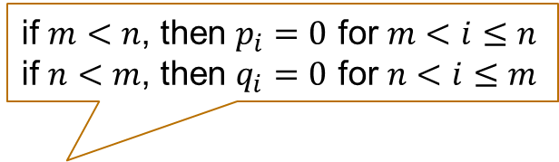
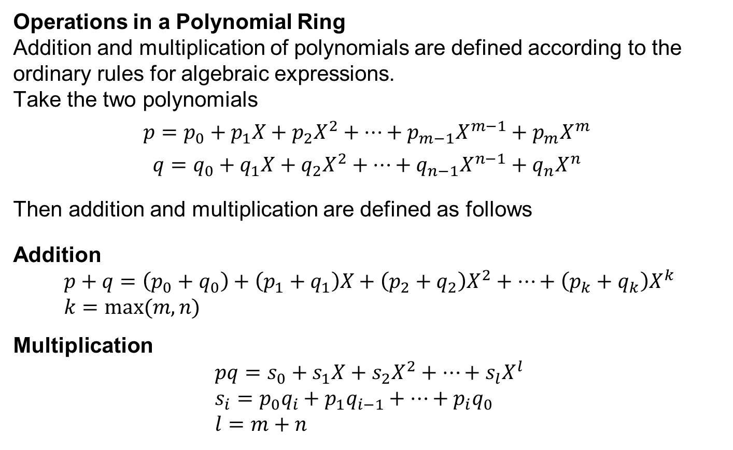
Polynomial Ring
Operations in a Polynomial Ring Addition and multiplication of polynomials are defined according to the ordinary rules for algebraic expressions. Take the two polynomials
$$p=p_{0}+p_{1}X+p_{2}X^{2}+…+p_{m−1}X^{m−1}+p_{m}X^{m}$$
$$q=q_{0}+q_{1}X+q_{2}X^{2}+…+q_{n−1}X^{n−1}+q_{n}X^{n}$$
Then addition and multiplication are defined as follows
Addition $$p+q=\left(p_{0}+q_{0}\right)+\left(p_{1}+q_{1}\right)X+\left(p_{2}+q_{2}\right)X^{2}+…+\left(p_{k}+q_{k}\right)X^{k} \\ k=max⁡(m,n)$$
Multiplication $$pq=s_{0}+s_{1}X+s_{2}X^{2}+…+s_{l}X^{l} \\ s_{i}=p_{0}q_{i}+p_{1}q_{i−1}+…+p_{i}q_{0} \\ l=m+n$$
if $m<n$, then $p_{i}=0$ for $m<i≤n$
if $n<m$, then $q_{i}=0$ for $n<i≤m$
What about the ring axioms? Exercise!

Slide 8
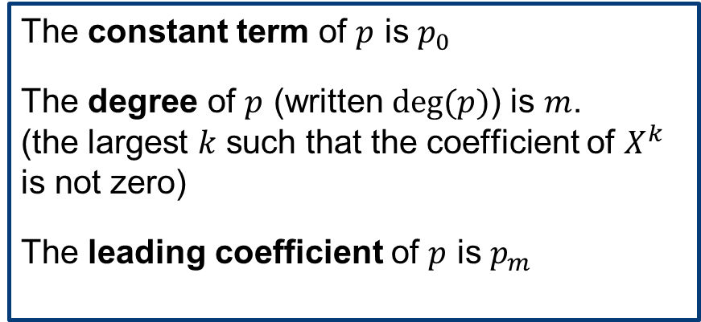

Polynomial Ring
Terminology for polynomials Take the polynomial
$$p=p_{0}+p_{1}X+p_{2}X^{2}+…+p_{m−1}X^{m−1}+p_{m}X^{m}$$
We define the following terminology:
The constant term of $p$ is $p_{0}$
The degree of $p$ (written $deg⁡(p)$) is $m$. (the largest $k$ such that the coefficient of $X^{k}$ is not zero)
The leading coefficient of $p$ is $p_{m}$
A constant polynomial is either the zero polynomial or of degree zero.
Two polynomials are associated if either one is the product of the other by a unit.
A polynomial is irreducible if it’s not the product of two non-constant polynomials.

Slide 9
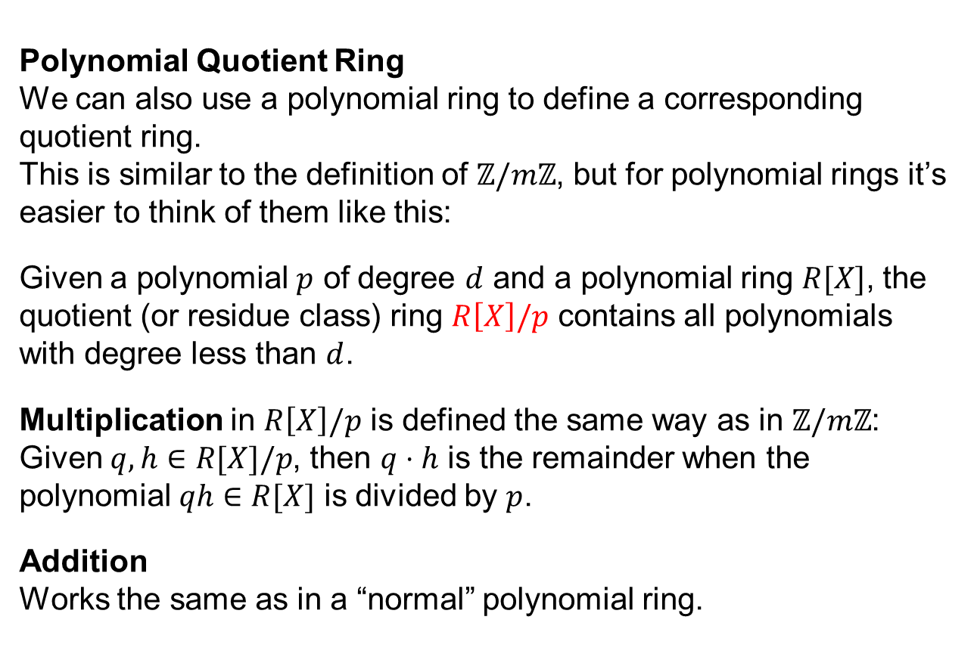
Polynomial Ring
Polynomial Quotient Ring We can also use a polynomial ring to define a corresponding quotient ring. This is similar to the definition of $ℤ/mℤ$, but for polynomial rings it’s easier to think of them like this:
Given a polynomial $p$ of degree $d$ and a polynomial ring $R[X]$, the quotient (or residue class) ring $R\left[X\right]/p$ contains all polynomials with degree less than $d$.
Multiplication in $R\left[X\right]/p$ is defined the same way as in $ℤ/mℤ$: Given $q,h∈R[X]/p$, then $q⋅h$ is the remainder when the polynomial $qh∈R[X]$ is divided by $p$.
Addition Works the same as in a “normal” polynomial ring.
We need the generally known long division of polynomials for this

Slide 10
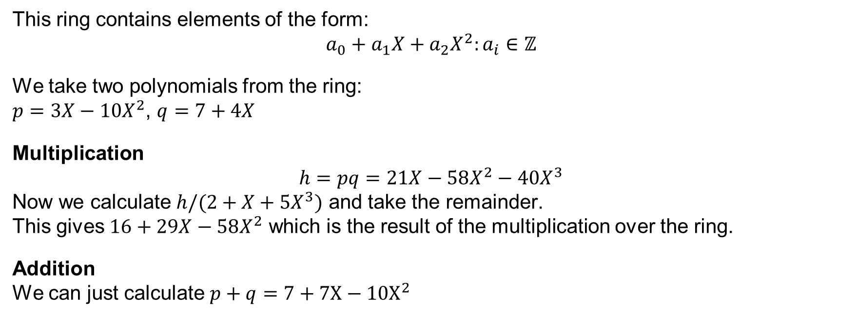

Polynomial Ring
Polynomial Quotient Ring – Examples
$$ℤ\left[X\right]/(2+X+5X^{3})$$
This ring contains elements of the form: $$a_{0}+a_{1}X+a_{2}X^{2}:a_{i}∈ℤ$$
We take two polynomials from the ring: $p=3X−10X^{2}$, $q=7+4X$
Multiplication $$h=pq=21X−58X^{2}−40X^{3}$$ Now we calculate $h/(2+X+5X^{3})$ and take the remainder. This gives $16+29X−58X^{2}$ which is the result of the multiplication over the ring.
Addition We can just calculate $p+q=7+7X−10X^{2}$
Notes:
h/(2+x+5x^3)=21x-58x^2-40x^3- (-8*(2+x+5x^3))

Slide 11

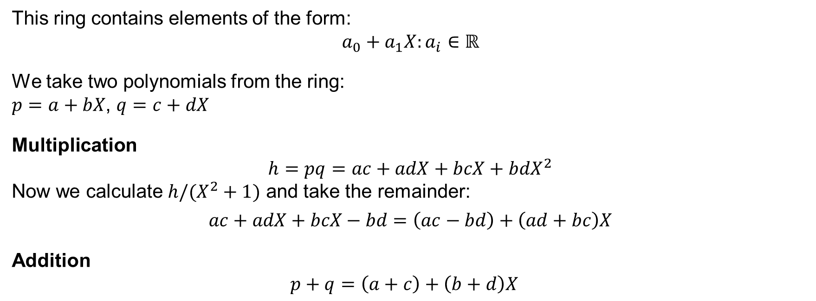
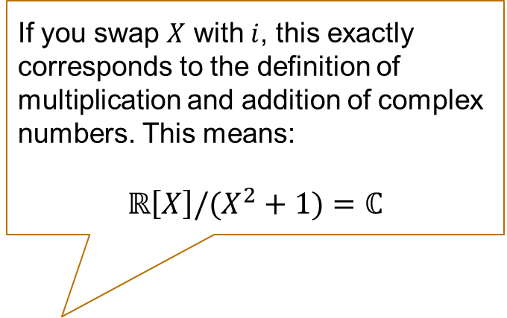
Polynomial Ring
Polynomial Quotient Ring – Examples
$$ℝ\left[X\right]/(X^{2}+1)$$
irreducible
This ring contains elements of the form: $$a_{0}+a_{1}X:a_{i}∈ℝ$$
We take two polynomials from the ring: $p=a+bX$, $q=c+dX$
Multiplication $$h=pq=ac+adX+bcX+bdX^{2}$$ Now we calculate $h/(X^{2}+1)$ and take the remainder:
$$ac+adX+bcX−bd=\left(ac−bd\right)+\left(ad+bc\right)X$$
Addition $p+q=\left(a+c\right)+\left(b+d\right)X$
If you swap $X$ with $i$, this exactly corresponds to the definition of multiplication and addition of complex numbers. This means:
$ℝ\left[X\right]/(X^{2}+1)=ℂ$

Slide 12
More background

Slide 13

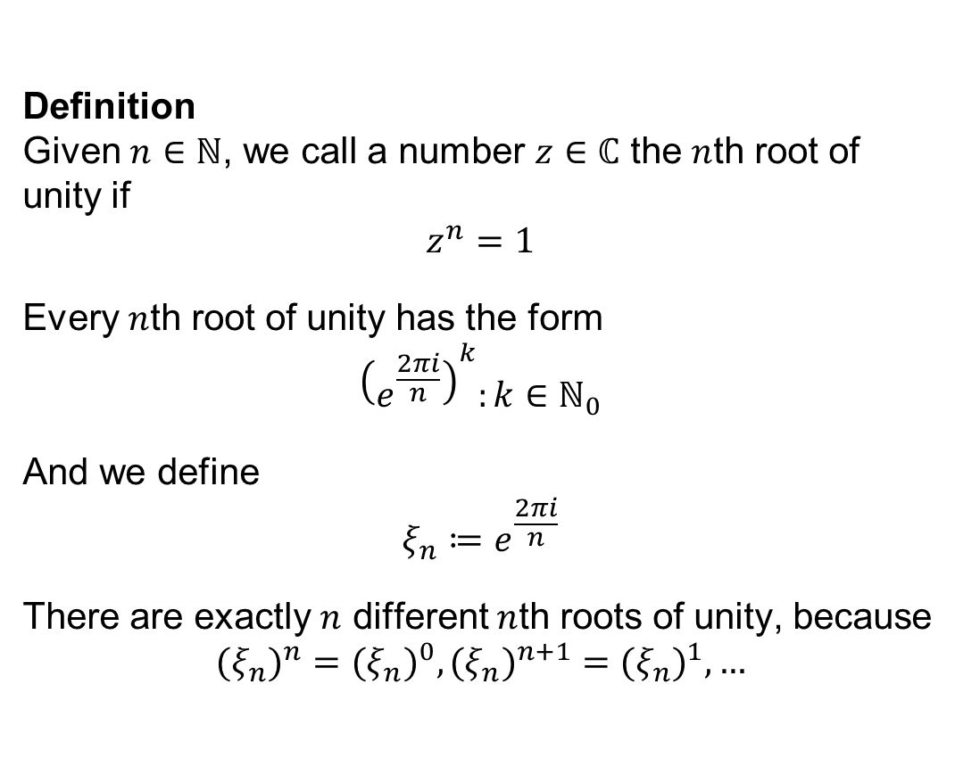

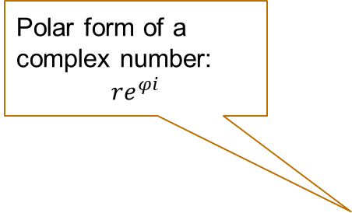

Root of Unity
Polar form of a complex number:
$$re^{φi}$$
Definition Given $n∈ℕ$, we call a number $z∈ℂ$ the $n$th root of unity if $$z^{n}=1$$
Every $n$th root of unity has the form $${\left(e^{\frac{2πi}{n}}\right)}^{k}:k∈ℕ_{0}$$
And we define $$ξ_{n}≔e^{\frac{2πi}{n}}$$
There are exactly $n$ different $n$th roots of unity, because $${{(ξ}_{n})}^{n}={{(ξ}_{n})}^{0},{{(ξ}_{n})}^{n+1}={{(ξ}_{n})}^{1},…$$
$$r$$
$$φ$$
$$e^{2πik}$$
1

Slide 14





Root of Unity
Example $$n=4$$
$${\left(ξ_{4}\right)}^{0}={\left(e^{\frac{2πi}{4}}\right)}^{0}=e^{0}=1$$
$${\left(ξ_{4}\right)}^{1}={\left(e^{\frac{2πi}{4}}\right)}^{1}=e^{\frac{1}{2}πi}=i$$
$${\left(ξ_{4}\right)}^{2}={\left(e^{\frac{2πi}{4}}\right)}^{2}=e^{πi}=−1$$
$${\left(ξ_{4}\right)}^{3}={\left(e^{\frac{2πi}{4}}\right)}^{3}=e^{\frac{3}{2}πi}=−i$$
$${\left(ξ_{4}\right)}^{4}={\left(e^{\frac{2πi}{4}}\right)}^{4}=e^{2πi}=e^{0}={\left(ξ_{4}\right)}^{0} \\ …$$
$${\left(ξ_{4}\right)}^{1}$$
$${\left(ξ_{4}\right)}^{2}$$
$${\left(ξ_{4}\right)}^{0}$$
1
$${\left(ξ_{4}\right)}^{3}$$

Slide 15







Root of Unity
Example $$n=6$$
$${\left(ξ_{6}\right)}^{0}={\left(e^{\frac{2πi}{6}}\right)}^{0}=e^{0}=1$$
$${\left(ξ_{6}\right)}^{1}={\left(e^{\frac{2πi}{6}}\right)}^{1}=e^{\frac{1}{3}πi}$$
$${\left(ξ_{6}\right)}^{2}={\left(e^{\frac{2πi}{6}}\right)}^{2}=e^{\frac{2}{3}πi}$$
$${\left(ξ_{6}\right)}^{3}={\left(e^{\frac{2πi}{6}}\right)}^{3}=e^{πi}=−1$$
$${\left(ξ_{6}\right)}^{4}={\left(e^{\frac{2πi}{6}}\right)}^{4}=e^{\frac{4}{3}πi}$$
$${\left(ξ_{6}\right)}^{5}={\left(e^{\frac{2πi}{6}}\right)}^{5}=e^{\frac{5}{3}πi}$$
$${\left(ξ_{6}\right)}^{2}$$
$${\left(ξ_{6}\right)}^{1}$$
$${\left(ξ_{6}\right)}^{3}$$
$${\left(ξ_{6}\right)}^{0}$$
1
$${\left(ξ_{6}\right)}^{4}$$
$${\left(ξ_{6}\right)}^{5}$$

Slide 16



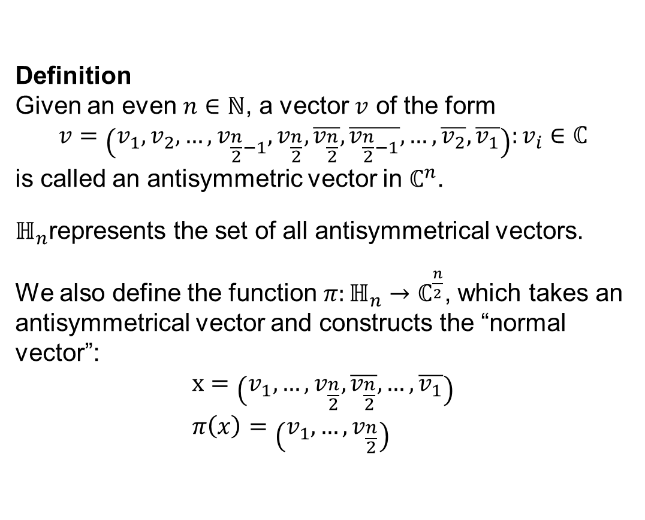





Antisymmetrical Vectors
Definition Given an even $n∈ℕ$, a vector $v$ of the form $$v=\left(v_{1}, v_{2},…,v_{\frac{n}{2}−1},v_{\frac{n}{2}},\overline{v_{\frac{n}{2}}},\overline{v_{\frac{n}{2}−1}},…,\overline{v_{2}},\overline{v_{1}}\right):v_{i}∈ℂ$$ is called an antisymmetric vector in $ℂ^{n}$.
$ℍ_{n}$represents the set of all antisymmetrical vectors.
We also define the function $π:ℍ_{n}→ℂ^{\frac{n}{2}}$, which takes an antisymmetrical vector and constructs the “normal vector”: $$x=\left(v_{1}, …,v_{\frac{n}{2}},\overline{v_{\frac{n}{2}}},…,\overline{v_{1}}\right) \\ π\left(x\right)=\left(v_{1},…,v_{\frac{n}{2}}\right)$$
Complex conjugate
$$y$$
$$z=x+iy$$
$$r$$
$$φ$$
$$x$$
$$φ$$
$$r$$
$$−y$$
$$\overline{z}=x−iy$$

Slide 17
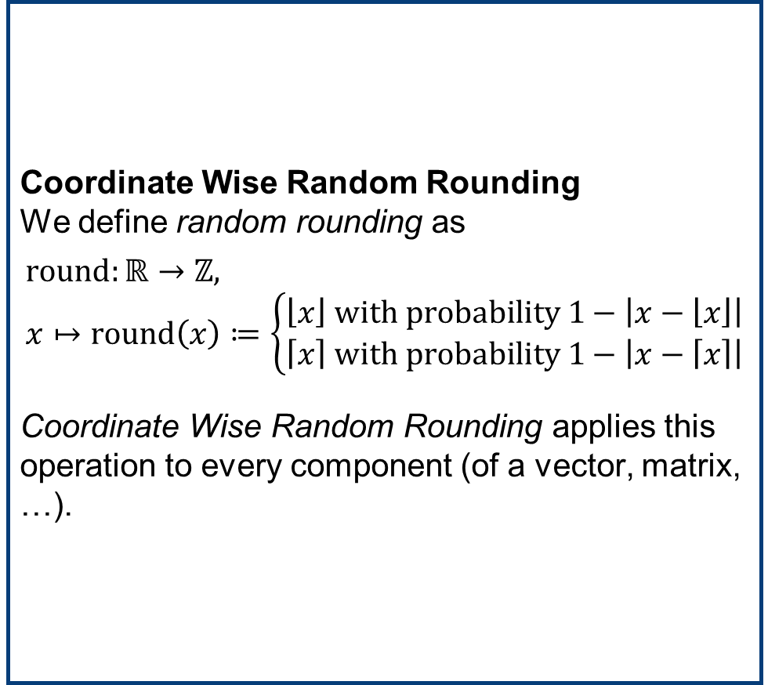
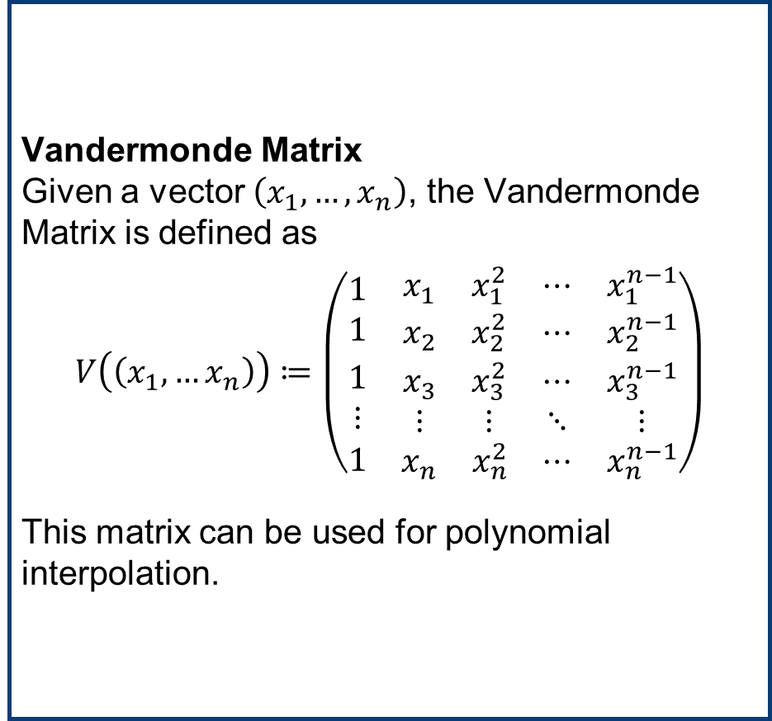
Vandermonde Matrix & Coordinate Wise Random Rounding
Vandermonde Matrix Given a vector $\left(x_{1},…,x_{n}\right)$, the Vandermonde Matrix is defined as
$$V\left(\left(x_{1},…x_{n}\right)\right)≔\left(\begin{matrix}\begin{matrix}1 \\ 1\end{matrix} & \begin{matrix}x_{1} & x_{1}^{2} \\ x_{2} & x_{2}^{2}\end{matrix} & \begin{matrix}⋯ & x_{1}^{n−1} \\ ⋯ & x_{2}^{n−1}\end{matrix} \\ \begin{matrix}1 \\ ⋮\end{matrix} & \begin{matrix}x_{3} & x_{3}^{2} \\ ⋮ & ⋮\end{matrix} & \begin{matrix}⋯ & x_{3}^{n−1} \\ ⋱ & ⋮\end{matrix} \\ 1 & \begin{matrix}x_{n} & x_{n}^{2}\end{matrix} & \begin{matrix}⋯ & x_{n}^{n−1}\end{matrix}\end{matrix}\right)$$
This matrix can be used for polynomial interpolation.
Coordinate Wise Random Rounding We define random rounding as
$$\text{round}:ℝ→ℤ, \\ x↦\text{round}\left(x\right)≔\left\{\begin{aligned}\left\lfloor x\right\rfloor \text{with} \text{probability}\text{ 1}−\left|x−\left\lfloor x\right\rfloor \right| \\ \left\lceil x\right\rceil \text{with} \text{probability} 1−\left|x−\left\lceil x\right\rceil \right|\end{aligned}\right.$$
Coordinate Wise Random Rounding applies this operation to every component (of a vector, matrix, …).

Slide 18
Ckks Overview

Slide 19
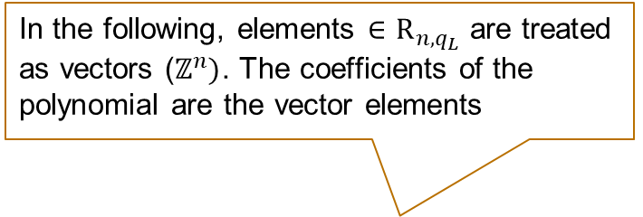
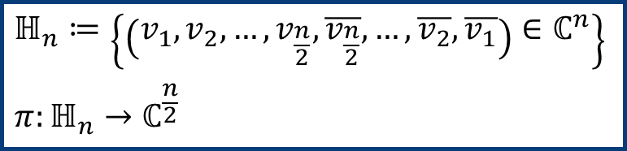
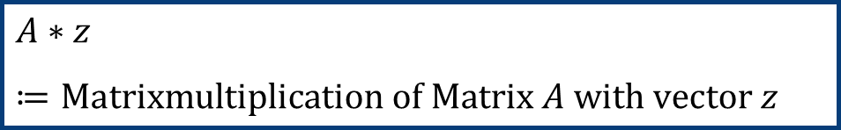
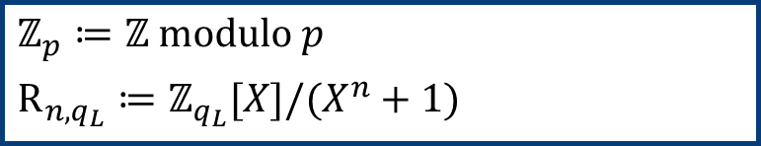
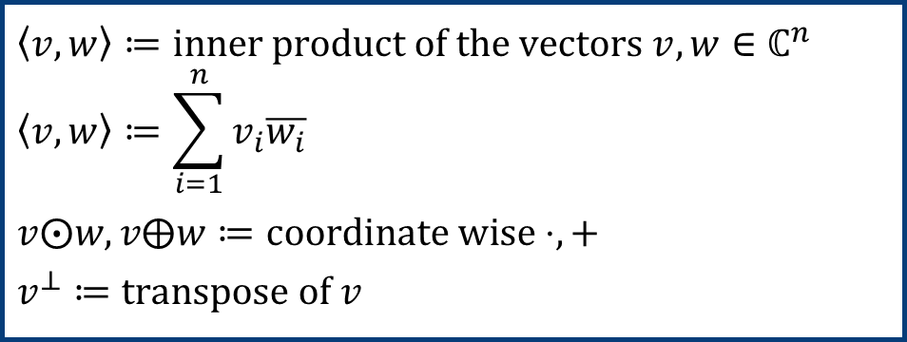
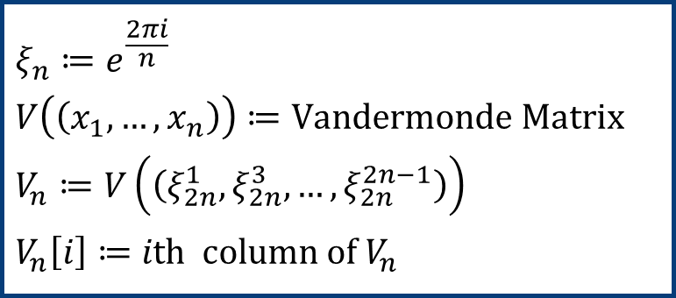

Notations and Abbreviations
In the following, elements $∈{\text{R}}_{n,q_{L}}$ are treated as vectors ($ℤ^{n})$. The coefficients of the polynomial are the vector elements
$q_{L}∈ℕ$, $n∈\left\{2^{k}\right|k∈ℕ\}$, $h,P∈ℤ$, $σ∈ℝ^{+}$
$$ℤ_{p}≔ℤ modulo p$$
$${\text{R}}_{n,q_{L}}≔ℤ_{q_{L}}[X]/(X^{n}+1)$$
$$A∗z≔\text{Matrixmultiplication} \text{of} \text{Matrix} A \text{with} \text{vector} z$$
$$ℍ_{n}≔\left\{\left(v_{1},v_{2},…,v_{\frac{n}{2}},\overline{v_{\frac{n}{2}}},…,\overline{v_{2}},\overline{v_{1}}\right)∈ℂ^{n}\right\}$$
$$π:ℍ_{n}→ℂ^{\frac{n}{2}}$$
$$\left\langle v,w\right\rangle ≔\text{inner} \text{product} \text{of} \text{the} \text{vectors} v,w∈ℂ^{n} \\ \left\langle v,w\right\rangle ≔\sum_{i=1}^{n}{v_{i}\overline{w_{i}}}$$
$$v⨀w,v⨁w≔\text{coordinate} \text{wise}⋅,+$$
$$v^{⊥}≔\text{transpose} \text{of} v$$
$$ξ_{n}≔e^{\frac{2πi}{n}}$$
$$V\left(\left(x_{1},…,x_{n}\right)\right)≔\text{Vandermonde} \text{Matrix}$$
$$V_{n}≔V\left(\left(ξ_{2n}^{1},ξ_{2n}^{3},…,ξ_{2n}^{2n−1}\right)\right)$$
$$V_{n}\left[i\right]≔i\text{th} \text{column} \text{of} V_{n}$$
$$\text{round}≔\text{random} \text{rounding}$$

Slide 20
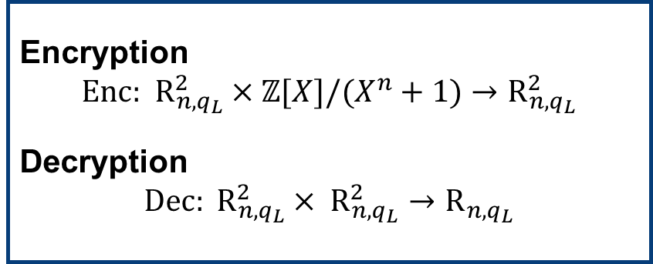

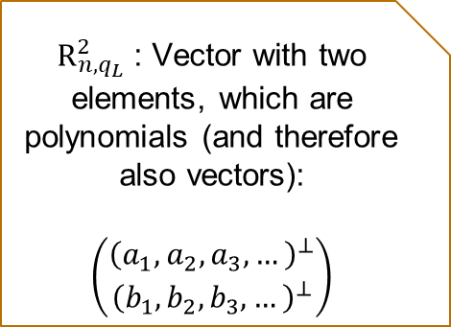
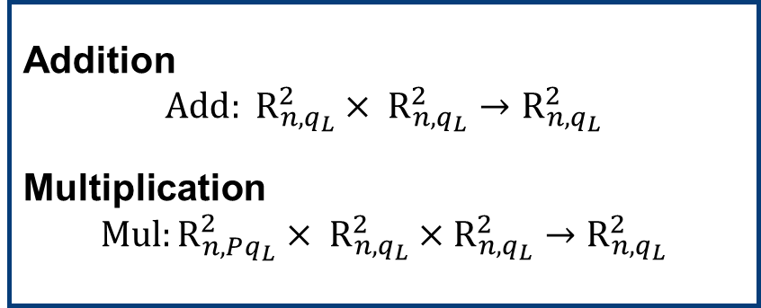
CKKS Algorithms Overview
Encoding $$\text{Ecd}\text{: } ℂ^{\frac{n}{2}}→ℤ[X]/(X^{n}+1)$$
Decoding $$\text{Dcd}:ℤ[X]/(X^{n}+1)→ℂ^{\frac{n}{2}}$$
plaintext message
${\text{R}}_{n,q_{L}}^{2}$: Vector with two elements, which are polynomials (and therefore also vectors):
$$\left(\begin{matrix}{\left(a_{1},a_{2},a_{3},…\right)}^{⊥} \\ {\left(b_{1},b_{2},b_{3},…\right)}^{⊥}\end{matrix}\right)$$
encoded message
key related
ciphertext
public key
Encryption $$\text{Enc}\text{: } {\text{R}}_{n,q_{L}}^{2}×ℤ[X]/(X^{n}+1)→{\text{R}}_{n,q_{L}}^{2}$$
Decryption $$\text{Dec}: {\text{R}}_{n,q_{L}}^{2}× {\text{R}}_{n,q_{L}}^{2}→{\text{R}}_{n,q_{L}}$$
Addition $$\text{Add}: {\text{R}}_{n,q_{L}}^{2}× {\text{R}}_{n,q_{L}}^{2}→{\text{R}}_{n,q_{L}}^{2}$$
Multiplication $$\text{Mul}:{\text{R}}_{n,Pq_{L}}^{2}× {\text{R}}_{n,q_{L}}^{2}×{\text{R}}_{n,q_{L}}^{2}→{\text{R}}_{n,q_{L}}^{2}$$
secret key

Slide 21
Summary – What did we learn today?
Rings and Polynomials
A ring consists of a set and two operations (addition and multiplication).
A polynomial ring contains polynomials.
A quotient ring is a special ring, in which after the operation a certain modulus is applied.
CKKS
What is CKKS?
Overview over Notations and Abbreviations
Overview over the Algorithms and how information is represented in CKKS.
More Mathematical Background
Root of Unity
Antisymmetrical Vectors
Vandermonde Matrix
Coordinate Wise Rounding

