Slide 1
The CKKS Cryptosystem Part 3: Final Words
<Author>
08/07/2025

Slide 2
How to work with the error

Slide 3
What about the error?
CKKS security is based on adding artificial errors ((R)LWE)
Executing operations on the ciphertext increases the error
This makes CKKS a levelled encryption schema
Every ciphertext has a certain level and doing operations on the ciphertext lowers the level
When we reach the lowest level, no more operations are possible (otherwise we would not be able to recover the results)
But: To meet the requirements of a FHE schema, we need to be able to do unlimited number of operations
How do we do this in CKKS?
(Rescaling)
Bootstrapping

Slide 4
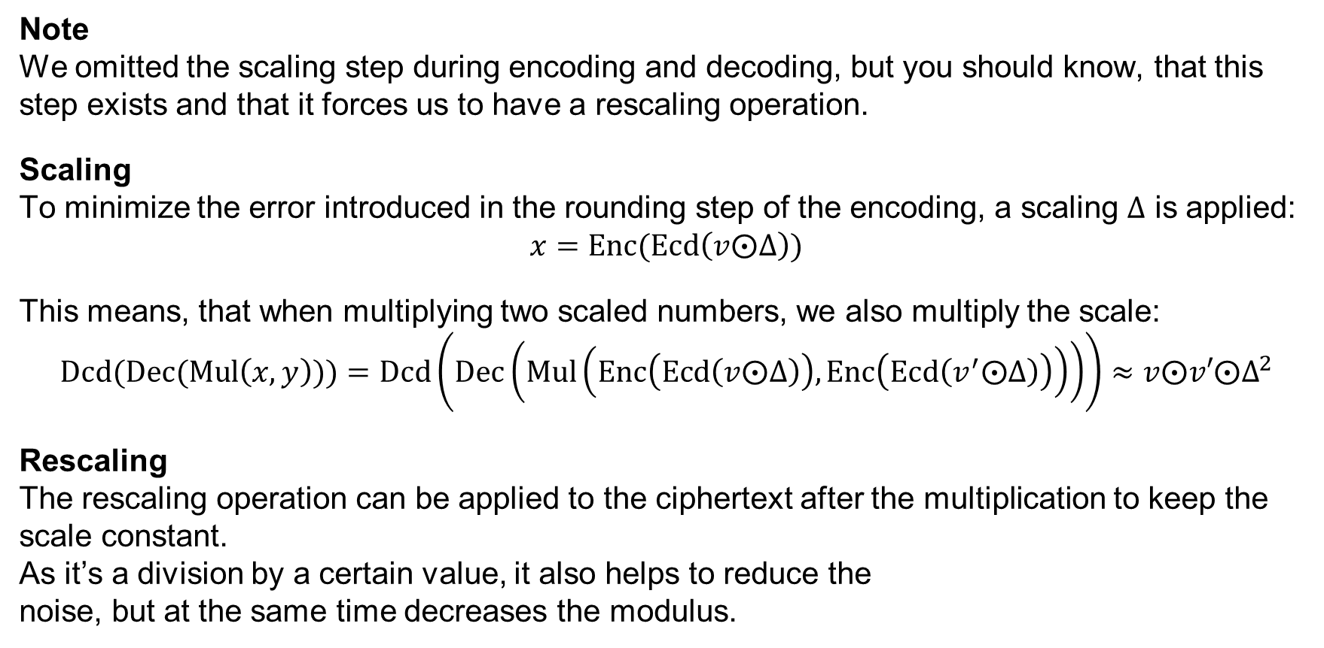
Rescaling
Note We omitted the scaling step during encoding and decoding, but you should know, that this step exists and that it forces us to have a rescaling operation.
Scaling To minimize the error introduced in the rounding step of the encoding, a scaling $Δ$ is applied: $$x=\text{Enc}(\text{Ecd}\left(v⨀Δ\right))$$
This means, that when multiplying two scaled numbers, we also multiply the scale: $$Dcd(\text{D}\text{ec}\text{(}\text{Mul}\left(x,y\right)))=\text{Dcd}\left(\text{Dec}\left(\text{Mul}\left(\text{Enc}\left(\text{Ecd}\left(v⨀Δ\right)\right),\text{Enc}\left(\text{Ecd}\left(v^{′}⨀Δ\right)\right)\right)\right)\right)≈v⨀v′⨀Δ^{2}$$
Rescaling The rescaling operation can be applied to the ciphertext after the multiplication to keep the scale constant. As it’s a division by a certain value, it also helps to reduce the noise, but at the same time decreases the modulus.
Addition? Adding two scaled values does not change the scaling factor

Slide 5



Bootstrapping
Goal Reduce the error in the ciphertext, thus allowing an infinite number of operations.
Idea We can evaluate the $\text{Dec}$ Operation homomorphically
Encrypt the message with a new public key
secret key
Error Level high: medium: low:
m
m
m
m
m
m
m is encrypted using a public key
Calculate the decryption homomorphically using the doubled encrypted message and the encryption of the secret key
m

Slide 6
Bootstrapping
Error Level high: medium: low:
Notes
The owner of the data must provide a bootstrapping key pair for every bootstrap operation and generate them beforehand
It is usually unclear how many bootstrap operations are necessary
The bootstrap operation itself also increases the error
Calculating the decryption homomorphically is not straightforward (especially in CKKS)
Bootstrapping introduces a huge performance overhead
secret key
m
m
m
m
m
m

Slide 7
How to set security parameters

Slide 8
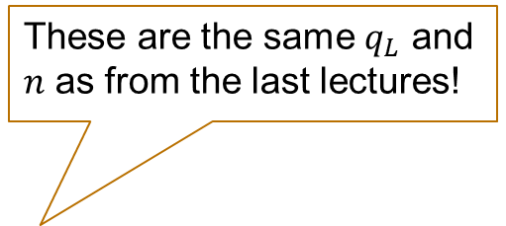
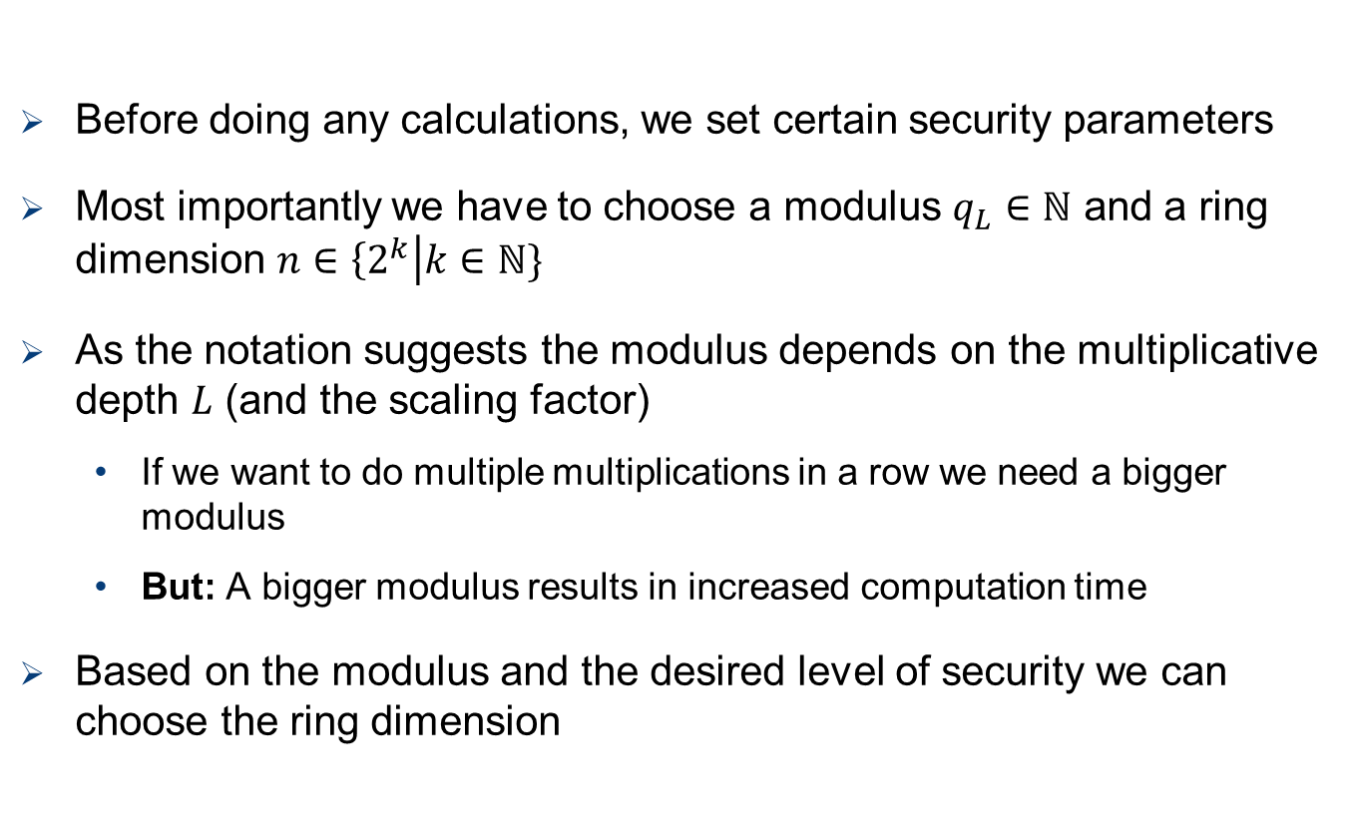
Security Parameters
Before doing any calculations, we set certain security parameters
Most importantly we have to choose a modulus $q_{L}∈ℕ$ and a ring dimension $n∈\left\{2^{k}\right|k∈ℕ\}$
As the notation suggests the modulus depends on the multiplicative depth $L$ (and the scaling factor)
If we want to do multiple multiplications in a row we need a bigger modulus
But: A bigger modulus results in increased computation time
Based on the modulus and the desired level of security we can choose the ring dimension
These are the same $q_{L}$ and $n$ as from the last lectures!

Slide 9
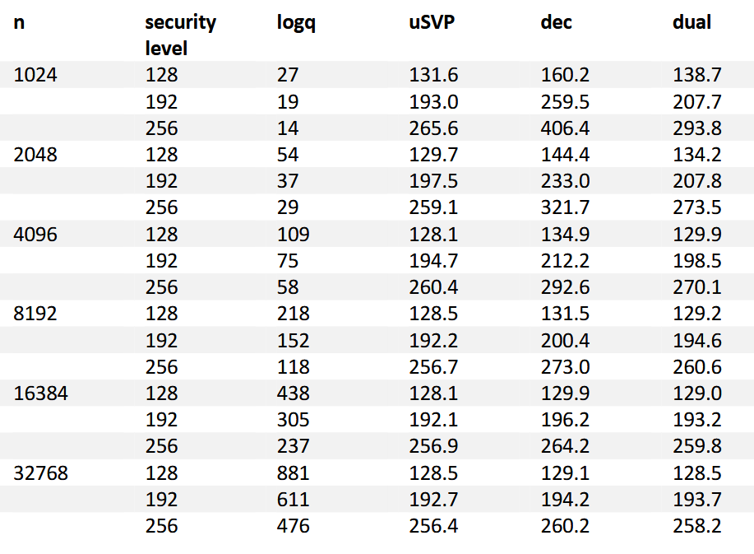

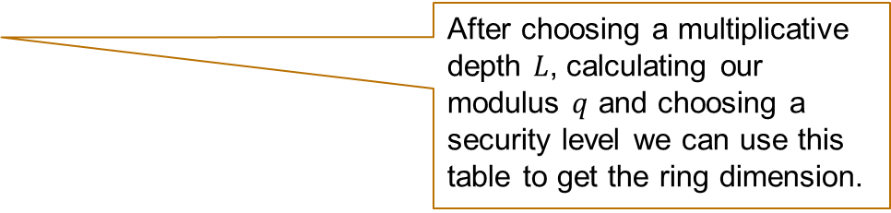
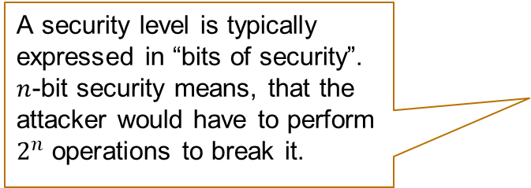
Security Parameters
Libraries like OpenFHE choose the parameters based on the Homomorphic Encryption Standard (https://homomorphicencryption.org/standard/)
They provide combinations of $n$ and $q$ which achieve different levels of security
These are currently known attacks on the (R)LWE with their according security level
A security level is typically expressed in “bits of security”. $n$-bit security means, that the attacker would have to perform $2^{n}$ operations to break it.
After choosing a multiplicative depth $L$, calculating our modulus $q$ and choosing a security level we can use this table to get the ring dimension.
Taken from http://homomorphicencryption.org/wp-content/uploads/2018/11/HomomorphicEncryptionStandardv1.1.pdf

Slide 10
Limitations of ckks

Slide 11
Addition and Multiplication are not enough!
CKKS (and other FHE encryption schemes) only allow addition and multiplication on the ciphertexts
In the real world we need more then that!
Example: Division
Exercise: How can we implement the division with addition and multiplication?

Slide 12
Addition and Multiplication are not enough!
CKKS (and other FHE encryption schemes) only allow addition and multiplication on the ciphertexts
In the real world we need more then that!
Example: Division
Answer: We cannot calculate this homomorphically! How can we know, that a number is bigger than another number?
#integer division a/b
def div(a,b):
result = 0
while(a > 0):
a = a – b
result++
return result
div(15,5) -> 3
What is the problem here?
We need other methods to implement more advanced functions like division, square root etc.

Slide 13
Summary – What did we learn today?
Security Parameters
The security parameters are chosen according to the desired level of security
Error Management
To be a FHE scheme CKKS (and others) implement functions that preserve the level (noise) of the ciphertext.
Bootstrapping is a method to reduce the noise, and it works by applying the decryption homomorphically.
CKKS Limitations
Implementing advanced functions is not straightforward

