Slide 1
Extension of the CKKS Cryptosystem: Part 1
<Author>
08/07/2025

Slide 2
Addition and Multiplication are not enough!
CKKS (and other FHE encryption schemes) only allow addition and multiplication on the ciphertexts
In the real world we need more then that!
Example: Division
Answer: We cannot calculate this homomorphically! How can we know, that a number is bigger than another number?
#integer division a/b
def div(a,b):
result = 0
while(a > 0):
a = a – b
result++
return result
div(15,5) -> 3
What is the problem here?
We need other methods to implement more advanced functions like division, square root etc.

Slide 3
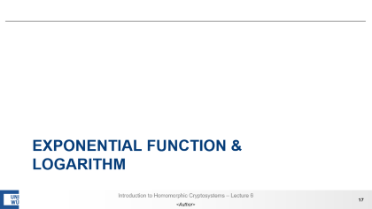





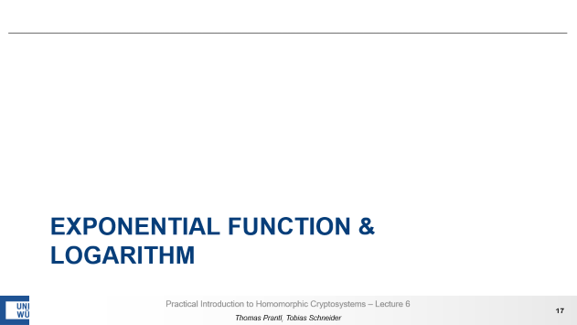

Mathematical Functions of Interest

Slide 4
division

Slide 5


Methods
We already know, that we cannot compute the division in the conventional way (iterative subtraction).
Based on our limitations in CKKS, there are only two suitable methods in literature:
We favour Newton-Raphson as it requires a smaller multiplicative depth.
Goldschmidt Iterative multiplication of dividend and divisor with a common factor $f_{i}$: $$q=\frac{a}{b}∗\frac{f_{1}}{f_{1}}∗\frac{f_{2}}{f_{2}}∗…$$
The goal is to make $b$ converge to $1$, so $$f_{i+1}=2−b_{i} (0<b<1)$$
When $b_{i}$ is close to $1$ you geht the result of the division through$a_{i}=q$
Newton-Raphson Find the reciprocal of $b$ with Newton’s method so that we can calculate: $$q=\frac{a}{b}=a∗\frac{1}{b}$$
Newton’s method can give us the $x$-value (root) for which a function $g(x)$ is zero by iteratively computing $$x_{n+1}=x_{n}−\frac{g\left(x\right)}{g′(x)}$$

Slide 6
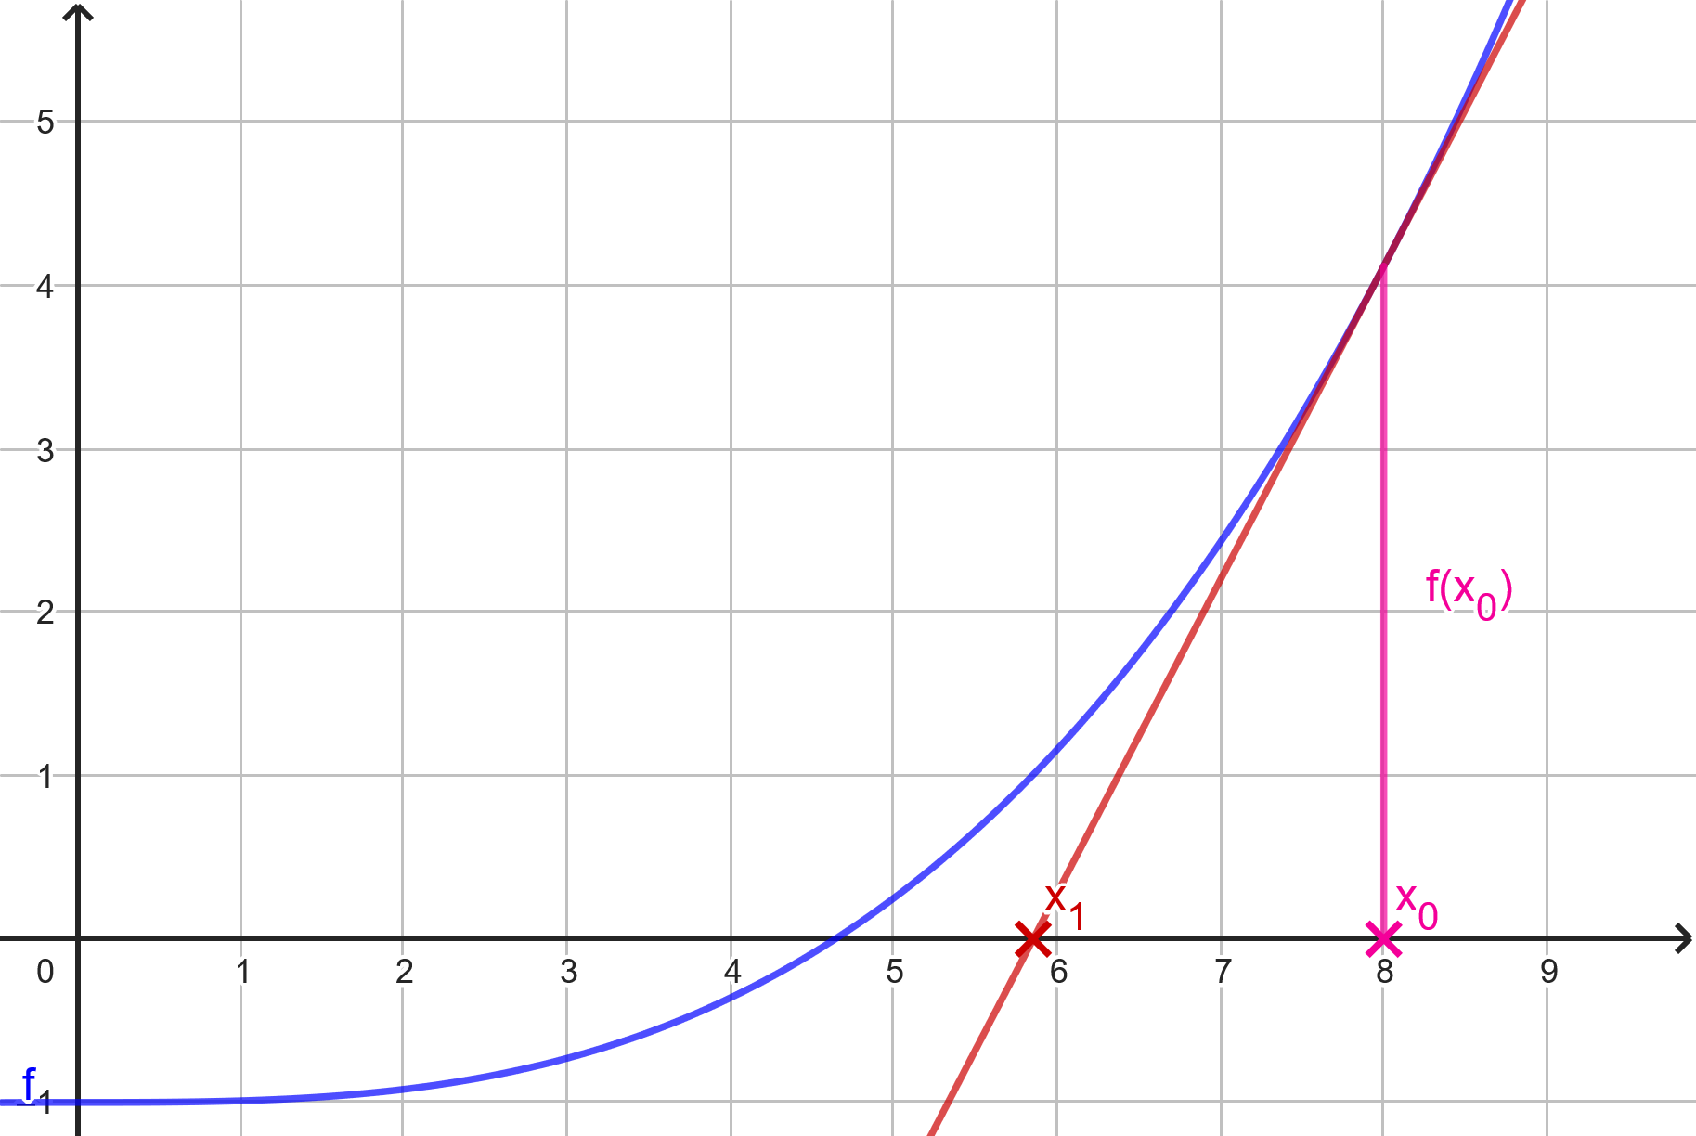
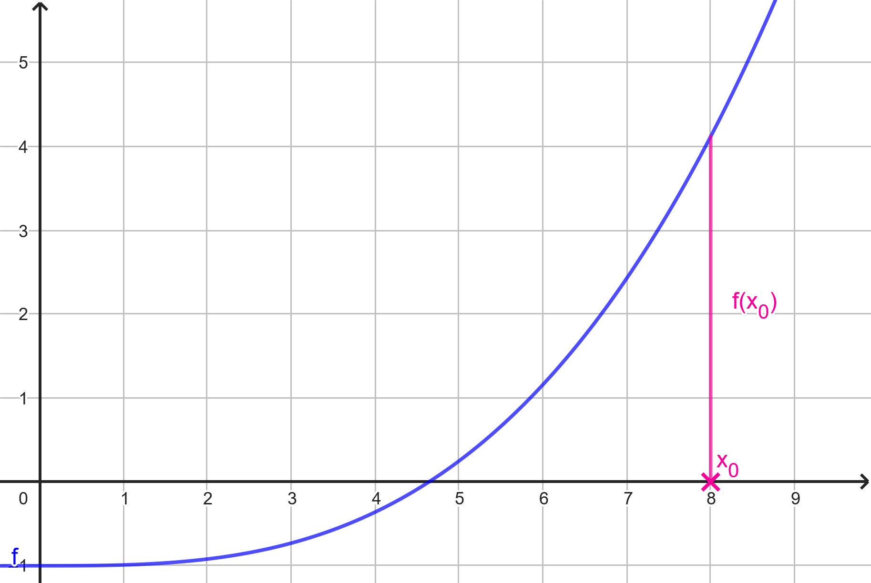
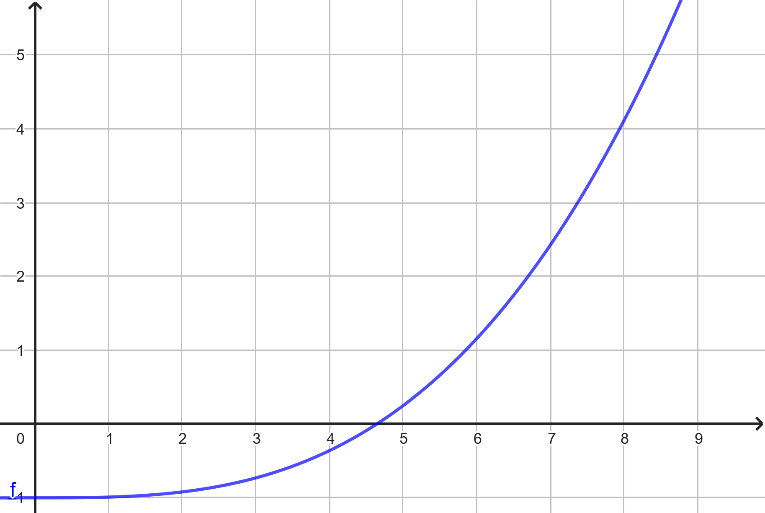
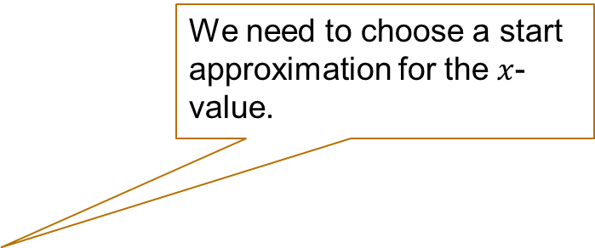
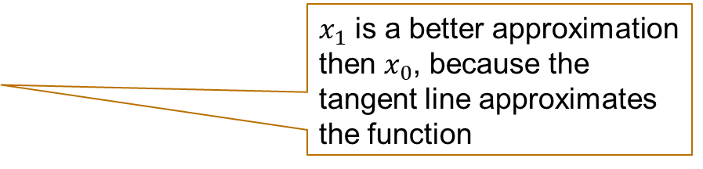
Intuition behind Newton-Raphson method
How does the Newton-Raphson method work?
We need to choose a start approximation for the $x$-value.
$x_{1}$ is a better approximation then $x_{0}$, because the tangent line approximates the function

Slide 7
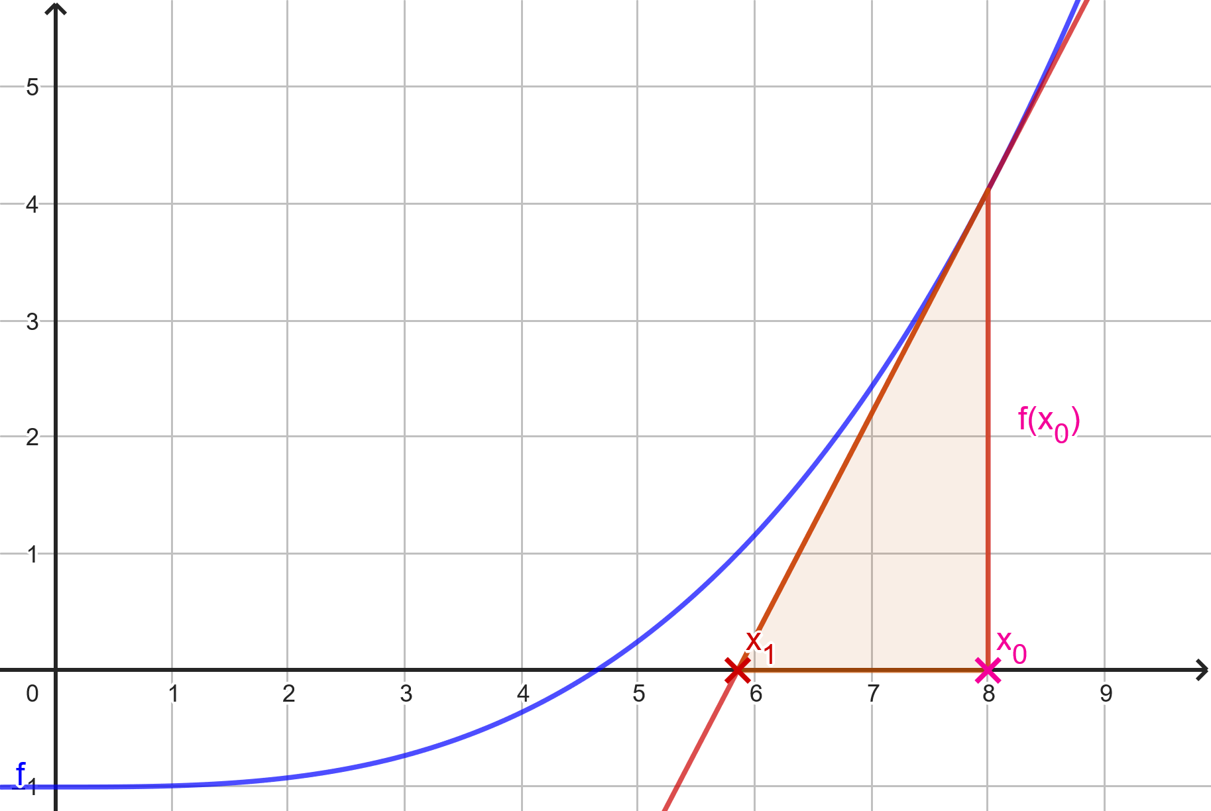
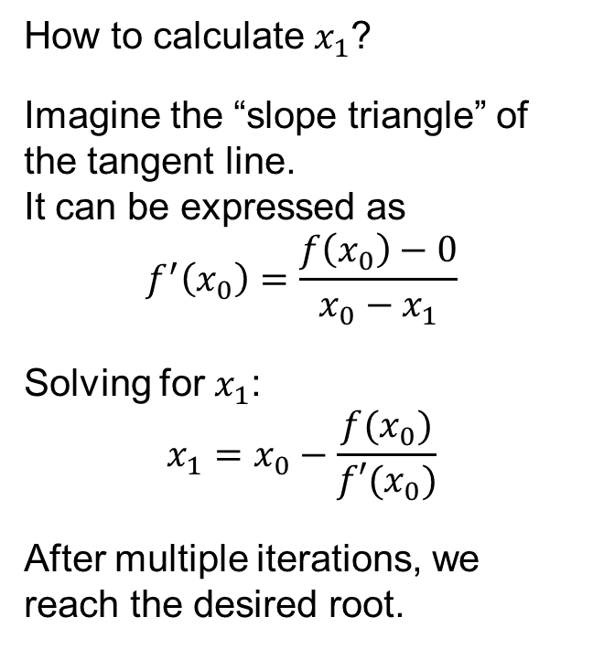
Intuition behind Newton-Raphson method
How does the Newton-Raphson method work?
How to calculate $x_{1}$?
Imagine the “slope triangle” of the tangent line. It can be expressed as $$f^{′}\left(x_{0}\right)=\frac{f\left(x_{0}\right)−0}{x_{0}−x_{1}}$$
Solving for $x_{1}$: $$x_{1}=x_{0}−\frac{f(x_{0})}{f′(x_{0})}$$
After multiple iterations, we reach the desired root.

Slide 8
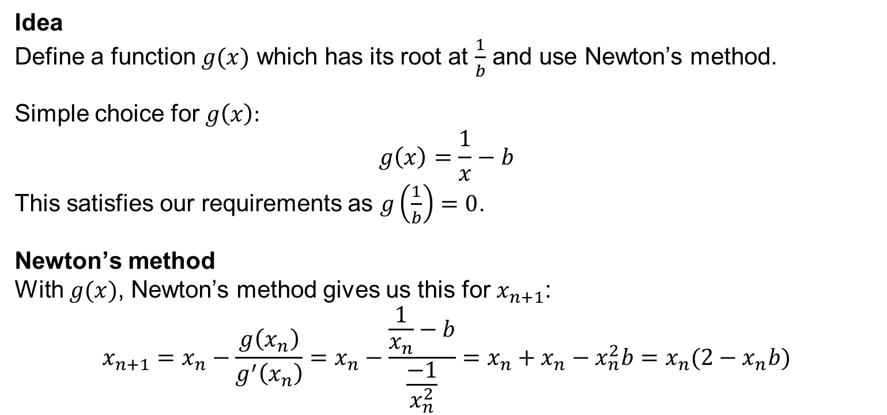

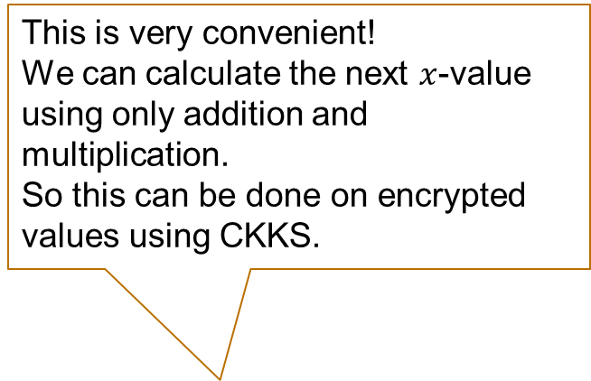
Back to Divison
Reminder We want to find the reciprocal of a value $b$ in to calculate $a∗\frac{1}{b}=\frac{a}{b}$
Idea Define a function $g(x)$ which has its root at $\frac{1}{b}$ and use Newton’s method.
Simple choice for $g\left(x\right):$ $$g\left(x\right)=\frac{1}{x}−b$$ This satisfies our requirements as $g\left(\frac{1}{b}\right)=0$.
Newton’s method With $g(x)$, Newton’s method gives us this for $x_{n+1}$: $$x_{n+1}=x_{n}−\frac{g\left(x_{n}\right)}{g^{′}\left(x_{n}\right)}=x_{n}−\frac{\frac{1}{x_{n}}−b}{\frac{−1}{x_{n}^{2}}}=x_{n}+x_{n}−x_{n}^{2}b=x_{n}(2−x_{n}b)$$
This is very convenient! We can calculate the next $x$-value using only addition and multiplication.
So this can be done on encrypted values using CKKS.
But how to choose $x_{0}$?

Slide 9
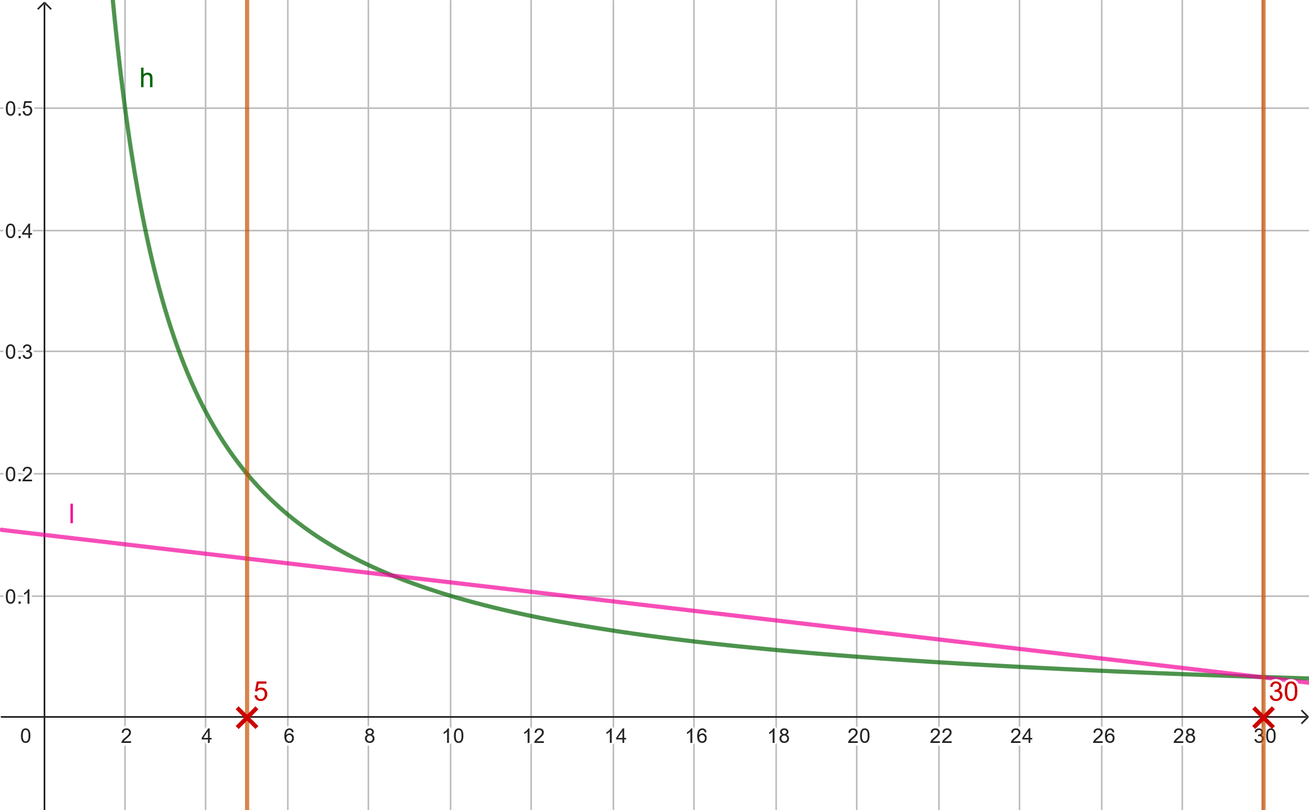
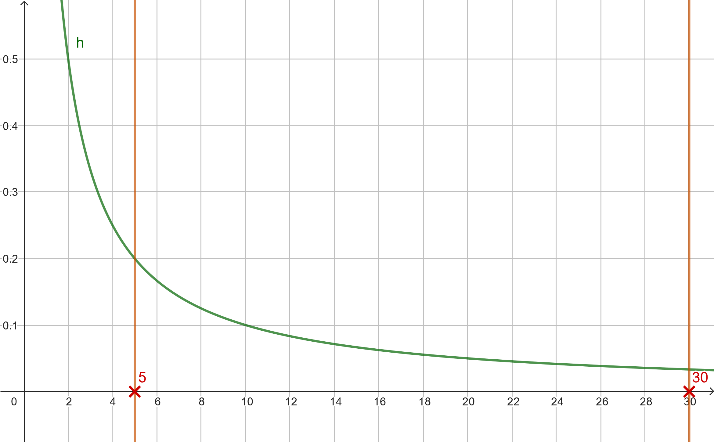
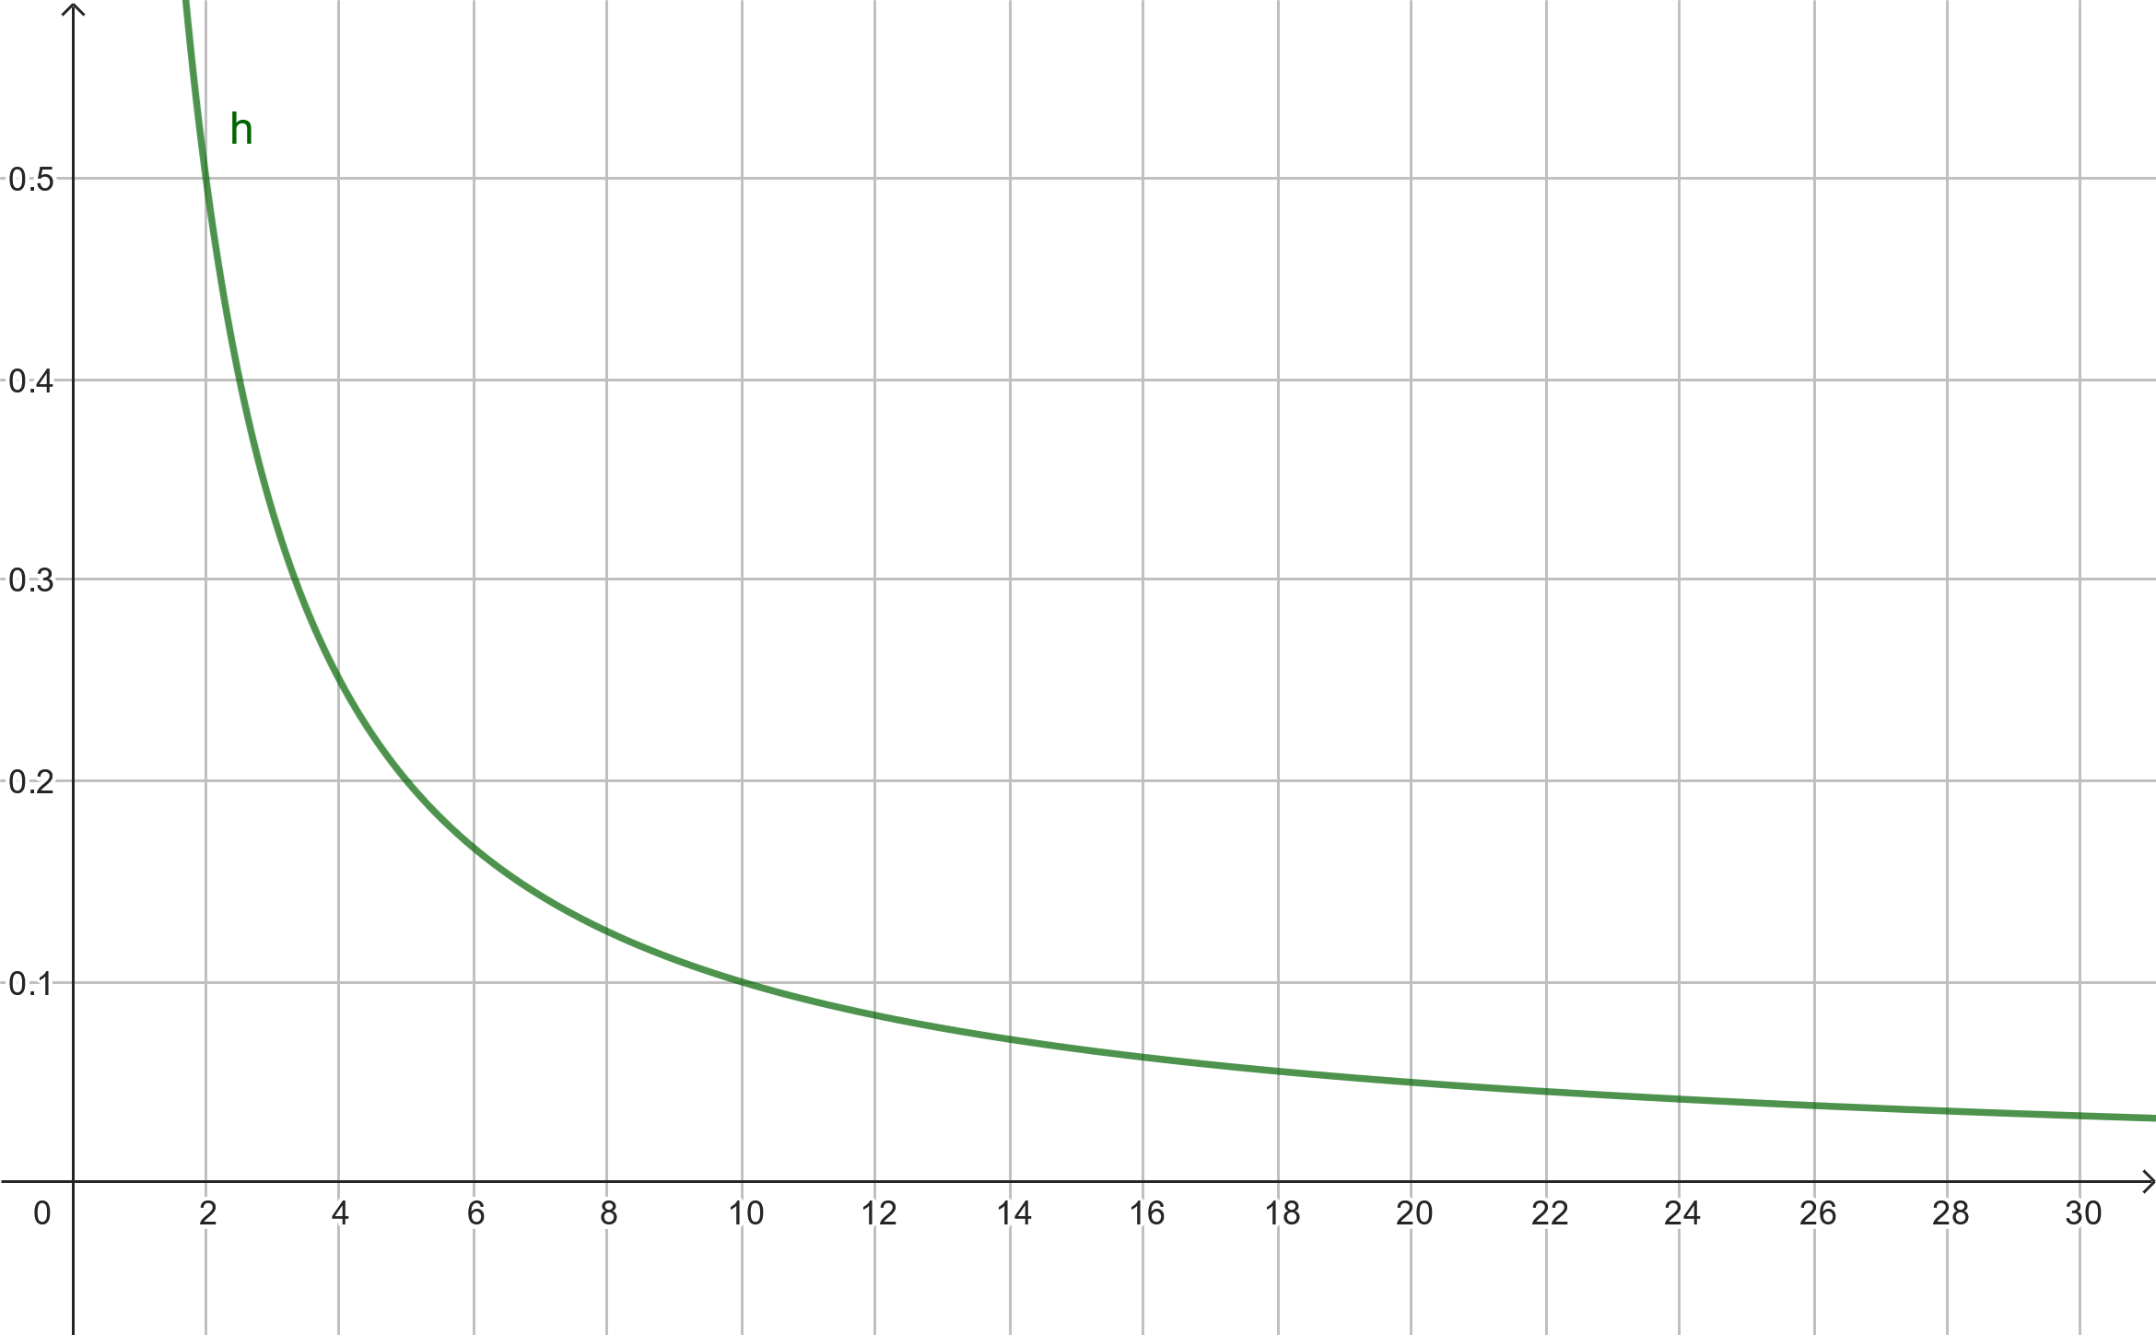
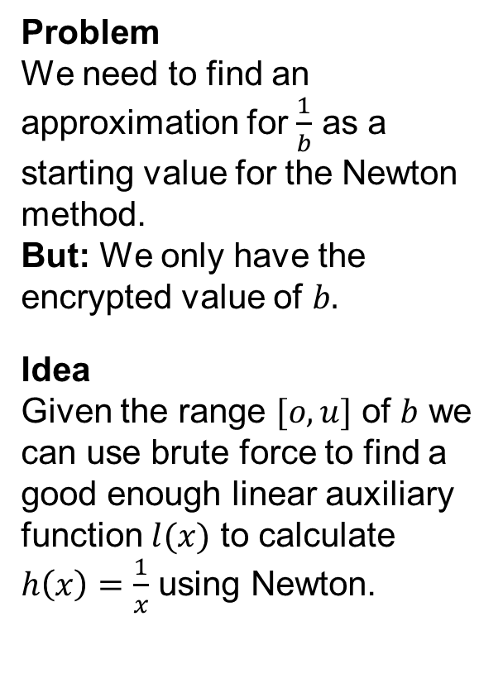
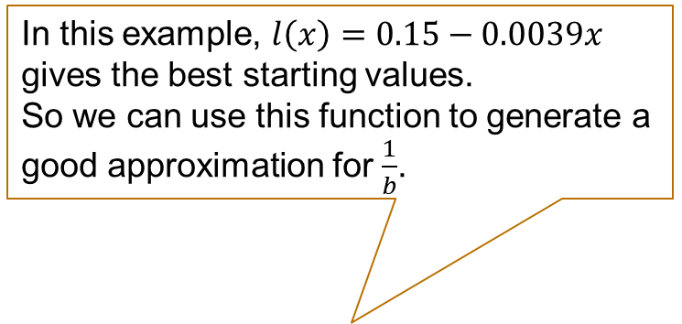
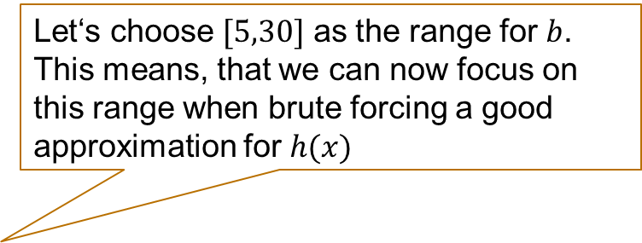
Choosing a starting value
Problem We need to find an approximation for $\frac{1}{b}$ as a starting value for the Newton method. But: We only have the encrypted value of $b.$
Idea Given the range $[o,u]$ of $b$ we can use brute force to find a good enough linear auxiliary function $l(x)$ to calculate $h\left(x\right)=\frac{1}{x}$ using Newton.
Let‘s choose $[5,30]$ as the range for $b$.
This means, that we can now focus on this range when brute forcing a good approximation for $h(x)$
In this example, $l\left(x\right)=0.15−0.0039x$ gives the best starting values.
So we can use this function to generate a good approximation for $\frac{1}{b}$.

Slide 10
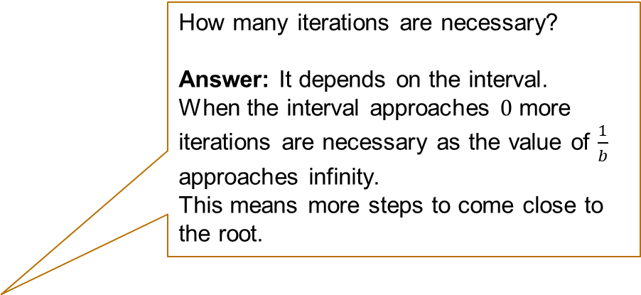

Division – Bringing it all together
To calculate the division homomorphically, we need these steps:
The parameters for linear approximation are calculated beforehand .
How many iterations are necessary?
Answer: It depends on the interval.
When the interval approaches $0$ more iterations are necessary as the value of $\frac{1}{b}$ approaches infinity.
This means more steps to come close to the root.
Input: $a,b,m,t | b∈[o,u]$
Calculate the starting point $x_{0}=l\left(b\right)=mb+t$ for the Newton-Rhapson method.
Recursively calculate $x_{n+1}=x_{n}(2−x_{n}b)$
Taking the last $x_{n}≈\frac{1}{b}$ and multiplying it with $a$ gives us the result $r≈\frac{a}{b}$
Computation time? Doing the division according to these steps is obviously significantly slower than doing it in the traditional way. Depending on the number of iterations the division can take multiple seconds when done homomorphically.

Slide 11
Square root

Slide 12
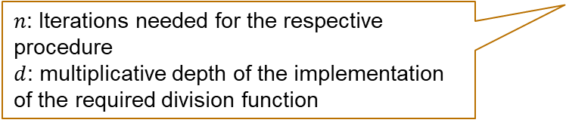
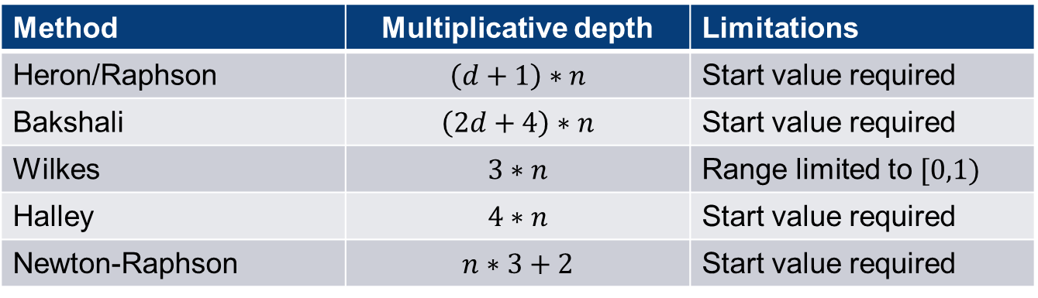
Methods
The traditional calculation of the square root is not applicable homomorphically (for the same reasons as with the division)
We also find multiple approaches in literature to calculate the square root differently. We won’t discuss them in detail, but we can compare them according to the multiplicate depth:
Method | Multiplicative depth | Limitations
Heron/Raphson | $$\left(d+1\right)∗n$$ | Start value required
Bakshali | $$\left(2d+4\right)∗n$$ | Start value required
Wilkes | $$3∗n$$ | Range limited to $[0,1)$
Halley | $$4∗n$$ | Start value required
Newton-Raphson | $$n∗3+2$$ | Start value required
$n$: Iterations needed for the respective procedure
$d$: multiplicative depth of the implementation of the required division function
The Newton-Raphson method is the best approach as a shallower multiplicative depth is very important for our use case.
Table taken from Prantl, T., Horn, L., Engel, S. et al. De Bello Homomorphico: Investigation of the extensibility of the OpenFHE library with basic mathematical functions by means of common approaches using the example of the CKKS cryptosystem. Int. J. Inf. Secur. 23, 1149–1169 (2024). https://doi.org/10.1007/s10207-023-00781-0

Slide 13

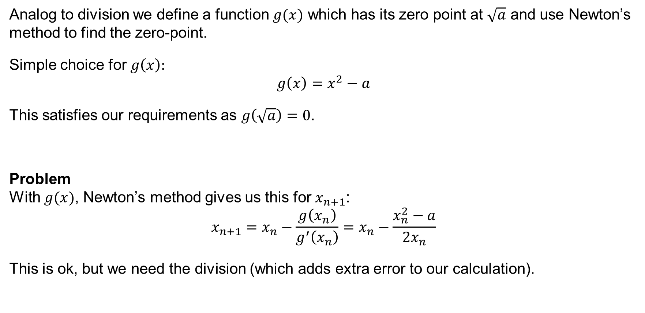
Square Root with Newton-Raphson
Analog to division we define a function $g(x)$ which has its zero point at $\sqrt{a}$ and use Newton’s method to find the zero-point.
Simple choice for $g\left(x\right):$ $$g\left(x\right)=x^{2}−a$$
This satisfies our requirements as $g\left(\sqrt{a}\right)=0$.
Problem With $g(x)$, Newton’s method gives us this for $x_{n+1}$: $$x_{n+1}=x_{n}−\frac{g\left(x_{n}\right)}{g^{′}\left(x_{n}\right)}=x_{n}−\frac{x_{n}^{2}−a}{{2x}_{n}}$$
This is ok, but we need the division (which adds extra error to our calculation).

Slide 14
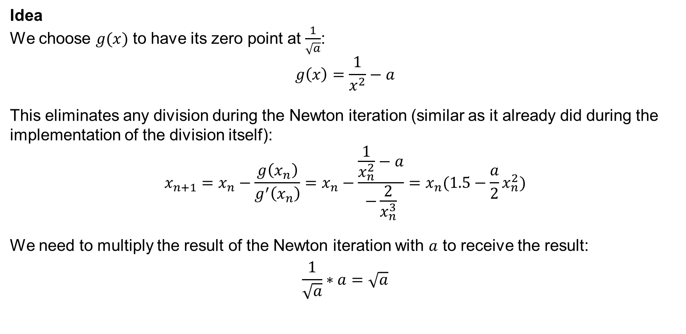
Square Root with Newton-Raphson
Idea We choose $g(x)$ to have its zero point at $\frac{1}{\sqrt{a}}$: $$g\left(x\right)=\frac{1}{x^{2}}−a$$
This eliminates any division during the Newton iteration (similar as it already did during the implementation of the division itself): $$x_{n+1}=x_{n}−\frac{g\left(x_{n}\right)}{g^{′}\left(x_{n}\right)}=x_{n}−\frac{\frac{1}{x_{n}^{2}}−a}{−\frac{2}{x_{n}^{3}}}=x_{n}(1.5−\frac{a}{2}x_{n}^{2})$$
We need to multiply the result of the Newton iteration with $a$ to receive the result:
$$\frac{1}{\sqrt{a}}∗a=\sqrt{a}$$

Slide 15
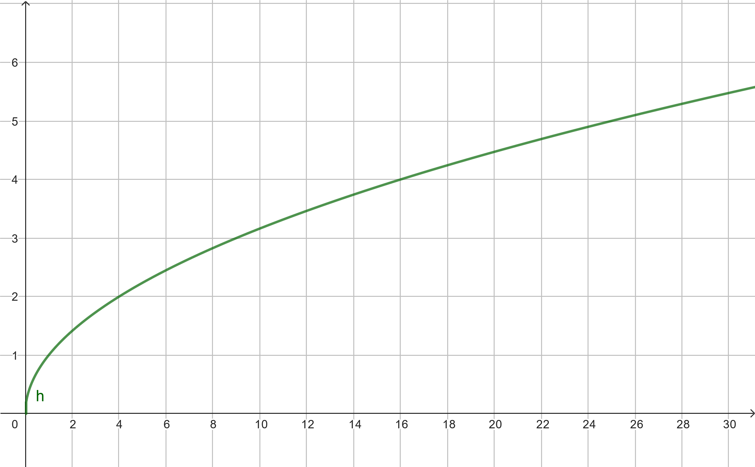
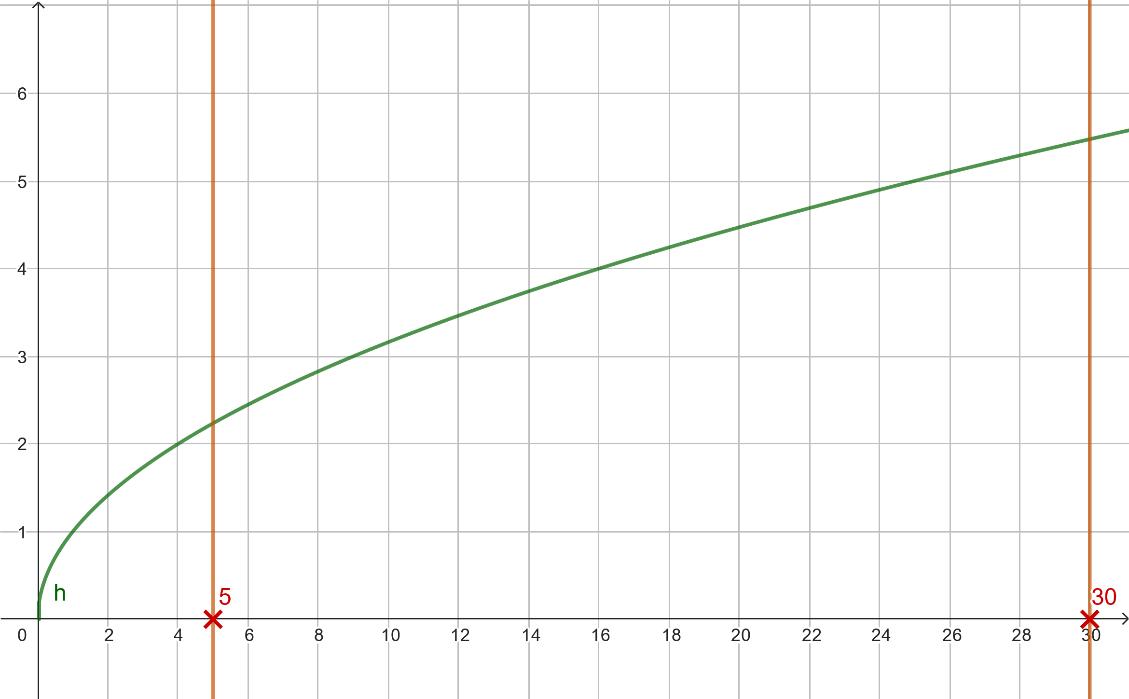
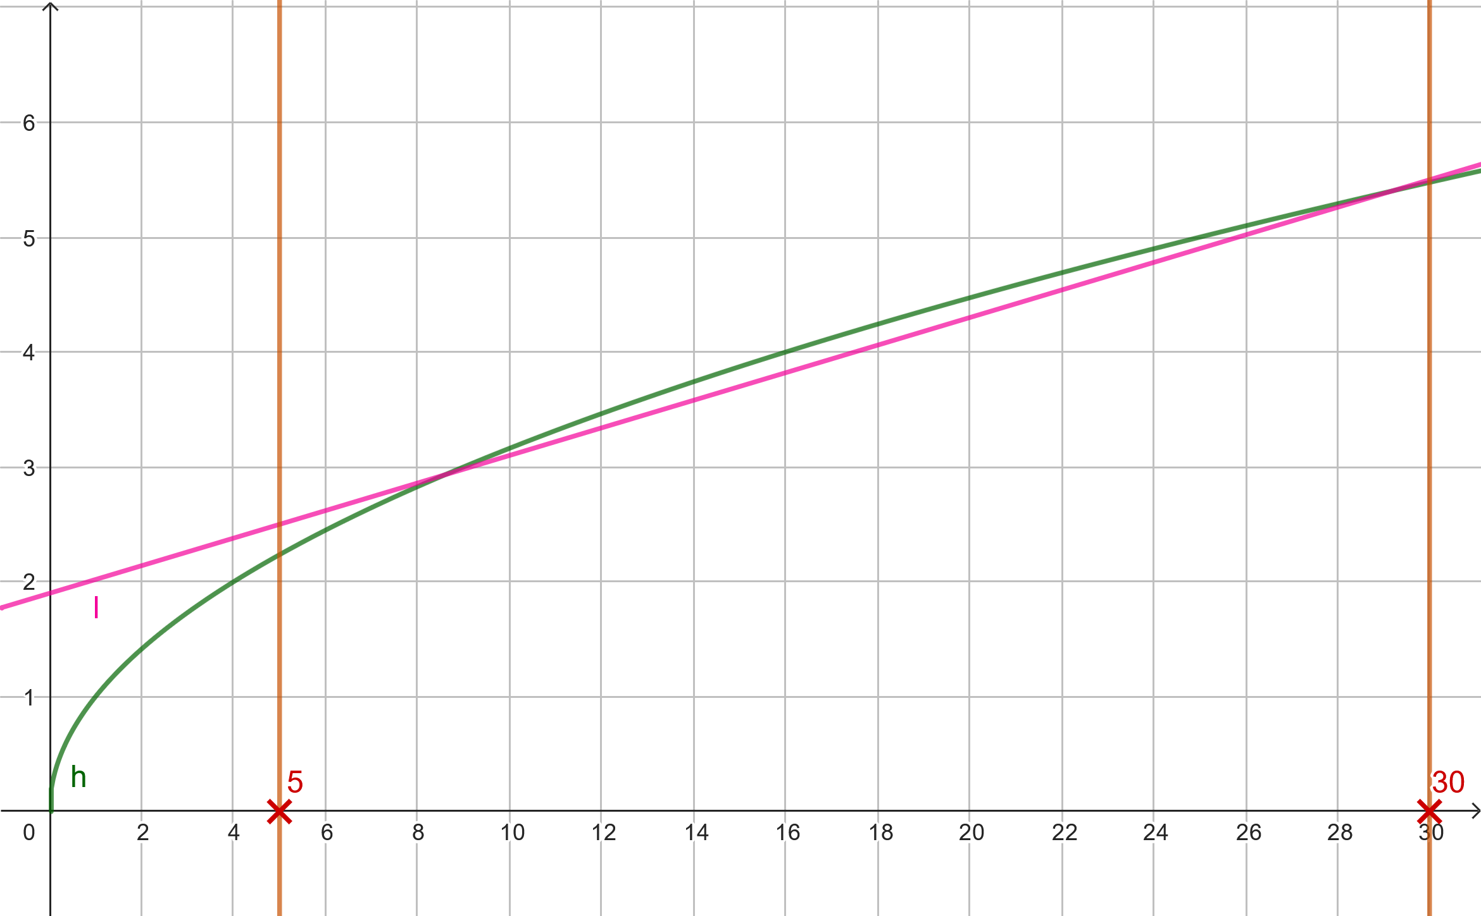
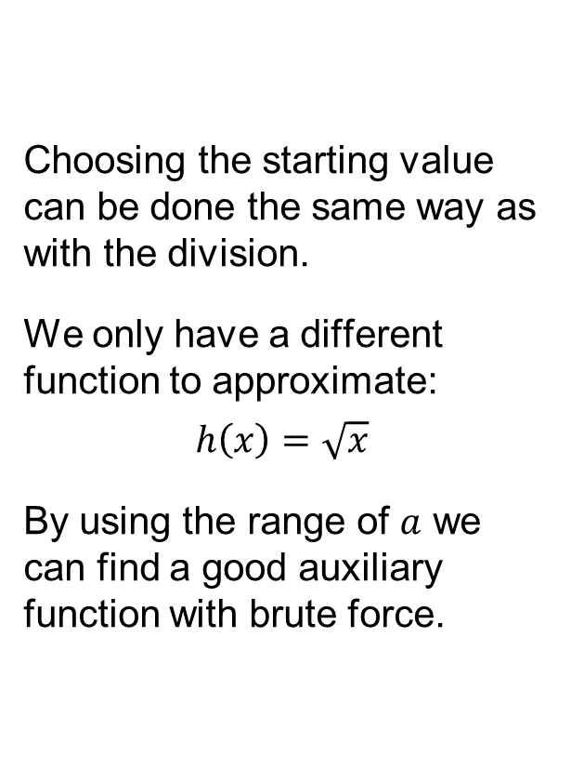
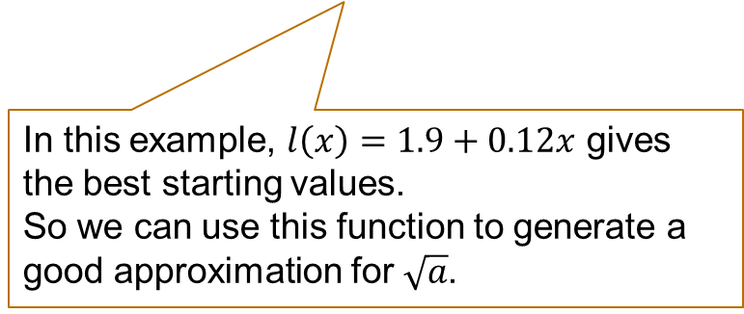
Choosing a starting value
Choosing the starting value can be done the same way as with the division.
We only have a different function to approximate:
$$h\left(x\right)=\sqrt{x}$$
By using the range of $a$ we can find a good auxiliary function with brute force.
In this example, $l\left(x\right)=1.9+0.12x$ gives the best starting values.
So we can use this function to generate a good approximation for $\sqrt{a}$.

Slide 16

Square Root – Bringing it all together
To calculate the square root homomorphically, we need these steps:
The parameters for linear approximation are calculated beforehand .
Input: $a, m, t| \sqrt{a}∈[o,u]$
Calculate the starting point $x_{0}=l(a), l\left(x\right)=mx+t$ for the Newton-Rhapson method.
Recursively calculate $x_{n+1}=x_{n}(1.5−\frac{a}{2}x_{n}^{2})$
Taking the last $x_{n}≈\frac{1}{\sqrt{a}}$ and multiplying it with $a$ gives us the result $r≈\sqrt{a}$
How many iterations are necessary?
Answer: It depends on the interval.
For most intervals 10 iterations provide enough precision.
Computation time? Doing the square root according to these steps is obviously significantly slower, than doing it in the traditional way. Depending on the number of iterations calculating the square root can take even more than 10 seconds.

Slide 17
Exponential function & Logarithm

Slide 18
Methods
The exponential function and logarithm are traditionally implemented using lookup tables, rounding and algorithms that involve conditional statements. This is the reason why we also need a different approach when calculating these functions homomorphically.
Note The following slide shows an overview over different alternative methods found in literature, but we won’t discuss them in more detail (as already done with the square root).

Slide 19
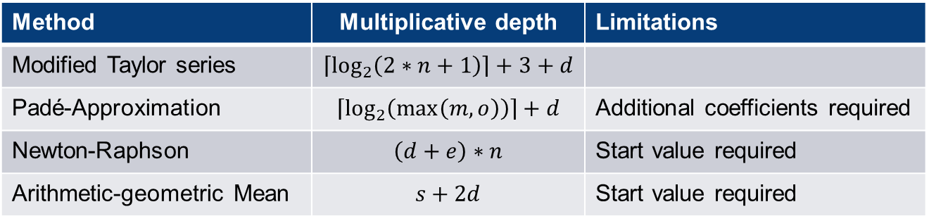
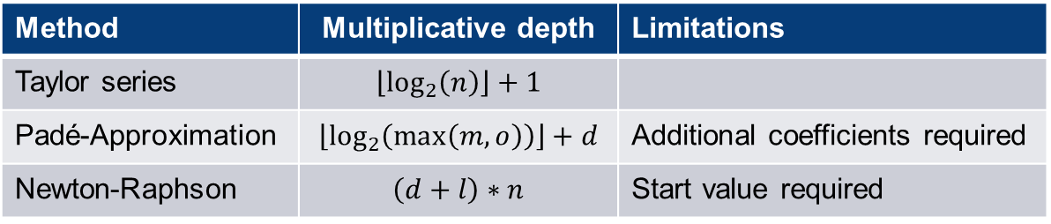
Methods
Exponential function
Logarithm
𝑛: Iterations needed for the respective procedure 𝑑,𝑙,𝑒,𝑠: multiplicative depth of the implementation of the required division, logarithm, exponential, square root function 𝑚,𝑜: degrees of polynomials used by the Padé-Approximation
Method | Multiplicative depth | Limitations
Taylor series | $$\left\lfloor \log_{2}\left(n\right)\right\rfloor +1$$
Padé-Approximation | $$\left\lfloor \log_{2}\left(\max\left(m,o\right)\right)\right\rfloor +d$$ | Additional coefficients required
Newton-Raphson | $$\left(d+l\right)∗n$$ | Start value required
Method | Multiplicative depth | Limitations
Modified Taylor series | $$\left\lceil \log_{2}\left(2∗n+1\right)\right\rceil +3+d$$
Padé-Approximation | $$\left\lceil \log_{2}\left(\max\left(m,o\right)\right)\right\rceil +d$$ | Additional coefficients required
Newton-Raphson | $$\left(d+e\right)∗n$$ | Start value required
Arithmetic-geometric Mean | $$s+2d$$ | Start value required
For both functions we will use the Taylor series as it combines the most advantages!
Tables taken from Prantl, T., Horn, L., Engel, S. et al. De Bello Homomorphico: Investigation of the extensibility of the OpenFHE library with basic mathematical functions by means of common approaches using the example of the CKKS cryptosystem. Int. J. Inf. Secur. 23, 1149–1169 (2024). https://doi.org/10.1007/s10207-023-00781-0

Slide 20
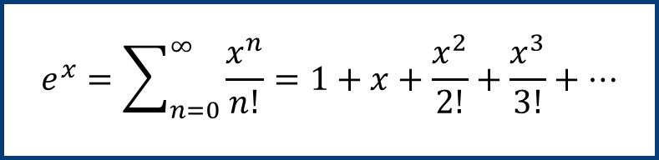
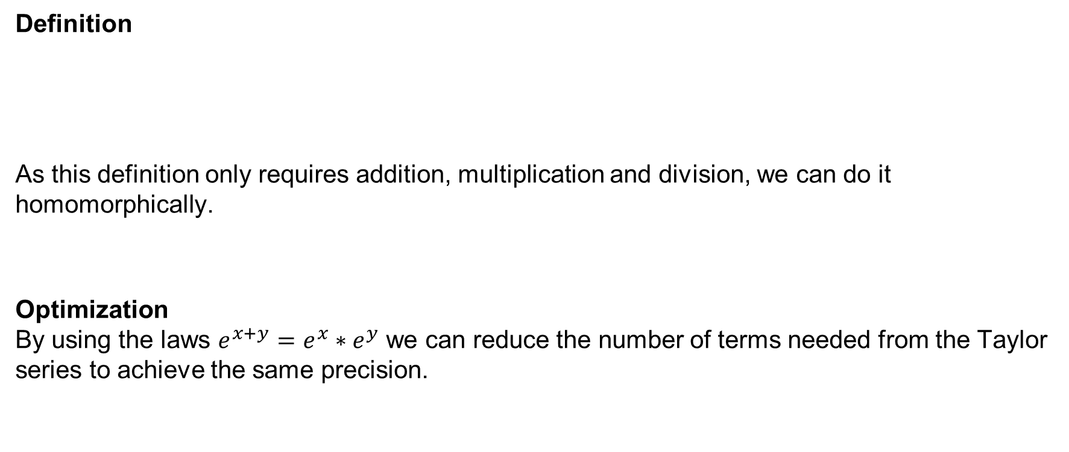
Exponential function using Taylor series
Exponential function and Logarithm are originally defined using a Taylor series
Definition As this definition only requires addition, multiplication and division, we can do it homomorphically.
Optimization By using the laws $e^{x+y}=e^{x}∗e^{y}$ we can reduce the number of terms needed from the Taylor series to achieve the same precision.
$$e^{x}=\sum_{n=0}^{∞}{\frac{x^{n}}{n!}}=1+x+\frac{x^{2}}{2!}+\frac{x^{3}}{3!}+…$$

Slide 21
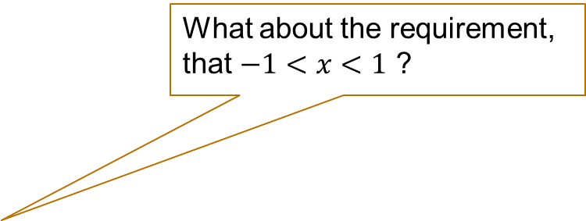
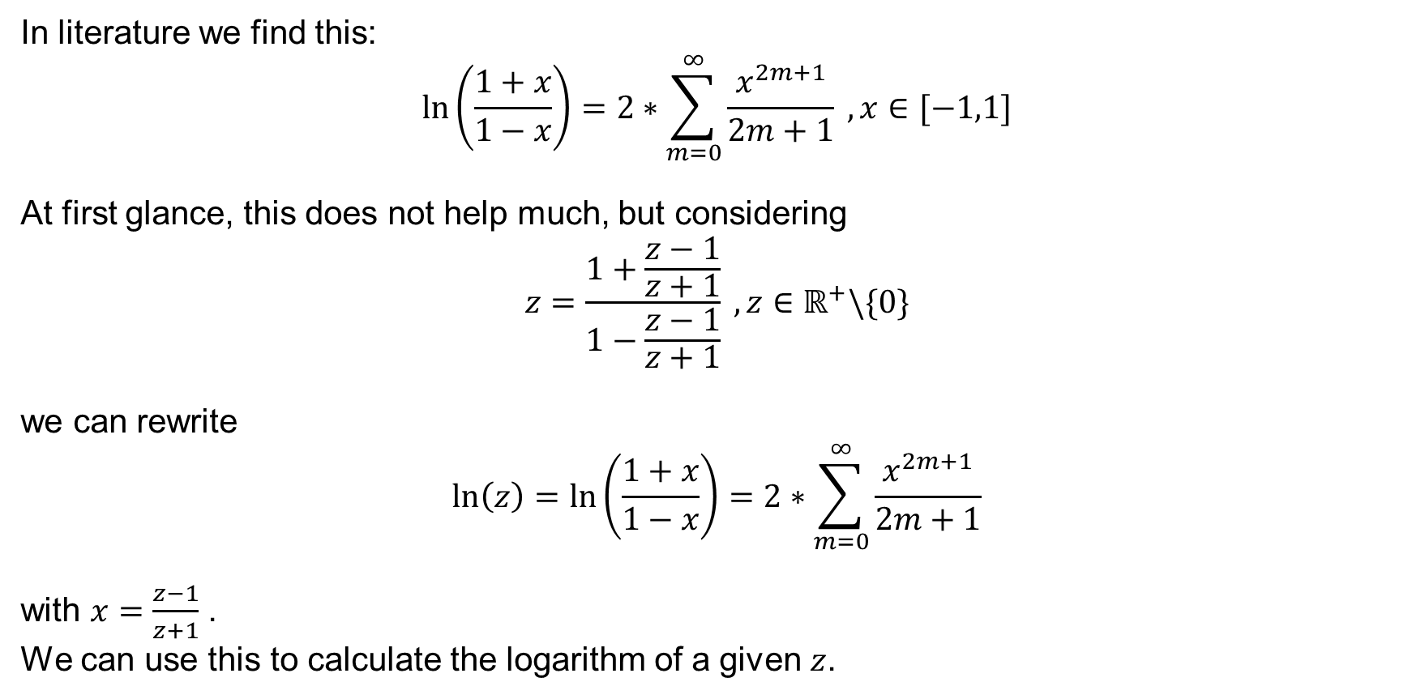
Logarithm using Taylor series
In literature we find this: $$\ln\left(\frac{1+x}{1−x}\right)=2∗\sum_{m=0}^{∞}{\frac{x^{2m+1}}{2m+1}} , x∈[−1,1]$$
At first glance, this does not help much, but considering $$z=\frac{1+\frac{z−1}{z+1}}{1−\frac{z−1}{z+1}} , z∈ℝ^{+}\backslash \{0\}$$
we can rewrite $$\ln\left(z\right)=\ln\left(\frac{1+x}{1−x}\right)=2∗\sum_{m=0}^{∞}{\frac{x^{2m+1}}{2m+1}}$$
with $x=\frac{z−1}{z+1}$ . We can use this to calculate the logarithm of a given $z$.
What about the requirement, that $−1<x<1$ ?

Slide 22
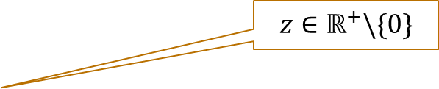



Logarithm using Taylor series
We can show that $–1 < x =\frac{z−1}{z+1} < 1$:
$$z>0$$
$$−2z<0$$
$$−2z−1<−1$$
$$−2z−1<−1<1$$
$$−z−1<z−1<z+1$$
As $z>0$we can divide by $(z+1)$:
$$\frac{−z−1}{z+1}<\frac{z−1}{z+1}<\frac{z+1}{z+1}$$
$$−1<x<1$$
This means, that we can use our modified Taylor series to calculate the logarithm for an arbitrary input value.
$$z∈ℝ^{+}\backslash \{0\}$$
Subtracting $1$
Adding $z$

Slide 23

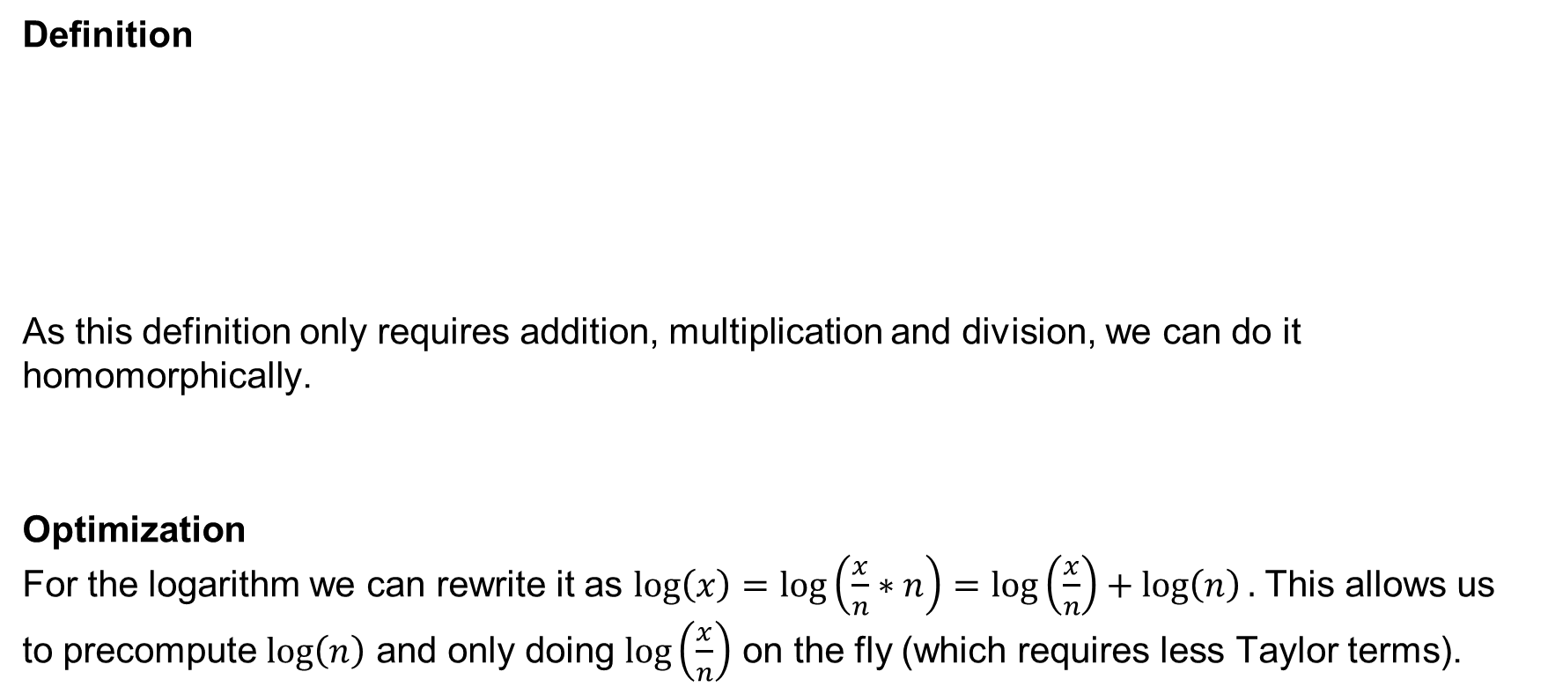
Logarithm using the Taylor series
Exponential function and Logarithm are originally defined using a Taylor series
Definition
As this definition only requires addition, multiplication and division, we can do it homomorphically.
Optimization For the logarithm we can rewrite it as $\log\left(x\right)=\log\left(\frac{x}{n}∗n\right)=\log\left(\frac{x}{n}\right)+\log\left(n\right).$ This allows us to precompute $\log\left(n\right)$ and only doing $\log\left(\frac{x}{n}\right)$ on the fly (which requires less Taylor terms).
$$\ln\left(z\right)=\ln\left(\frac{1+x}{1−x}\right)=2∗\sum_{m=0}^{∞}{\frac{x^{2m+1}}{2m+1}} \\ x=\frac{z−1}{z+1}$$

Slide 24
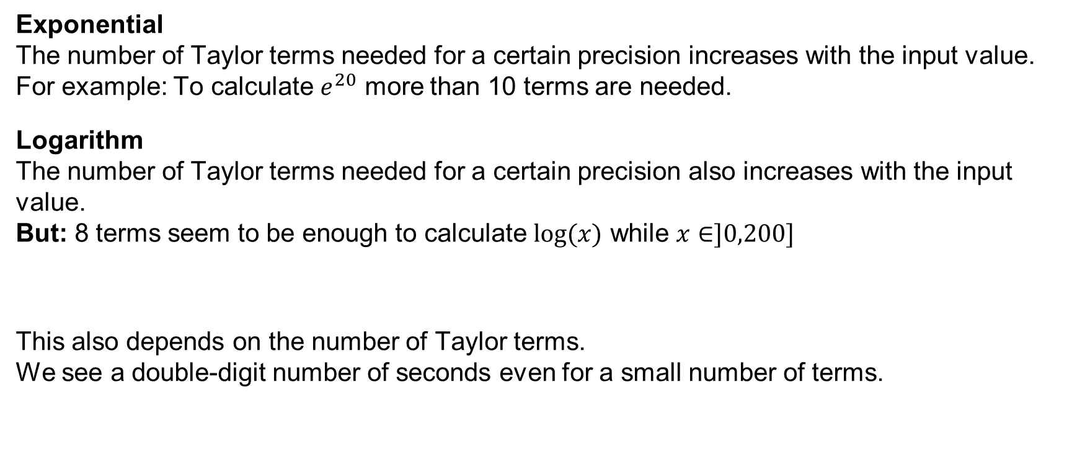
Evaluation of Exponential function & Logarithm with Taylor
How many Taylor terms are necessary to achieve a good precision?
Exponential The number of Taylor terms needed for a certain precision increases with the input value. For example: To calculate $e^{20}$ more than 10 terms are needed.
Logarithm The number of Taylor terms needed for a certain precision also increases with the input value. But: 8 terms seem to be enough to calculate $\log{(x)}$ while $x∈]0,200]$
This also depends on the number of Taylor terms. We see a double-digit number of seconds even for a small number of terms.
Computation time?

Slide 25
Maximum and minimum

Slide 26
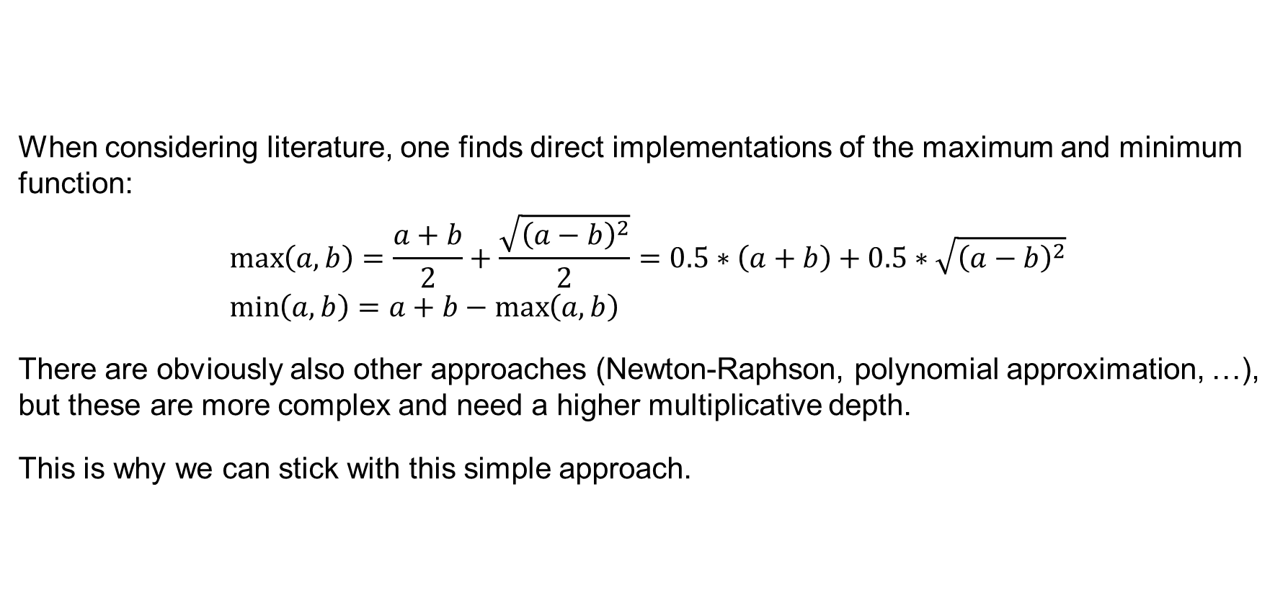
Maximum and Minimum can be implemented directly!
When considering literature, one finds direct implementations of the maximum and minimum function:
$$\max\left(a,b\right)=\frac{a+b}{2}+\frac{\sqrt{{\left(a−b\right)}^{2}}}{2}=0.5∗\left(a+b\right)+0.5∗\sqrt{{\left(a−b\right)}^{2}} \\ \min\left(a,b\right)=a+b−\max\left(a,b\right)$$
There are obviously also other approaches (Newton-Raphson, polynomial approximation, …), but these are more complex and need a higher multiplicative depth.
This is why we can stick with this simple approach.

Slide 27
Summary – What did we learn today?
Homomorphic implementation of mathematic functions
Calculating complex mathematical functions homomorphically is always much slower. Most of the methods are done iteratively. This means that we only approximate the result of the function.
For division and square root we use Newton-Raphson. Limiting the search area with an interval provides good approximation for the starting value.
For exponential function and logarithm, we use their respective definitions as a Taylor series. Optimizations can be applied
Newton-Raphson This method can be used to find the roots of a certain function.
For maximum and minimum, we can use a direct definition using division, addition, square root and multiplication

