Slide 1
Extension of the CKKS Cryptosystem: Part 2
<Author>
08/07/2025

Slide 2
The Binary step function

Slide 3
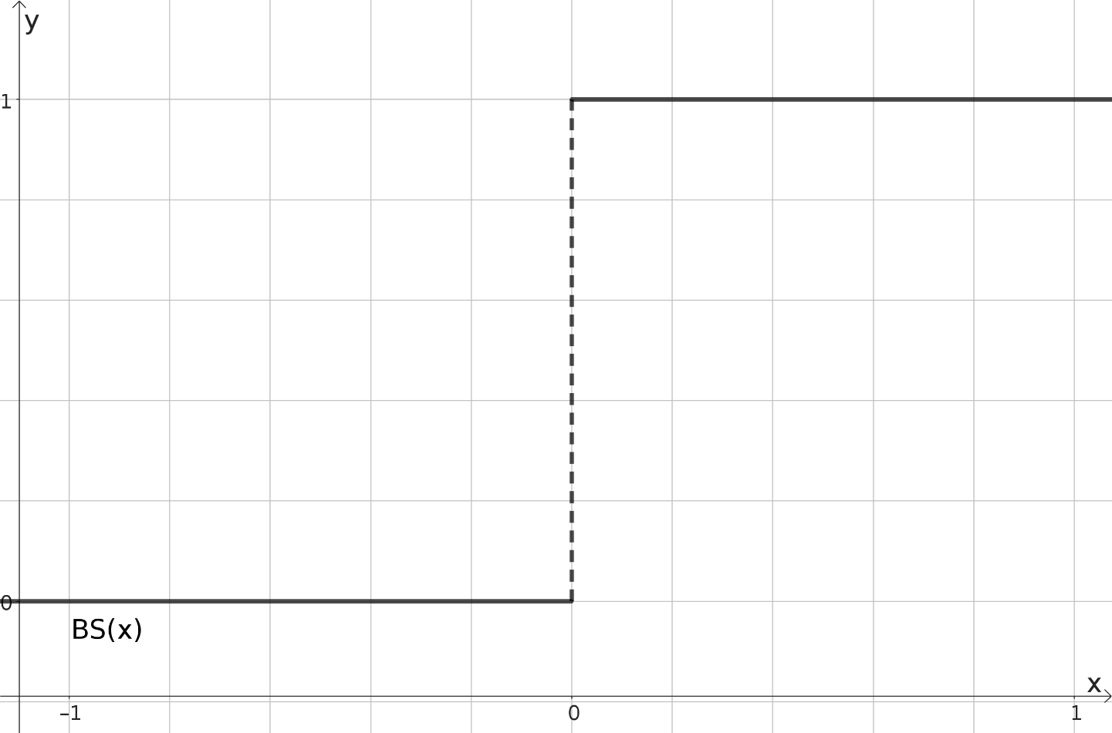
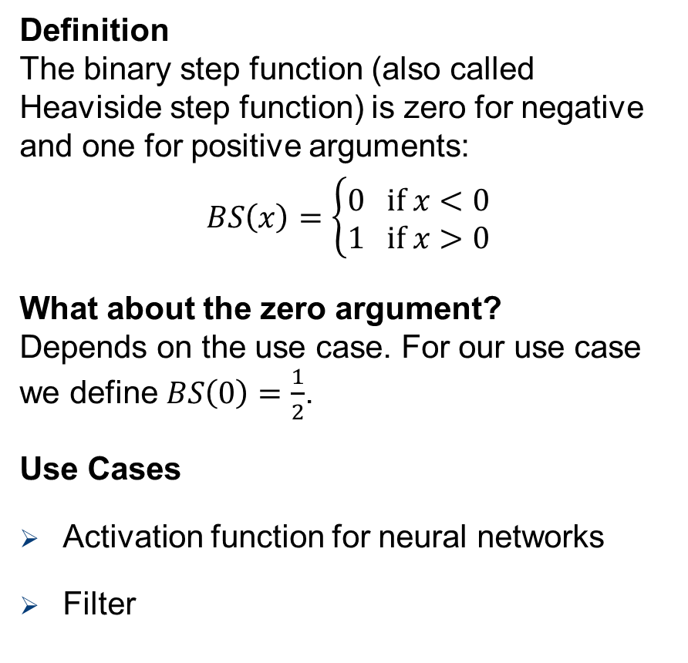
The Binary Step Function
Definition The binary step function (also called Heaviside step function) is zero for negative and one for positive arguments:
$$BS\left(x\right)=\left\{\begin{aligned}0 \text{if} x<0 \\ 1 \text{if} x>0\end{aligned}\right.$$
What about the zero argument? Depends on the use case. For our use case we define $BS\left(0\right)=\frac{1}{2}$.
Use Cases
Activation function for neural networks
Filter

Slide 4
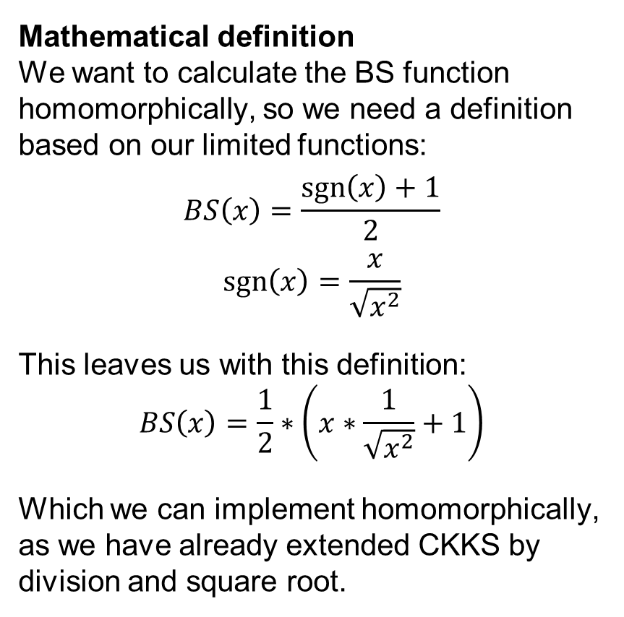

The Binary Step Function
Mathematical definition We want to calculate the BS function homomorphically, so we need a definition based on our limited functions:
$$BS\left(x\right)=\frac{\operatorname{sgn}\left(x\right)+1}{2}$$
$$\operatorname{sgn}\left(x\right)=\frac{x}{\sqrt{x^{2}}}$$
This leaves us with this definition: $$BS\left(x\right)=\frac{1}{2}∗\left(x∗\frac{1}{\sqrt{x^{2}}}+1\right)$$
Which we can implement homomorphically, as we have already extended CKKS by division and square root.
But how do we do $sgn⁡(x)$?

Slide 5
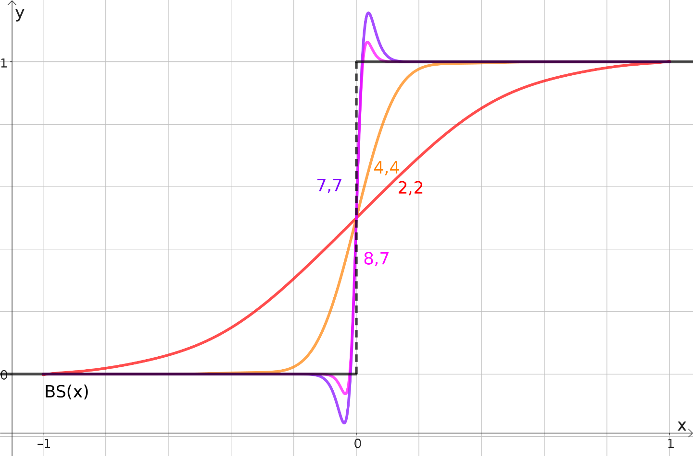
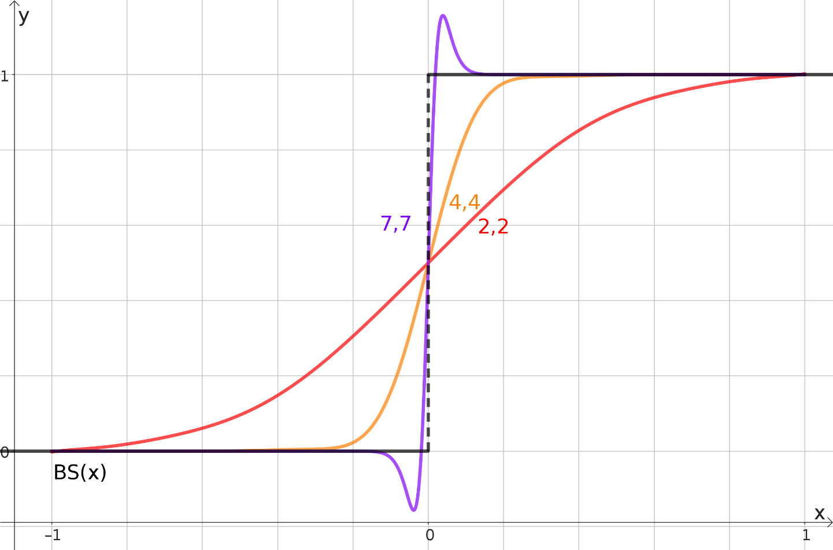
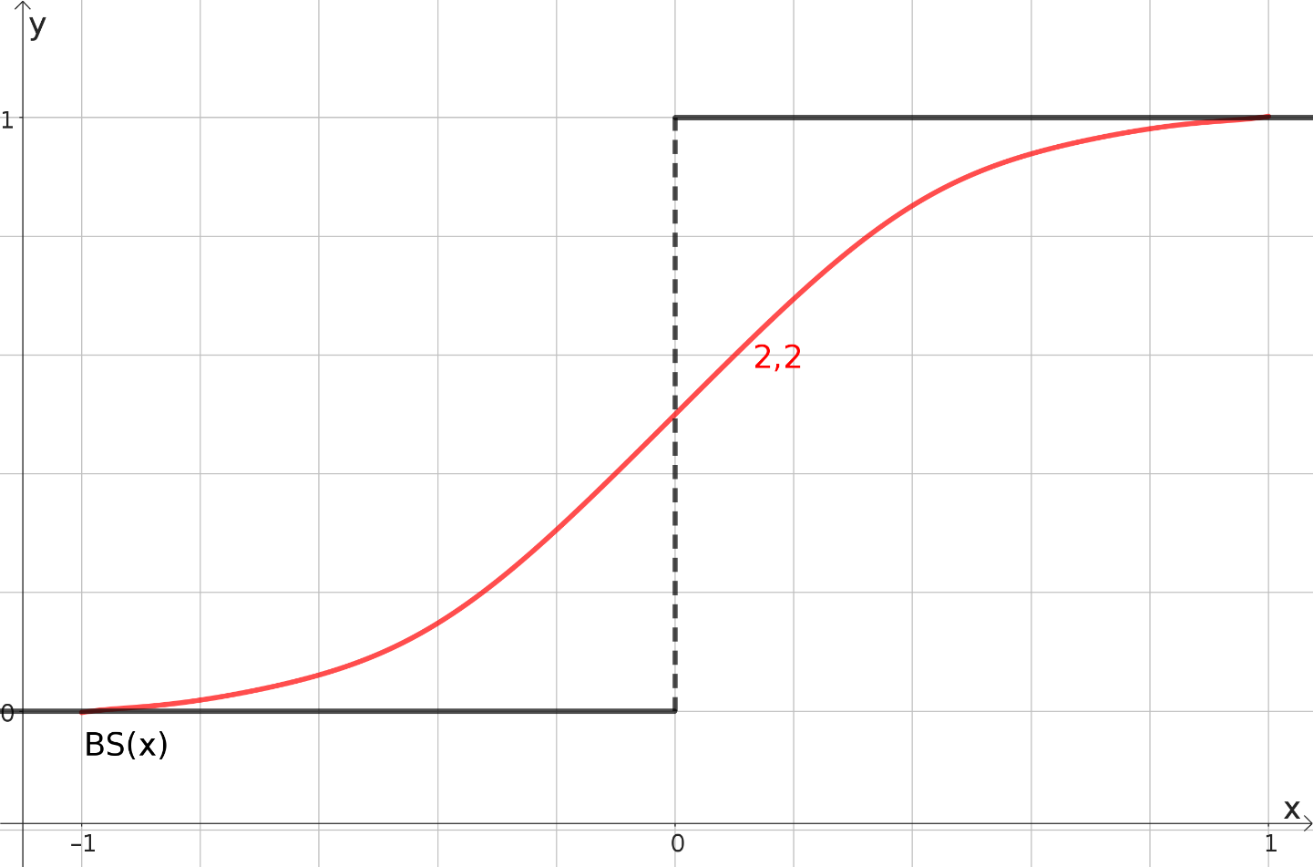
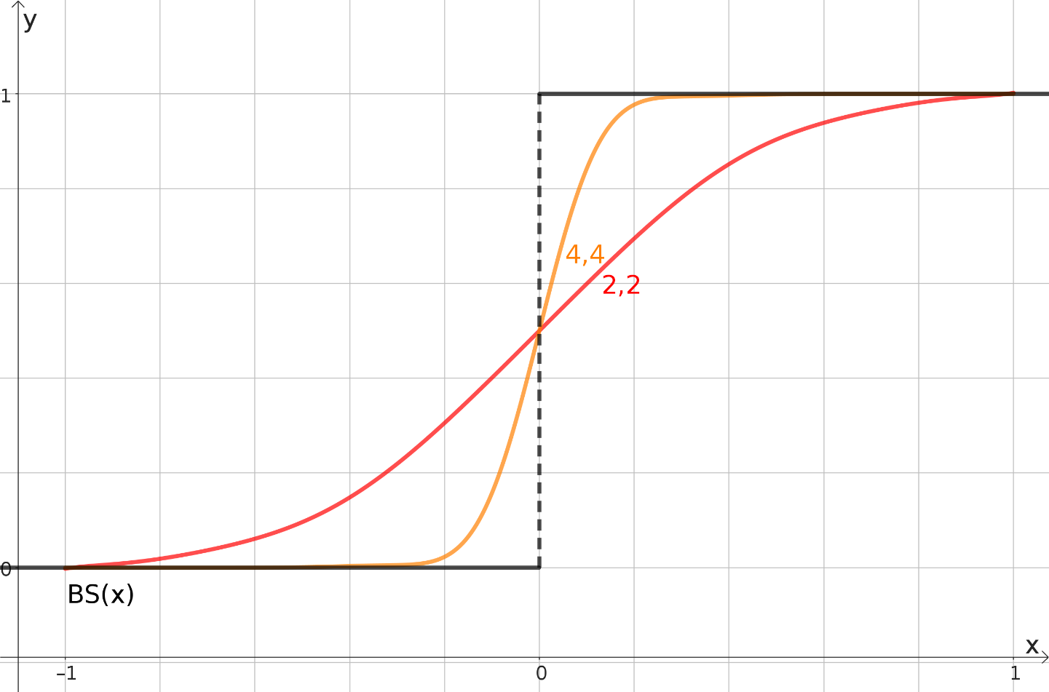
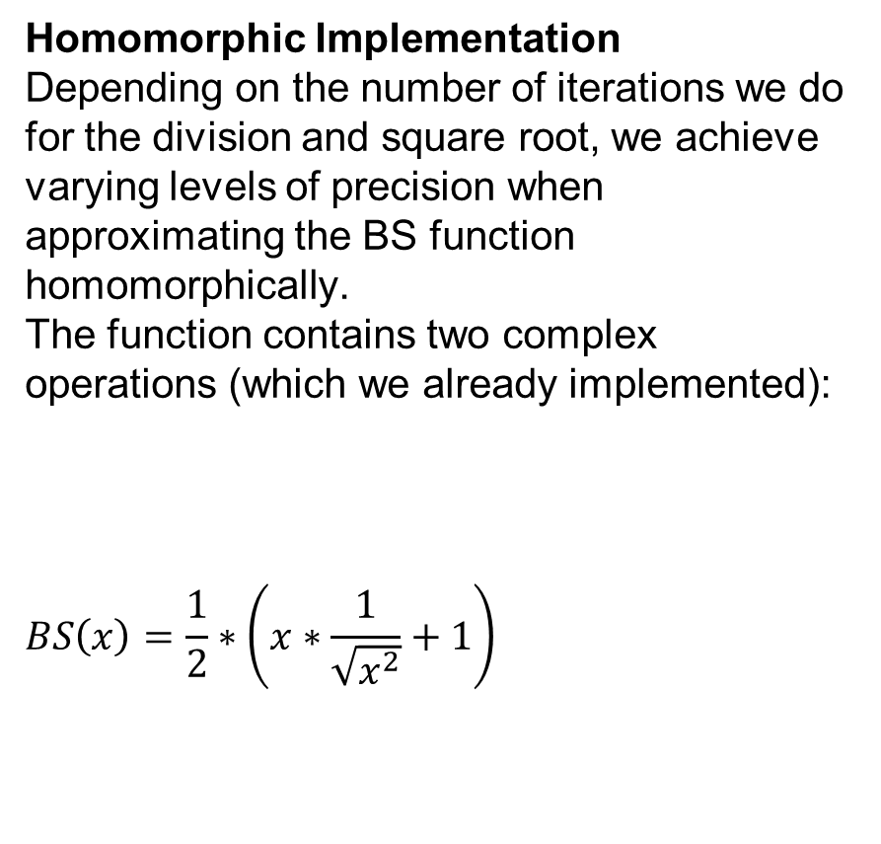
The Binary Step Function
Homomorphic Implementation Depending on the number of iterations we do for the division and square root, we achieve varying levels of precision when approximating the BS function homomorphically. The function contains two complex operations (which we already implemented):
$$BS\left(x\right)=\frac{1}{2}∗\left(x∗\frac{1}{\sqrt{x^{2}}}+1\right)$$
Inverse
square root
<square root iterations>,<inverse iterations>

Slide 6

How can we use the Binary Step Function?
Example Task From a given set of tuples:
$$\left\{\left(λ_{1},L_{1}\right),\left(λ_{2},L_{2}\right),…\left(λ_{n}, L_{n}\right)\right\}, { λ}_{i}∈ℝ, L_{i}∈ℝ$$ Find the $λ_{x}$ who’s corresponding $L_{x}$ is the minimum of all $L_{i}, 0<i≤n$.
This is obviously easy on unencrypted numbers:
def find_smallest_L(lambdas,L):
min = -1
min_L = MAX
for i in range(0, len(L))
if L[i] < min_L min_L = L[i]
min = i
return lambdas[min]
def find_smallest_L(lambdas,L):
min_L = min(L)
for i in range(0, len(L))
if L[i] == min_L return lambdas[i]
But we cannot do this on encrypted numbers!
But we cannot do this on encrypted numbers!

Slide 7
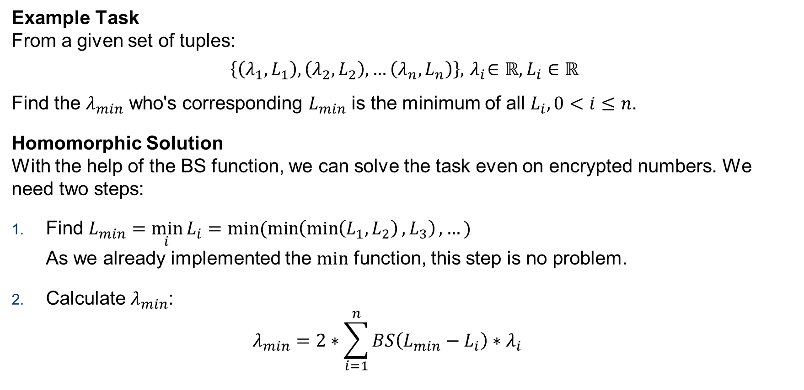
How can we use the Binary Step Function?
Example Task From a given set of tuples:
$$\left\{\left(λ_{1},L_{1}\right),\left(λ_{2},L_{2}\right),…\left(λ_{n}, L_{n}\right)\right\}, { λ}_{i}∈ℝ, L_{i}∈ℝ$$ Find the $λ_{min}$ who's corresponding $L_{min}$ is the minimum of all $L_{i}, 0<i≤n$.
Homomorphic Solution With the help of the BS function, we can solve the task even on encrypted numbers. We need two steps:
Find $L_{min}=\min_{i}{L_{i}}=min(\min\left(\min\left(L_{1},L_{2}\right),L_{3}\right),…)$ As we already implemented the $\text{min}$ function, this step is no problem.
Calculate $λ_{min}$: $λ_{min}=2∗\sum_{i=1}^{n}{BS\left(L_{min}−L_{i}\right)∗λ_{i}}$

Slide 8


The Binary Step Function
Scaling Factor As we saw already, the BS function becomes less accurate when approaching zero:
This is why we normally include a scaling factor to all calculations involving the BS function: $$λ_{min}=2∗\sum_{i=1}^{n}{BS\left({s(L}_{min}−L_{i})\right)∗λ_{i}}$$
However, we cannot get rid of error introduced by the BS function. This means, that small shares of the other lambdas “leak” into our solution.

Slide 9
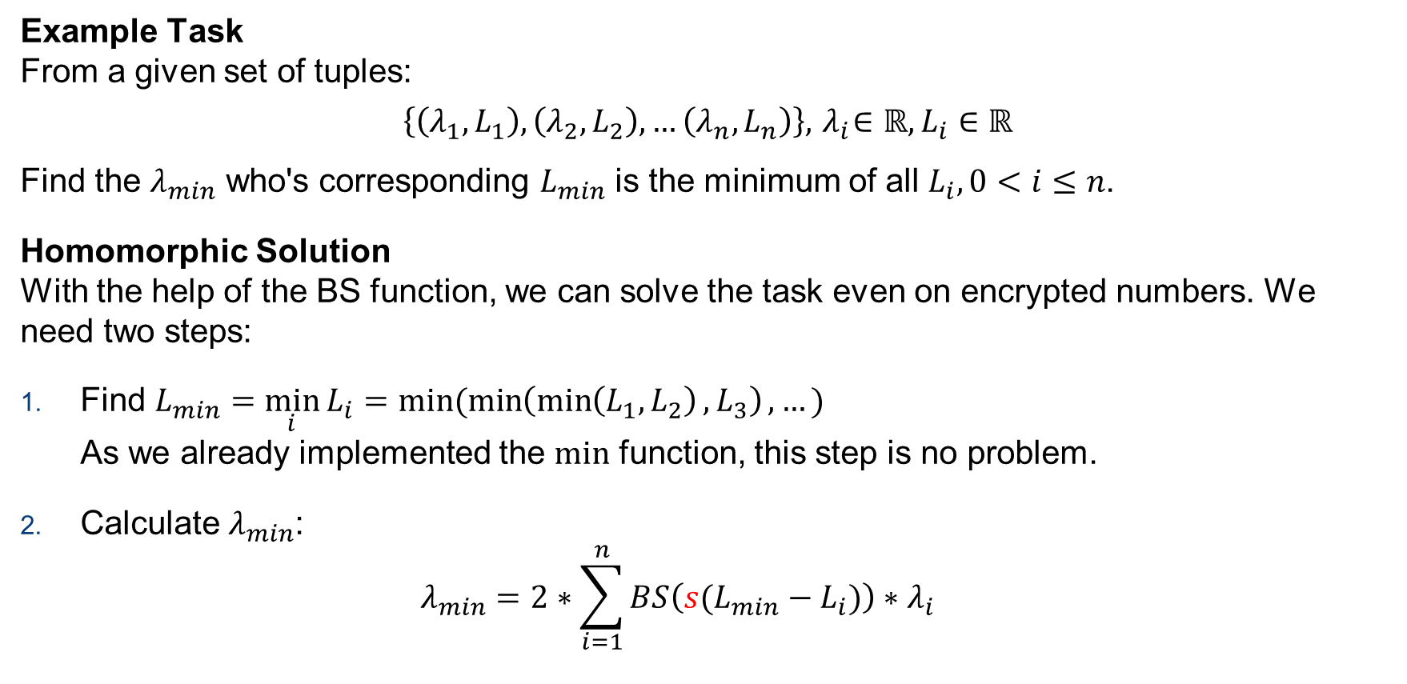
How can we use the Binary Step Function?
Example Task From a given set of tuples:
$$\left\{\left(λ_{1},L_{1}\right),\left(λ_{2},L_{2}\right),…\left(λ_{n}, L_{n}\right)\right\}, { λ}_{i}∈ℝ, L_{i}∈ℝ$$ Find the $λ_{min}$ who's corresponding $L_{min}$ is the minimum of all $L_{i}, 0<i≤n$.
Homomorphic Solution With the help of the BS function, we can solve the task even on encrypted numbers. We need two steps:
Find $L_{min}=\min_{i}{L_{i}}=min(\min\left(\min\left(L_{1},L_{2}\right),L_{3}\right),…)$ As we already implemented the $\text{min}$ function, this step is no problem.
Calculate $λ_{min}$: $λ_{min}=2∗\sum_{i=1}^{n}{BS\left({s(L}_{min}−L_{i})\right)∗λ_{i}}$
This is a very interesting solution! Can we generalise this to get a function that allows us to do arbitrary case differentiations?

Slide 10
Equals and Smaller than function

Slide 11

Equals Function
Goal We want to use the BS function to create a conditional assignment. In pseudo code it would look like this:
Solution
$$EQ\left(a,b,c,d\right)=c∗BS\left(a−b\right)∗BS\left(b−a\right)∗4+d∗{\left(BS\left(a−b\right)−BS\left(b−a\right)\right)}^{2}$$
Properties $$EQ\left(a,b,c,d\right)=\left\{\begin{aligned}c \text{if} a=b \\ d \text{if} a<b \\ d \text{if} a>b\end{aligned}\right.$$
def if_eq(a,b,c,d):
if a == b
return c
else
return d

Slide 12
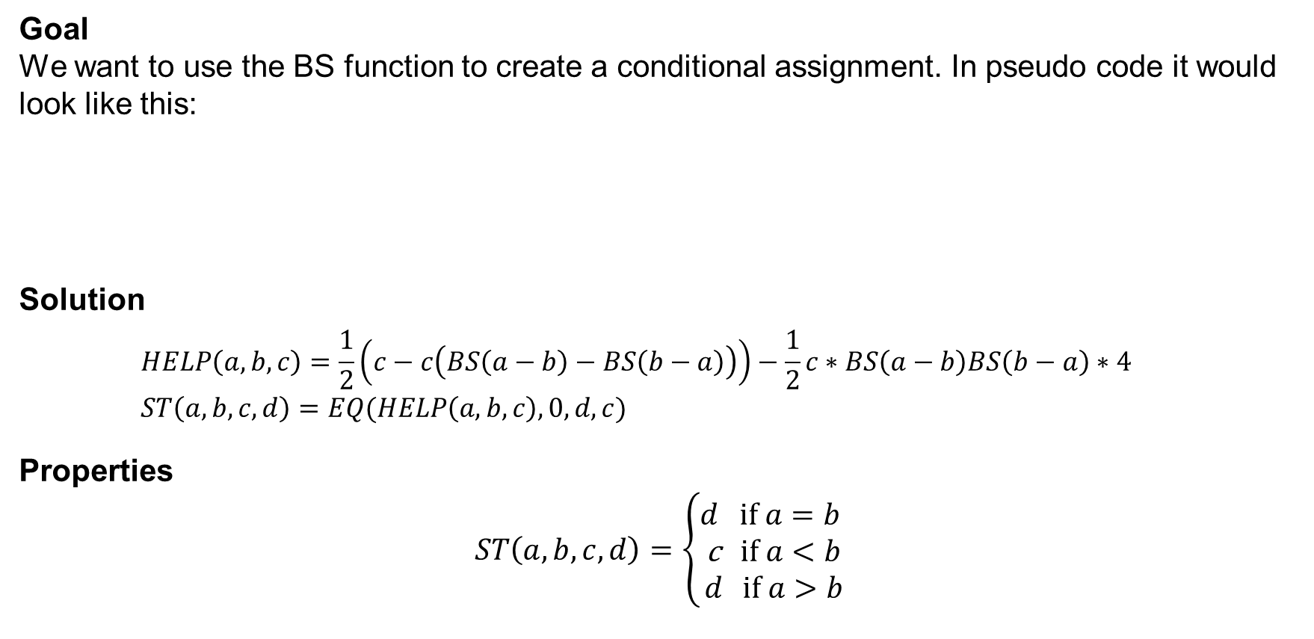
Smaller Than Function
Goal We want to use the BS function to create a conditional assignment. In pseudo code it would look like this:
Solution
$$HELP\left(a,b,c\right)=\frac{1}{2}\left(c−c\left(BS\left(a−b\right)−BS\left(b−a\right)\right)\right)−\frac{1}{2}c∗BS\left(a−b\right)BS\left(b−a\right)∗4 \\ ST\left(a,b,c,d\right)=EQ(HELP\left(a,b,c\right),0,d,c)$$
Properties $$ST\left(a,b,c,d\right)=\left\{\begin{aligned}d \text{if} a=b \\ \text{c} \text{if} a<b \\ d \text{if} a>b\end{aligned}\right.$$
def if_st(a,b,c,d):
if a < b
return c
else
return d

Slide 13
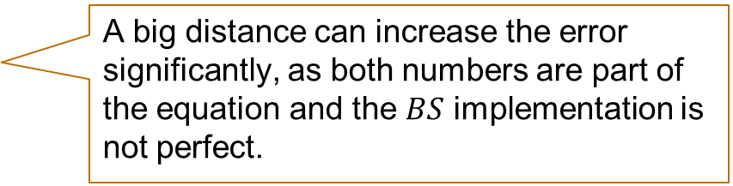
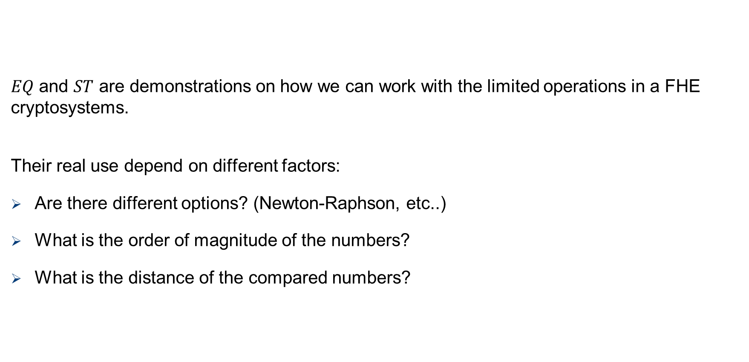
But: It’s more a theory
$EQ$ and $ST$ are demonstrations on how we can work with the limited operations in a FHE cryptosystems.
Their real use depend on different factors:
Are there different options? (Newton-Raphson, etc..)
What is the order of magnitude of the numbers?
What is the distance of the compared numbers?
A big distance can increase the error significantly, as both numbers are part of the equation and the $BS$ implementation is not perfect.

Slide 14


Conditional Branching
$EQ$ and $ST$ (and thus, abusing the BS function) enable more complex operations. In some way they resemble conditional branching, as they also allow to change the control flow based on conditions:
def example(bool, input):
if(bool == 0):
input = <operation1>
input = <operation2>
[…]
return input
else:
input = <operation3>
input = <operation4>
[…]
return input
Input: $b,i$
$$c_{1}=EQ\left(b,0,1,0\right)$$
$$c_{2}=EQ\left(b,0,0,1\right)$$
$$r=c_{1}∗\text{<}\text{operation}\text{1> + }c_{2}∗\text{<}\text{operation}\text{3}\text{>}$$
$$r=c_{1}∗\text{<}\text{operation}\text{2}\text{> + }c_{2}∗\text{<}\text{operation}\text{4}\text{>}$$
$$[…]$$

Slide 15
Summary – What did we learn today?
Binary Step Function The BS function is zero for negative values and one for positive values. It can be implemented homomorphically, but the error is significant.
Conditional Branching The BS function can be used to implement conditional branching. This allows the execution of operations based on a condition.

