Slide 1
THE RAF In WW2
Aaron Waidmann

Slide 2

Overview
Introduction
Battle of Britain
Types of planes
Operation sealion

Slide 3
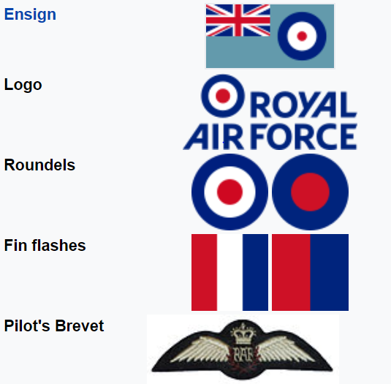
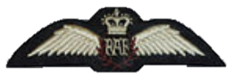
Introduction
Founded in 1918
Oldest independent air force
Developed strategic bombing

Slide 4
The battle of Britain
Massive power differences
German propaganda
1960 vs 2550 aircrafts
Hitler did not want to destroy Great Britain
Churchill put all power into the RAF

Slide 5
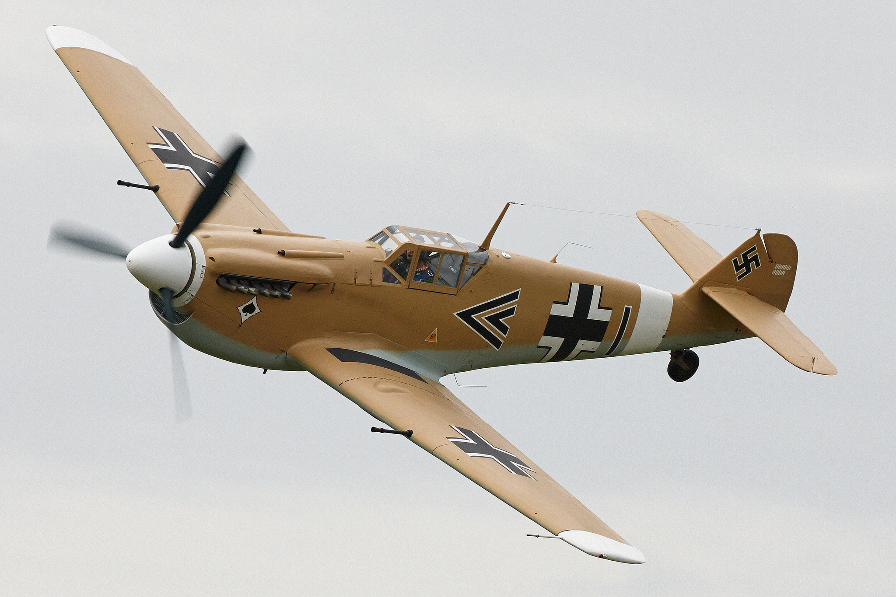
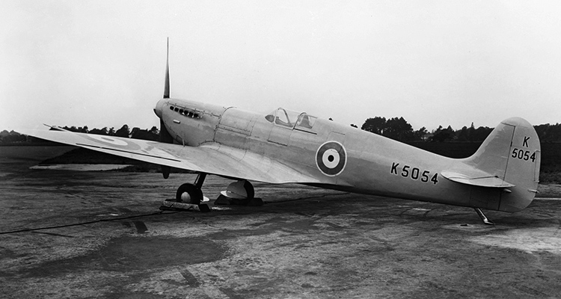
Fighter
Spitfire II
Messerschmitt 109
Wing span 10m
Guns 8 x 7.7mm
Built 20300
Wing span 10m
Guns 2 x 13mm
Built 34000

Slide 6
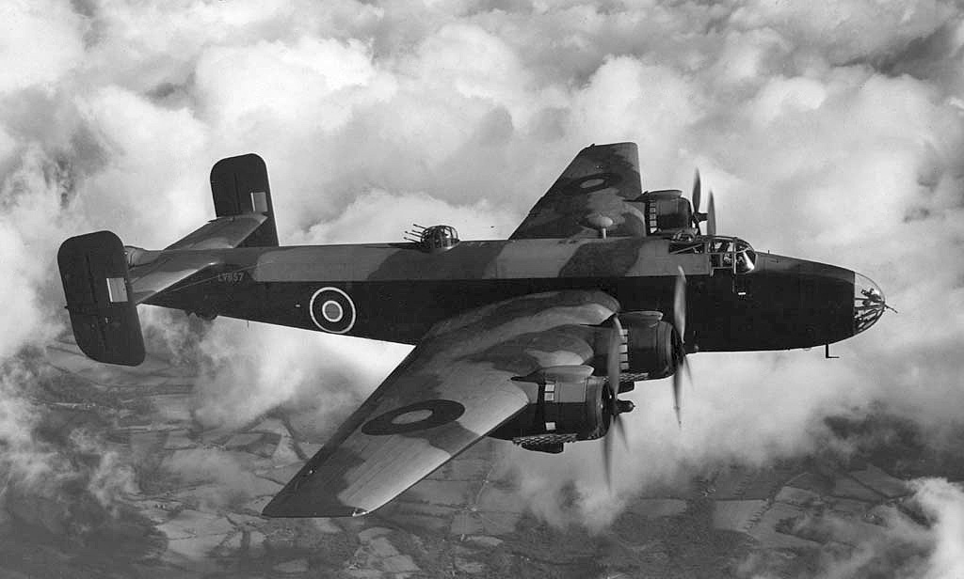
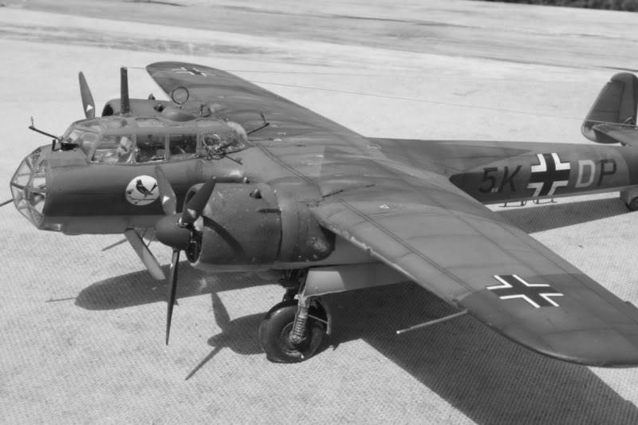
Bomber
Halifax
Dornier 17
„Fliegender Bleistift“
Wing span 31m
Carry-weight – 6000kg
Built 6200
Wing span 18m
Carry-weight 500 – 1000kg
Built 2139

Slide 7
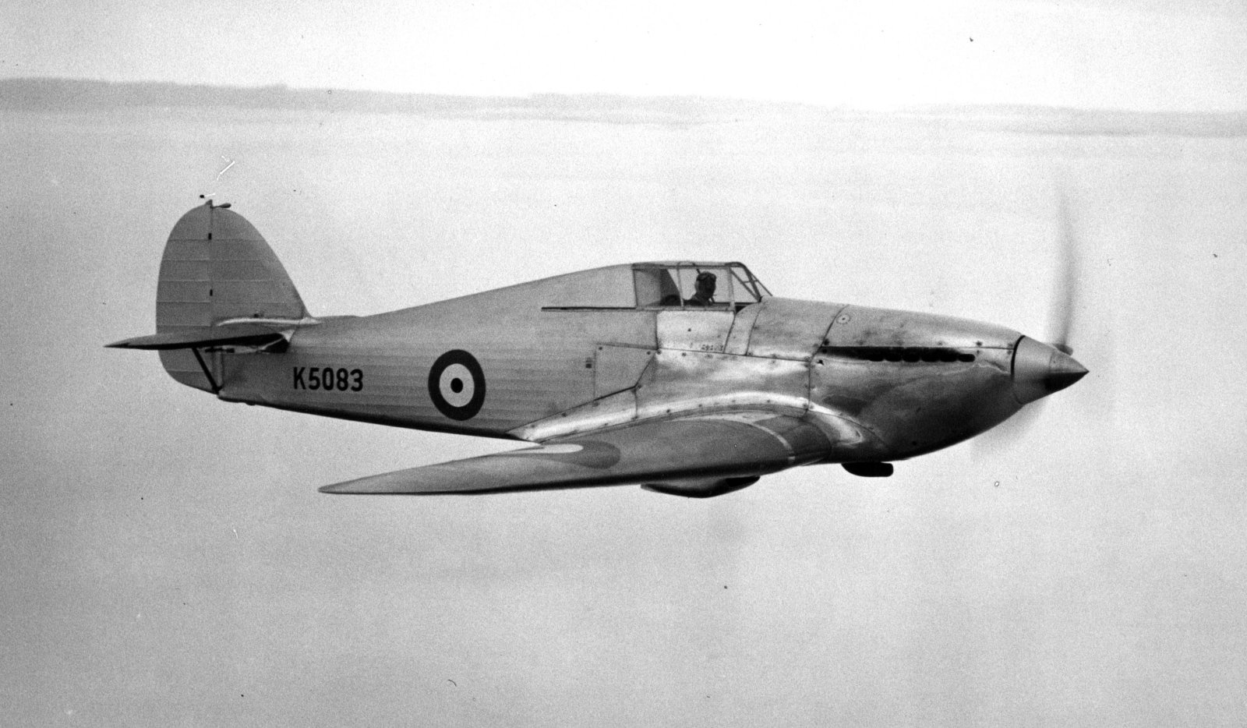
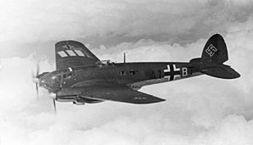
Attack
Hawker Hurricane
Heinkel He 111
Wing span 12m
Guns 4 x 20mm
Built 14500
Wing span 22m
Guns - 7 x 7.92mm
Built 6500

Slide 8
Operation Sealion

