Slide 1





Schulich Ignite 2020

Slide 2
Session Overview
Useful topics for games
Projectiles & Gravity
Collisions
Time to work on your own games!

Slide 3
Projectiles

Slide 4
What are projectiles?
Projectiles are just any object that can be “thrown” or “shot” and have some type of gravity - such as balls or bullets in video games!
Notes:
x = 300
y = 500
x_pos = []
y_pos = []
x_speed = []
y_speed = []
def setup():
size(600, 600)
def draw():
global x, y, x_pos, y_pos, x_speed, y_speed
background(240, 240, 240)
if keyPressed:
if key == ' ':
x_pos.append(x)
y_pos.append(y - 25)
x_speed.append(0)
y_speed.append(-10)
elif key == 'a':
x -= 10
elif key == 'd':
x += 10
fill(20, 200, 200)
triangle(x - 20, y + 10, x, y - 10, x + 20, y + 10)
for i in range(len(x_pos)):
fill(255, 20, 20)
circle(x_pos[i], y_pos[i], 25)
x_pos[i] += x_speed[i]
y_pos[i] += y_speed[i]

Slide 5
Simple projectiles
First, let’s look at a simple version - projectiles with no gravity, just some speed.
x_pos = [] y_pos = [] y_speed = -8
def draw(): global x_pos, y_pos, y_speed for i in range(len(x_pos)): fill(255, 20, 20) circle(x_pos[i], y_pos[i], 25) y_pos[i] += y_speed

Slide 6
Projectiles with gravity
For projectiles to have “gravity”, we just need to give them a speed for both the x and y directions, and make the y_speed increase over time.
This makes it so as times goes on, it’ll start falling faster and faster.

Slide 7
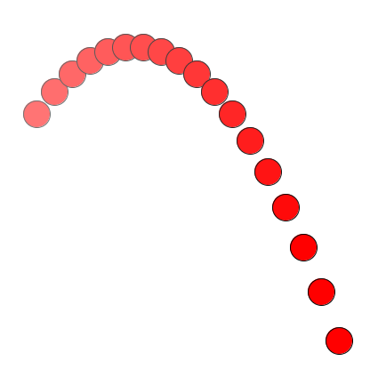
Projectiles with gravity
x = 100 y = 200 x_speed = 3 y_speed = -3
def draw():
global x, y, x_speed, y_speed
background(255, 255, 255)
x += x_speed y += y_speed y_speed += 1
circle(x, y, 30)
As time goes on, the ball starts to fall faster and faster

Slide 8
Exercise 1: Throwing a ball
When you click, add a ball at the mouse position.
This ball should be “thrown” upwards and to the right, and then it should fall down due to gravity.
Hint: What should the speed start out as for the ball to initially move upward? What should you add to it for it to go downward after?
Notes:
x_pos = []
y_pos = []
x_speed = []
y_speed = []
def setup():
size(600, 600)
def draw():
global x_pos, y_pos, x_speed, y_speed
background(240, 240, 240)
if mousePressed:
x_pos.append(mouseX)
y_pos.append(mouseY)
x_speed.append(10)
y_speed.append(-40)
for i in range(len(x_pos)):
fill(255, 20, 20)
circle(x_pos[i], y_pos[i], 25)
x_pos[i] += x_speed[i]
y_pos[i] += y_speed[i]
y_speed[i] += 2.5

Slide 9
Collisions

Slide 10
What are collisions?
Essentially, a “collision” is just a fancy word for when an object hits another and stops moving or bounces off.

Slide 11
How do they work?
They work almost the same way as what we’ve been doing to make balls bounce of the edges of the screen - except with a few more if statements!
Every time we move our object, we need to check if it’s “overlaps” anything else. If it does, either change direction and stop it. If not, just keep going!

Slide 12
Overlapping
Before we start, let’s make a function to check if two lines are overlapping in one direction.
# Check if there is overlap between two lines # (each with a starting point and length)
def overlap(point_1, len_1, point_2, len_2):
if point_1 + len_1 >= point_2 and point_1 <= point_2 + len_2:
return True # Overlap!
else:
return False # No overlap
Overlap
len_1
point_1
len_2
point_2

Slide 13
Square colliding with a rectangle
First, using the overlap function we made earlier, we check if the square is overlapping the rectangle in the x direction.
# Our square overlaps the rect in the X direction
overlap_x = overlap(x, square_size, rect_x, rect_width):
(x, y)

Slide 14
Square colliding with a rectangle
Next, we check if the square is overlapping the rectangle in the y direction.
# Our square overlaps the rect in the Y direction
overlap_y = overlap(y, square_size, rect_y, rect_height):
(x, y)

Slide 15
Square colliding with a rectangle
Now, if BOTH of those things are true, that means our square hit our rectangle!
# Our square overlaps the rect in the X direction overlap_x = overlap(x, square_size, rect_x, rect_width)
# Our square overlaps the rect in the Y direction
overlap_y = overlap(y, square_size, rect_y, rect_height)
if overlap_x and overlap_y:
# Stop rectangle from going any further
else:
# Keep moving rectangle
(x, y)

Slide 16
Exercise 2: Bouncing square
Make a square that bounces moves downwards and bounces off the screen edges.
Use what we learned before to make it also bounce off the blue rectangle!

