Slide 1





Schulich Ignite 2020

Slide 2
Session Overview
For in range
While loops
Getting inputs
Examples - Lots of Practice!

Slide 3
Loops continued
Notes:
You guys already have been using loops, Draw is in fact a loop. It’s something that runs over and over and over again, which sounds a lot like draw. But sometimes we need our own loop for our own purposes.

Slide 4
What Is Range?
Range is a list of numbers from 0 to 1 less than the number you give it
range(9) # [0, 1, 2, 3, 4, 5, 6, 7, 8] Not 9!
x = 6
range(x) # [0, 1, 2, 3, 4, 5] Not 6!

Slide 5
Using range with loops
Range is very convenient if we want to repeat code, but we don’t need to use any variables from a list.
For example, if we wanted to just print “Hi!” 6 times, we could write
for i in range(6): print(“Hi!”)

Slide 6
Using range with loops and multiple lists
Another great place for range is if we need to use multiple lists. What if we wanted to draw many circles, and each has a different size? How do we use both lists?
balls = [100, 200, 300, 400] sizes = [20, 30, 40, 20]
# We use a range of 4 since we have a list of 4 balls for i in range(4): circle(balls[i], 100, sizes[i])

Slide 7
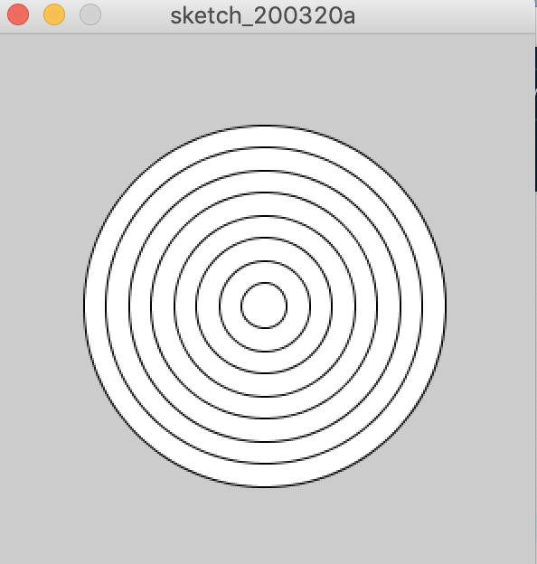
How do we use it?
Remember the dartboard example from last time?
How could you colour it?

Slide 8
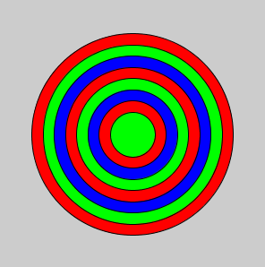
Why Is It Useful?
r = color(255, 0, 0)
g = color(0, 255, 0)
b = color(0, 0, 255)
sizes = [225, 200, 175, 150, 125, 100, 75, 50]
colors = [ r, g, b, r, g, b, r, g]
for i in range(8):
fill(colors[i])
circle(150, 150, sizes[i])

Slide 9
While loops
Another kind of loop is while loop while condition == True:
# Do something here
A while loop works kind of like a repeating if statement
As long as the boolean expression is True, the code inside will be repeated!
Notes:
Here is the form of a while loop. You guys are familiar to when we should stop the loop. While a condition is true than we do something.
Again we have curly brackets in between to tell it what we want it to do.

Slide 10
How do we use them?
For example, if we wanted to make a simple loop that counts to 10
i = 1 while i != 10: print(i) i += 1
This loop will run as long as i is not equal to 10.
Notes:
Consider this problem! We must ask ourselves, at what point do we stop looping?

Slide 11
How do we use them?
In this example, what would happen if we removed the line that said: i += 1?
i = 1 while i != 10: print(i) # i += 1 <- Remove this line! What does our loop do now? Does it do what we would expect? Challenge: Instead of removing i += 1, what if it was changed somehow? (Why would i < 10 be better than i != 10?)
Notes:
Consider this problem! We must ask ourselves, at what point do we stop looping?
If we remove i += 1, then i will never change. Since i equals 1, i != 10 is always true!
This is what we call an “infinite loop” (and usually they’re bad things)
Challenge answer: Instead of having i += 1, if we chose i += 2, i would equal:
1, 3, 5, 7, 9, 11, 13, 15, 17…
Notice that i != 10 is always true again, and we have another infinite loop!
Using i < 10 can safeguard us from this.

Slide 12
How are while loops useful?
Like for loops, while loops are a great for repeating code and using multiple lists! Let’s use them to draw a few circles with different positions and sizes again!
i = 0 positions = [100, 200, 300, 400] sizes = [10, 20, 30, 40]
# Remember, since lists start at index 0, we need our loop # to go from i = 0, all the way up to i = 3 while i < 4: circle(positions[i], 100, sizes[i]) i += 1
Notes:
Consider this problem! We must ask ourselves, at what point do we stop looping?

Slide 13
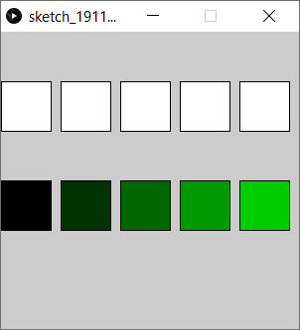
Exercise 1:Fancy Squares
Use a while loop to display 5 evenly spaced squares (Hint: the x position will depend on the loop counter)
Add another while loop to make squares with colours! (Hint: the red/green/blue will depend on the loop counter)

Slide 14
A More Complex Screensaver Example
for i in range(4): if x[i] >= 975 or x[i] <= 25: xvel *= -1 if y[i] >= 975 or y[i] <= 25: yvel *= -1 x[i] += xvel y[i] += yvel ellipse(x[i], y[i], 50, 50)
Notes:
import random
x = [0, 0, 0, 0]
y = [0, 0, 0, 0]
xvel = 5
yvel = 5
def setup():
global x, y
size(1000, 1000)
for i in range(4):
x[i] = random.randint(0, 900)+50
y[i] = random.randint(0, 900)+50
def draw():
global x, y, xvel, yvel
background(0)
for i in range(4):
if (x[i]>=975 or x[i]<=25):
xvel*=-1
if (y[i]>=975 or y[i]<=25):
yvel*=-1
x[i]+=xvel
y[i]+=yvel
ellipse(x[i], y[i], 50, 50)

Slide 15
Inputs

Slide 16
Status Values
mousePressed - A boolean value that is True when a mouse button is pressed
keyPressed - A boolean value that is True when any key is pressed on the keyboard

Slide 17
mousePressed Example
if mousePressed: # These are all global Variables r += 3 g += 10 b += 25 fill(r, g, b) circle(500, 500, 500)
Notes:
r = 25
g = 5
b = 0
def setup():
size(1000, 1000)
def draw():
background(255)
global r, g, b
if mousePressed:
r += 3
g += 10
b += 25
fill(r, g, b)
circle(500, 500, 500)

Slide 18
mouseButton
mouseButton checks for left click or right click. This example changes colour depending on which button you choose
if mousePressed and mouseButton == LEFT: fill(0, 255, 0) elif mousePressed and mouseButton == RIGHT: fill(255, 0, 0) circle(mouseX, mouseY, 50)

Slide 19
keyPressed Example
# draw_circle and draw_square are global if keyPressed and not draw_circle: draw_circle = True draw_square = False elif keyPressed and not draw_square: draw_circle = False draw_square = True if draw_circle: circle(500, 500, 500) if draw_square: square(250, 250, 500)
Notes:
draw_circle = True
draw_square = False
def setup():
size(1000, 1000)
def draw():
background(255)
fill(0)
global draw_circle, draw_square
if keyPressed and not draw_circle:
draw_circle = True
draw_square = False
elif keyPressed and not draw_square:
draw_circle = False
draw_square = True
if draw_circle:
circle(500, 500, 500)
if draw_square:
square(250, 250, 500)

Slide 20
Key
key - A string that represents which letter or number has been pressed (arrow keys, shift and others have a different variable)
So if you press the ‘a’ key on your keyboard then:
key == “a”

Slide 21
key example
textSize(32) textAlign(CENTER)
if key != " ": # Not Spacebar text(key, 500, 500)
else: text("<space>", 500, 500)
Notes:
def setup():
size(1000, 1000)
def draw():
background(0)
textSize(32)
textAlign(CENTER)
if key != " ":
text(key, 500, 500)
else:
text("<space>", 500, 500)

Slide 22
CODED and Key Codes
CODED - A value that key is set to when the key that is pressed is not a letter or number (i.e. arrow keys, shift etc.)
keyCode - can be used to check keys that are not numbers or letters (you should always check if key == CODED before checking keyCode’s)
For example if you press the up arrow then: key == CODED and keyCode == UP

Slide 23
CODED and Key Codes example
if keyPressed: if key == CODED: if keyCode == UP: # Remember y starts at 0 y -= 5 if keyCode == DOWN: y += 5 if keyCode == LEFT: x -= 5 if keyCode == RIGHT: x += 5 circle(x, y, 100)
Notes:
x = 500
y = 500
def setup():
size(1000, 1000)
def draw():
global x, y
background(0)
if keyPressed:
if key == CODED:
if keyCode == UP: # Remember y starts at 0
y -= 5
if keyCode == DOWN:
y += 5
if keyCode == LEFT:
x -= 5
if keyCode == RIGHT:
x += 5
circle(x, y, 100)

Slide 24
Exercise 2:Swarm the mouse!
When the mouse is pressed, make all the balls follow the mouse.
You’ll be grouped with other students and a mentor to pair program this activity!
Answers will be shared on Google Drive later
Notes:
balls_x = []
balls_y = []
balls_color = []
balls_speed_x = []
balls_speed_y = []
def setup():
size(500, 500)
global balls_x, balls_y, balls_color, balls_speed_x, balls_speed_y
# Create 10 random balls
for i in range(10):
# Add random coordinate
balls_x.append(random(width))
balls_y.append(random(height))
# Add random color
c = color(random(255), random(255), random(255))
balls_color.append(c)
# Add speeds (just zero to start)
balls_speed_x.append(0)
balls_speed_y.append(0)
def draw():
background(0)
global balls_x, balls_y, balls_color, balls_speed_x, balls_speed_y
# Draw the balls and make them follow the mouse when the mouse is pressed
for i in range(len(balls_x)):
fill(balls_color[i]) # You can either do fill(r, g, b) or fill( color(r, g, b) ). We're doing the second one here
circle(balls_x[i], balls_y[i], 30)
# Move the balls by their respective speed
balls_x[i] += balls_speed_x[i]
balls_y[i] += balls_speed_y[i]
# Slow down over time
balls_speed_x[i] *= 0.99
balls_speed_y[i] *= 0.99
if mousePressed:
# dist(x1, y1, x2, y2) is a shortcut for the Pythagorean Theorem for Processing
distance = dist(balls_x[i], balls_y[i], mouseX, mouseY)
dist_x = mouseX - balls_x[i]
dist_y = mouseY - balls_y[i]
# Some math here:
# (If you want to skip the math, just make force_x = dist_x and force_y = dist_y)
# We want the ratio of dist_x / dist and dist_y / dist to point the ball in the right direction
# We also want to invert the ratio and scale it - things closer should have more force to it!
force = 1 / distance
force_x = 0.2 * dist_x * force
force_y = 0.2 * dist_y * force
balls_speed_x[i] += force_x
balls_speed_y[i] += force_y

