Slide 1
Hamiltonian Circuit and The Icosian Game
Made By:-
Harsimranjeet Saini Avinal Kumar Pooja Nehra
185087 185067 185101

Slide 2
Hamiltonian Circuits
A Hamiltonian circuit is a path that use each vertex of a graph exactly once and returns to the starting vertex. A graph that contains a Hamiltonian circuit is called Hamiltonian graph.
Hamiltonian paths and cycles are named after William Rowan Hamilton who invented the Icosian game, now also known as Hamilton's puzzle, which involves finding a Hamiltonian cycle in the edge graph of the dodecahedron. Hamilton solved this problem using the Icosian calculus,

Slide 3
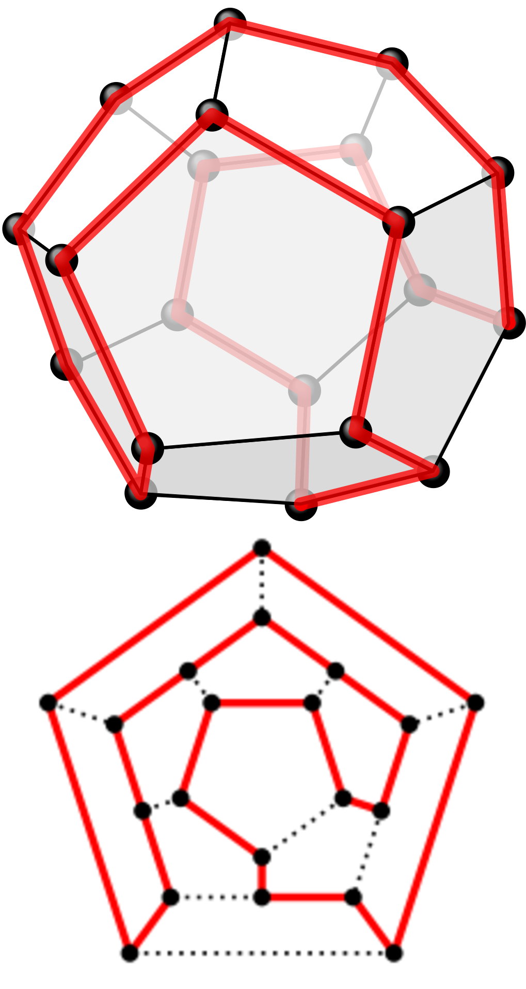
Icosian Game
The Icosian game is a mathematical game invented in 1857 by William Rowan Hamilton. The game's objective is finding a Hamiltonian cycle along the edges of a dodecahedron such that every vertex is visited a single time, and the ending point is the same as the starting point. The puzzle was distributed commercially as a pegboard with holes at the nodes of the dodecahedral graph and was subsequently marketed in Europe in many forms.
The motivation for Hamilton was the problem of symmetries of an icosahedron, for which he invented Icosian calculus—an algebraic tool to compute the symmetries. The solution of the puzzle is a cycle containing twenty (in ancient Greek icosa) edges (i.e. a Hamiltonian circuit on the dodecahedron).

Slide 4
Objective & Rules of Game
The game’s objective is finding a Hamiltonian Cycle following these Rules:-
Hamiltonian cycle must be along the edges of a dodecahedron such that every vertex is visited a single time
No edge is visited twice
Ending point is the same as the starting point

Slide 5
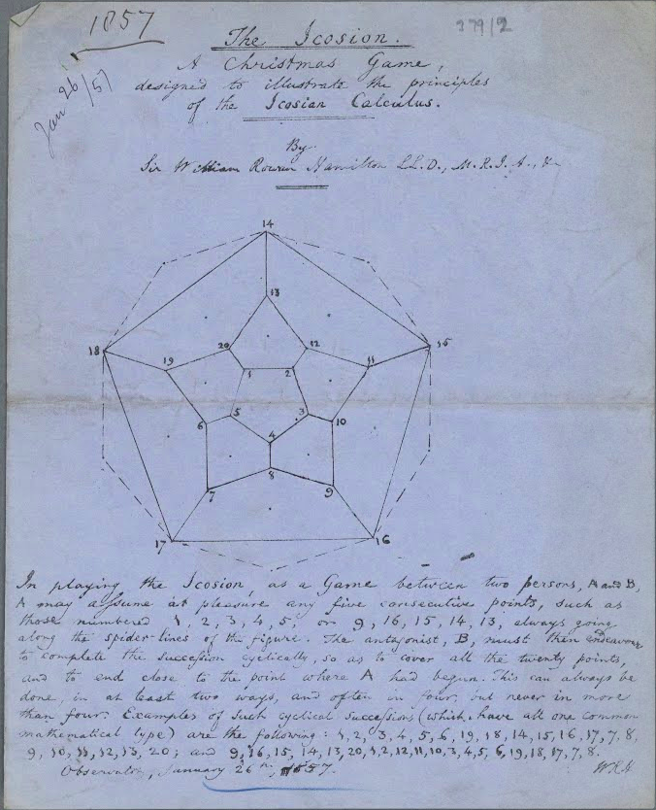
The original paper of Icosian game By William Rowan Hamilton,1857

Slide 6
Thank you

