Slide 1
Analyzing the Brain Development scRNA-seq Data between Mouse and Human
By 생명공학부 신인수

Slide 2
Table of Contents
Understanding Seurat
Paper 1
Paper 2
Reproducing Previous Studies
Human Study 1
Human Study 2

Slide 3
GitHub Repository
https://github.com/Deserav/mouse-human-develop

Slide 4
Understanding Seurat

Slide 5
Paper 1
Stuart, T., Butler, A., Hoffman, P., Hafemeister, C., Papalexi, E., Mauck III, W. M., ... & Satija, R. (2019). Comprehensive integration of single-cell data. Cell, 177(7), 1888-1902.
Release of Seurat v3
Shows mechanism and usage of various functions implemented in Seurat v3

Slide 6
Normalization
NormalizeData: multiply scale factor 10,000 per cell and natural log
ScaleData: Calculate z score for all cells (columns of expression matrix)

Slide 7

Feature Selection
FindVariableFeatures
R loess package: span = 0.3,
Second degree polynomial
Cell 1
Cell 2
Cell 3
X | Y
log₁₀x̅₁ | log₁₀σ₁
log₁₀x̅₂ | log₁₀σ₂
log₁₀x̅₃ | log₁₀σ₃
Gene 1
x̅₁ | σ₁
x̅₂ | σ₂
x̅₃ | σ₃
Gene 2
σ_{i} = expected variance
x̅ = calculated mean
Maximum of z_{ij} → √N (outliers)
Calculate variance of all z_{ij} per gene
Return the highest 2,000
selection.method = “vst”
Gene 3
.
.
.
.
.
.
.
.
.
Gene n
x̅_{n} | σ_{n}
log₁₀x̅_{n} | log₁₀σ_{n}

Slide 8
Paper 2
Hafemeister, C., Satija, R. Normalization and variance stabilization of single-cell RNA-seq data using regularized negative binomial regression. Genome Biol 20, 296 (2019).
Why VST (variance stabilizing transformation) is performed

Slide 9
Premise
scRNA-seq has many factors that cause technical errors: cell lysis, reverse transcription efficiency, molecular catching
Without normalization, UMI count and sequencing depth is correlated.
We want to know “differential expression” among cells.
Variance of gene expression should reflect biological traits and not sequencing depth.

Slide 10
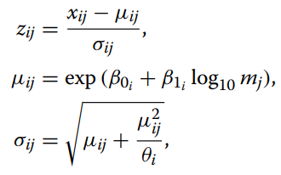
Method
Cell 1
Cell j
Cell k
Generalized Linear Model by Negative Binomial
Gene 1
Gene 2
Gene 3
Calculate for all genes
Kernel regression to find out relationship between β₀, β₁, θ → shows global relationship
Calculate Pearson residuals (z_{ij})
.
.
.
.
.
.
.
.
.
Gene i
→ x_{i}
.
.
.
.
.
.
.
.
.
Gene n
m₁
m_{j}
m_{k}
→ m

Slide 11
Results
Simply using the negative binomial model causes overfitting → VST alleviates this by regularizing parameters.
Better method than ‘scale factor’ based normalization methods: log-normalization, relative counts

Slide 12
Reproducing Previous Studies

Slide 13
Human Study 1
Darmanis, S., Sloan, S. A., Zhang, Y., Enge, M., Caneda, C., Shuer, L. M., ... & Quake, S. R. (2015). A survey of human brain transcriptome diversity at the single cell level. Proceedings of the National Academy of Sciences, 112(23), 7285-7290
GSE67835
4 embryonic samples and 8 adult samples of anterior temporal lobe
482 cells → Final data has 466 → Seurat not used

Slide 14
Anticipated Workflow
for loop to combine all .txt files
Load Data:
466 cells
Delete last three rows: no_feature, ambiguous, alignment_not_unique
Transform Data:
log(CPM + 1)
ViSNE
(Rtsne package)
BIC
(mclust package)
Plotting

Slide 15
ViSNE
Amir, E. A. D., Davis, K. L., Tadmor, M. D., Simonds, E. F., Levine, J. H., Bendall, S. C., ... & Pe'er, D. (2013). viSNE enables visualization of high dimensional single-cell data and reveals phenotypic heterogeneity of leukemia. Nature biotechnology, 31(6), 545-552.
http://www.c2b2.columbia. edu/danapeerlab/html/cyt.html
https://dpeerlab.github.io/dpeerlab-website/cyt-download.html MATLAB based Cyt
Cytobank API

Slide 16
Not implemented in tsne package as mentioned in paper
Does not use PCA in prior (unlike tSNE)
https://github.com/lmweber/Rtsne-example/blob/master/Rtsne_viSNE_example_Marrow1.R
Transform count matrix by: arcsin(x/5)
Then run tSNE from Rtsne package
Set dims to 2 or 3

Slide 17
BIC(Bayesian Information Criteria)
mclust package
https://cran.r-project.org/web/packages/mclust/vignettes/mclust.html
mclustBIC function fits data to 12 models
The researchers found 10 clusters right away (how?)
10 PC are chosen
Mclust function to find clusters: 10 PCs are used

Slide 18
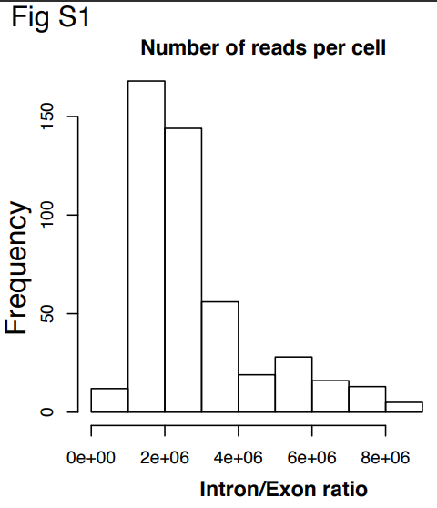
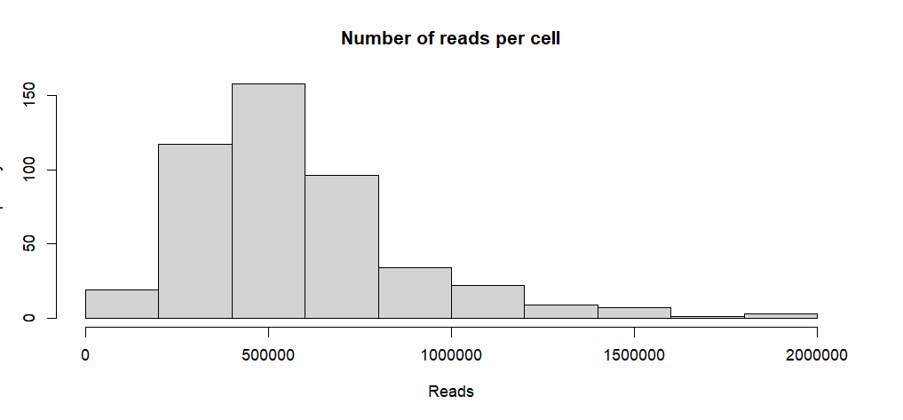
Plotting: Number of reads per cell

Slide 19
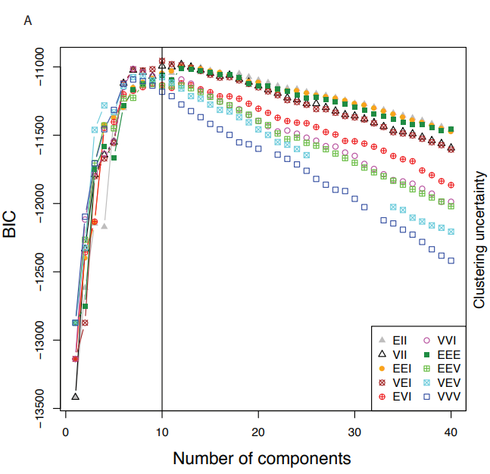
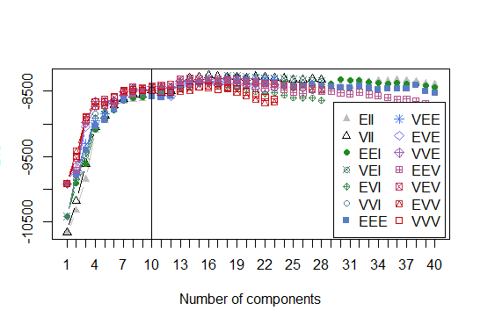
BIC
10 Clusters
12 Clusters

Slide 20
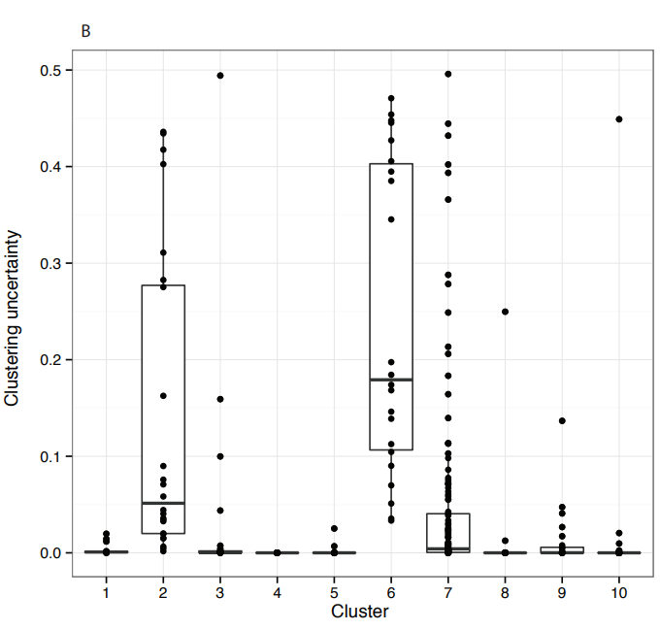
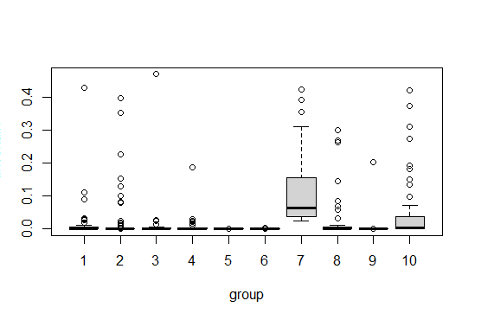
Clustering Uncertainty
10 Clusters
10 Clusters

Slide 21
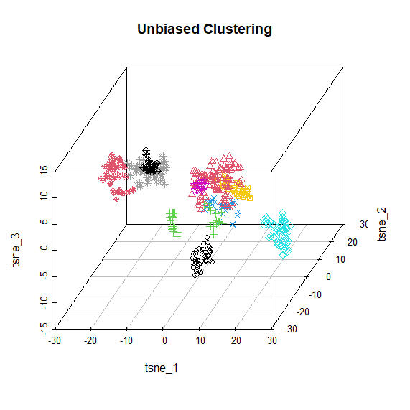
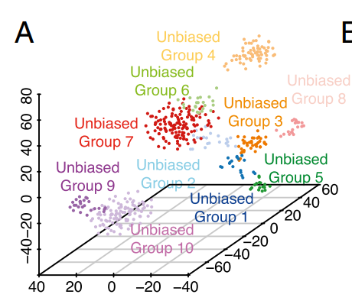
10 Clusters
10 Clusters

Slide 22
Limitations
Too little cells – only 466.
Any sort of filtering cannot be done.
Little explanation on how data is analyzed.

Slide 23
Human Study 2
Zhong, S., Zhang, S., Fan, X., Wu, Q., Yan, L., Dong, J., ... & Wang, X. (2018). A single-cell RNA-seq survey of the developmental landscape of the human prefrontal cortex. Nature, 555(7697), 524-528.
GSE104276
GW8, GW9, GW10, GW12, GW13, GW16, GW19, GW23 and GW26 samples: prefrontal cortex
2,394 cells → 2,309 cells after filtering
Data given by TPM
Seurat, Monocle2, Monocle3

Slide 24
Anticipated Workflow
for loop to make Seurat objects per sample
Merge all samples
Normalize data:
log((TPM/10)+1)
Filtering
Gene : at least 3 cells
Cell : > normalized 1
Remove hemoglobin cells
Plot by Seurat
Monocle 2
Trajectory and pseudotime analysis

Slide 25
Seurat Standard Workflow
pbmc <- CreateSeuratObject(counts = pbmc.counts)
pbmc <- NormalizeData(object = pbmc) → scale.factor = 100000
pbmc <- FindVariableFeatures(object = pbmc)
pbmc <- ScaleData(object = pbmc)
pbmc <- RunPCA(object = pbmc)
pbmc <- FindNeighbors(object = pbmc)
pbmc <- FindClusters(object = pbmc)
pbmc <- RunTSNE(object = pbmc)
DimPlot(object = pbmc, reduction = "tsne")

Slide 26
Filtering
 | Initial | Gene : at least 3 cells Cell : > normalized 1 | Delete hemoglobin genes
Original | 2,394 cells 24,153 genes | 2,333 cells 17,854 genes | 2,309 cells 17,854 genes
Reproduce | 2,394 cells 24,153 genes | 2,344 cells 17,962 genes | 2,328 cells 17,962 genes

Slide 27
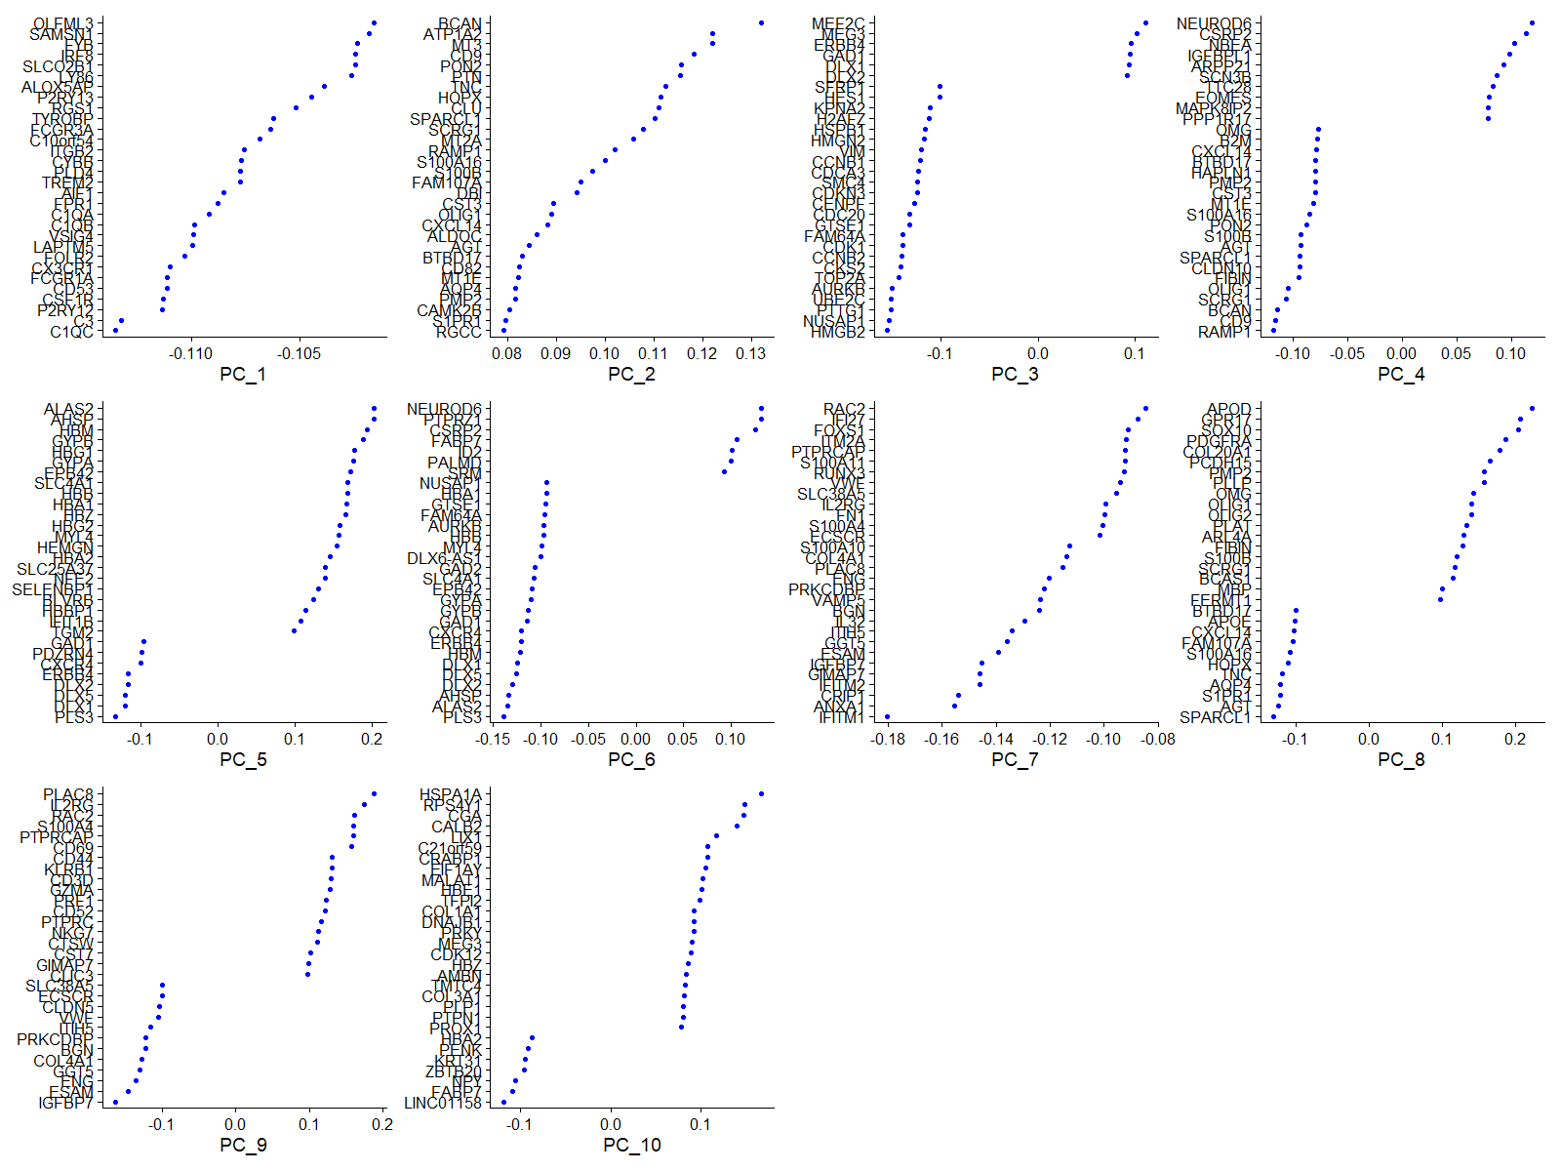
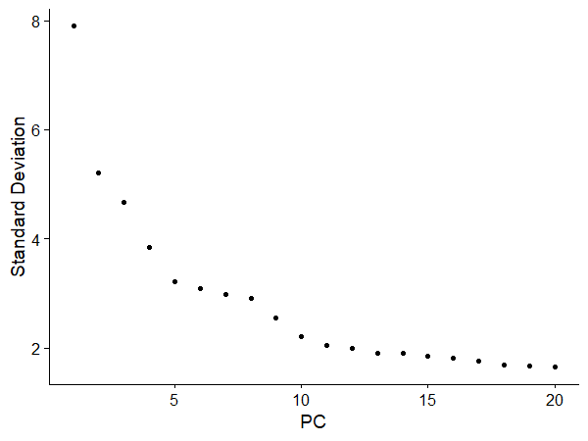
Plotting : Initial clustering

Slide 28
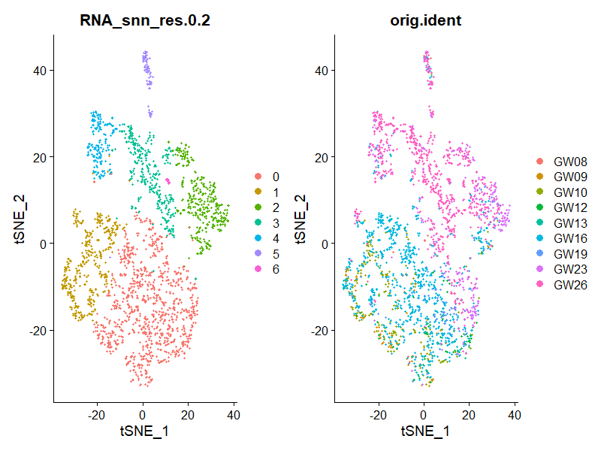
Plotting : Initial clustering
Remove

Slide 29
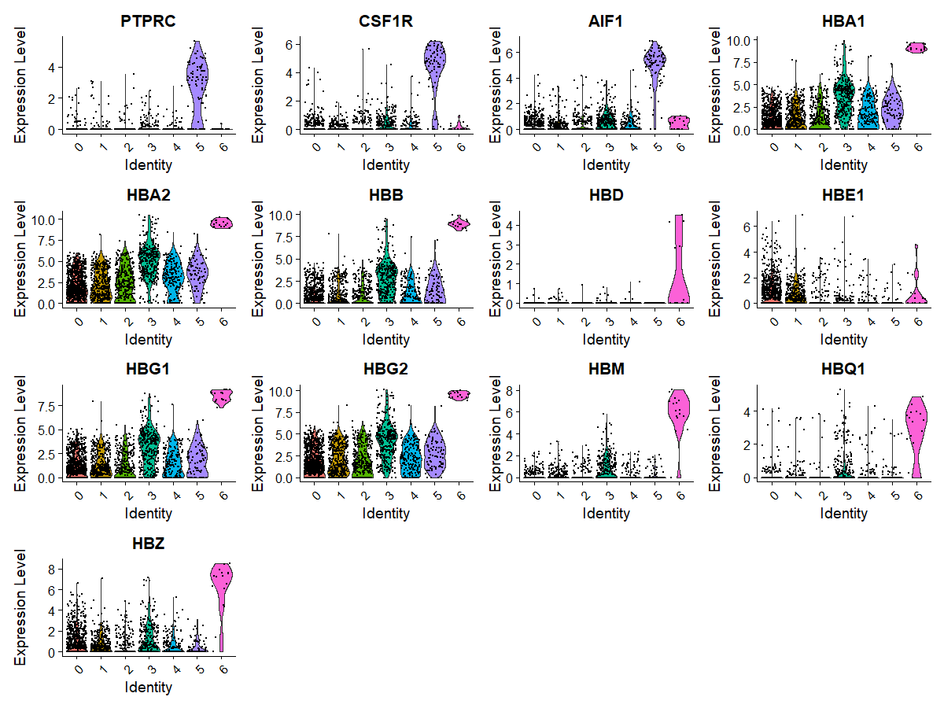

Slide 30
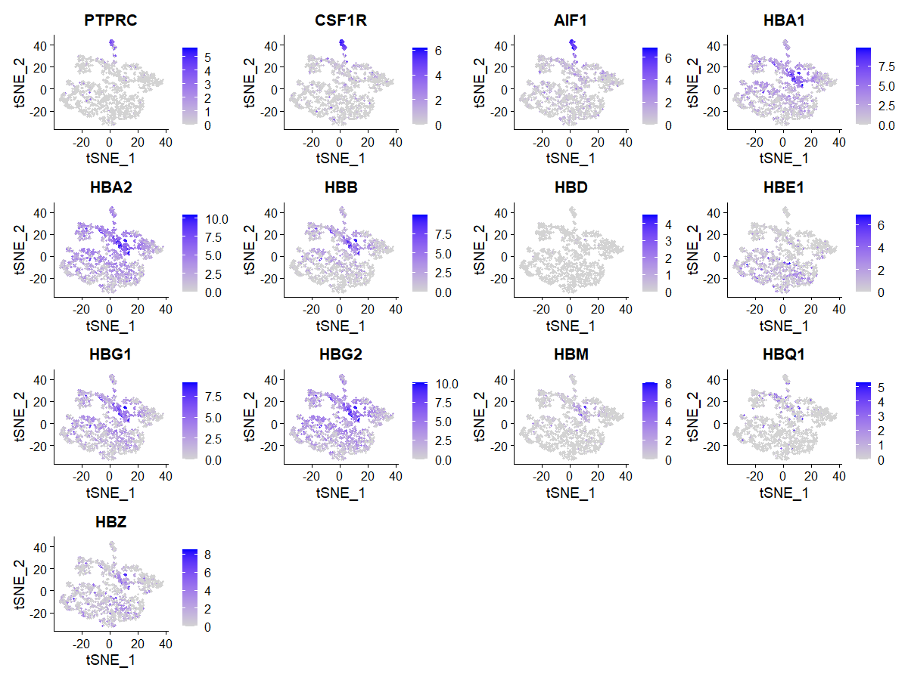

Slide 31
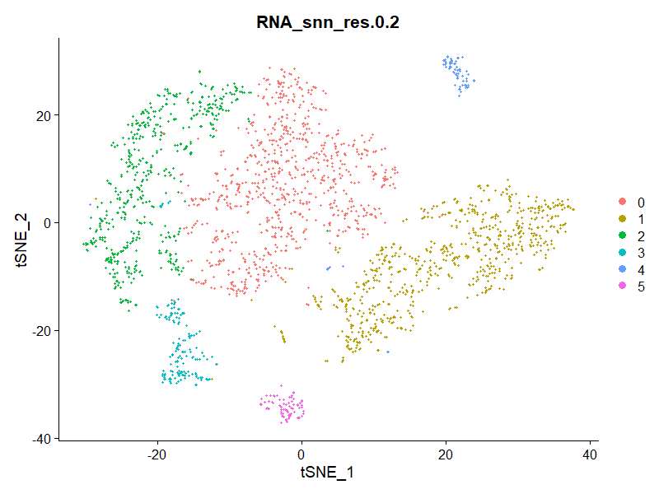
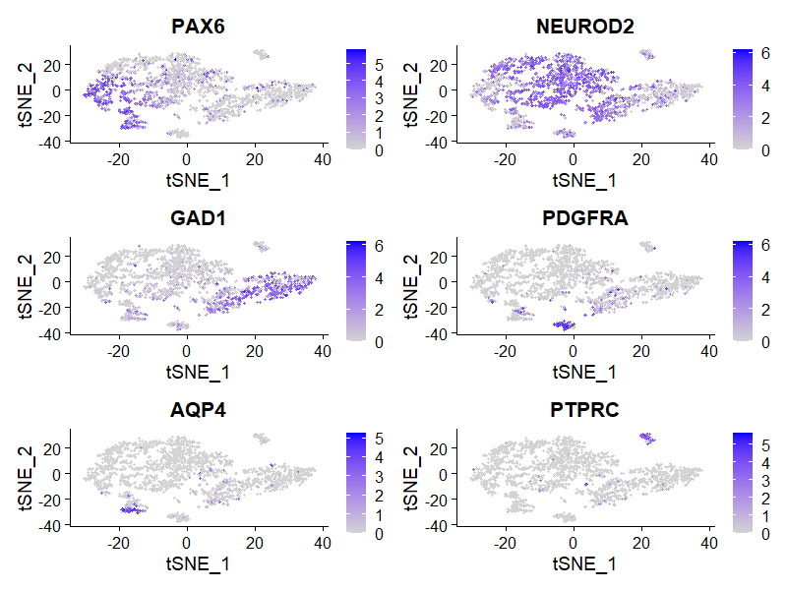
Final clustering and markers

Slide 32
neural progenitor cells(NPC) | excitatory neurons | interneurons | oligodendrocyte progenitor cells(OPC) | astrocytes | microglia
PAX6 | NEUROD2 | GAD1 | PDGFRA | AQP4 | PTPRC
PAX6 : part of cluster 2 and most of cluster 3
NEUROD2: most of cluster 0
GAD1: most of cluster 1
PDGFRA: most of cluster 5
AQP4: part of cluster 3
PTPRC: most of cluster 4.
0: excitatory neurons
1: interneurons
2: NPCs
3: astrocyte
4: microglia
5: OPCs

Slide 33
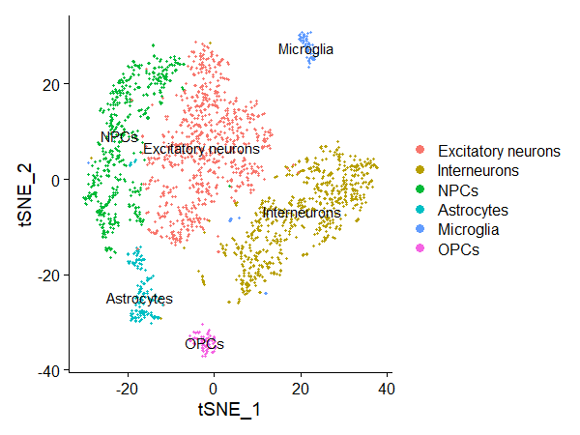
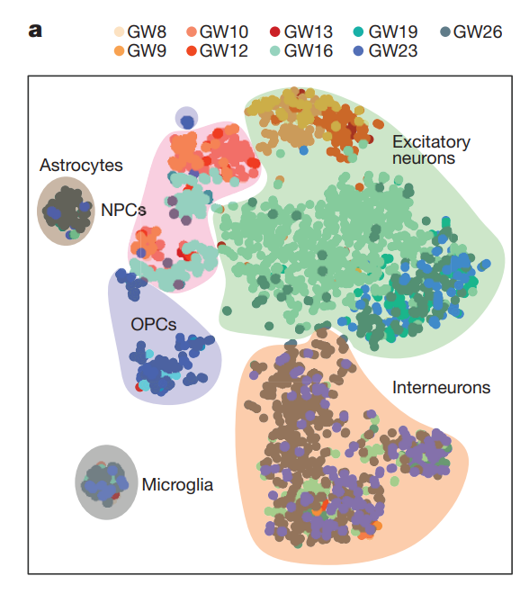
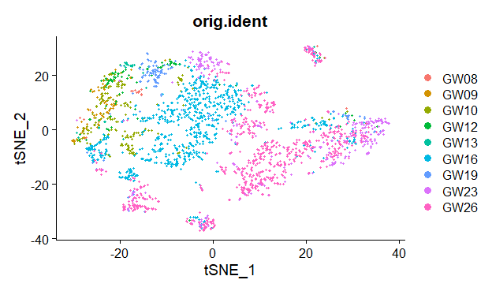

Slide 34
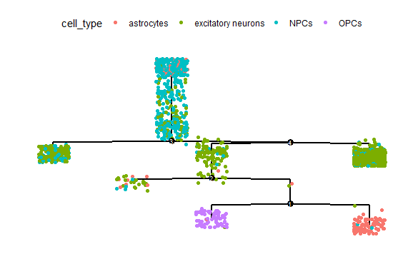
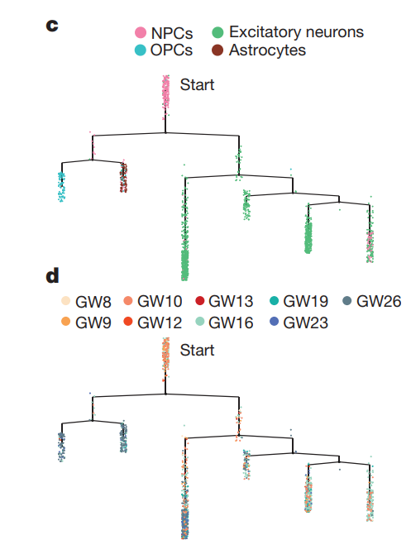
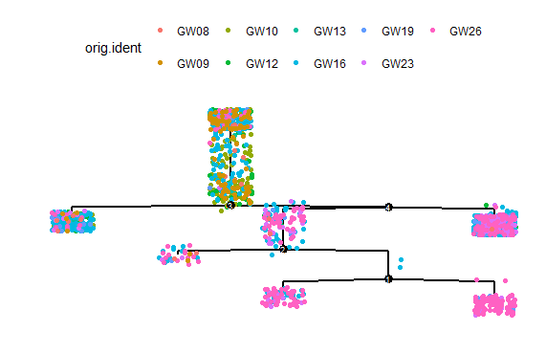

Slide 35
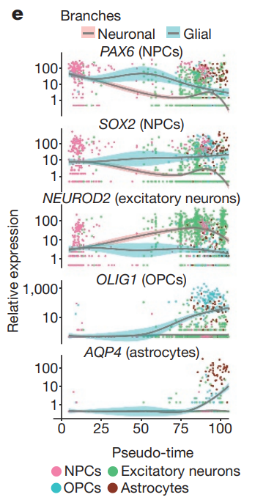
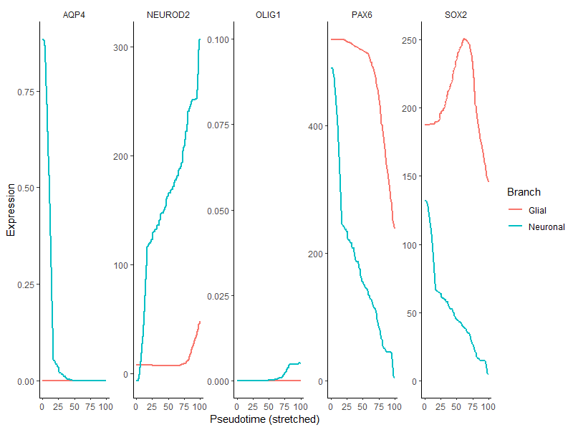

Slide 36
 | Original | Reproduce
AQP4 (astrocytes) | Glial : Increase Neuronal : Near 0 | Glial : Near 0 Neuronal : Decrease
NEUROD2 (excitatory neurons) | Glial : Constant Neuronal : Increase | Glial : late increase Neuronal : Drastic incrase
OLIG1 | Glial : Increase Neuronal : Near 0 | Glial : Slight increase Neuronal : Near 0
PAX6 (NPCs) | Glial : Decrease Neuronal : Decrease | Glial : Decrease Neuronal : Decrease
SOX2 | Glial : constant Neuronal : decrease | Glial : increase then decrease Neuronal : decrease
Different markers used for immunofluorescent staining
Patterns are roughly similar except AQP4 (opposite)

Slide 37
Limitations
TPM data is provided: Seurat and Monocle not optimal.
NormalizeData in Seurat, newCellData in Monocle erroneous
Custom normalization method: log((TPM/10)+1)
Hard to use raw counts to start analysis
Clustering not accurate: astrocytes and NPCs

Slide 38
Overall Improvements
Use raw counts as input data.
Precise clustering is required.
More knowledge on data analysis.

