Slide 1
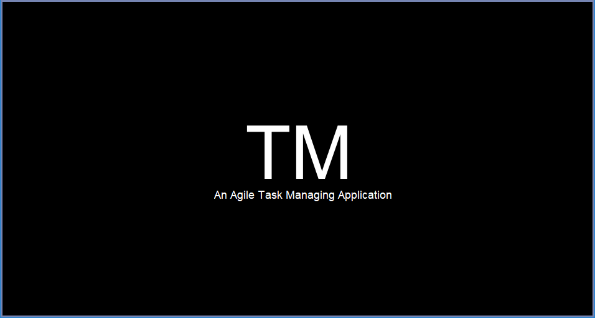
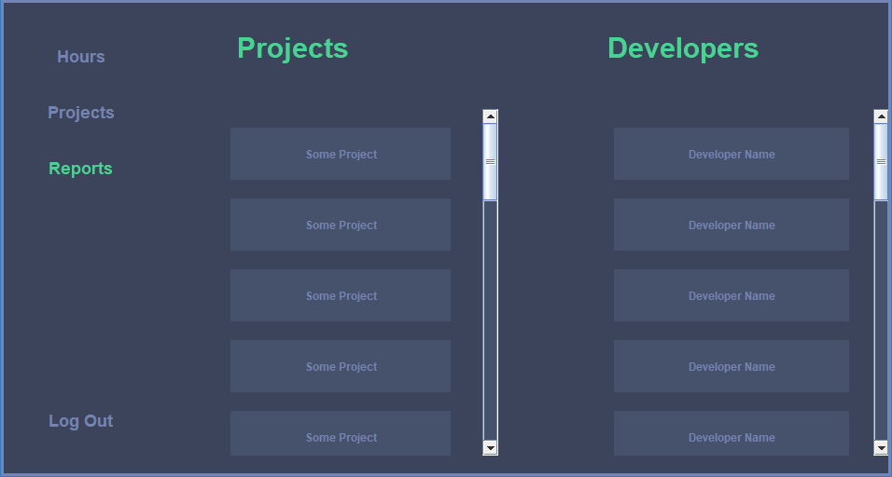
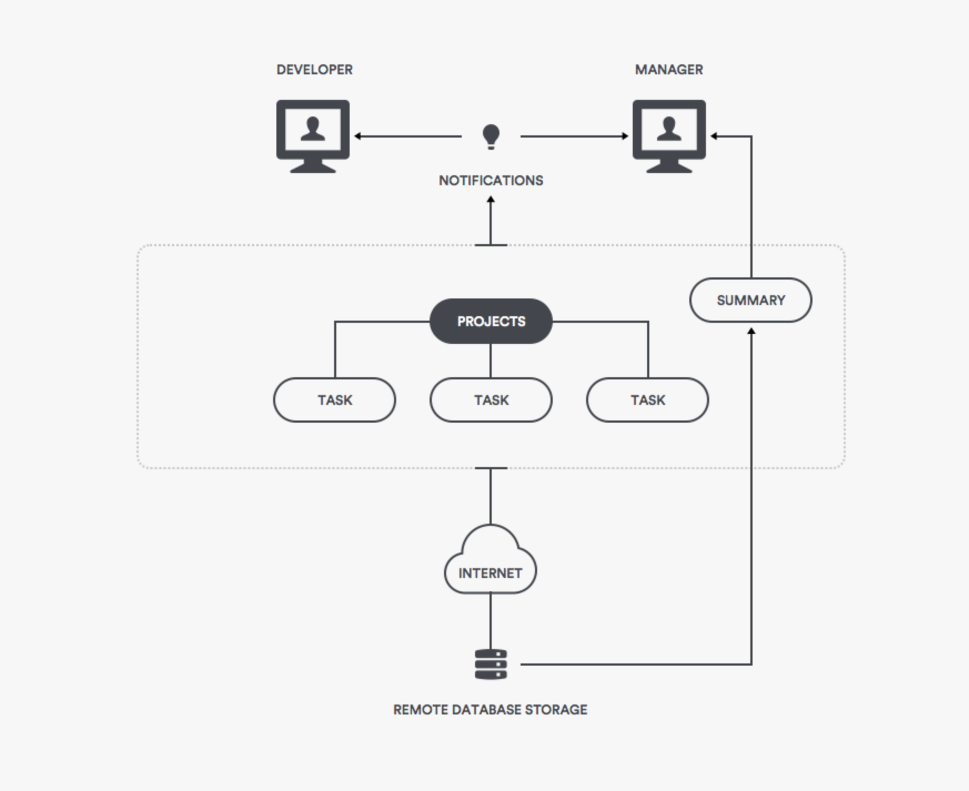
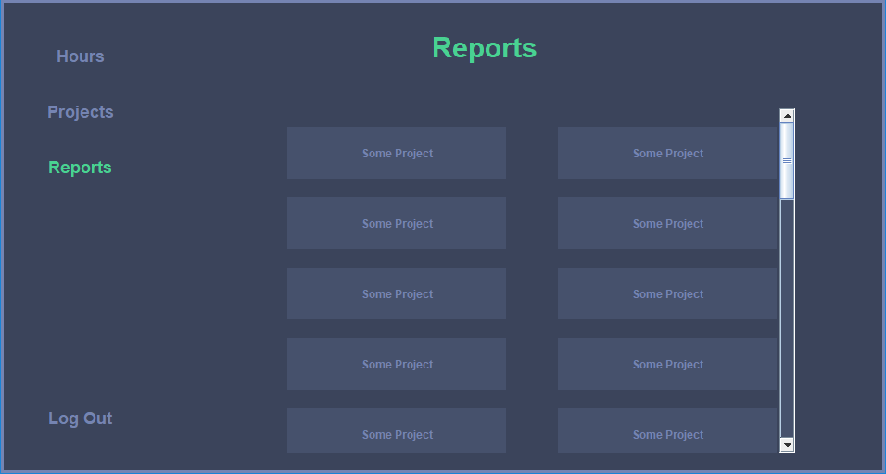
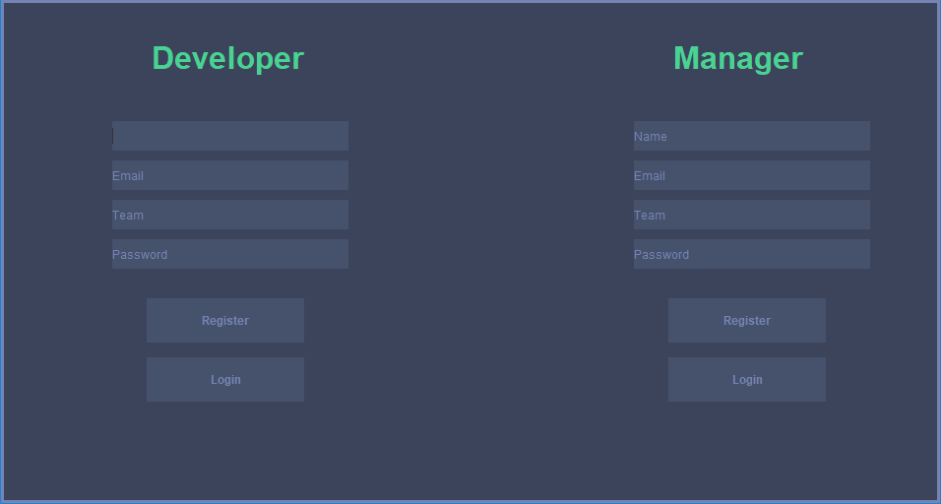
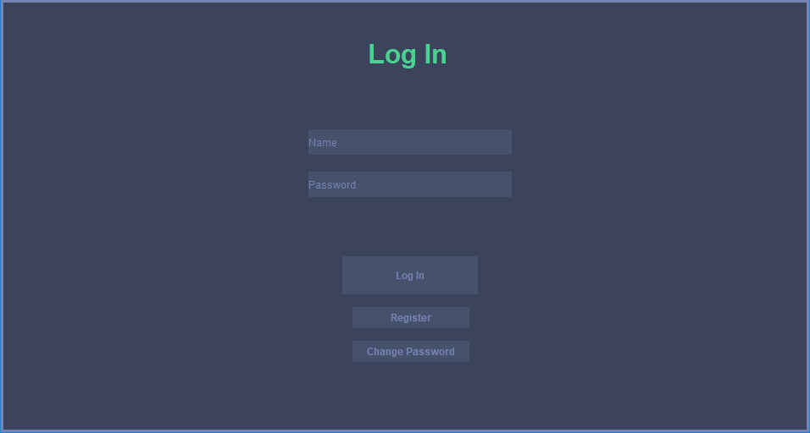
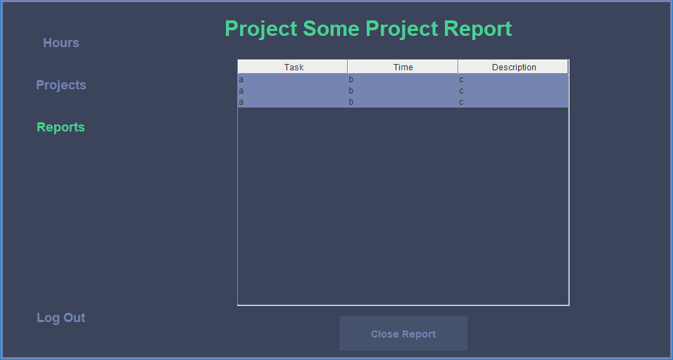
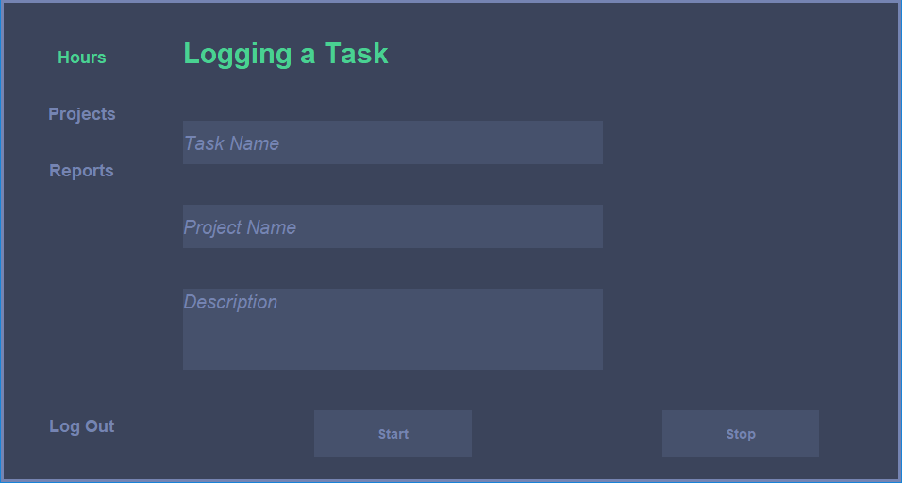
TM
Time Management Software
CSC-131 Spring 2018 Team 6
Introduction
Our Time Management application "TM" is created mainly for developers and managers of small teams to help them track time more efficiently to increase productivity.
Clients in a commercial setting will find that actively managing time will increase revenue for that company; however, this product is not just for commercial uses. Clients in a non-commercial setting will find such application useful.
Project Overview
TM is a Time Management GUI application, that will help teams track time spent on projects with the purpose of increasing efficiency of a team or a single developer who would like to maximize his/her time to increase profits. TM is a desktop application.
When users open up TM, they are greeted with a log in/create account graphical user interface. After logging in the application will either take them to a dashboard for developers or a dashboard for managers. Each type of user has their own uses from this point.
Challenges
One of the main challenges our team has faced in this project was to settle with the choice of strategy to facilitate collaboration and separation of tasks within the team.
As for programming-specific issues we faced were effectively connecting front-end and back-end as well as creating an intuitive UI that approximates the prototype we have developed early on.
Along the way our team had to refactor our design multiple times due to unforeseen challenges, such as time constraints and unclear initial specifications.
Conclusions
In the end, we have produced a functional yet not perfect product: there are some UX issues that may not be as intuitive as we have anticipated, but overall developing TM has been a great learning experience, that helped our team get a well-rounded experience in team and project management, provided practice in different programming languages and helped us gain useful knowledge for future projects.
Participants
[Jacob Wurz
Avery Johnson
Marina Nikiforova
Evamarie Najera
Bryant Lu

