Slide 1
MQTT between RaspberryPi & NodeMCU(ESP8266)
Provider:黃永鴻

Slide 2
摘要
Build MQTT Server on your RaspberryPi

Slide 3




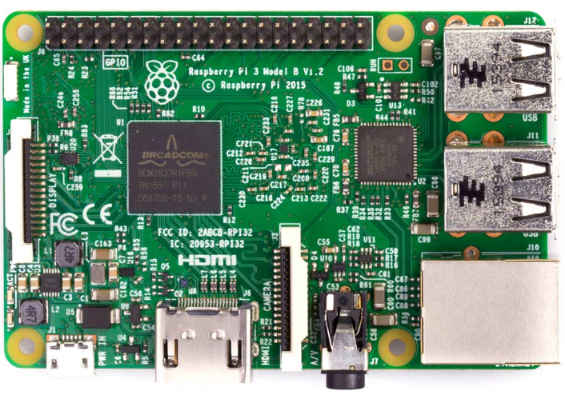

系統架構圖

Slide 4
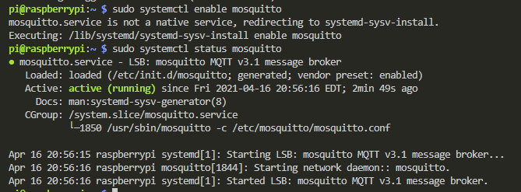
步驟
sudo apt install mosquitto mosquitto-clients
sudo systemctl enable mosquitto
sudo systemctl status mosquitto

Slide 5
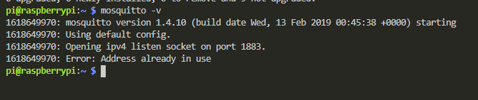
步驟
mosquitto -v

Slide 6
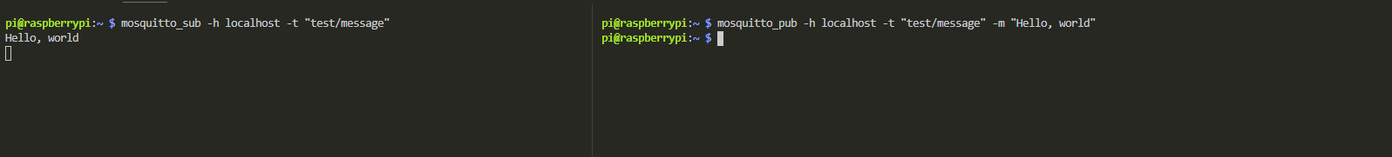
步驟
mosquitto_sub -h localhost -t "test/message“
mosquitto_pub -h localhost -t "test/message" -m "Hello, world"

Slide 7
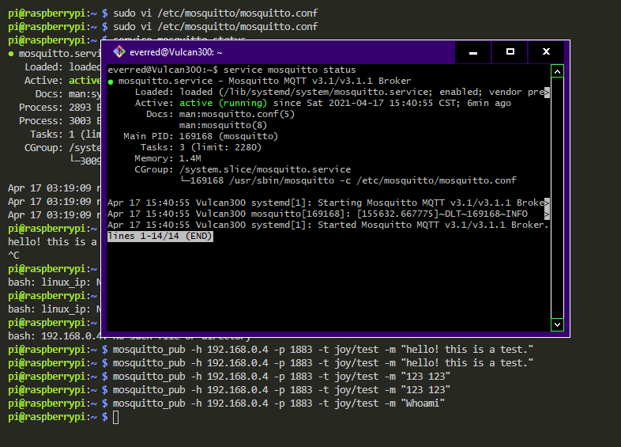
步驟test My Ubuntu (broker&sub) Raspberry Pi 3 (pub)

Slide 8
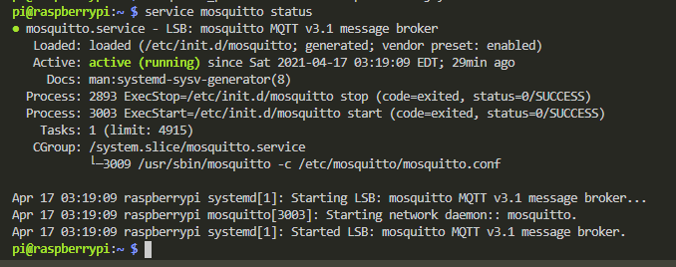
步驟test My Ubuntu (broker&sub) Raspberry Pi 3 (pub)

Slide 9
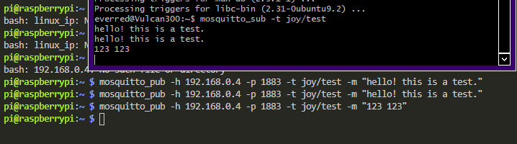
步驟test My Ubuntu (broker&sub) Raspberry Pi 3 (pub)

Slide 10
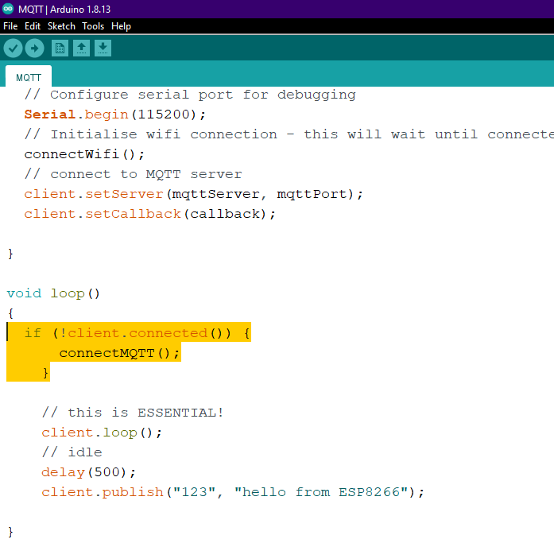
步驟test Raspberry Pi3(broker&sub) NodeMcu Esp8266(pub)

Slide 11
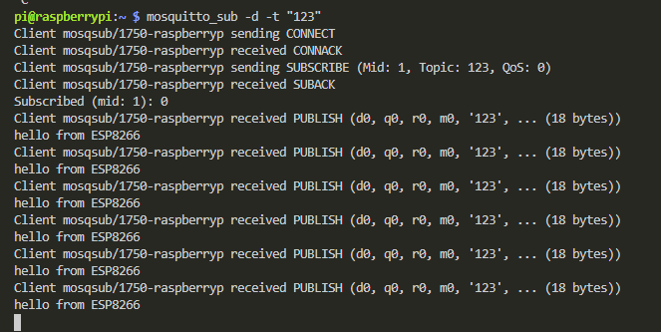
步驟test Raspberry Pi3(broker&sub) NodeMcu Esp8266(pub)

Slide 12
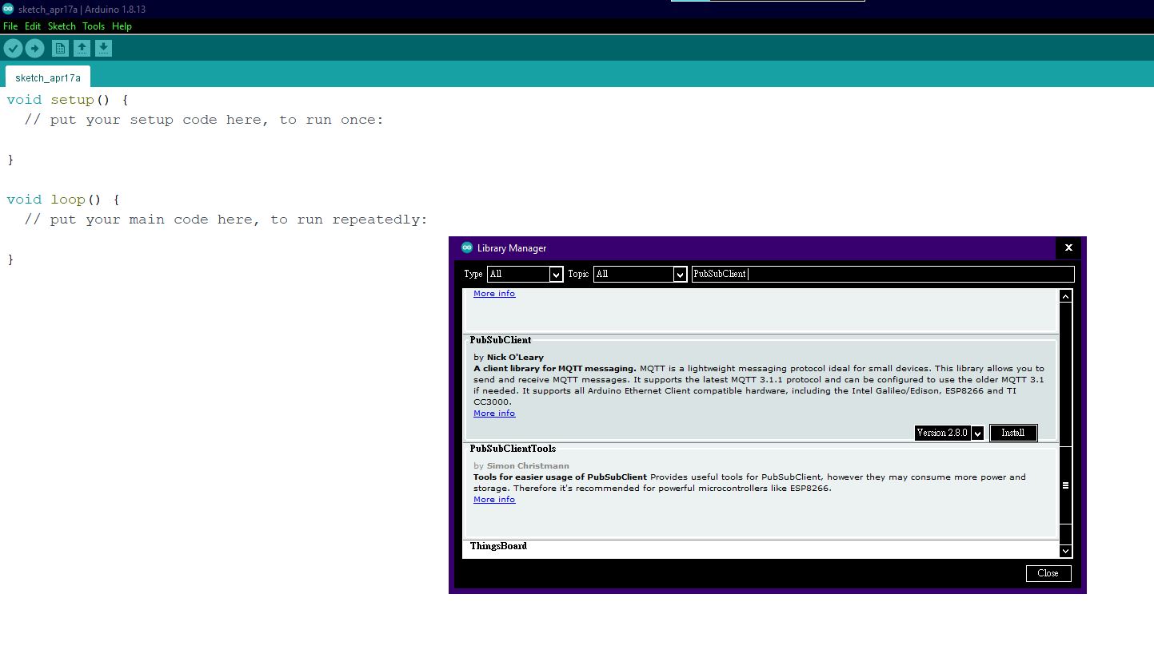
NodeMcu ESP8266步驟

Slide 13

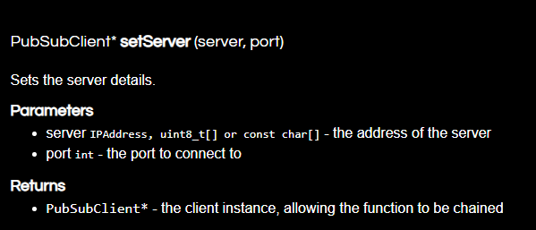
NodeMcu ESP8266步驟

Slide 14
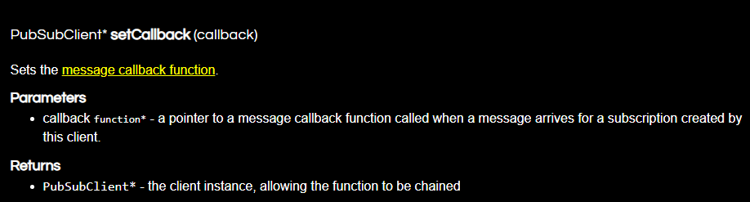
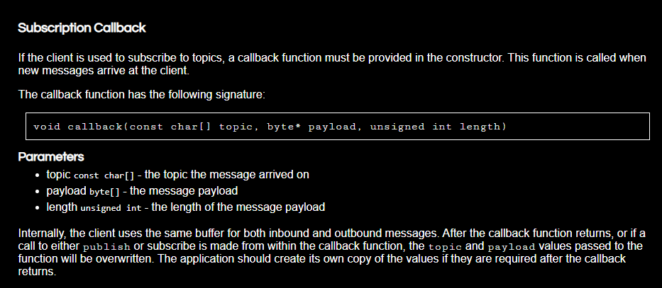
NodeMcu ESP8266步驟

Slide 15
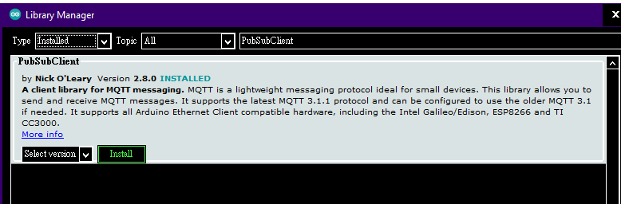
NodeMcu ESP8266步驟

Slide 16
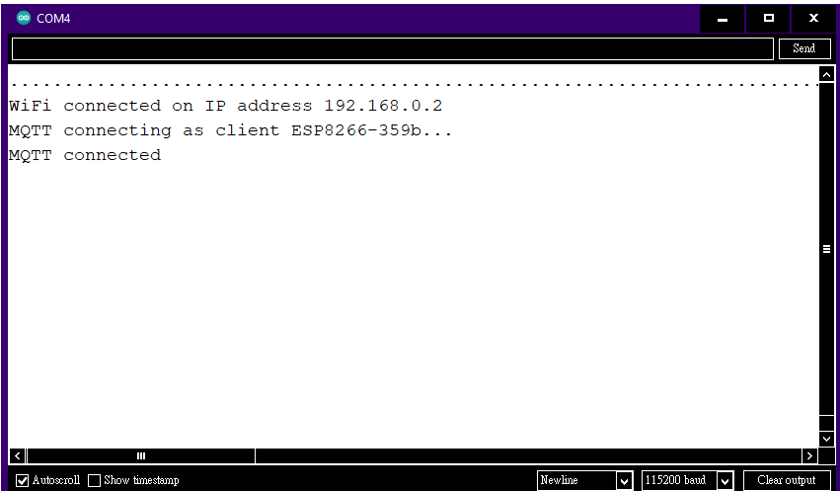
NodeMcu ESP8266步驟

Slide 17
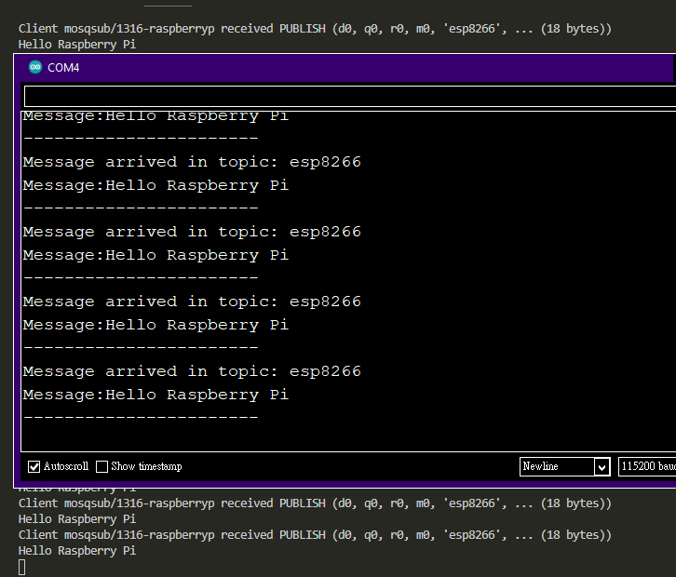
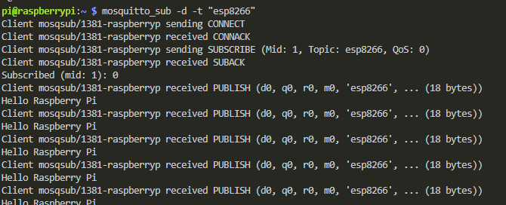
simplePubSub

Slide 18
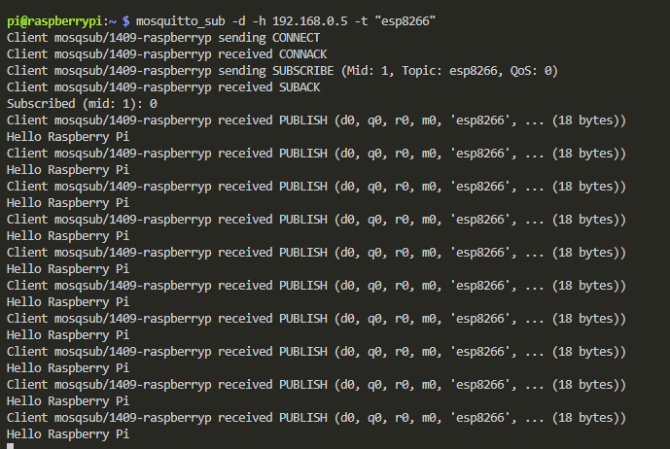
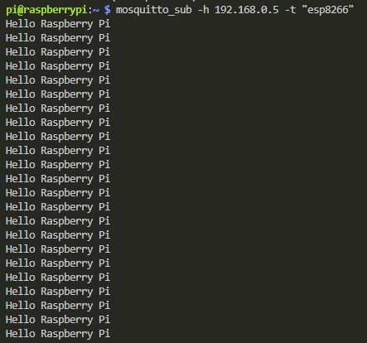
simplePubSub

Slide 19
參考資料
(603) ESP8266 (NodeMcu) Raspberry Pi MQTT | ESP8266 Publish/Subscribe - YouTube

Slide 20
附錄

Slide 21

Thank you!

