Slide 1


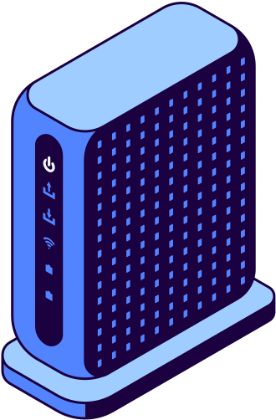
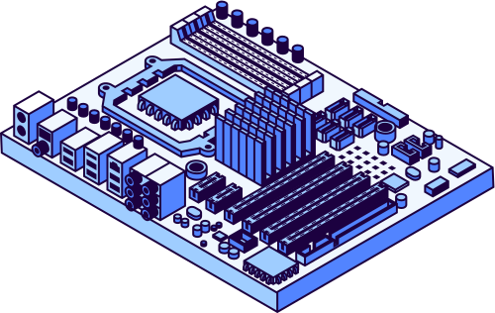

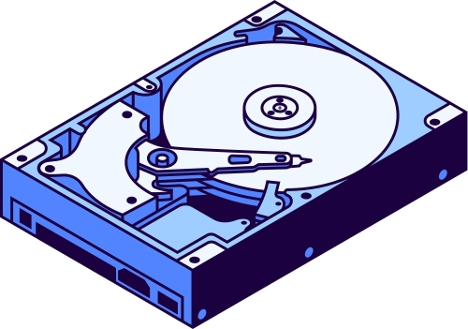
Worksight
DESERT EAGLES · AMD DEVELOPER HACKATHON ACT III
Intelligent Industry track · visual quality inspection
Find defects on a new part from 20 photos of good parts. Gemma on AMD explains what to check.
web-production-d9743.up.railway.app

Slide 2
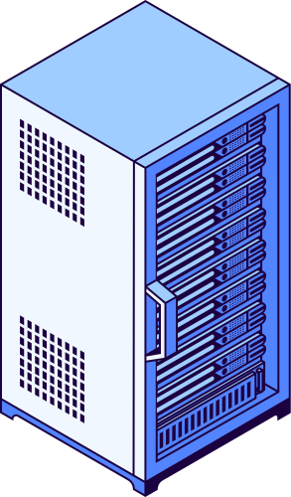


Why this project
A new part on the line has no defect dataset.
Defects are rare, so collecting and labelling hundreds of them takes weeks, and every new part or camera view starts again.
Quality engineers end up checking by eye. Worksight starts from what every line already has: photos of good parts.

Slide 3



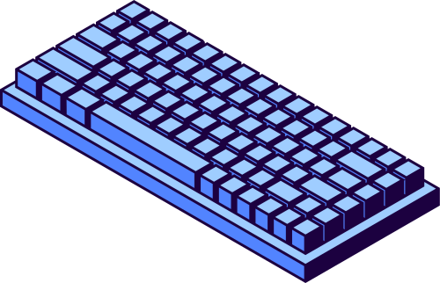
How it works
1.
20 photos of good parts build a profile in about 9 seconds. No defect labels, no training.
2.
Each new part gets an anomaly score, a heatmap of where it differs and the closest good reference.
3.
Gemma on AMD Token Factory explains what looks wrong and what to check. The engineer records the decision.

Slide 4
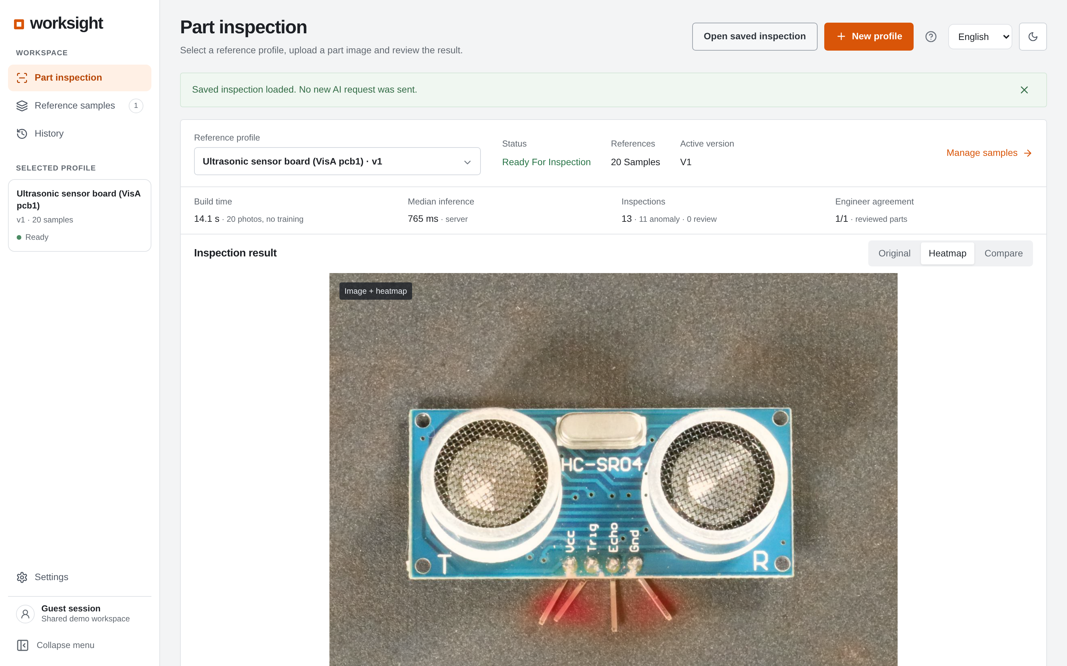

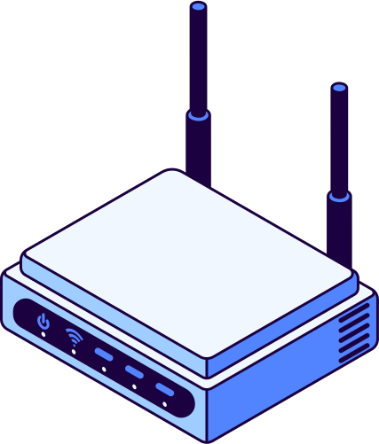
Algorithm, AI and engineer in one view.
Heatmap and closest good reference · Pass, Fail or Needs review
Gemma's explanation starts with each inspection · one-page PDF report
History, batch inspection, part documents · 7 languages · guided tour
The live product

Slide 5

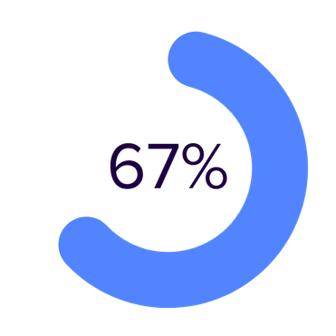
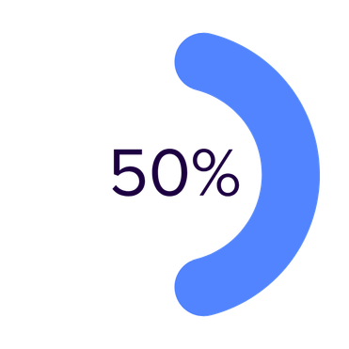
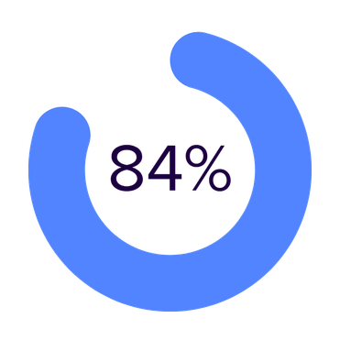
Benchmarks
Public VisA dataset, four circuit-board sets, held-out test: 100 defective and about 100 good boards each, 20 good references per profile, CPU. Not an AMD GPU run.

Slide 6
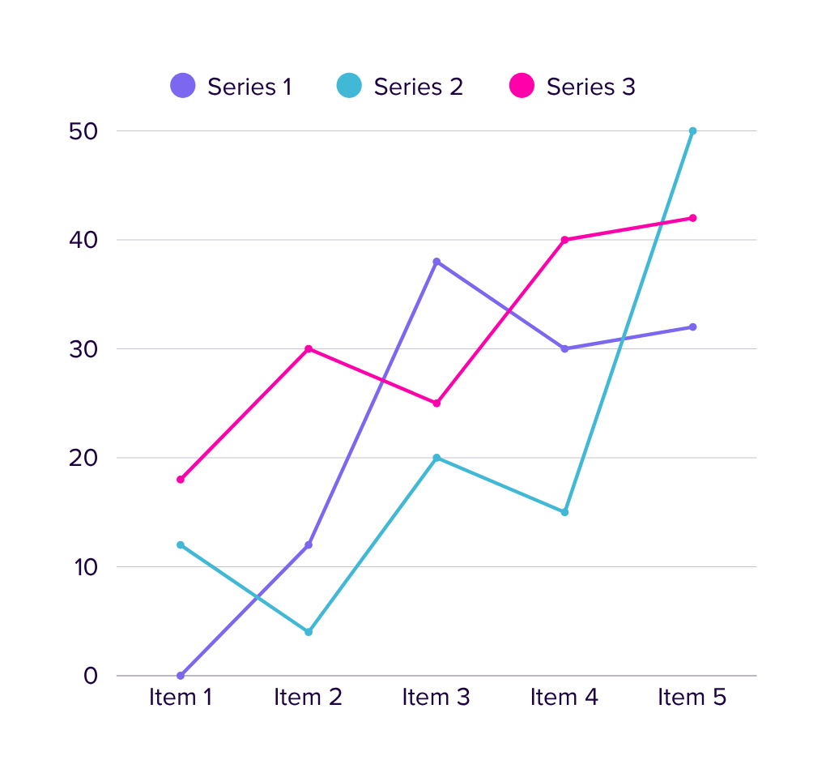
AUROC 0.88–0.99 on four PCB sets.
Detector v2 raised dev AUROC from 0.806 to 0.862 (384 px, all patches).
A 24-variant scoring sweep found nothing better, so production stayed unchanged.
0.19–0.30 s median per image on CPU.
Set | AUROC | F1 | False alarms | Recall | p50, ms
pcb1 | 0.905 | 0.591 | 5% | 44% | 250
pcb2 | 0.884 | 0.715 | 6% | 59% | 304
pcb3 | 0.875 | 0.613 | 4% | 46% | 250
pcb4 | 0.992 | 0.921 | 2% | 87% | 194
Same references and test as v1; numbers from docs/BENCHMARK.md in the repository.
Analytics

Slide 7
Small, fast and easy to inspect.
Detector: PyTorch, frozen ResNet-18 features, nearest-patch distance, threshold from leave-one-out scores
Backend: FastAPI, SQLite records, background job queue, PDF/DOCX export
Web: Next.js 16, React, TypeScript, zod
AI: Gemma-4-31B-IT on AMD Token Factory, DeepSeek-V4.1-Flash fallback
Hosting: Railway · Tests: pytest, Vitest, Playwright
Tech stack

Slide 8
Partner tech and why
AMD Token Factory
Gemma 4 31B
DeepSeek V4.1
AMD Instinct
Runs Gemma on AMD GPUs behind an OpenAI-compatible API. The key stays on our server.
Google's vision-language model reads the photo, heatmap, closest reference and part documents and explains in plain words.
Fallback model on Token Factory, so an explanation still arrives when Gemma is busy.
Next: the detector itself on an AMD GPU with ROCm. The run script is ready in the repo.

Slide 9
Market and competition
AI visual inspection is forecast to grow by about $27B by 2029 (Technavio).
Most tools need labelled defects, or are code libraries for data scientists.
Worksight starts from good photos, explains each result in plain words and keeps the engineer's decision separate: a workspace for the line, not a notebook.

Slide 10
Business model and roadmap
1.
Subscription per camera view, or on-premises on AMD hardware for plants that keep images on site.
2.
Pilot on one line and one camera: measure engineer minutes per part and escaped defects.
3.
Next: detector on AMD Instinct, personal accounts and team workspaces, edge station on AMD Ryzen AI.

Slide 11





About us · Desert Eagles
Two-person team behind Worksight.
Bakhtiyar: detector, benchmarks, Gemma integration.
Ali: operator workspace and reports.
Telegram: @kingcrimson314
Bakhtiyar
Ali
CEO · AI engineer
Frontend developer

Slide 12



Try it
Live demo
GitHub
Telegram
web-production-d9743.up.railway.app
github.com/DesertEaglesTech/worksight
t.me/kingcrimson314

Slide 13
Worksight
DESERT EAGLES
Thank You

