Slide 1

worksight.
Industrial visual inspection
An operator workspace for the quality desk
SYNTHETIC DEMO / BACKEND INTEGRATION PENDING
Notes:
Cover asset: original synthetic image generated with ImageGen for Worksight. No real specimen or AMD execution is represented. Source repository: https://github.com/DesertEaglesTech/worksight. This deck describes the implemented web workflow and pending backend integration.

Slide 2
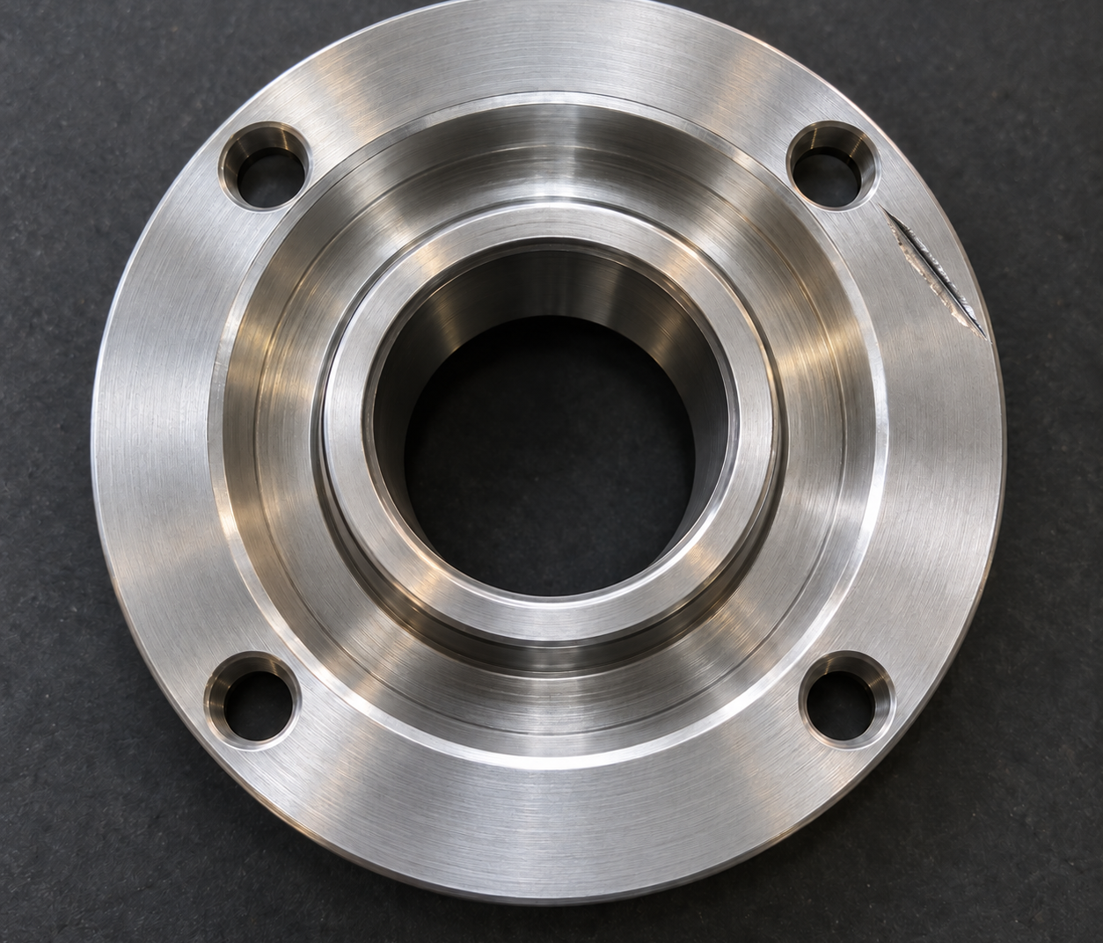
THE QUALITY ENGINEER’S TASK
The inspection decision
A result needs visible evidence
Which reference was used?
Where is the unusual region?
Does the engineer agree?
Worksight keeps that context with the image.
Notes:
This is product framing, not measured market research. Defective part illustration: ImageGen edit of the synthetic reference, adding a gouge. No defect detection or benchmark is proven by this image.

Slide 3
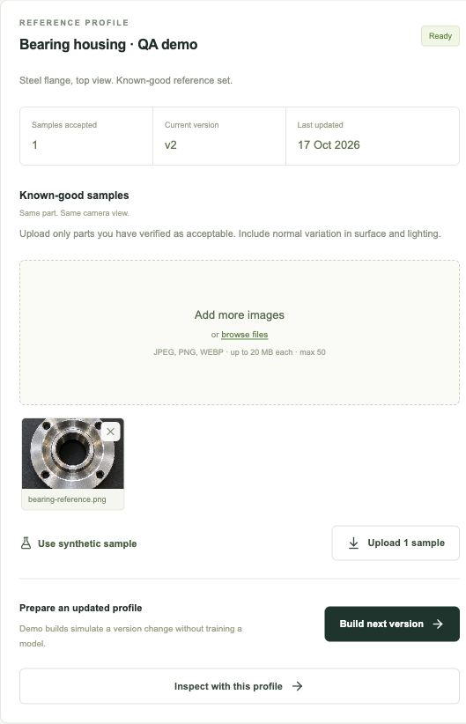
REFERENCE PROFILES
A reference for each part
Create a profile for the part and camera view.
Preview the known-good samples before upload.
Build status comes from the job API.
Notes:
Screenshot of the actual Worksight interface in demo mode, captured during profile creation and sample upload. Files are held temporarily by the demo adapter. Live persistence belongs to FastAPI. Build jobs in this recording are simulated.

Slide 4
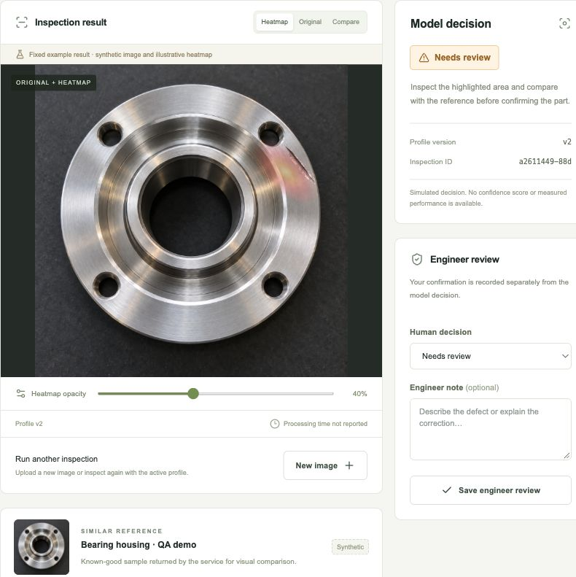
INSPECTION EVIDENCE
Original, heatmap and reference
The surface stays visible under the heatmap.
Adjust overlay opacity.
Compare the similar reference.
Review the returned decision.
Processing time appears only when reported.
Notes:
Actual UI capture. The original is synthetic and the heatmap is a hand-authored illustrative overlay for testing. The example decision is fixed regardless of upload. Processing time is null and displayed as not reported. There is no confidence percentage or hardware utilization claim.

Slide 5
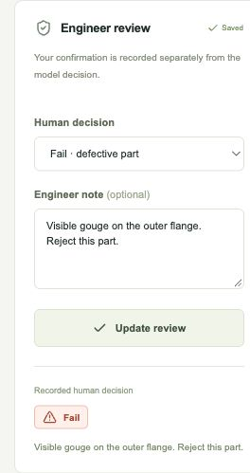
ENGINEER FEEDBACK
Human confirmation stays separate
Model decision: Needs review
Engineer confirmation: Fail
The engineer records the defect and a note. The original model result remains visible.
A profile update creates a new version in the demo workflow.
Notes:
Actual Worksight UI capture with model review and engineer fail recorded separately. Demo profile updates simulate version changes only, do not train a model and imply no improvement. Prior inspection retains v1 while repeat inspection uses v2.

Slide 6
IMPLEMENTATION STATUS
Web workflow ready for integration
Implemented
Pending backend evidence
Next.js operator workspace
Typed client and server proxy
Explicit disposable demo
Confirmed FastAPI contract
Real AMD / ROCm inference run
Live inspection and update validation
Versions, comparison and rollback appear only when supported by the service.
Notes:
Status as implemented in this checkout. ML/FastAPI service URL and approved contract have not been supplied. The live adapter has unit coverage and production proxy outage checks, but real inference has not been validated. Hosted demo publication was blocked by the environment approval policy. No invented hardware, speed, accuracy or improvement claims.

