Slide 1
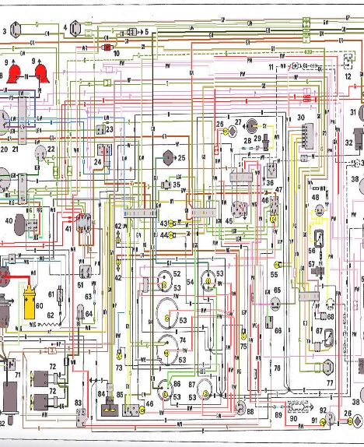
Schéma

Slide 2
[Application lifecycle] The route is parsed and is handled by the good router method
Router
1
http://localhost/#contact/1

Slide 3
[Application lifecycle] The router create model
Model
Router
2
1
http://localhost/#contact/1

Slide 4
[Application lifecycle] The router creates the the view
View
Model
3
Router
2
1
http://localhost/#contact/1

Slide 5
[Application lifecycle] The view is injected into one of the application layout
Layout
4
View
Model
3
Router
2
1
http://localhost/#contact/1

Slide 6
[Application lifecycle] The view call the service to load the data
Layout
Service
4
5
View
Model
3
2
Router
1
http://localhost/#contact/1

Slide 7
[Application lifecycle] The service returns JSON to load in the view
Layout
Service
4
5
6
View
Model
3
2
Router
1
http://localhost/#contact/1

Slide 8
[Application lifecycle] The data is injected into the model as attributes
Layout
Service
4
5
6
View
7
Model
3
Router
2
1
http://localhost/#contact/1

Slide 9
[Application lifecycle] The model trigger a :change event
Layout
Service
4
5
6
View
7
Model
3
8
Router
2
1
http://localhost/#contact/1

Slide 10
[Application lifecycle] The view handles the event and call the template to be rendered
Layout
Service
4
5
6
Template
View
7
Model
9
3
8
Router
2
1
http://localhost/#contact/1

Slide 11
[Application lifecycle] The view DOM element is updated and visible in the layout
Layout
Service
4
10
5
6
Template
View
7
Model
9
3
8
Router
2
1
http://localhost/#contact/1

Slide 12
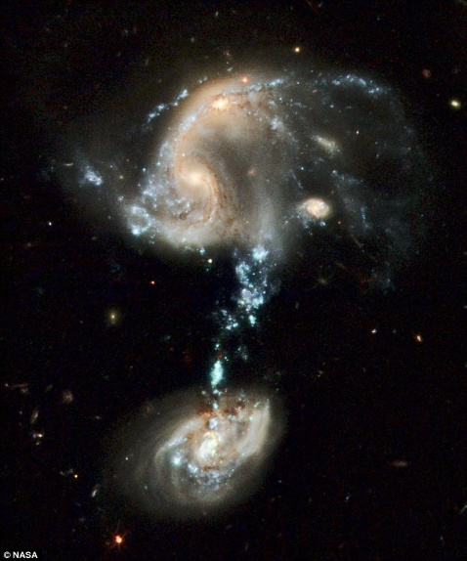
Questionnenemt ?

Slide 13












What kind of page is it?
1
?
?
?
?
Detail
List
Search
Special page
Super easy
=
1 form
My page
=
many items
Basic list
Interactions or modification of lines
Single search input
Several criteria
Can my page fit in a known pattern?
Think 15 minutes and suggest something
Component
Detail
View
Component
Composite
View
Component
List View
Component
ListView
With
LineView
Component
Custom View
Component
SearchView
ResultView
Technical leader
DT
Ditto for all children views
1

Slide 14
Qu’est ce que mon écran
1
?
?
?
?
Un détail
Une liste
Une recherche
Un écran bizarre
Très simple
=
1 formulaire
Ma page est composée de plusieurs blocs
Une liste basique
Avec interaction ou edition
des lignes
Champ recherche unique
Plusieurs critères de recherche
Est-ce que je peux le faire facilement rentrer dans un pattern connu
Je réfléchis 15 min et fais une proposition
Component
Detail
View
Component
Composite
View
Component
List View
Component
ListView
avec LineView
Component
Custom View
Component
SearchView
ResultView
Référent technique
DT
Même question pour les sous vues
1

Slide 15
Project1
Project1
Project1
Projects
User
Users
Users
Users
Users
Users

Slide 16
Accueil
Home
User
Recherche
Detail
1
2
Detail Complexe
MENU
PAGES

Slide 17

Component
Backbone
View
Component
Core
View
Component
Custom View
Component
Detail
View
Component
SearchView
Component
Composite
View
Component
ListView
avec LineView
Component
List View
Behaviour inheritance
Component
ResultView

Slide 18
View
JSON
Template
HTML

Slide 19
View
JSON
Service
1
Promise(JSON)
2
JSON
3
Model

Slide 20
ReferenceName1
Service
ReferenceName2
2
Service
3
ReferenceName3
Service
1
View
Promise.all
4

Slide 21


