Slide 1
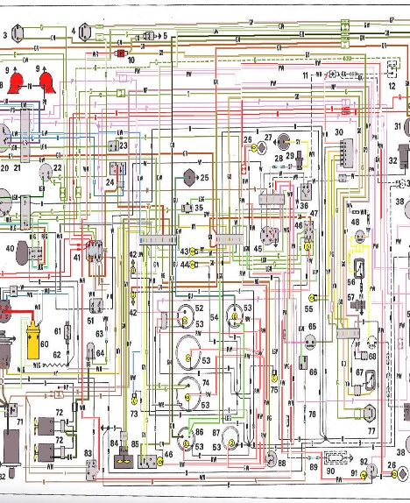
Schéma

Slide 2
[Application lifecycle] The route is parsed and is handled by the good router method
Router
1
http://localhost/#contact/1

Slide 3
[Application lifecycle] The router create model
Model
Router
2
1
http://localhost/#contact/1

Slide 4
[Application lifecycle] The router creates the the view
View
Model
3
Router
2
1
http://localhost/#contact/1

Slide 5
[Application lifecycle] The view is injected into one of the application layout
Layout
4
View
Model
3
Router
2
1
http://localhost/#contact/1

Slide 6
[Application lifecycle] The view call the service to load the data
Layout
Service
4
5
View
Model
3
2
Router
1
http://localhost/#contact/1

Slide 7
[Application lifecycle] The service returns JSON to load in the view
Layout
Service
4
5
6
View
Model
3
2
Router
1
http://localhost/#contact/1

Slide 8
[Application lifecycle] The data is injected into the model as attributes
Layout
Service
4
5
6
View
7
Model
3
Router
2
1
http://localhost/#contact/1

Slide 9
[Application lifecycle] The model trigger a :change event
Layout
Service
4
5
6
View
7
Model
3
8
Router
2
1
http://localhost/#contact/1

Slide 10
[Application lifecycle] The view handles the event and call the template to be rendered
Layout
Service
4
5
6
Template
View
7
Model
9
3
8
Router
2
1
http://localhost/#contact/1

Slide 11
[Application lifecycle] The view DOM element is updated and visible in the layout
Layout
Service
4
10
5
6
Template
View
7
Model
9
3
8
Router
2
1
http://localhost/#contact/1

