Slide 1


GROUP 10
EG/2021/4474
EG/2021/4781
EG/2021/4807
OFFENSIVE AND DEFENSIVE
WI-FI/BLUETOOTH PEN TOOL

Slide 2

INTRODUCTION TO THE PEN TOOL
Wireless technologies like Wi-Fi and Bluetooth are widely used but are increasingly vulnerable to cyber threats such as deauthentication attacks, rogue access points and device tracking.
Ethical penetration testing is essential to identify and address these risks.
However, most existing tools are complex, costly, and not easily portable.
Our project introduces a
compact, low-cost and portable penetration testing tool
based on the ESP32 microcontroller with a TFT touch screen
offering both offensive and defensive wireless testing capabilities
through a user-friendly interface.

Slide 3

PROBLEM STATEMENT
Increasing threats to wireless networks such as deauthentication attacks, rogue access points and device MAC address identification.
Lack of affordable and accessible testing tools.
Need for a device that supports both offensive and defensive testing modes.
OBJECTIVE
To develop a secure, portable Wi-Fi/Bluetooth penetration testing tool that works in noisy and high-traffic environments using ESP32, enhanced for reliability, and controlled via an intuitive touch interface.

Slide 4

PROJECT SCOPE
1
Wi-Fi & Bluetooth scanning
2
Packet sniffing & logging
3
Fake AP simulation & SSID flooding
4
Offline PCAP analysis via SD card
5
TFT-based GUI for real-time interaction

Slide 5

PEN TOOL
CAPABILITIES
WI-FI
BLUETOOTH
UI/UTILITIES
Join/shutdown Wi-Fi
SSID generation
Beacon spam
Probe and beacon sniffing
Bluetooth scanner
BLE shutdown
Skimmer detection
Probe and beacon sniffing
TFT GUI
Touch navigation
PCAP logging

Slide 6

KEY COMPONENTS
ESP32 microcontroller
2.8” ILI9341 TFT touchscreen
SD card module
Battery power supply

Slide 7

PIN CONNECTIONS
TOUCH SCREEN DISPLAY
SD CARD MODULE

Slide 8
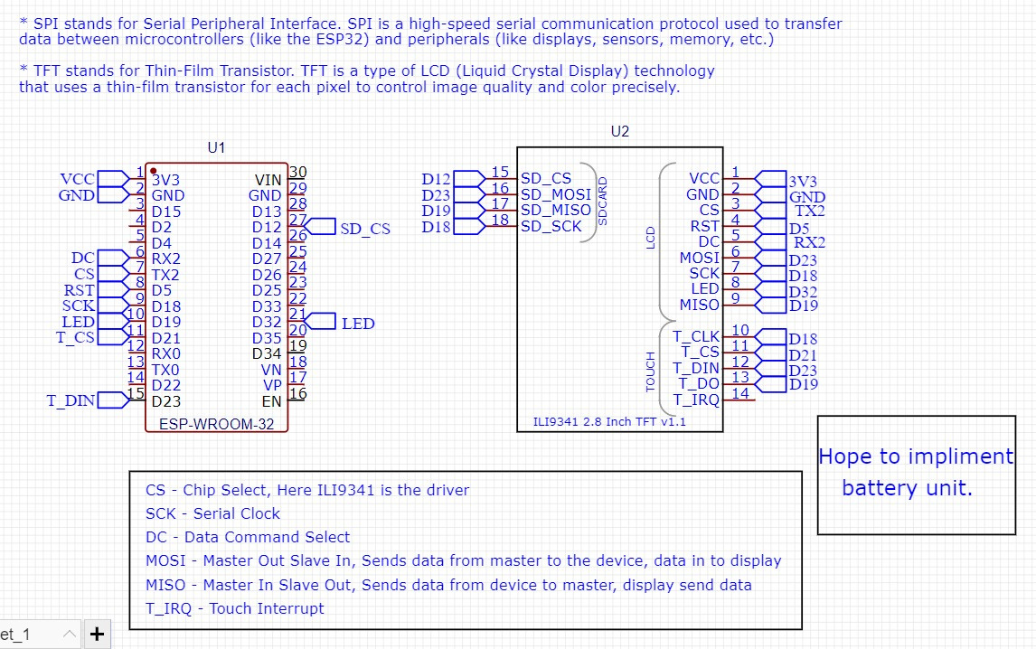
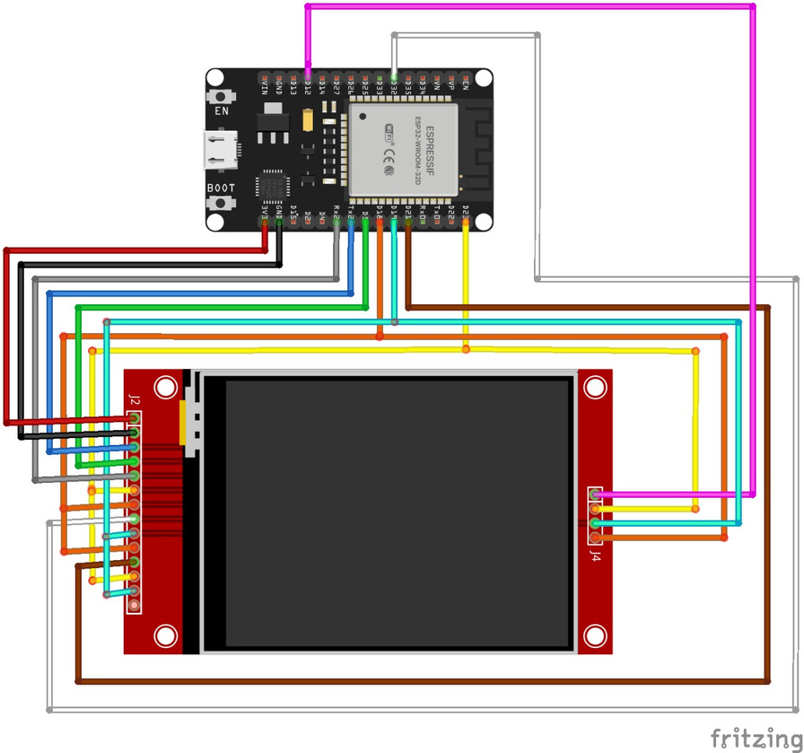
SCHEMATIC OF THE CIRCUIT
USING EASY EDA SOFTWARE
USING FRITZING SOFTWARE

Slide 9

ONLINE REAL TIME FEATURES
CONSTRAINTS
Wi-Fi scan (SSID, RSSI)
Bluetooth scan
SSID flooding, fake APs
Channel analyzer, packet density monitor
No deauth frame transmission (ESP32 limitation)
Range varies with antenna setup (50–100m)
No cloud support (for privacy & safety)
Ethical use required – used to test own networks
OFFLINE ANALYSIS FEATURES
Capture PCAP logs
View scan logs
Analyze via Wireshark
FEATURES & CONSTRAINTS

Slide 10

EXPECTED OUTCOMES
Identify wireless vulnerabilities
Provide recommendations for wireless security hardening
Increase team expertise in embedded systems, wireless protocol analysis etc.

Slide 11
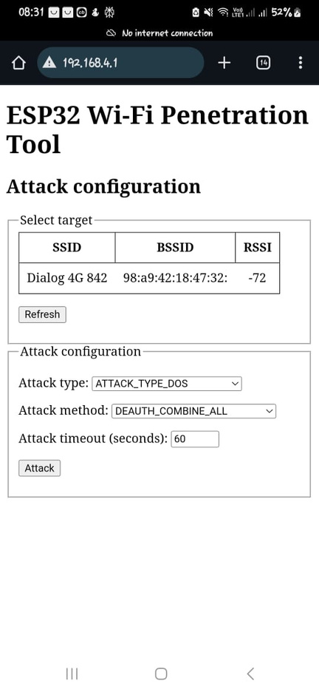
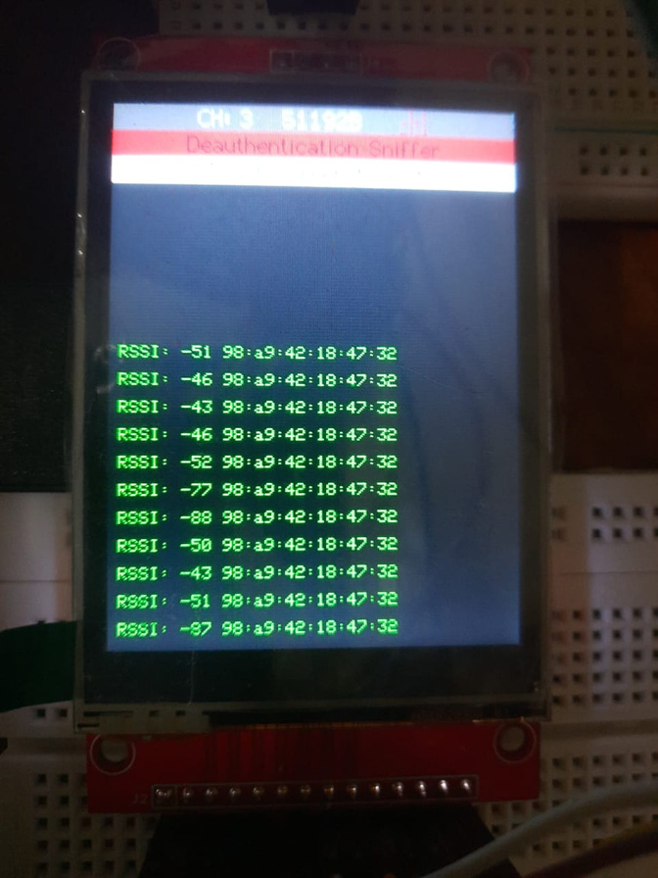
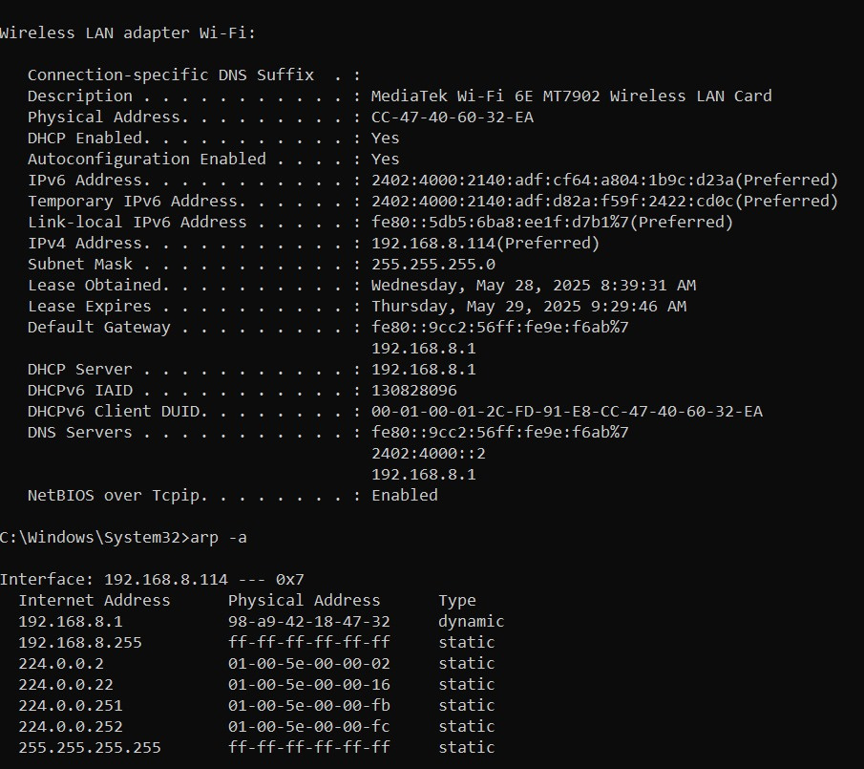
TESTING

Slide 12

WHAT'S NEXT
Implementing the battery to use as a portable device
Enclosure setup
Implementation of further Bluetooth capabilities
Evil portal attacks and PCAP file analyzing on Wireshark

Slide 13

CONCLUSION
ESP32 PEN tool is a powerful, low-cost solution for real-time wireless security assessment.
Designed for education, ethical hacking, and research.
Expandable, customizable, and user-friendly.
A practical embedded systems project with real-world applications.

Slide 14

THANK YOU!

