Slide 1
Hotel Management System
Group 6

Slide 2
Aim
There are lot of complicated things to handle when managing a hotel
Room reservation
Facility management
Income and expenditure management
Staff handling
Handling data about employees and guests
Manually handling above facts are difficult.
So an automated system can be implemented to handle above facts automatically.

Slide 3
Outcomes
Easy to
maintain database
Use GUI
More accurate in calculations

Slide 4
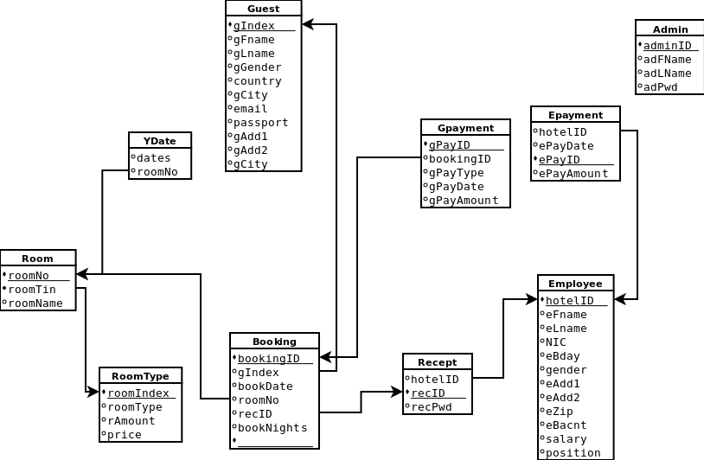
Relational Schema

Slide 5
Time line
 | week 1 | week 2 | week 3 | week 4 | week 5 | week 6 | week 7 | week 8 | week 9
Problem analysis
Designing ER diagram
Data modelling and mapping
Logical and physical designing of database
Implementation

Slide 6
Implementation of Hotel Management System

Slide 7
Things we had to concern in our implementation
Designing the GUI
Creating the Database
Connecting the Database with the GUI

Slide 8
Designing the GUI
Designing a GUI with the support of HTML.
Sketch the prototype using the ER diagram we had already created.
Implemented our sketch with HTML.
Styling and positioning the components of the GUI using Bootstrap.

Slide 9
Creating the Database
Designed the Database using MySQL by using the ER diagram.

Slide 10
Connecting Database with the GUI
We created Database with MYSQL and GUI with HTML.
- Then we identified it is easy to use PHP to connect them together.
Therefore we used PHP to connect them.

Slide 11
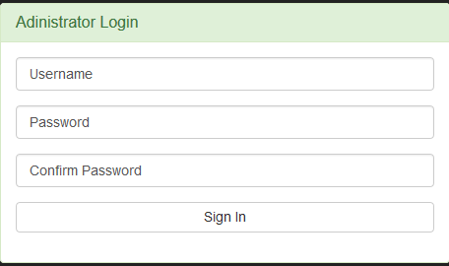
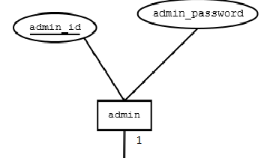

Slide 12
DEMONSTRATION

