Slide 1
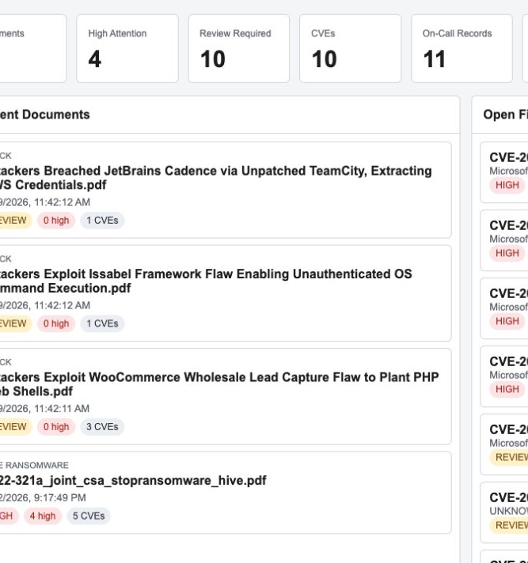
Threat Intelligence
On-Call Memory
Slack PDF intake, analyst knowledge retention, and Power Apps-ready review workflow
Proof of concept overview
30 September 2026
Notes:
This proof of concept preserves threat intelligence knowledge that currently lives in Slack.
The goal is to stop support teams from repeating the same document analysis when shifts change or a PDF appears again.

Slide 2
The operational problem
Useful analysis exists, but Slack alone does not provide durable team memory
1. Findings posted
2. Shift changes
3. PDF returns
4. Work repeats
An on-call analyst shares a PDF and writes structured notes in Slack.
The next analyst may not know what the previous team already reviewed.
The same document can be shared again days or weeks later.
The team analyzes the same material again and again because prior decisions are hard to find.
Business need: retain the document, CVEs, affected technology, analyst comments, decisions, and first/last seen history so every on-call shift can continue from the same evidence.
Threat Intelligence POC
02
Notes:
The main problem is repeated effort, not simply missing files.
Slack supports fast collaboration, but knowledge becomes difficult to search and reuse after on-call ownership changes.
The POC turns each Slack entry into durable operational memory.

Slide 3
Two-phase solution
Phase 1 preserves analyst knowledge; Phase 2 automates PDF analysis
PHASE 1
PHASE 2
Slack knowledge capture
Automated PDF analysis
Read the team's standard Slack note format
Use the Slack sender as the analyst identity
Store CVEs, technology, status, decision, comments, and seen history
Detect when a previously captured PDF appears again
Download PDFs shared in the Slack channel
Extract CVEs, evidence text, technology, and security indicators
Classify relevance and create one review finding per CVE
Reuse local semantic memory to recognize prior or similar content
Shared outcome: one searchable record of what arrived, what the system found, and what analysts decided
Threat Intelligence POC
03
Notes:
Phase 1 works even before full automation. It preserves the support team's own notes from Slack.
Phase 2 adds automated PDF extraction and review findings.
Both phases write to the same repository model so SharePoint can replace local storage later.

Slide 4
End-to-end architecture
The Dockerized Python service connects intake, analysis, memory, and analyst review
Slack
Python in Docker
PDF analysis
Structured memory
Analyst app
Structured analyst notes and PDF attachments
Channel discovery, parsing, download, and orchestration
CVEs, evidence, technologies, indicators, and relevance
Local JSON, SQLite, and Excel today; SharePoint later
Dashboard, documents, findings, comments, and decisions
Repository abstraction
The analysis code writes the same document, finding, indicator, memory, and feedback payloads regardless of whether the backend is local storage or SharePoint.
Threat Intelligence POC
04
Notes:
Slack remains the working channel for the support team.
Python handles repeatable processing inside Docker, so the host machine does not need a Python setup.
The repository boundary keeps the local POC aligned with the future SharePoint implementation.

Slide 5
Slack becomes the intake channel
The team keeps its current workflow and uses a predictable note format
EXAMPLE SLACK NOTE
WHAT THE PIPELINE STORES
Document and threat
Today findings:
Document: aa22-321a_joint_csa_stopransomware_hive.pdf
Threat: Hive Ransomware
Impacted Technology: FortiOS, Microsoft Exchange
CVE Count: 5
CVE: CVE-2020-12812; CVE-2021-31207;
CVE-2021-34473; CVE-2021-34523; CVE-2021-42321
One reusable record for the PDF
CVE and technology
One on-call memory record per CVE
Analyst identity
Slack sender details identify who added the note
Message identity
Prevents the same Slack message from creating duplicate rows
Seen history
First seen, last seen, times seen, and re-seen events
Normal intake starts in Slack. The web form supports manual backfill or correction when needed.
Threat Intelligence POC
05
Notes:
The team does not need to re-enter every finding in the web page.
The normal source is the structured Slack message and its PDF attachment.
The analyst name comes from the Slack sender. The manual form remains available for backfill or correction.

Slide 6
Dashboard
A quick view of workload, urgency, and recent activity
FEATURES
Documents shows the number of processed PDFs
Review Required counts CVE findings, not documents
High Attention highlights urgent evidence
Re-Seen Items exposes repeated Slack PDFs
Recent documents and open findings support fast navigation
Current POC: 4 documents and 10 CVE findings
Threat Intelligence POC
06
Notes:
The dashboard separates documents from findings. Four PDFs can contain ten CVEs, so the review count can be higher than the document count.
This screen helps the on-call lead understand the queue before opening individual records.

Slide 7
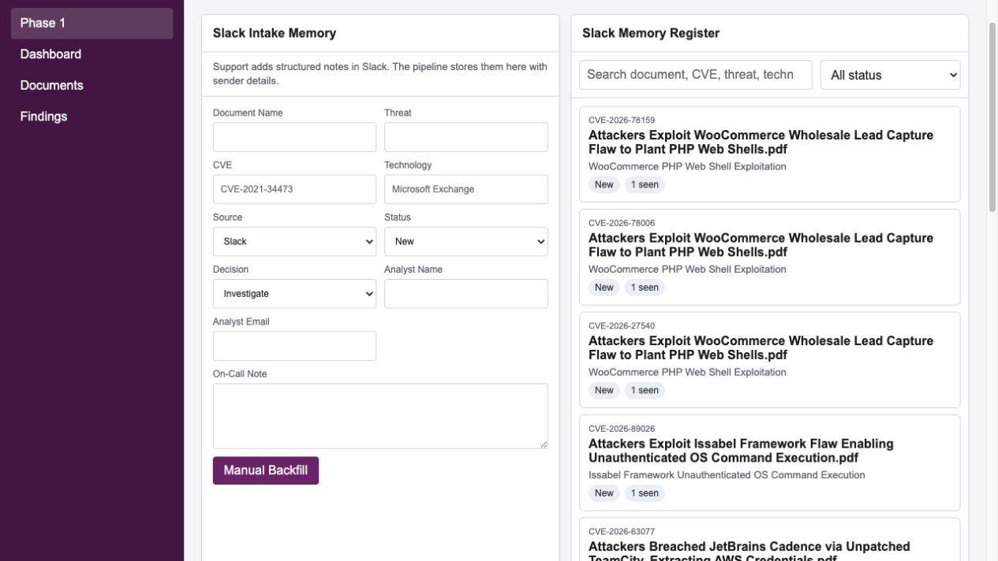
Phase 1: Slack memory
Analyst notes remain searchable across on-call shifts
FEATURES
Search by document, CVE, threat, or technology
See analyst identity captured from Slack
Track status, decision, comments, and note history
Show first seen, last seen, and times seen
Manual backfill supports missing historical records
Outcome: the next shift can continue from the previous analyst's work
Threat Intelligence POC
07
Notes:
This screen represents the first phase of the use case.
The memory register is populated from Slack. Analysts can search prior work and add review comments or decisions.
The manual area is secondary and supports backfill, not the normal intake flow.

Slide 8
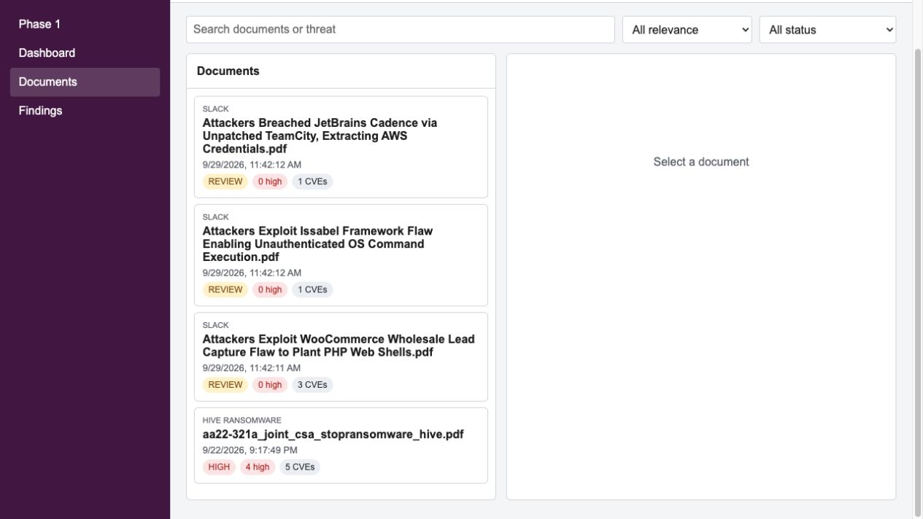
Documents
One place to inspect every PDF and its analysis history
FEATURES
Search by document name or threat
Filter by relevance and workflow status
Compare CVE count and high-attention count
Open the original PDF from the selected record
Review findings, indicators, similar content, and comments
A document can produce several findings
Threat Intelligence POC
08
Notes:
The Documents screen answers whether a PDF has already been processed and what the analysis produced.
Selecting a document reveals its detailed findings, indicators, similar content, and analyst comments.

Slide 9
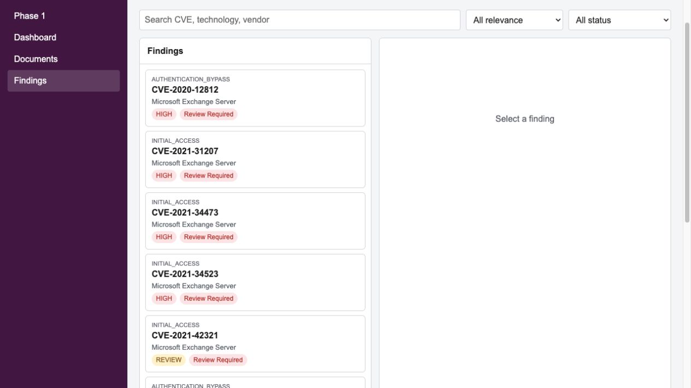
Findings
Each CVE becomes a focused review item with supporting evidence
FEATURES
One finding per document and CVE combination
Show technology, vendor, category, and relevance
Retain evidence text and PDF page reference
Assign status and analyst decision
Add comments without losing earlier review history
Finding means a CVE or security issue that needs analyst review
Threat Intelligence POC
09
Notes:
A finding is not another document. It is one CVE or security issue extracted from a document.
This level allows analysts to review, comment on, and close each security issue independently.

Slide 10
Re-seen document handling
A repeated PDF resurfaces prior analysis instead of creating repeated work
First share
Memory stored
PDF shared again
History shown
Slack message and PDF enter the pipeline.
Document, findings, notes, and first-seen time are saved.
The pipeline matches the same Slack file ID or PDF filename.
A re-seen event records the repeat and points analysts to prior work.
CURRENT PROOF
1 re-seen event is stored for the Hive ransomware PDF. The second Slack share matched the original file identity, while the existing document and findings remained intact.
Threat Intelligence POC
10
Notes:
This is the key control for preventing repeated analysis.
The current POC detected one repeat of the Hive ransomware PDF.
Rerunning the pipeline does not inflate the duplicate count because each duplicate event has a stable identity.

Slide 11
What the POC proves today
The workflow runs locally with real Slack messages and PDFs
4
10
11
1
PDF documents
CVE findings
on-call records
re-seen event
Slack connection
Bot authentication, channel discovery, message reading, and PDF download
Automated analysis
PDF text extraction, CVEs, evidence windows, technology, indicators, and relevance
Durable memory
Local repository payloads, SQLite semantic memory, and Excel output
Analyst workflow
Dashboard, searchable records, statuses, decisions, comments, and duplicate history
Latest Docker verification: 50 automated tests passed
Threat Intelligence POC
11
Notes:
These numbers come from the current local repository and dashboard.
The POC has processed four PDFs and created ten CVE findings, eleven on-call records, and one re-seen event.
The latest Docker test run completed with fifty tests passing.

Slide 12
Path to SharePoint and Power Apps
The POC already uses the data boundaries needed for the production version
CURRENT LOCAL POC
PRODUCTION TARGET
Python stores structured payloads in local JSON, SQLite, and Excel. The local web app demonstrates the intended analyst experience.
Python publishes structured records to SharePoint lists. Power Apps reads those lists and writes analyst comments, decisions, and status changes back.
No Microsoft work or school account required
Useful for development, testing, and manager demonstration
Same document and finding models as the target solution
SharePoint lists for Documents, Findings, Indicators, Memory, and Feedback
Power Apps screens based on the validated prototype workflow
Future Python runs reuse analyst feedback and previous analysis
Recommended next step: pilot the workflow with the support team, then confirm the SharePoint schema and Power Apps build when the organization account is available
Threat Intelligence POC
12
Notes:
The local web app is a proof of the workflow, not a replacement for the organization's Power Apps environment.
Once Microsoft licensing and a work or school account are available, SharePoint becomes the structured memory and Power Apps becomes the analyst interface.
The proposed next step is a short support-team pilot followed by confirmation of the SharePoint list schema.

Slide 13
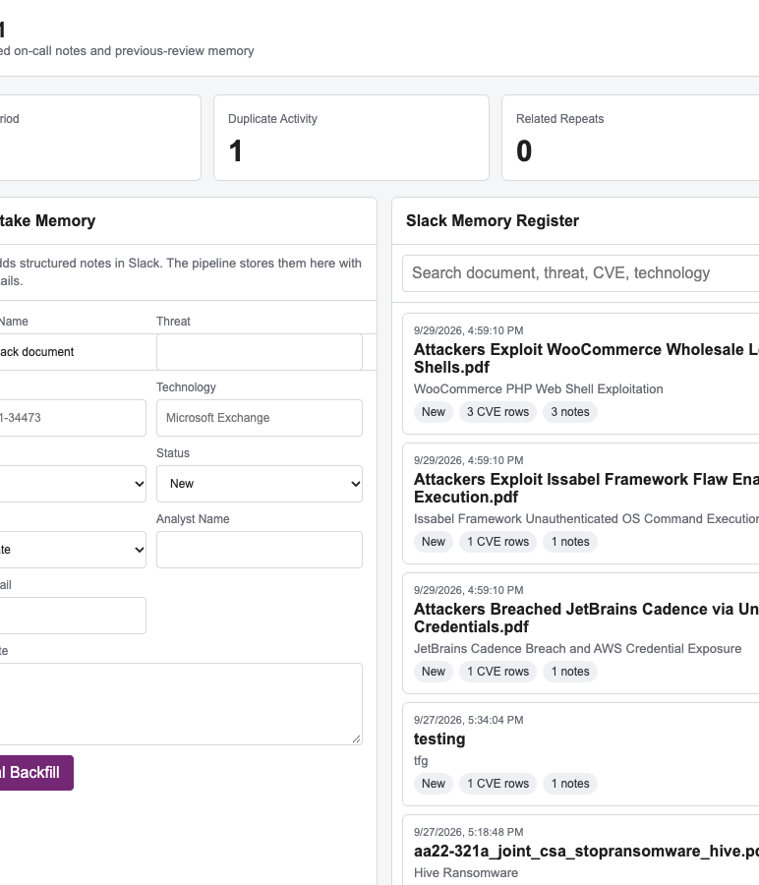
Use case walkthrough
Slack advisory intake, document memory, duplicate awareness, and analyst review
Manager demo section
Notes:
This section turns the architecture into a concrete demo story. Use it after the architecture slides to show how the idea works for one real support workflow.

Slide 14
Use case
A support analyst receives a threat advisory PDF in Slack and needs prior context before starting another review.
1. Advisory arrives
2. Memory check
3. Evidence review
4. Decision capture
The Slack channel receives a PDF and structured note from the on-call team.
The app stores the document, date, analyst note, CVEs, technologies, and duplicate activity.
The analyst opens the document record and checks extracted evidence from the PDF.
The analyst records status, comment, and action so future reviews start with history.
Manager message
The prototype reduces repeat analysis by keeping document-level memory that can later move to SharePoint and Power Apps.
Notes:
Talk track: The use case starts with the support process the team already uses. The change is that the knowledge becomes searchable and reusable.

Slide 15
Phase 1 memory screen
Analysts can add notes to Slack-received documents and review prior document memory by date.
What to show
The top metrics answer how many PDFs and analyst inputs exist for the selected period. The register groups memory by document, which avoids repeating the same PDF for every CVE.
Why it matters
A handoff analyst can see when the document arrived, what the last note said, and whether the advisory was already seen.
Notes:
Show the document selector and the memory register. Point out that the analyst records knowledge at the document level, while CVEs remain visible inside the detail view.

Slide 16
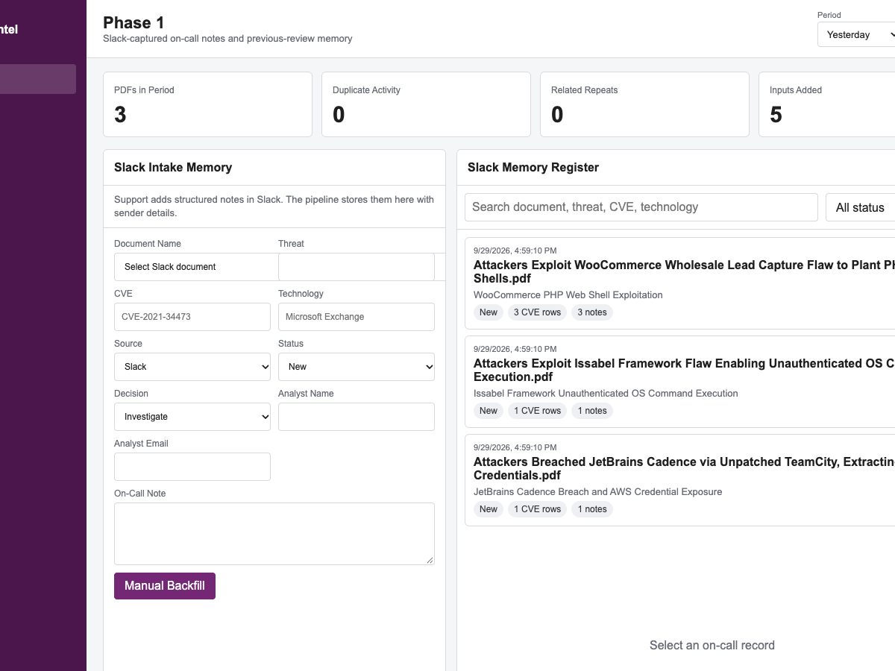
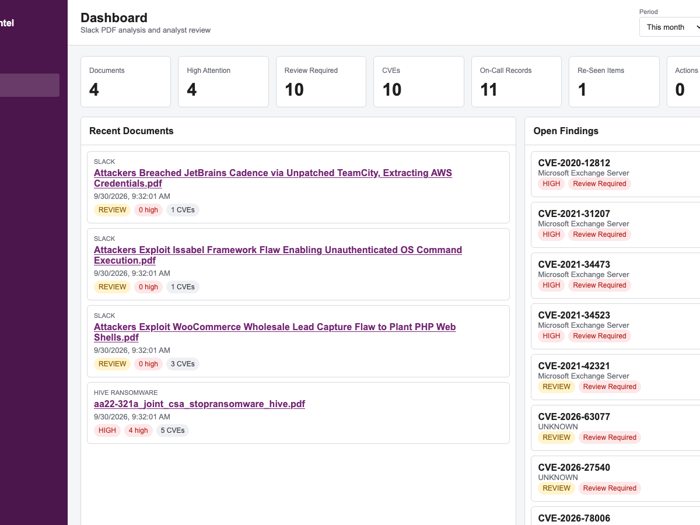
Date and month review
The same screens can answer daily and monthly activity questions without exporting a spreadsheet first.
Examples: yesterday's PDFs, today's manual inputs, this month's duplicate activity, and open reviews in the selected period.
Notes:
Talk track: The date filter is meant for manager reporting and analyst handoff. It gives a simple view by day or month.

Slide 17
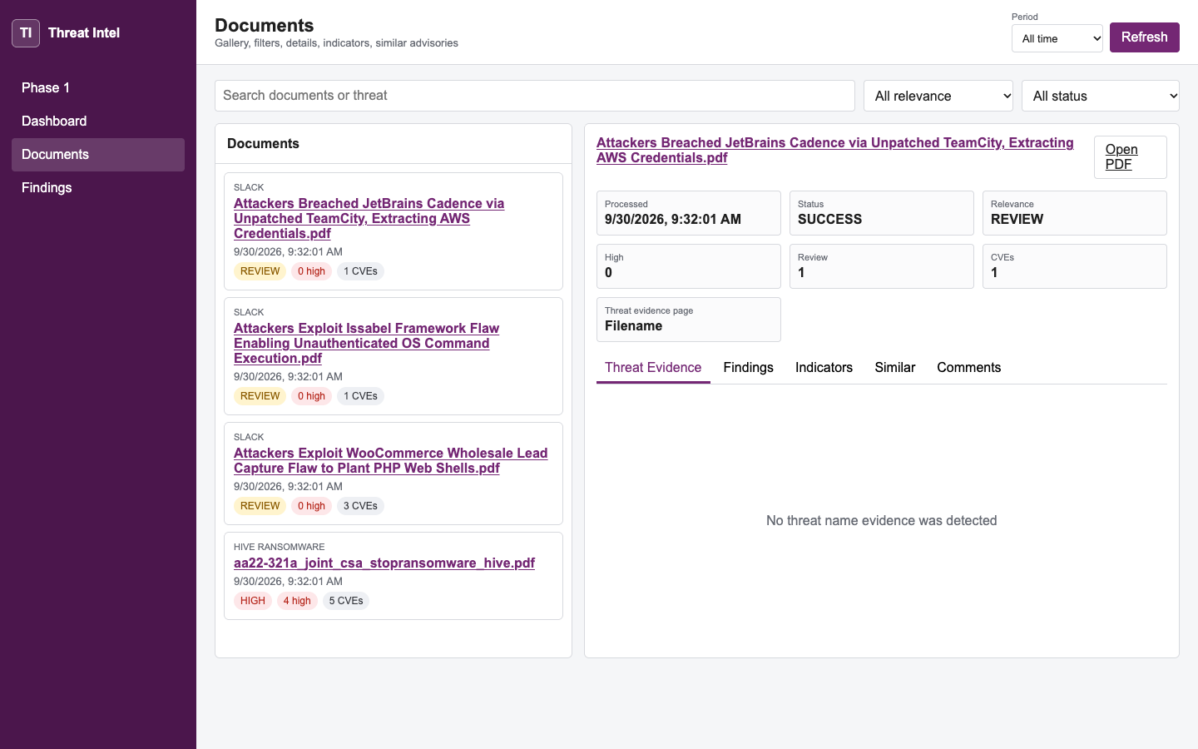
Document evidence view
Each Slack PDF becomes a document record with status, relevance, CVE counts, and an open PDF link.
Demo points
Open PDF link, processing status, relevance, CVE count, indicators, similar advisories, and comments.
SharePoint mapping
These fields can map to SharePoint document and finding lists for Power Apps access.
Notes:
This slide shows the document-level record. In production, the PDF URL would point to SharePoint instead of the local prototype.

Slide 18
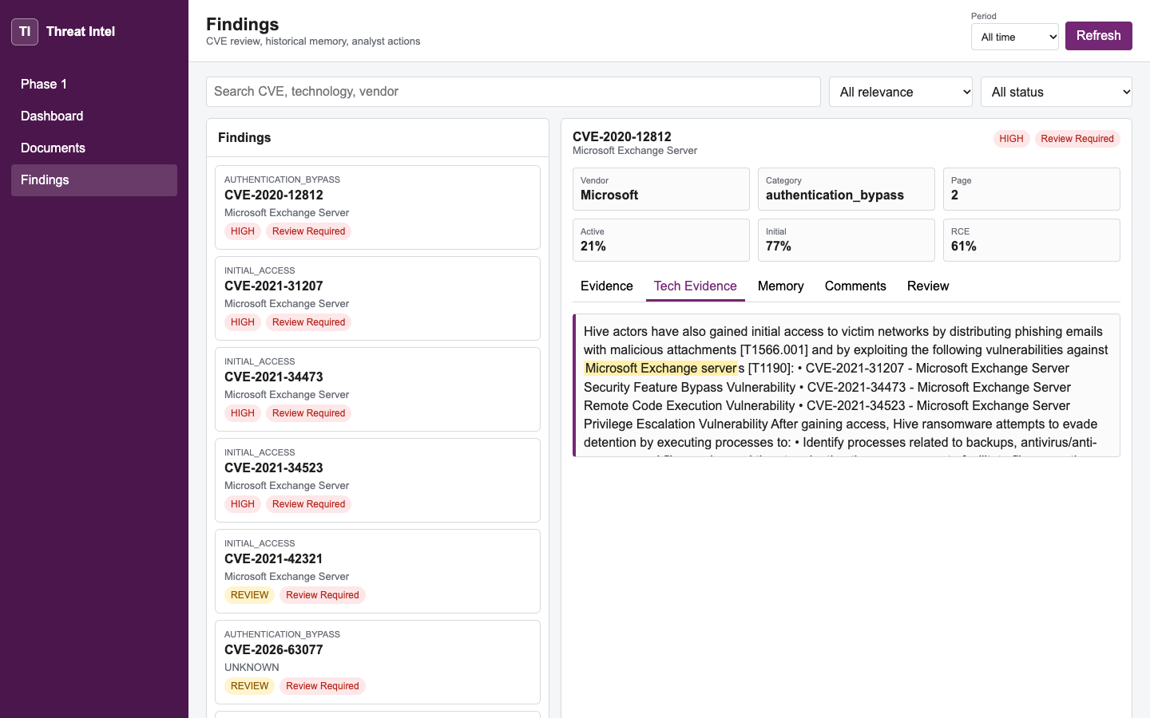
Finding evidence view
The finding page shows why the system selected a CVE or technology, with exact PDF evidence.
What changed recently
The app now captures supporting evidence for threat names and technologies, not just the extracted CVE.
Analyst action
Reviewers can record status, decision, owner, and comment. Future processing can use that memory.
Notes:
Show the Tech Evidence tab. This helps answer the manager question: why did the automation connect this CVE to this technology?

Slide 19
Duplicate and related-repeat handling
The prototype flags exact duplicate PDFs and can also flag different PDFs with the same CVE or technology.
Exact duplicate
Related repeat
Analyst context
Same Slack file or same PDF name appears again. The app records the first and later sighting.
A different document shares a CVE or technology already seen in memory.
The note can show the earlier document date and latest analyst comment.
Example talking point
If a new PDF mentions the same Exchange CVE next month, the analyst should see prior notes before repeating the same investigation.
Notes:
This is the manager value: the system remembers prior work even when the new file has a different name.

Slide 20
Power Apps target shape
The local prototype keeps to capabilities that can map cleanly to SharePoint lists and Power Apps screens.
SharePoint memory
Python processing
Power Apps screen
Documents, findings, statuses, analyst comments, decisions, first seen, last seen, and times seen.
Slack collection, PDF download, CVE extraction, technology evidence, duplicate checks, and semantic memory.
Analyst-friendly review pages for intake memory, documents, findings, and filtered activity.
Current state: local Excel/JSON/SQLite repository. Target state: SharePoint lists plus document library, with the same screen logic in Power Apps.
Notes:
Be clear that this is a prototype. The manager should understand that the local build demonstrates the workflow before SharePoint credentials and licensing are available.

Slide 21
Suggested demo flow
Use this sequence when presenting from the deck without running the local application.
Opening
Show the workflow
Show the screens
Current Slack notes are hard to reuse when on-call ownership changes.
Slack PDF enters the pipeline, the app stores memory, and analysts review prior notes.
Phase 1 memory, date filtering, document evidence, and finding evidence.
Close
Optional ask
Ask for a SharePoint/Power Apps pilot using the same fields and workflow.
Request a small test workspace, one SharePoint site, and sample analyst feedback.
Notes:
This final slide gives the presenter a simple path through the story. It avoids technical setup and focuses on the operational value.

