Slide 1

Project 2
Team members ：Desheng Guo, Fengkai YU, Xunke DENG, Chengcheng Zheng, Panthakan Boonsuriyatham
Introduction
the aims of the analysis

Slide 2
Project 2
Team members ：Desheng Guo, Fengkai YU, Xunke DENG, Chengcheng Zheng, Panthakan Boonsuriyatham
exploratory data analysis

Slide 3
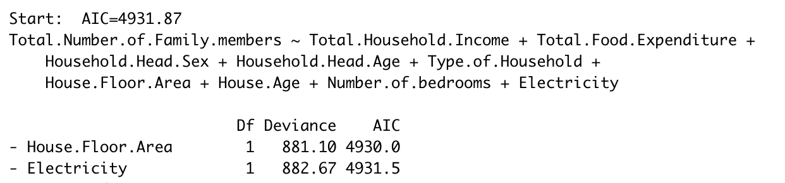
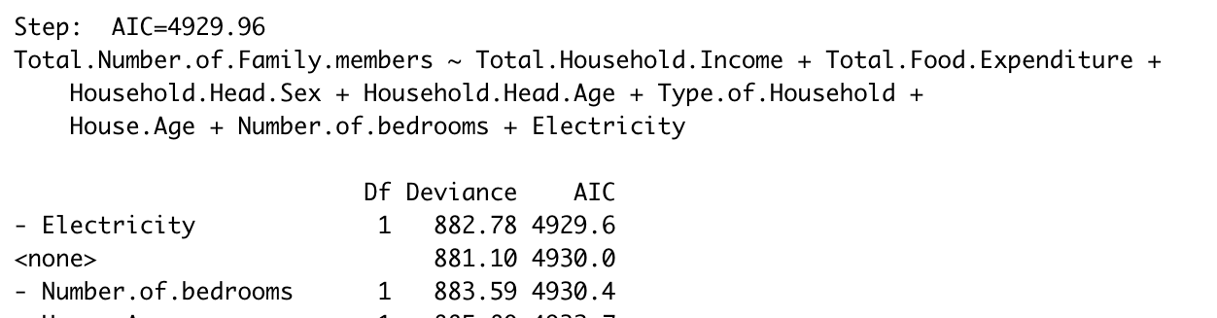
statistical modelling and results
Team members ：Desheng Guo, Fengkai YU, Xunke DENG, Chengcheng Zheng, Panthakan Boonsuriyatham
Assumptions：
1. The human time risk of different objects with the same characteristics and at the same time is homogeneous.
2. When the sample size is larger and larger, the mean of frequency tends to variance.
1.Preliminary fitting model
$$M odel\text{=}\text{glm}\left(\text{Total}\text{.}\text{Number}\text{.}\text{of}\text{.}\text{Family}\text{.}\text{members}\sim \text{Total}\text{.}\text{Household}\text{.}\text{Income}+\text{Total}\text{.}\text{Food}\text{.}\text{Expenditure}+\text{Household}\text{.}\text{Head}\text{.}\text{Sex}\text{+}\text{Household}\text{.}\text{Head}\text{.}\text{Age}\text{+}\text{Type}\text{.}\text{of}\text{.}\text{Household}\text{+}\text{House}\text{.}\text{Floor}\text{.}\text{Area}\text{+}\text{House}\text{.}\text{Age}\text{+}\text{Number}\text{.}\text{of}\text{.}\text{bedrooms}\text{+}\text{Electricity}\text{,}\text{data}\text{=}\text{data}\text{, }\text{family}\text{ = "}\text{poisson}\text{"}\right)$$
2.The stepwise method was used to complete the screening of independent variables.
Step 1:
The AIC of “House.Floor.Area” is the lowest, so drop it.
Step 2:
The AIC of “Electricity” is the lowest, drop it

Slide 4
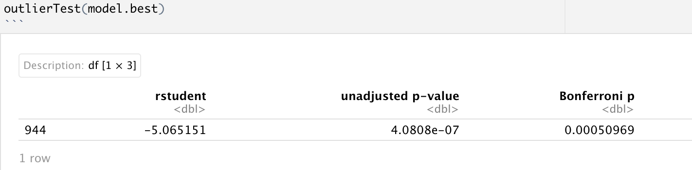
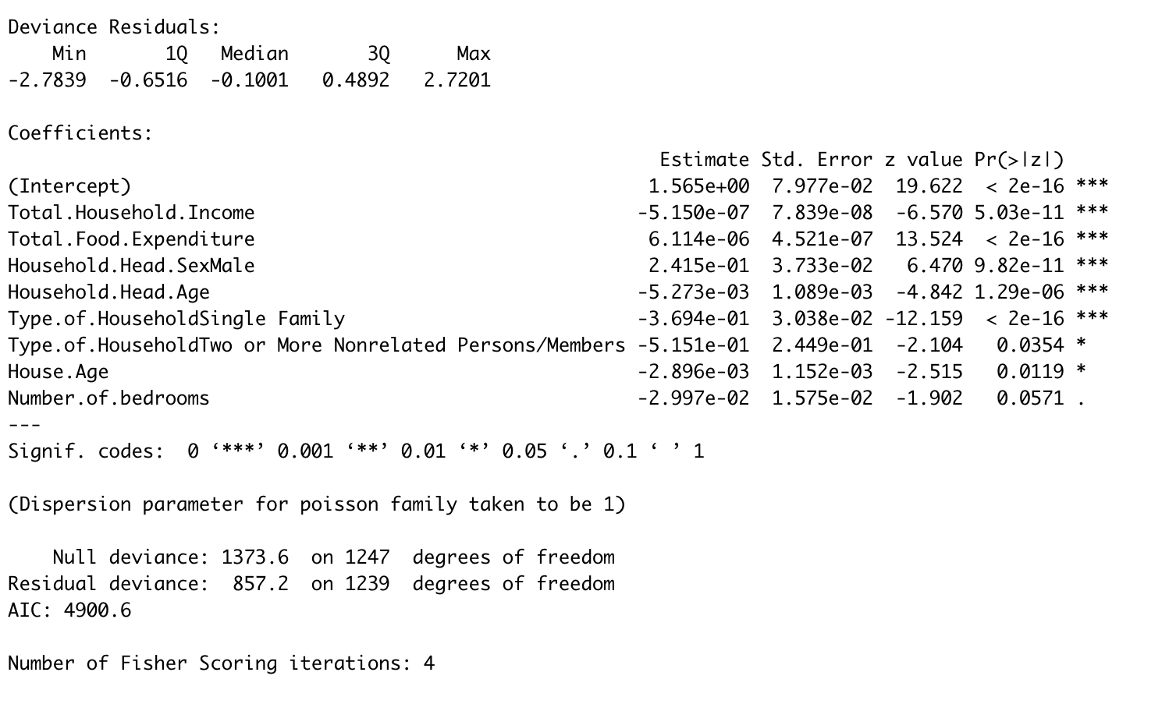
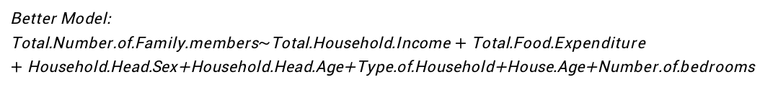
statistical modelling and results
Team members ：Desheng Guo, Fengkai YU, Xunke DENG, Chengcheng Zheng, Panthakan Boonsuriyatham
Look for outliers in the model and remove the row of outliers
Get better model after stepwise method and dropped the outlier
Better $\text{Model}\text{: }$
$$\text{Total}\text{.}\text{Number}\text{.}\text{of}\text{.}\text{Family}\text{.}\text{members}\sim \text{Total}\text{.}\text{Household}\text{.}\text{Income}+\text{Total}\text{.}\text{Food}\text{.}\text{Expenditure}+\text{Household}\text{.}\text{Head}\text{.}\text{Sex}\text{+}\text{Household}\text{.}\text{Head}\text{.}\text{Age}\text{+}\text{Type}\text{.}\text{of}\text{.}\text{Household}\text{+}\text{House}\text{.}\text{Age}\text{+}\text{Number}\text{.}\text{of}\text{.}\text{bedrooms}$$

Slide 5
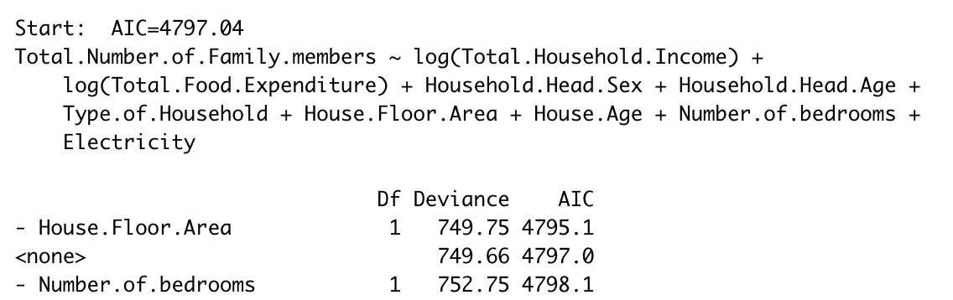
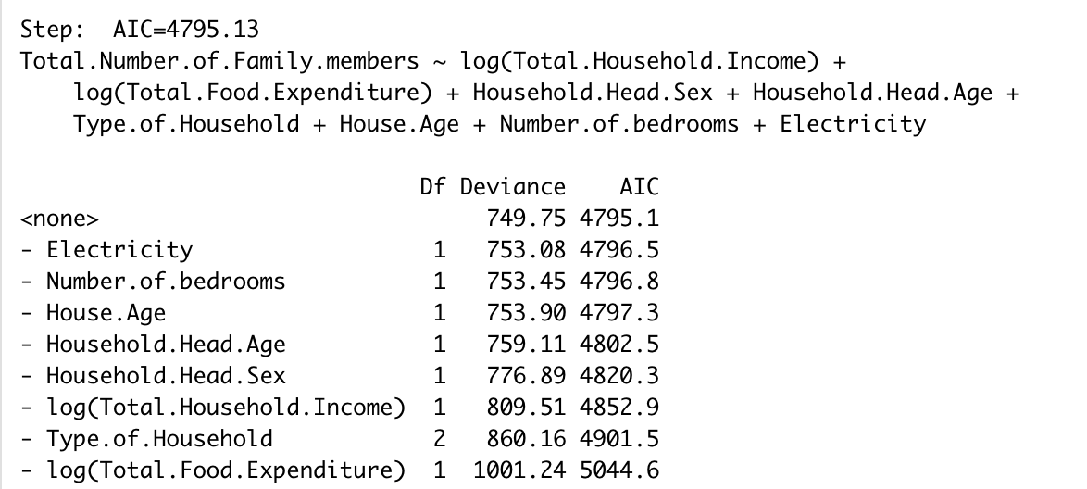
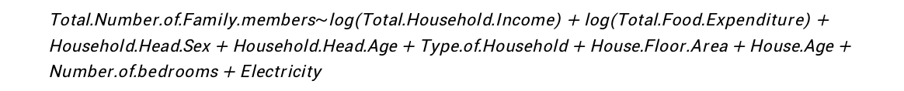
statistical modelling and results
Team members ：Desheng Guo, Fengkai YU, Xunke DENG, Chengcheng Zheng, Panthakan Boonsuriyatham
Another model with logarithmic transformation
$$\text{Total}\text{.}\text{Number}\text{.}\text{of}\text{.}\text{Family}\text{.}\text{members}\sim \text{log}\text{(}\text{Total}\text{.}\text{Household}\text{.}\text{Income}\text{) + }\text{log}\text{(}\text{Total}\text{.}\text{Food}\text{.}\text{Expenditure}\text{) + }\text{Household}\text{.}\text{Head}\text{.}\text{Sex}\text{ + }\text{Household}\text{.}\text{Head}\text{.}\text{Age}\text{ + }\text{Type}\text{.}\text{of}\text{.}\text{Household}\text{ + }\text{House}\text{.}\text{Floor}\text{.}\text{Area}\text{ + }\text{House}\text{.}\text{Age}\text{ + }\text{Number}\text{.}\text{of}\text{.}\text{bedrooms}\text{ + }\text{Electricity}$$
The stepwise method was used to complete the screening of independent variables.
The AIC of “House.Floor.Area” is the lowest, so drop it.
The model after drop “House.Floor.Area”

Slide 6
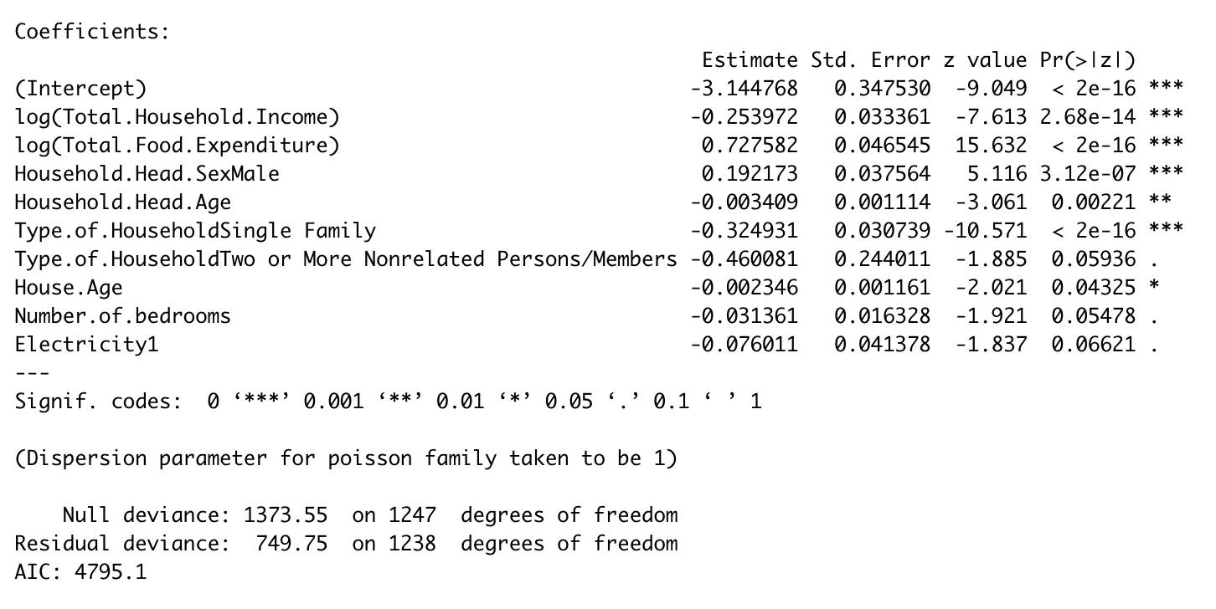
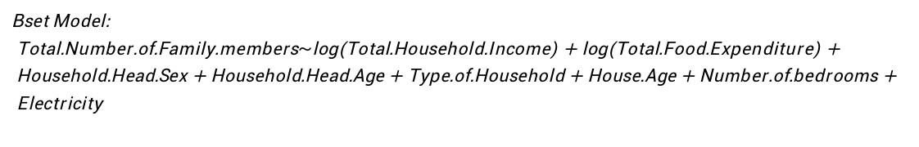
statistical modelling and results
Team members ：Desheng Guo, Fengkai YU, Xunke DENG, Chengcheng Zheng, Panthakan Boonsuriyatham
Bset $\text{Model}\text{: }$
$$\text{Total}\text{.}\text{Number}\text{.}\text{of}\text{.}\text{Family}\text{.}\text{members}\sim \text{l}\text{og}\text{(}\text{Total}\text{.}\text{Household}\text{.}\text{Income}\text{) + }\text{log}\text{(}\text{Total}\text{.}\text{Food}\text{.}\text{Expenditure}\text{) + }\text{Household}\text{.}\text{Head}\text{.}\text{Sex}\text{ + }\text{Household}\text{.}\text{Head}\text{.}\text{Age}\text{ + }\text{Type}\text{.}\text{of}\text{.}\text{Household}\text{ + }\text{House}\text{.}\text{Age}\text{ + }\text{Number}\text{.}\text{of}\text{.}\text{bedrooms}\text{ + }\text{Electricity}$$
Get the bset model after stepwise method and dropped the outlier

Slide 7
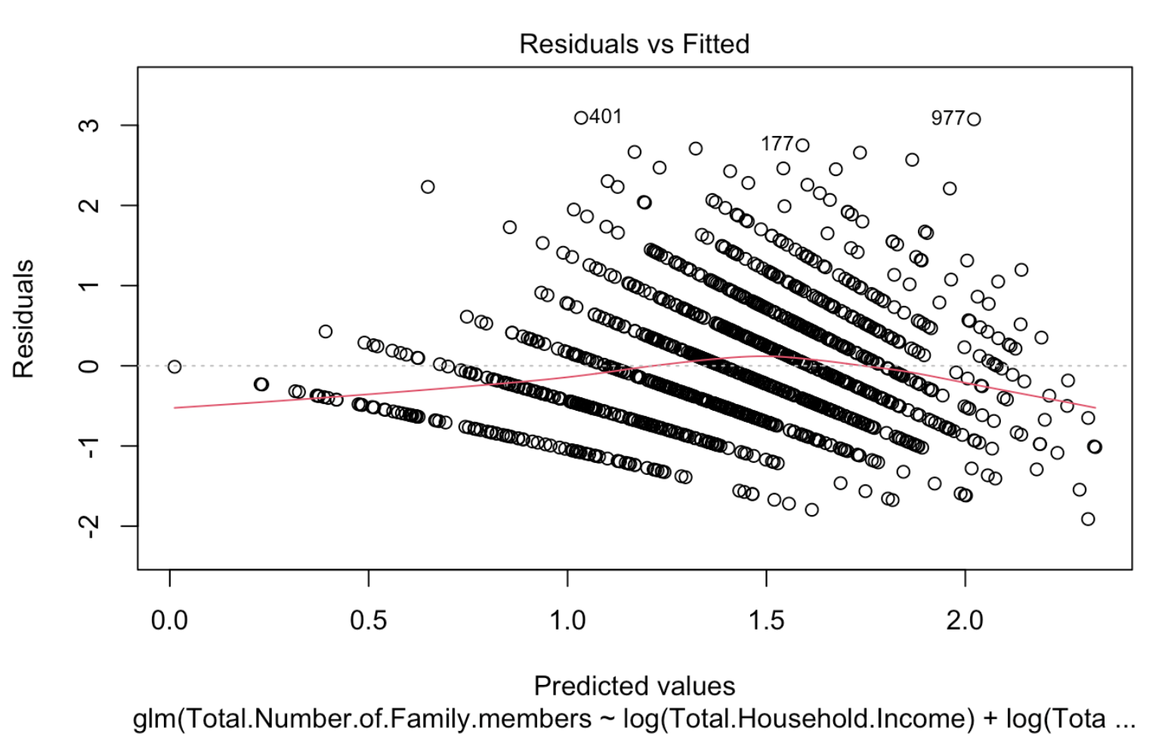
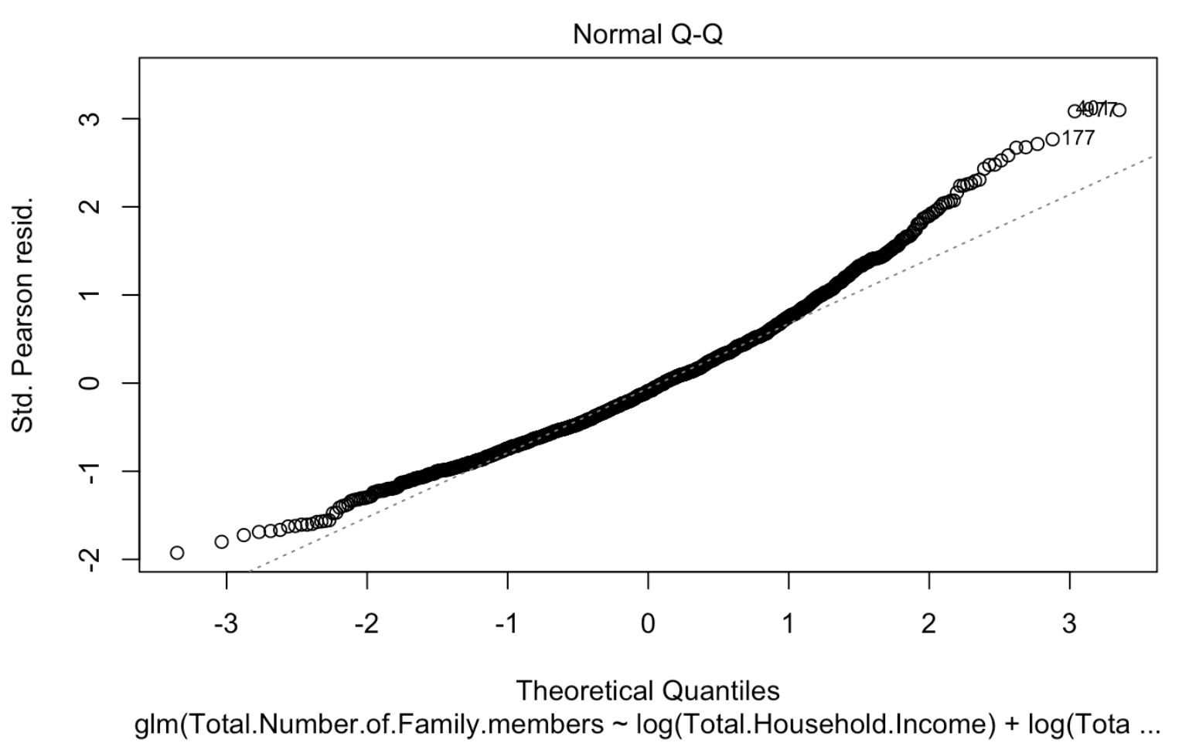
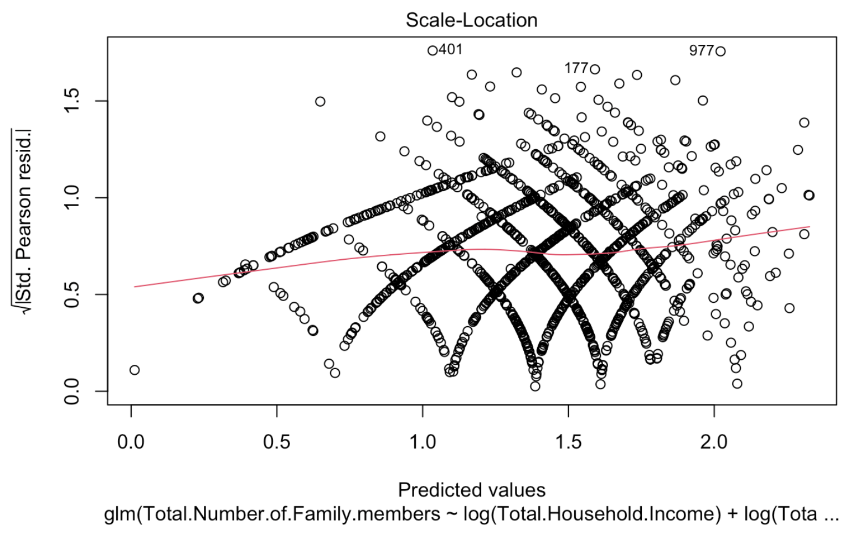
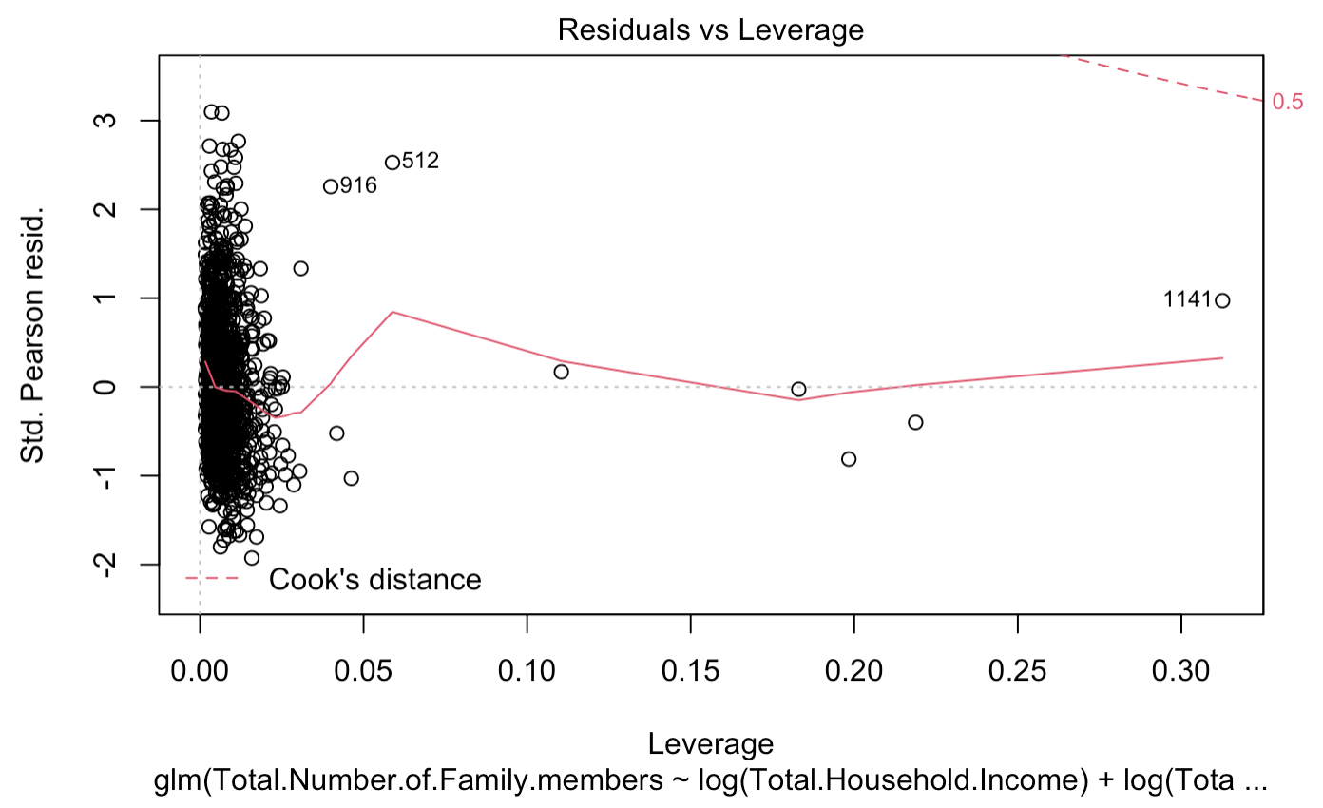
statistical modelling and results
Team members ：Desheng Guo, Fengkai YU, Xunke DENG, Chengcheng Zheng, Panthakan Boonsuriyatham
The plots of model

Slide 8
statistical modelling and results
Team members ：Desheng Guo, Fengkai YU, Xunke DENG, Chengcheng Zheng, Panthakan Boonsuriyatham
Here are the coefficient and plots of model
Intercept | 0.043
log(Total.Household.Income) | 0.776
log(Total.Food.Expenditure) | 2.070
Household.Head.SexMale | 1.211
Household.Head.Age | 0.997
Type.of.HouseholdSingle Family | 0.723
Type.of.HouseholdTwo or More Nonrelated Persons/Members | 0.631
House.Age | 0.998
Number.of.bedrooms | 0.969
Electricity1 | 0.927

Slide 9
Project 2
Team members ：Desheng Guo, Fengkai YU, Xunke DENG, Chengcheng Zheng, Panthakan Boonsuriyatham
Conclusions and Future Work

