Slide 1
Factors influence
the number of people living in a household
Team 2
Team member: Desheng Guo, Fengkai YU, Xunke DENG,
Chengcheng Zheng, Panthakan Boonsuriyatham
Notes:
Hello everyone, this group 2. Today we are going to talk about the household related variable which has the biggest impaction on the number of people living in the household.

Slide 2
PART 01
Introduction
Notes:
Our presentation is divided into five parts: the introduction, exploratory data analysis, modeling, results and conclusions, and the further works. Now let’s beginning with the introduction of the project.

Slide 3

1
Research Question
Introduction
2
Research
Approach
3
Data
Collection
4
Data
Analyze
Notes:
In this part, we come out the research question, chose the appropriate research approach. What’s more, we detailed the Data Collection and the main method used for data analysis.

Slide 4
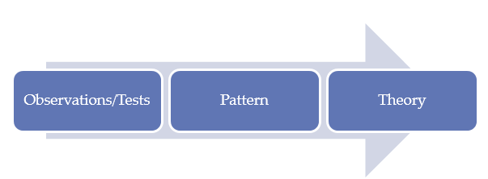
Research Question
Inductive
Research Approach
Which household related variables influence
the number of people living in a household?
Notes:
As I mentioned just now, the main purpose of our study is to find out the household related variable which has the biggest impaction on the number of people living in the household. Since the way we used to do the research is analyzing the observations, generating the pattern, and finally, getting the theory, which is inductive research approach.

Slide 5
FIES (Family Income and Expenditure Survey)
Recorded in MIMAROPA of the Philippines.
1249 samples with 11 variables
· Total.Household.Income is the Annual household income (in Philippine peso)
· Region is the region of the Philippines which a household is in
· Total.Food.Expenditure is the annual expenditure by the household on food
(in Philippine peso)
· Household.Head.Sex is the head of the households sex
· Household.Head.Age is the head of the households age (in years)
· Type.of.Household is the relationship between the group of people living in the house
· Total.Number.of.Family.members is the number of people living in the house
· House.Floor.Area is the floor area of the house (in square meter)
· House.Age is the age of the building (in years)
· Number.of.bedrooms is the number of bedrooms in the house
· Electricity is the electricity status of the house (1=Yes, 0=No)
where “head of the household” is the person who is in charge of that house.
Data
Collection
Generalized Linear Model
(GLM)
Data Analyze
Notes:
To start the project, the Family Income and Expenditure Survey data we used is collected from the MIMAROPA of Philippines. The Family Income and Expenditure Survey is a survey of every household in a country which is taken every three years. In this project, our dataset is collected in MIMAROPA and 1294 samples with 11 variables were recorded. To do the analysis, we use the Generalized Linear Model. Okay, now, let my partner to introduce more specific information of our project to you.

Slide 6
PART 02
Exploratory Data Analysis

Slide 7
Statistics Summary
Summary statistics of continuous variables
Variable | Mean | SD | Min | Median | Max | IQR
Total.Number.of.Family.members | 4 | 2 | 1 | 4 | 16 | 2
Total.Household.Income | 216,685 | 263,207 | 18,784 | 140,483 | 2,891,788 | 89,919
Total.Food.Expenditure | 70,760 | 41,638 | 10,488 | 62,590 | 413,844 | 24,118
Household.Head.Age | 51 | 14 | 15 | 51 | 87 | 10
House.Floor.Area | 49 | 49 | 5 | 36 | 750 | 24
House.Age | 16 | 13 | 0 | 14 | 105 | 8
Number.of.bedrooms | 2 | 1 | 0 | 2 | 7 | 0
Summary statistics of discrete variables
Variable | Counts
Household.Head.Sex | Mal: 983, Fem: 266
Type.of.Household | Sin: 900, Ext: 344, Two: 5
Electricity | 1: 1069, 0: 180
Notes:
The first table is Summary statistics of continuous variables.
We can see that the SD of Total.Numberof.Family.memers is 2 and its variance is 4 equal to its mean.
The mean of total house income is much higher than its median. So there are lots of households income is below the mean. There may be some household, whose income are very high. It can be outliers in the dataset.
From the discrete variables table, we can see although there are there types of household, the main types are single house and extended house. There is only 5 unrelated household.

Slide 8
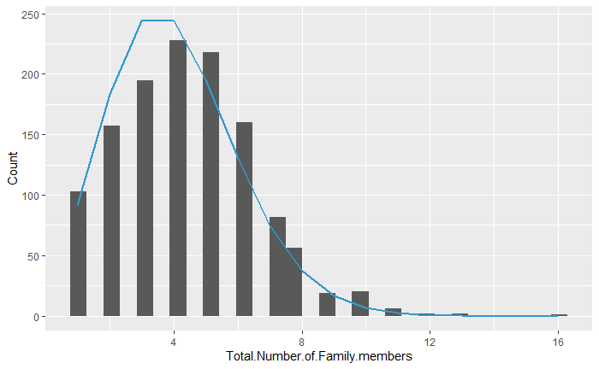
Distribution of Total.Number.of.Family.members
The distribution of number of family members follows
Poisson distribution.
Note:
The blue line is the standard Poisson distribution whose mean equals 4.
The bar is the distribution of Total.Number.of.Family.members.
Notes:
In this slide, we want to explore the distribution of Total number of family members.
The bars are….
The blue line is….
We can infer from the graph that…..

Slide 9
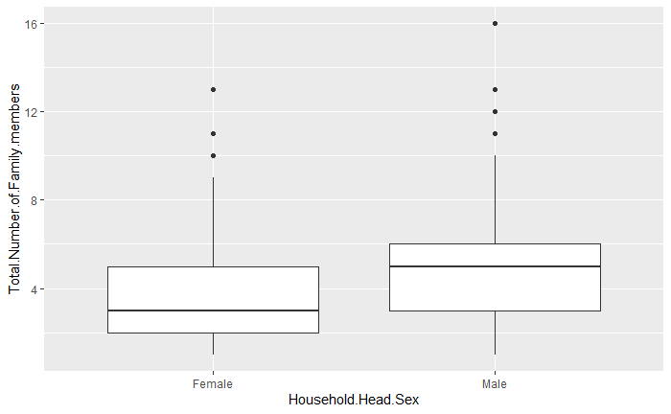
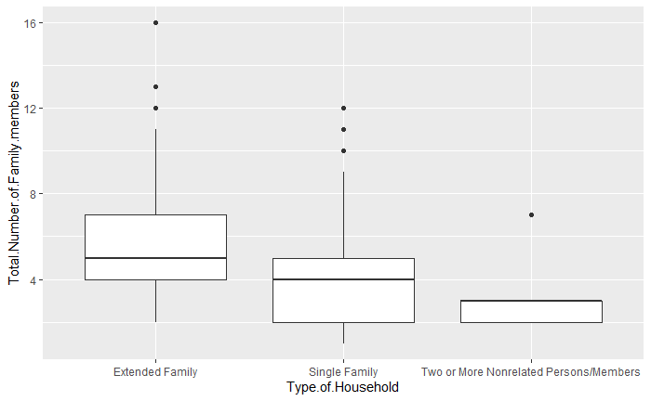
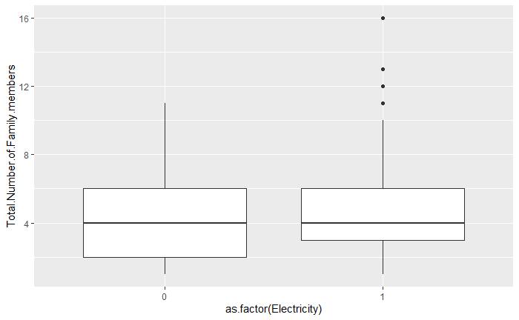
Analysis of Features
1.On average, male head families have more members than female.
2. Extended Families have more members than single families and single families have more members than nonrelated persons families.
3. Electricity has no impact on the numbers of members in each family.
Notes:
Next, we use boxplot to explore the relationship of Total number of family members and three discrete variables.
We can see that, on average…… but…….

Slide 10
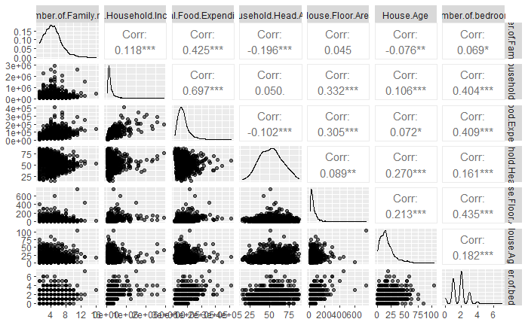
Analysis of Features
Weak or very weak correlation
Weak or even no linear relationship
Except income and expenditure (moderate positive correlation), other features only have weak or very weak correlation.
No multicollinearity
Notes:
Next, we use scatter plot to explore the relationship of Total number of family and other continuous variables.
From the first row in the matrix, we can see that the correlationof Total number of family and other continuous variables are weak or very weak.
From the triangle area in the picture, we can see that except the correlation of food expenditure and household income, other correlations are also weak or very weak. the correlation of food expenditure and household income are moderate. It shows us that there is no multicollinearity between independent variables.

Slide 11
PART 03
Modeling

Slide 12
Model Optimization Process
Best
Model
Step wise & Drop Outlier
Preliminary model
After we use logarithm transformation, we repeat step wise and dropping outlier again. Finally, we get our best model whose AIC is 4795.
We use the Poisson regression model in GLM to preliminarily fit all variables.
Logarithm Transform
Step wise
Drop Outlier
Because “Total.Household.Income” and “Total.Food.Expenditure” are too large, their coefficients are too close to 1. So we use logarithm transform, which makes us see the influence of these two variables more clearly.
“House.Floor.Area”, “Electricity” are dropped out. AIC decreases from 4932 to 4930.
One outlier is detected whose “Total.Food.Expenditure” is much higher than other samples. AIC decreases from 4930 to 4901.
Notes:
The stepwise method was used to complete the screening of independent variables.

Slide 13
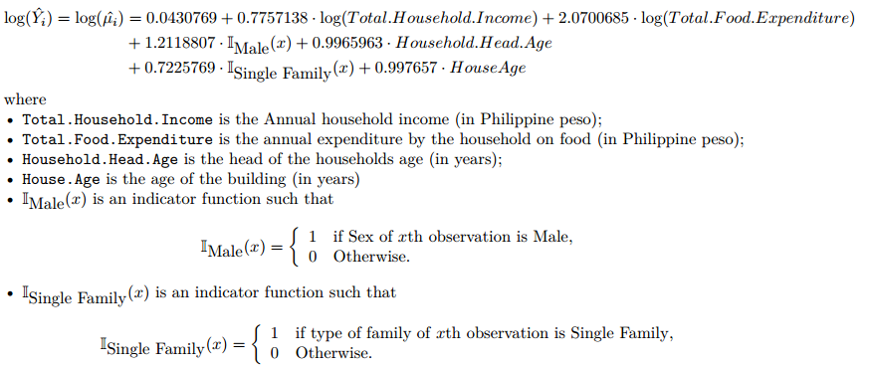
Best Model & Goodness of Fit of Model
Best Model:
Goodness of Fit of Poisson Model：
chisq | df | p.value
749.7502 | 1238 | 1
Notes:
We use chi square test to test the goodness of fit of the Poisson model
The p value is 1, which indicates that the goodness of fit of the model is good.

Slide 14
PART 04
Results and Conclusion

Slide 15
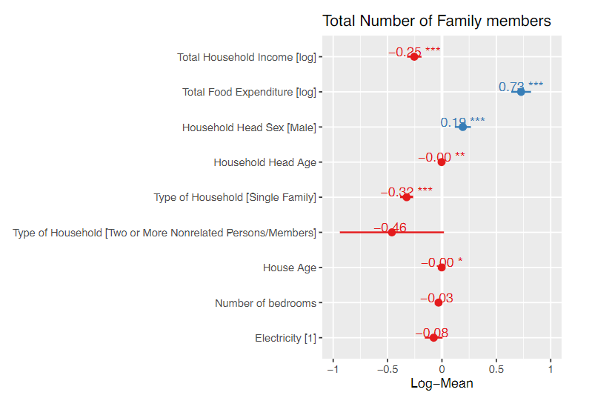
Coefficient and Interpretation
Parameter | Exp(coef)
Intercept | 0.043
log(Total.Household.Income) | 0.776
log(Total.Food.Expenditure) | 2.070
Household.Head.SexMale | 1.211
Household.Head.Age | 0.997
Type.of.HouseholdSingle Family | 0.723
Type.of.HouseholdTwo or More Nonrelated Persons/Members | 0.631
House.Age | 0.998
Number.of.bedrooms | 0.969
Electricity1 | 0.927
Exp(coef)
Notes:
This is the figure of incidence Rate Ratios.This is the coefficient of the model.and then we can get some conclutions.

Slide 16
Conclusions
Positive Impactions
Negative Impactions
log(Total.Household.Income)
Type.of.HouseholdSingle Family
House.Age
Household.Head.Age
log(Total.Food.Expenditure)
(the biggest impaction)
Household.Head.SexMale
Notes:
That is, the increase of annual household food expenditure (Philippine Peso), the gender of the head of household is male, which has a positive impact on the number of people living in this house, and the increase of annual household income (in Philippine Peso), the age of the head of household (in), single families and construction age (in) have a negative impact on the number of people living in this house.

Slide 17
PART 05
Future Work

Slide 18
Future Work
Larger Sample Size
Shorter Sample Period
Sampling each three year
Sampling each year
Sampling in
MIMAROPA
Sampling among Philippine
Notes:
To improve our research, there are some further works we can do. We can work on both data collection and model building. For data collection, we can make research more relevant by increasing the diversity of data. For example, sampling among Philippine rather than in MIMAROPA to larger the sample size. Or sampling each year rather each three years to shorter the sample period. For model building, we can try to use other different kinds of models. For example, try to use a multilinear model to replace the current Poisson model. All of the above work is to make the model more realistic.

Slide 19
THANK
YOU

