Slide 1

Project 2
Team members ：Desheng Guo, Fengkai YU, Xunke DENG, Chengcheng Zheng, Panthakan Boonsuriyatham
Introduction
the aims of the analysis

Slide 2
Project 2
Team members ：Desheng Guo, Fengkai YU, Xunke DENG, Chengcheng Zheng, Panthakan Boonsuriyatham
exploratory data analysis

Slide 3
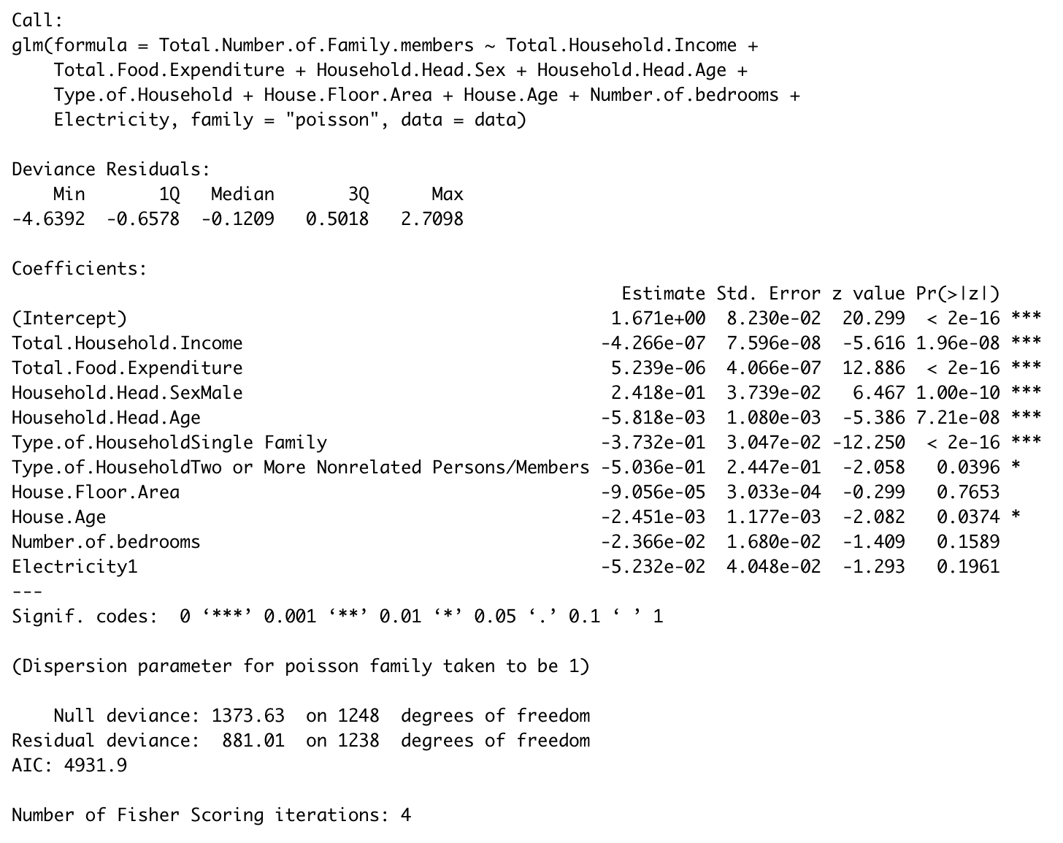
statistical modelling and results
Team members ：Desheng Guo, Fengkai YU, Xunke DENG, Chengcheng Zheng, Panthakan Boonsuriyatham
This study decided to use Poisson regression to fit the model. Poisson regression mainly has two assumptions. Firstly, the human time risk of different objects with the same characteristics and at the same time is homogeneous. Secondly, when the sample size is larger and larger, the mean of frequency tends to variance.
First: Preliminary fitting model
model<-glm(Total.Number.of.Family.members~Total.Household.Income+Total.Food.Expenditure+Household.Head.Sex+Household.Head.Age+Type.of.Household+House.Floor.Area+House.Age+Number.of.bedrooms+Electricity, data=data, family = "poisson")

Slide 4
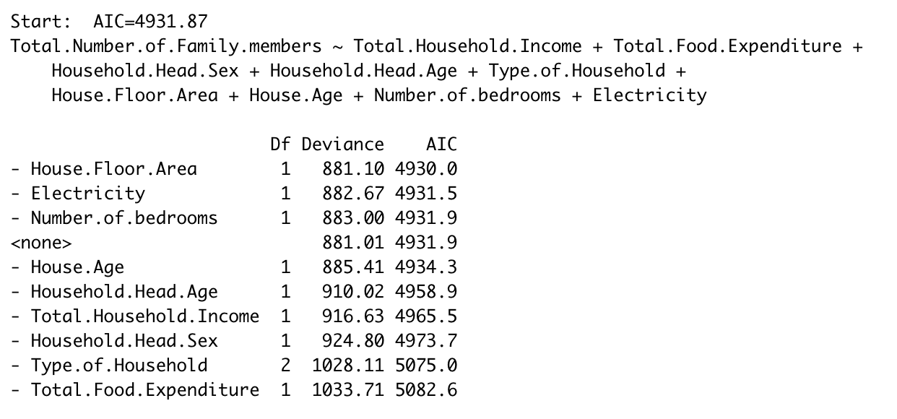
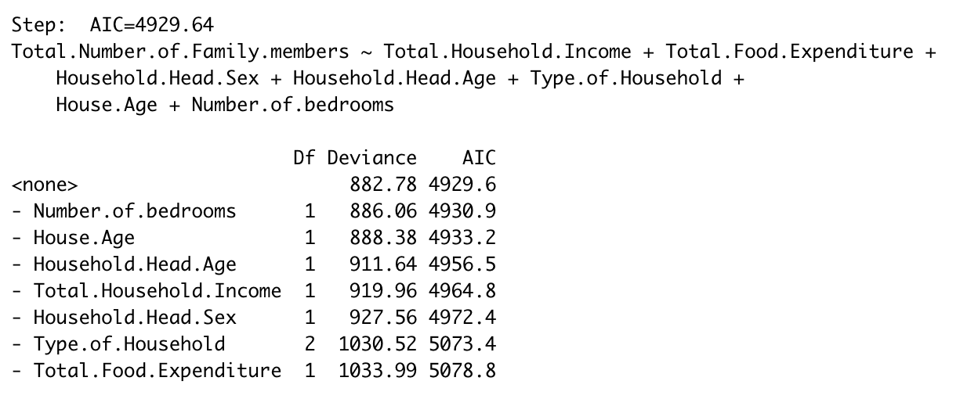
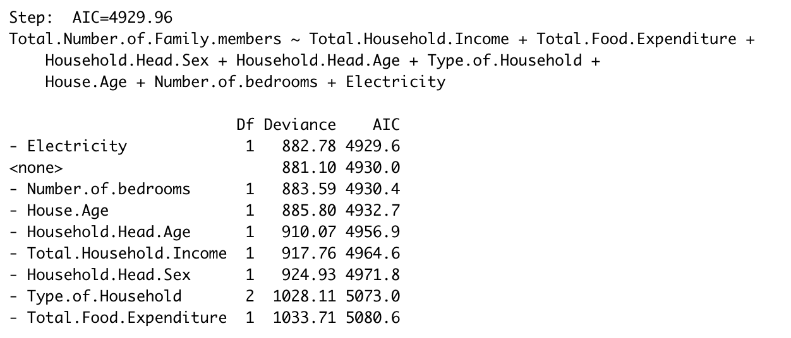
statistical modelling and results
Team members ：Desheng Guo, Fengkai YU, Xunke DENG, Chengcheng Zheng, Panthakan Boonsuriyatham
The stepwise method was used to complete the screening of independent variables.
Second: Stepwise method
Step 1:
The AIC of “House.Floor.Area” is the lowest, so drop it.
Step 3:
After dropped “House.Floor.Area” and “Electricity”
Step 2:
The AIC of “Electricity” is the lowest, drop it

Slide 5
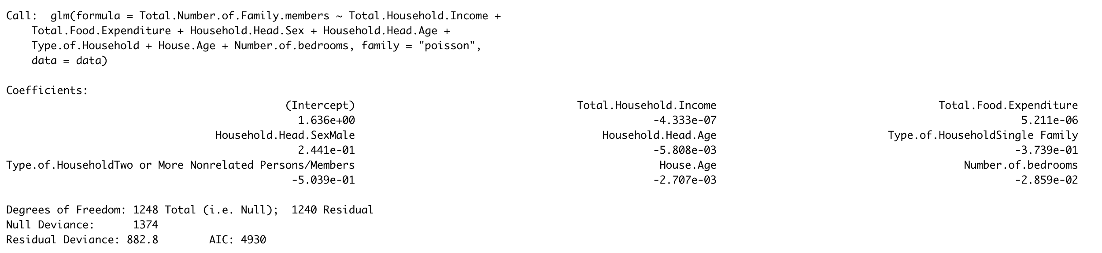
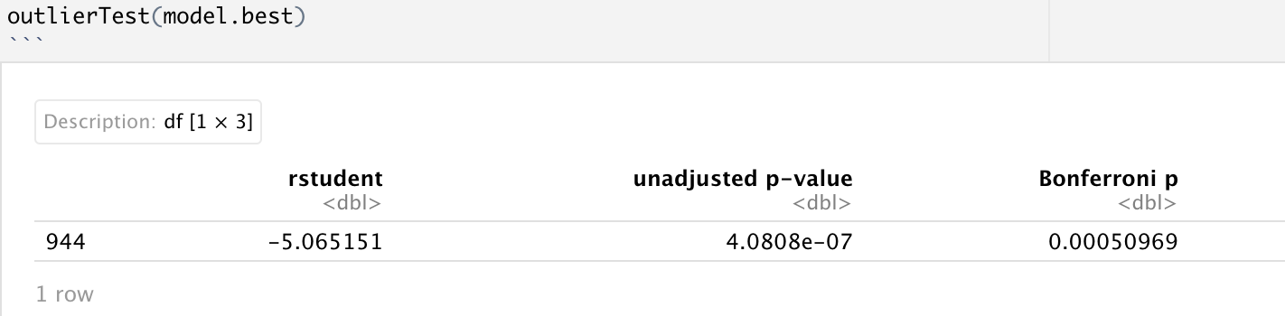
statistical modelling and results
Team members ：Desheng Guo, Fengkai YU, Xunke DENG, Chengcheng Zheng, Panthakan Boonsuriyatham
The stepwise method was used to complete the screening of independent variables.
Second: Stepwise method
The model after dropped “House.Floor.Area” and “Electricity”
Look for outliers in the model

Slide 6
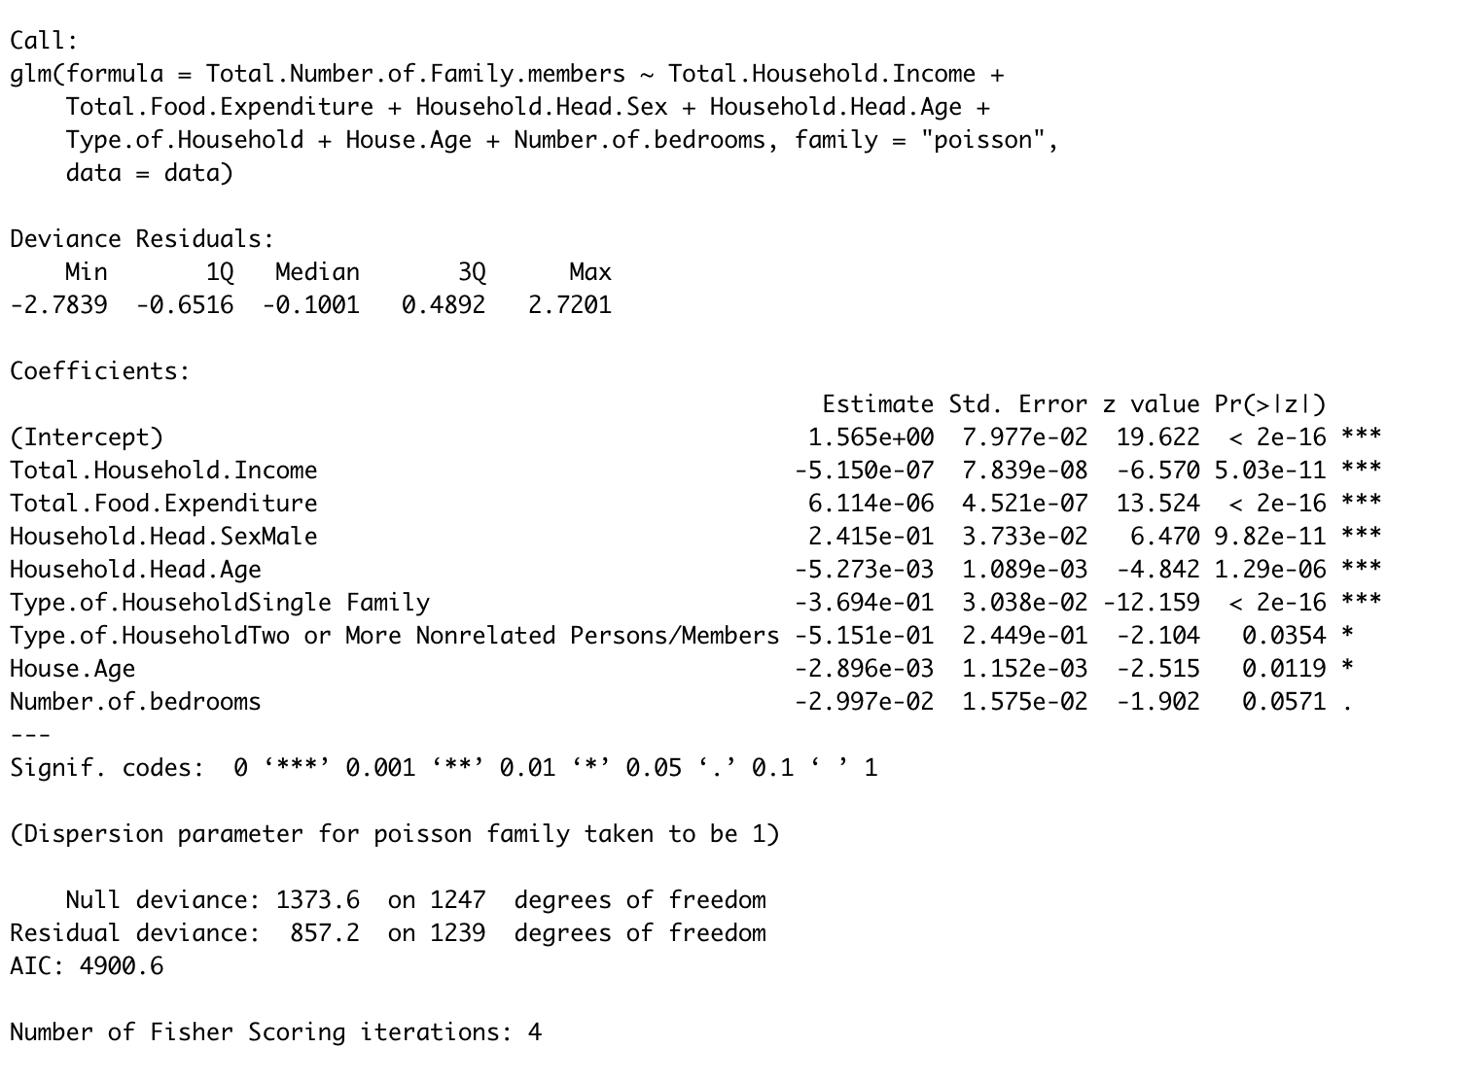
statistical modelling and results
Team members ：Desheng Guo, Fengkai YU, Xunke DENG, Chengcheng Zheng, Panthakan Boonsuriyatham
Get the best model after dropped the outlier

Slide 7
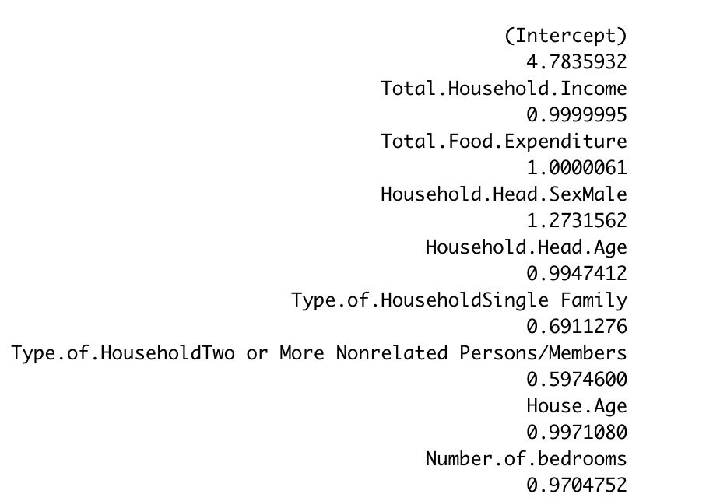
statistical modelling and results
Team members ：Desheng Guo, Fengkai YU, Xunke DENG, Chengcheng Zheng, Panthakan Boonsuriyatham
Here are the coefficient and interpretation of model
In the MIMAROPA region, all variables except Number.of.bedrooms and Electricity show significance. While keeping other variables unchanged, the annual household income (in Philippines Peso) will be increased by 1 unit, and the number of people living in the house will be multiplied by 0.999995. Annual expenditure by the household on food changes, the number of epilepsy will be multiplied by 1.0000061. If the gender of head of the houses sex is male, the number of people living in the house will be multiplied by 1.2731562, indicating that the owner is male, which has a positive impact on the increase of the number of people living in the room. The number of people living in the house will be multiplied by 0.9947412 for each additional year of head of the houses age. In the relationship between the group of people living in the house, both single family and two or more nonrelated persons / members will both have a negative impact on the increase of the number of people living in the room. The number of people living in the house will be multiplied by 0.9971080 for each year of age of the building.

Slide 8
Project 2
Team members ：Desheng Guo, Fengkai YU, Xunke DENG, Chengcheng Zheng, Panthakan Boonsuriyatham
Conclusions and Future Work

