Slide 1

AI Data Center Energy and Cost Forecasting
Forecasting 2026 power, cost and carbon, and choosing the best region to run GPU workloads
AWS S3
Athena
SageMaker
Power BI

Slide 2



AI is outgrowing its power budget
Power demand
Cloud cost
Carbon impact
GPU clusters draw far more electricity every year, and the growth is hard to predict.
Energy and instance prices differ by region, so budgets drift without a forecast.
The same workload can emit over 20x more CO2 depending on where it runs.
Key question: where and when should we run GPU workloads?

Slide 3

Objective
Forecast
Forecast 2026 and recommend the best region
Monthly energy, cost and carbon for each region
Cheapest
Lowest GPU price per hour
Greenest
Lowest carbon emitted per kWh

Slide 4






Cloud architecture
Sources
S3 raw
Athena
S3 processed
SageMaker
Power BI
3 raw datasets
raw/ folders
SQL + cleaning
Monthly Parquet
Trend forecast
Dashboard
Cost and scale
S3, Athena and a stopped notebook cost almost nothing at this size. Production would add scheduled Glue jobs, SageMaker pipelines and streaming data.

Slide 5
Data and method
70,176
4
96
12
simulated hourly GPU rows
regions compared
monthly summary rows
months forecast (2026)
Athena cleaned the timestamps and built the monthly summary table
SageMaker fitted a linear trend per region and per metric
Forecast results were saved to S3 and loaded into Power BI

Slide 6
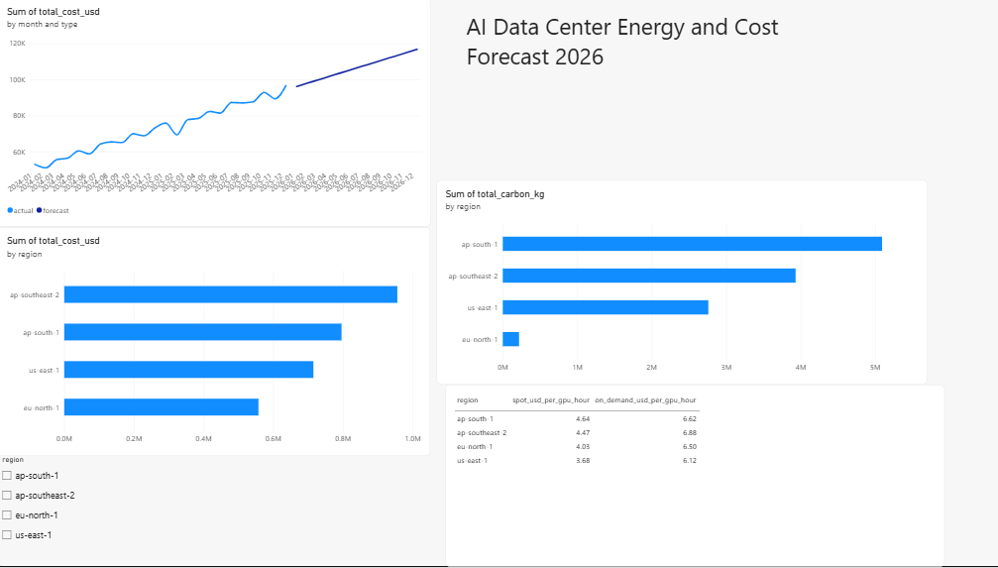


The Power BI dashboard
Actual vs forecast cost
Region slicer filters the visuals
Cost, carbon and GPU price compared

Slide 7
Monthly cost keeps climbing into 2026
~2.2x
monthly cost, Jan 2024 to Dec 2026
~117K
USD forecast for Dec 2026, all regions

Slide 8
Cheapest and cleanest are different regions
Cheapest GPU price: us-east-1. Lowest carbon and energy cost: eu-north-1.

Slide 9
Where to run GPU workloads
Cheapest GPU price
Greenest and lowest energy cost
us-east-1
eu-north-1
$3.68 per GPU-hour on spot
30 g CO2 per kWh, lowest electricity bill
Run flexible training jobs in eu-north-1. Use us-east-1 spot when hourly price matters most.

Slide 10


Limitations and next steps
Limitations
Next steps
GPU usage and prices are simulated or illustrative
Linear trend only, no seasonality
Glue crawler was blocked, so tables were built manually in Athena
Power BI reads downloaded CSVs, not live S3
Cheapest hour to run (time-of-day analysis)
Prophet or SageMaker DeepAR for seasonality
Live prices from the AWS Pricing API
Live Athena connection in Power BI

