Slide 1
Heuristics:
h1(n)=0
h2(n)=no of misplaced tiles
h3(n)=Manhattan distance
h4(n)=Nilson sequence score

Slide 2
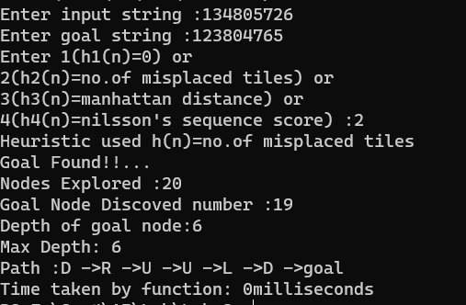
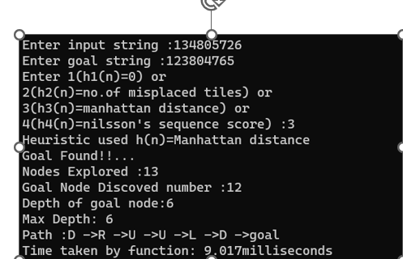
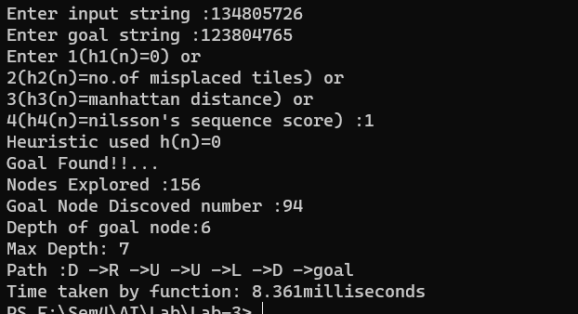
Observe and verify that better heuristics expand lesser states:
Consider these two examples:
Input String:134805726
Goal String:123804765

Slide 3
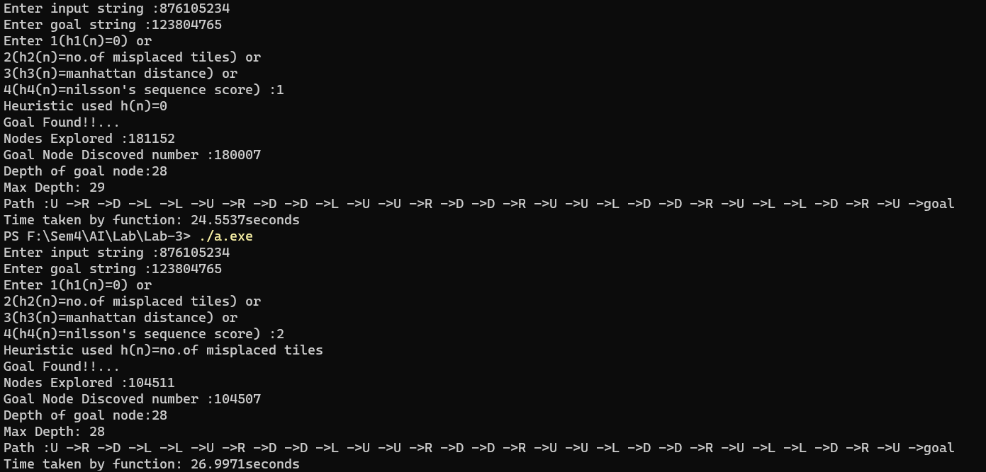
Example 2)
Input String:
Goal String:

Slide 4
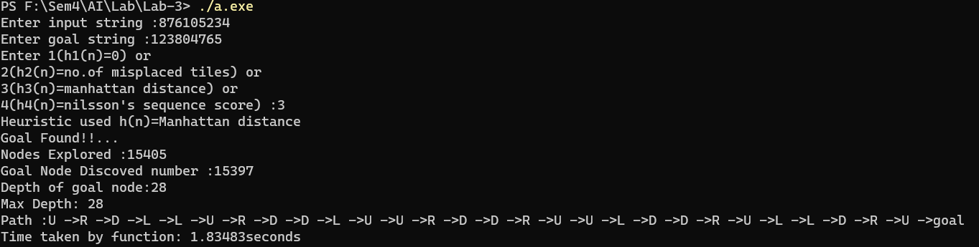
As based on observations when heuristic used is Manhattan distance the number of states explored is less than no of misplaced tiles heuristic which is a better heuristic than the first one.

Slide 5
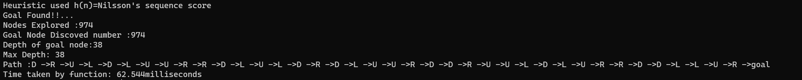
Note that when heuristic used is Nilsson’s sequence score it expands(most cases) less states than our heuristics but it reaches the goal in sub optimal way(see the depth for reference).

Slide 6
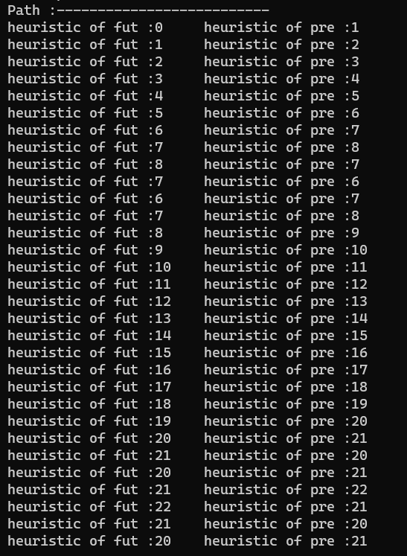
3 and 5)
5c)
Obseve and verify monotone restrictions:
Consider a case of Manhattan distance:
The beside diagram illustrates the path from ending(goal) tracking
back to source.
If we observe near the goal point h(n’)<=h(n)+cost()
(since cost is 1 for adjacent nodes
We get h(n’) from the fut and h(n) from pre. The above equation
Only validates when node is near goal.
If I conider node next to source h(pre)=20.
h(fut to our pre)=21
This clearly implies h(n’)=21 <= 20 + 1
So therefore monotone restriction is maintained in Manhattan distances

Slide 7
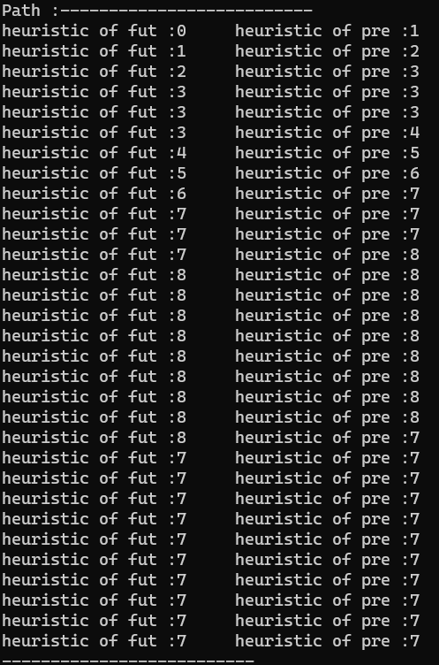
5b)No of misplaced tiles
See the diagram illsustrated beside :
Same notations as of previous, optimal path = 31 units
If we see here at any point h(fut)<=h(pre)+1
Minimum cost path is 1.
Hence Monotone restriction is satisfied in no.of misplaced tiles heuristic

Slide 8
5a)
In the case of h(n)=0
We need not even run the code mathematically we can say it.
Cost()=distance from source(>=1 other than source)
h(n’) = 0
h(n) = 0
Therefore
h(n’)<=h(n) + cost()

Slide 9
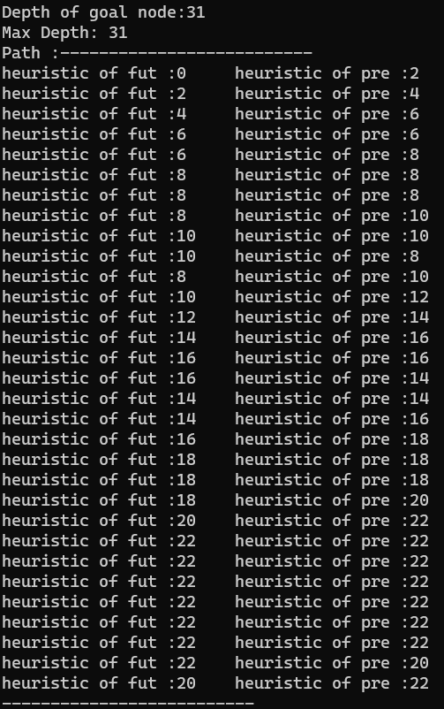
6) Observe and verify if cost of empty tile is added
Manhattan Distance
Consider the node next to source as present..
h(pre)=20
h(fut)=22
Cost(fut,pre)=1
This implies
h(fut) =22 is not less than h(pre)=20 + 1
Hence monotone restriction violated sometimes in Manhattan distance.

Slide 10
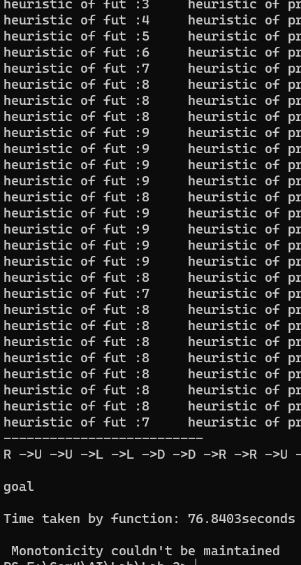
No.of misplaced tiles
Monotonicity couldn’t be maintained
I have written code such that if h(newnode)>h(present)+1
Return false
Since cost =1 for adjacent and monotonicity condition fails

Slide 11
4) Unreachability
Here if we observe that in unreachable it generates all the nodes of unreachable state(9!/2 = 181440 nodes)
So the heuristic with explores faster will give goal is unreachable solution faster
Therefore time required wil be:
h1(n) < h2(n) < h3(n) < h4(n)
Since computation increases in heuristics from left to right in the above.

