Slide 1

SAMSUNG PRISM
Generative AI
Hackathon
3rd Edition 2026 – 27
Theme ID – Theme 1
Team Name – SRMIST_NOVA
College Name – SRM Institute of Science & Technology
Member Name & Email 1- Deshna Dey (dd2942@srmist.edu.in)
Member Name & Email 2- Anoushka Nayak (an1565@srmist.edu.in)
Member Name & Email 3- Aleesha Bhave (ab0373@srmist.edu.in)
Member Name & Email 4- Shanavi Santhana (ss9680@srmist.edu.in)
Submission Github link - https://github.com/DeshnaDey/Samsung-PRISM.git
Notes:
Opening slide for the 3rd edition of the PRISM Generative AI Hackathon. Replace the SAMSUNG PRISM pill with the official PRISM logo image if you have the asset. Confirm the academic year label (2026-27) before circulating.

Slide 2
Theme
Problem: You give the system a question in plain English. It searches a set of code snippets and ranks them from most to least relevant.
Scope: Natural-language-to-code retrieval.
Given: a plain-English query, and a set of code snippets (up to a few thousand, of different lengths).
Task: return the snippets sorted by how well they answer the query.
Constraints:
Runs on CPU only. No GPU needed, and it stays fast.
Evaluated via MTEB's AppsRetrieval task on CoIR-Retrieval/apps. This is a fixed harness, so every team is scored the same way.
Metrics: NDCG@10 and MRR. Both measure how close the correct snippet is to the top.

Slide 3
Goals and success criteria:
P0: Retrieval accuracy. Find the right snippet.
P1: Retrieval across versions. Re-index a changed codebase quickly.
Bonus: search across all versions at once, even when snippets look almost the same.

Slide 4
Existing Solutions & Gaps
Keyword search (BM25): fast and strong at exact matches like function names and error strings. But it misses questions that describe behaviour without naming it.
Meaning search (dense bi-encoder, e.g. all-MiniLM): understands meaning. But general models are trained on plain text, not code, so they miss code structure and identifiers. Note: scores on this task are low for every team, so ranking is relative.
Metric | Baseline (all-MiniLM-L6-v2) | Current best (arctic-embed-m)
NDCG@10 | 0.066 | 0.082
MRR | 0.056 | 0.068
Recall@100 | 0.253 | 0.307

Slide 5
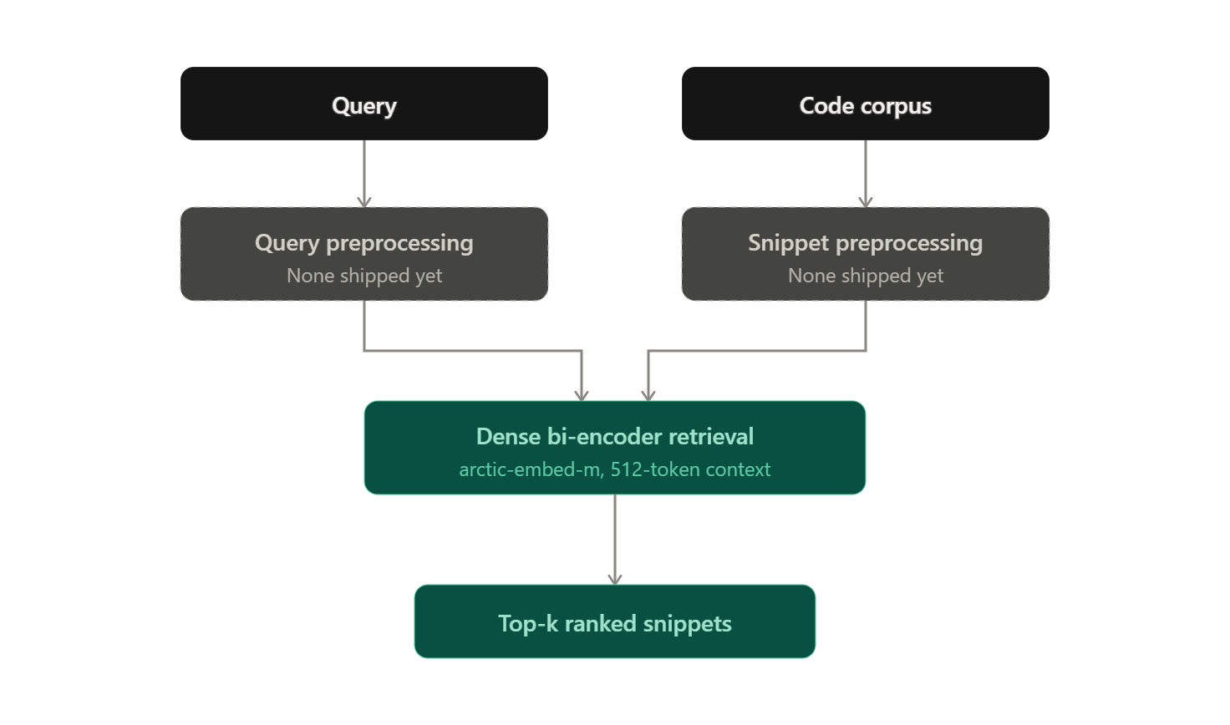
Our Solution: What We Shipped
What runs today:

Slide 6
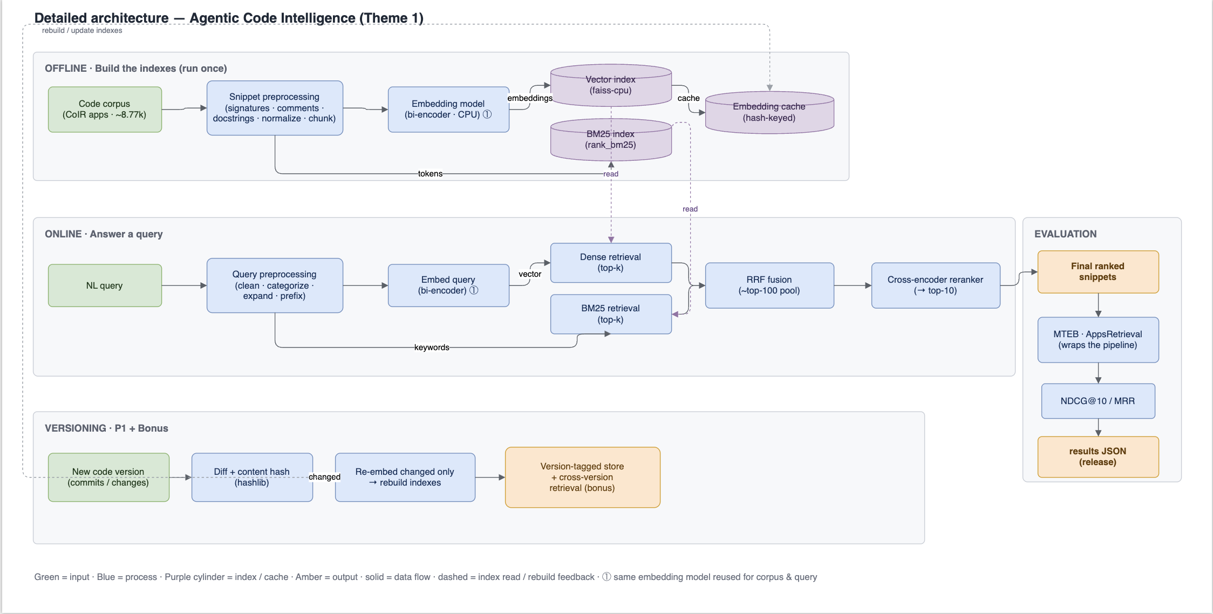
Architecture Diagram
Key: Shipped = dense retrieval (arctic-embed-m). Tested and rejected = BM25 fusion, query compression. Planned = cross-encoder reranking, version-aware caching.

Slide 7
Demo & Product Walkthrough

Slide 8
Tools and tech stack used
Language: Python 3.11
ML/retrieval: PyTorch 2.14.0 (CPU build), sentence-transformers 6.0.1, transformers 5.17.0, MTEB 2.20.11 (AppsRetrieval task, v2 API)
Numerics: NumPy 2.4.6
Diagnostics: rank_bm25 (used only for testing, not in the final pipeline)
Testing: pytest, with a correctness suite (determinism, payload checks, self-retrieval sanity, version guard)
Packaging: Docker (CPU-only image, model and dataset included so the graded run needs no internet)
Dataset: CoIR-Retrieval/apps (8,765 snippets; 5,000 train and 3,765 test queries, one correct answer per query)

Slide 9
Impact & Use case
Code retrieval is the slow step in AI coding tools. Before an AI agent can fix a bug or add a feature, it has to find the right file and the right block of code. This gets harder as the codebase grows.
Use case: point the retriever at a codebase (or its change history, for the P1 goal) and get back the top matching snippets for a plain-English query. It is the search layer an AI coding agent needs before it can act, without loading the whole codebase into an LLM.

Slide 10
Innovation highlights, results and limitations
Results:
- Baseline (all-MiniLM, no preprocessing): NDCG@10 0.066, MRR 0.056
- Current best (arctic-embed-m): NDCG@10 0.082, MRR 0.068 (up 24.7% on NDCG@10); recall@100 0.307 (up 21.4%). Scores are low across this benchmark, so ranking against other teams is what counts.
Innovation highlight: we measured before we built. We tested two likely improvements (BM25 fusion and query compression) with their own scripts before adding them. Both were rejected with clear evidence instead of assumed to help.
Limitation, stated plainly: recall@100 is 0.307, so for most queries the correct snippet is not even in the top 100. This caps everything after it, including any future reranker. Query length predicts failure even with no truncation (short queries: 0.894 recall; long queries: 0.545). This points to the encoder itself as the real lever, not input cleanup.

Slide 11
What’s next
Top priority: fine-tune or mine hard negatives on the 5,000-pair train split. Our tests showed the encoder does not use a query's later words well, so the headroom is in the encoder, not the input.
Also backlogged: index the unused meta_information.starter_code field (currently unused), add cross-encoder reranking on the top-k, and switch to a code-specific encoder.

Slide 12
Brownie points slide (differentiation)
Evidence over assumption: every component choice (BM25 fusion, query compression) was tested with a script before we built it, and rejected with numbers, not guesses. Negative results are logged, not thrown away.
Train/test discipline held strictly: all tuning happens on the train split. The test split is used only for the official baseline and the final run, so there is no leakage.
Root-caused the actual bottleneck instead of chasing symptoms: we showed query length predicts failure even with no truncation, which moves effort from input cleanup to the encoder. Most teams would guess this; we measured it.
Reproducibility built in from the start: pinned versions, a correctness test suite (determinism, payload checks, self-retrieval sanity), and a CPU-only Docker image with the model and dataset included, so the graded run needs no internet.

Slide 13
Checklist- Updated on Public GitHub
Working prototype code — public or shared GitHub repo: YES
README with reproducible setup instructions: YES
Demo video, max 5 minutes (YouTube or Drive link): YES
Presentation file (PPT or PDF): YES

Slide 14
Thank you
Organised by the Language AI Team and the PRISM Team, Samsung R&D Institute India
Notes:
Closing slide. Add the Google Form URL and a contact email before sharing. Edition 2 organising team for reference: Language AI - Sourabh Tiwari, Gaurav, Sanjeeth Pothireddy, Gorang Maniar; PRISM - Binny Lakra, Prakhar Chandrakar, Vishu Kumar; Kick-off and mentors - Giridhar Jakki, Deepraj Prabhakar Patkar (Language AI), Srimanu Prasad Nagaraju, Ashish Kumar (Tech Strategy).

