Slide 1
StockBot
Chart()
Stores all trading and indecators and score . Anything that you want tyo see visualised on a chart.
Historic()
OHLCV()
LIVE()
TA()
Random()
EntryStrategies()
Frame()
Handles Data and Charts for one data set
EntryStrategies()
Frame()
Handles Data and Charts for one data set
EntryStrategies()
Frame()
Handles Data and Charts for one data set
DataManager()
Stores all trading and indecators and score . Anything that you want tyo see visualised on a chart.
Trader()
ExitStrategy()
Trader()
ExitStrategy()
Trader()
ExitStrategy()
Bank()

Slide 3
Prev HighPoint
4 bars where gapped over
Close

Slide 5
open
open
HP
pivot
Dist 2
close
Dist 1
close
Prev low
Shock value = dist 1 / dist 2

Slide 6
Pullback Bounce signals
open
Support Zone
close

Slide 7
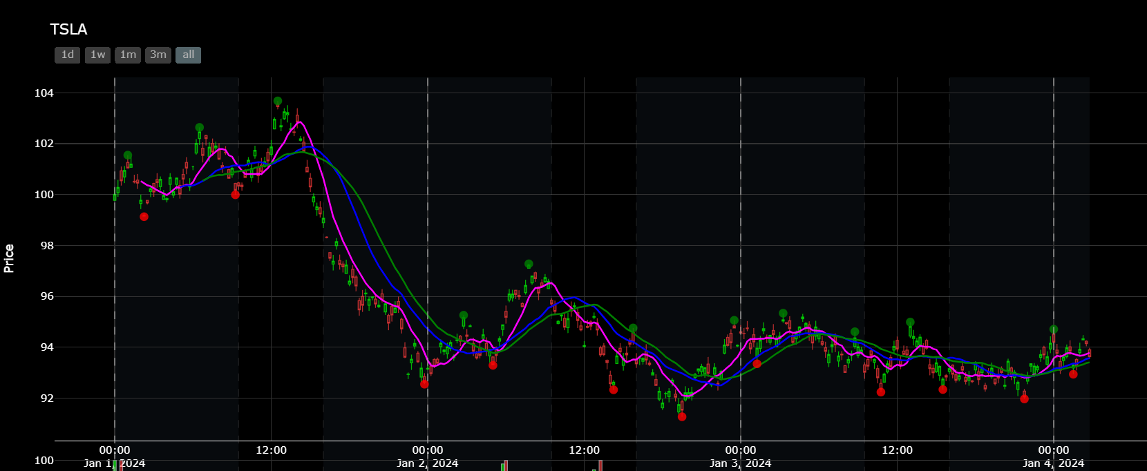
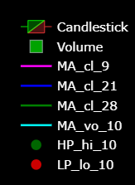
Get two points of similar price levels (variable: can choose if starting with HP or LP, variable to choose tolerance):
Start at the end of the chart and work backwards to get the most recent zone first
Points must be both HP or both LP
Points cannot be more than two points apart (variable: can choose number of points apart for the initaila match pair)
The initaial rectangles cannot be higher than it is wide (width is counted in number of bars, height is counted as mutiples of ATR) (variable for H vs W, W is constant: can choose H ratio)
If after checking the first two say LPs no match is found then switch to checking the first two HPs and so on back and forth alternating backwards though the data
When a pair of points is found, get the highest opposite point (assuming starting with LPs) between these two LPs and the single HP points to form a rectangle (Zone). The opposite point can just be the highest high not nessersarliy a defined point within the HP column of the dataframe.
Project the zone left and right until two things happen at the same time:
The 21MA moves out of the rectangle (create this temp 21MA within the class, Blue line on the chart)
At least 3 consecutive candlesticks move out of the rectangle
When the zone is complete, start again from the left most point within the zone just created and start steps 1 to 3 again. So to be clear you are working in an orgainsed fashion working through the candlesstick chart from right to left (newest to oldest)

Slide 8
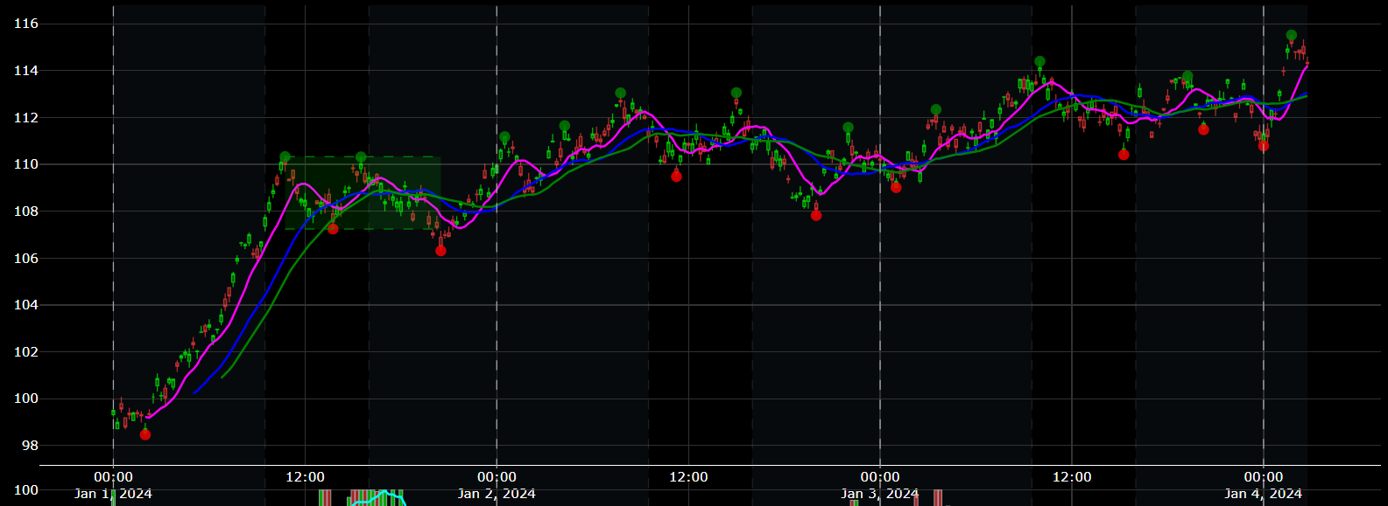

Slide 9
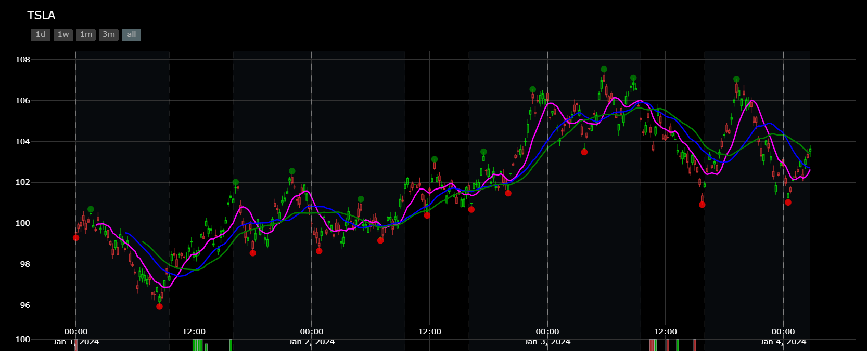

Slide 10
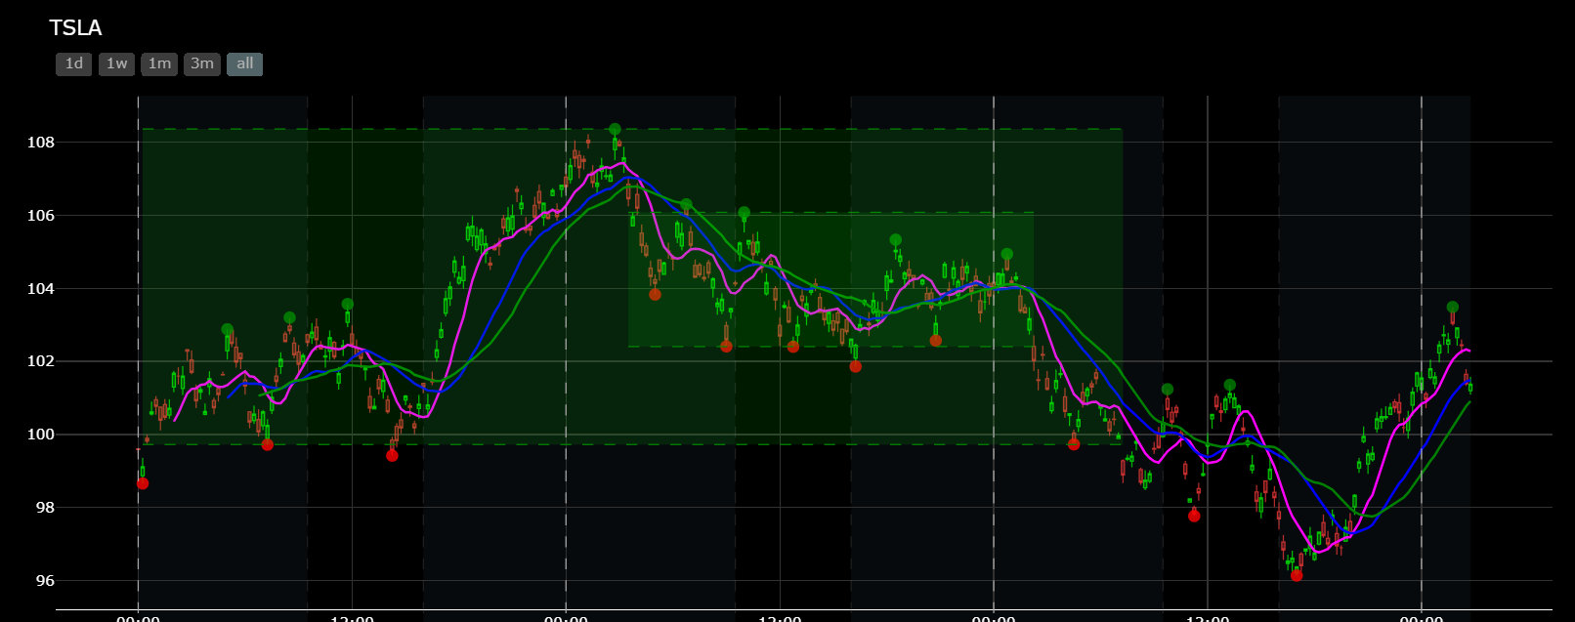
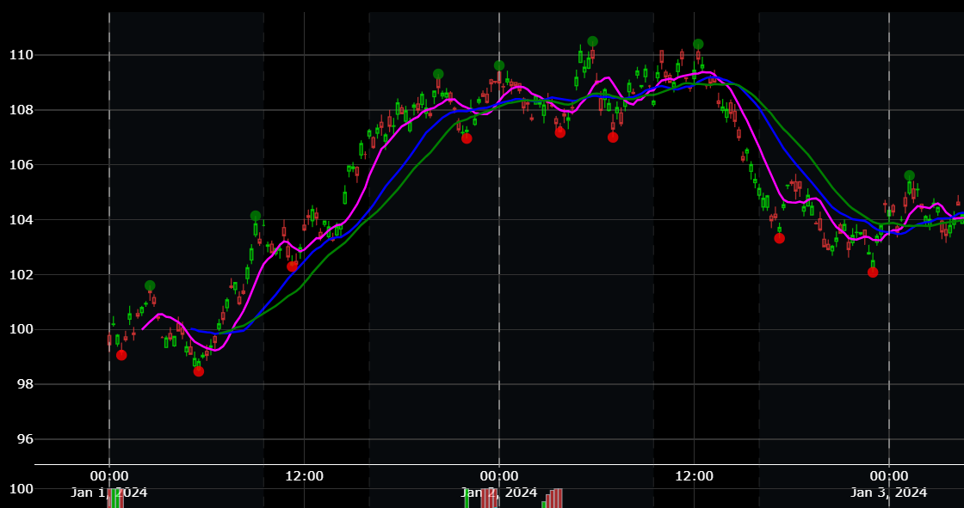
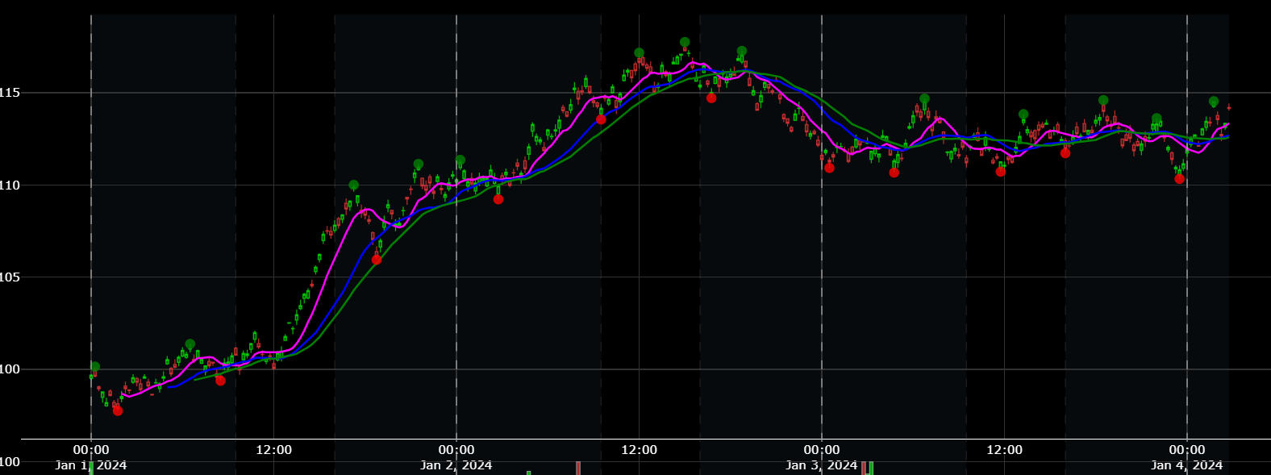

Slide 11
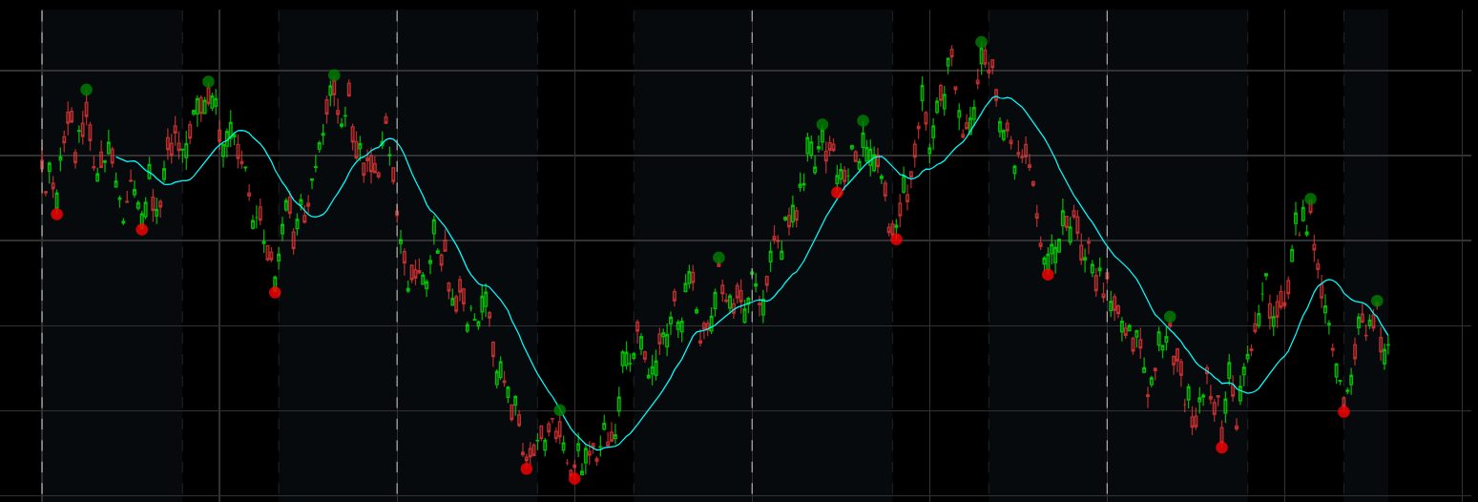
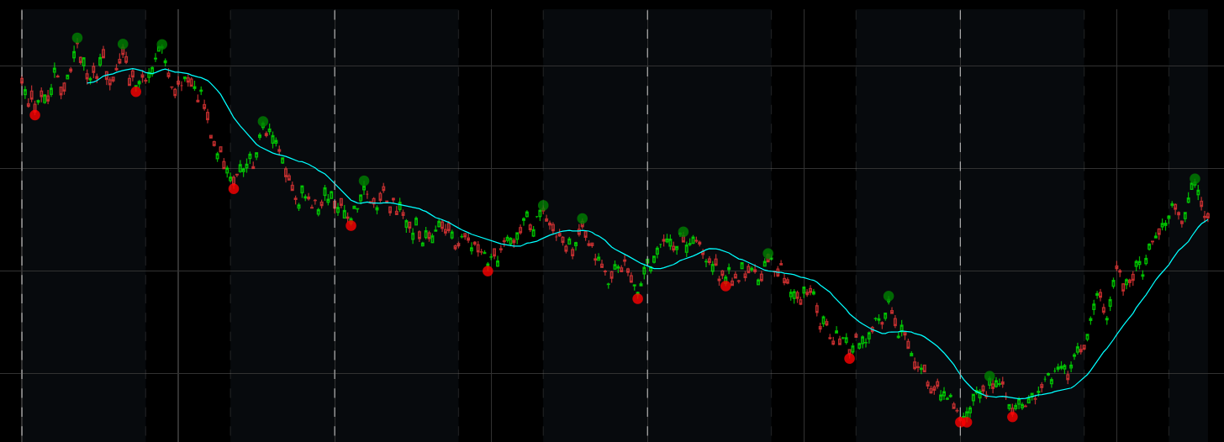

Slide 12
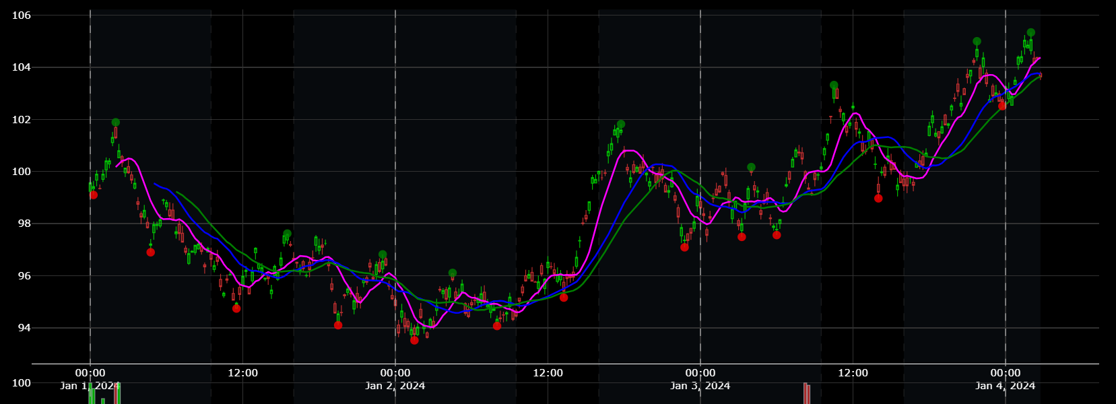
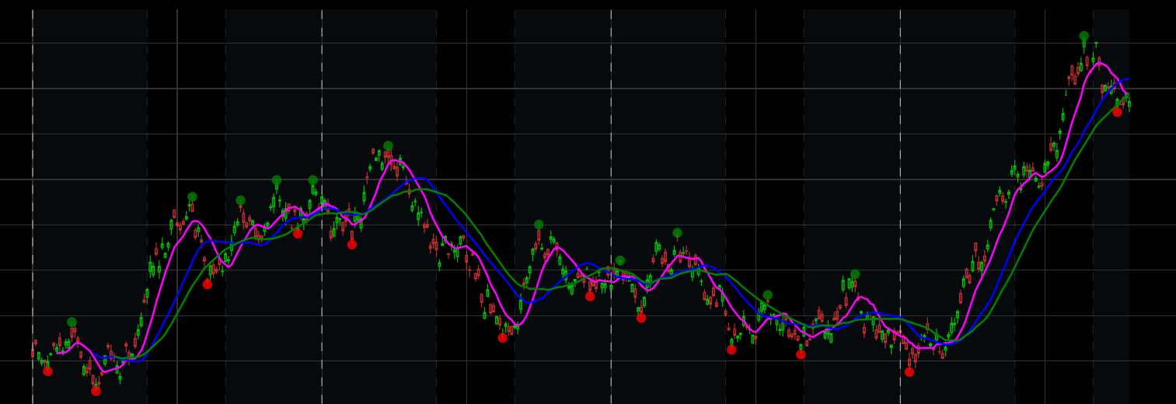

Slide 13
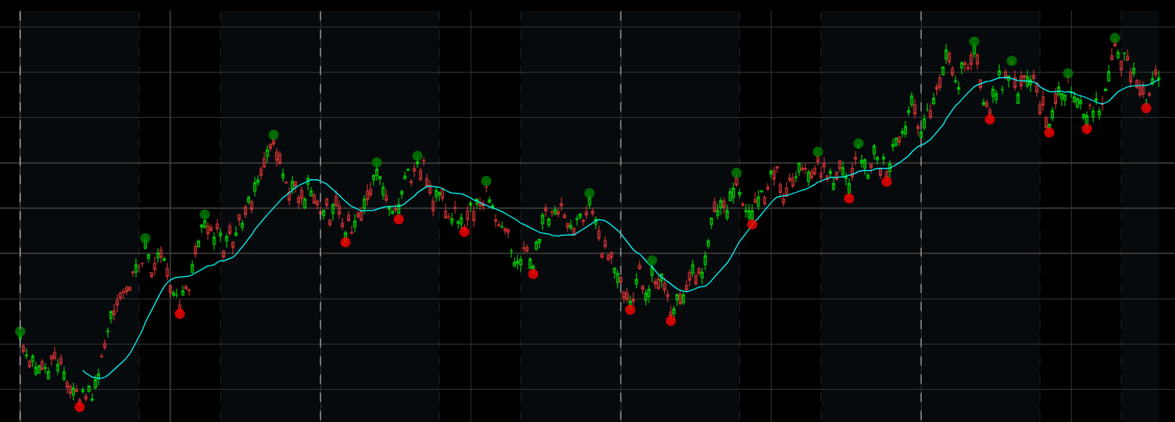
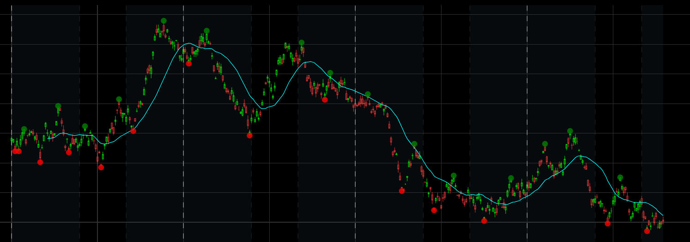
Micro Trend Rules:
Example down trends:
Start at the end of the data and work backwards through all of the HPs as defined in the pointsCol1
Find the next previous point that is nth * ATR higher (slopeTolerance) than the current point.
Draw a line through the points and project it forward until the the low of the candlestick (bar) is > projected line and continues to be so for nth number of bars (projectionPeriod).
If it is the last HP on the chart and all bars after than point are lower then switch to creating own micro HPs by checking if a high of a bar is > the bar to the left and right and then draw a best fit line from the last HP and through any micro HPs to the end of the data.
If no micro HPs found in step 4 then just use highs of each bar if there are more 2 bars from the last HP to the end of the chart and again find the best fit line.
When the best fit line is created from either step 4 or 5 find the high that most protrudes above the best fit line then draw the final line from that high back to the HP

Slide 14
