Slide 1
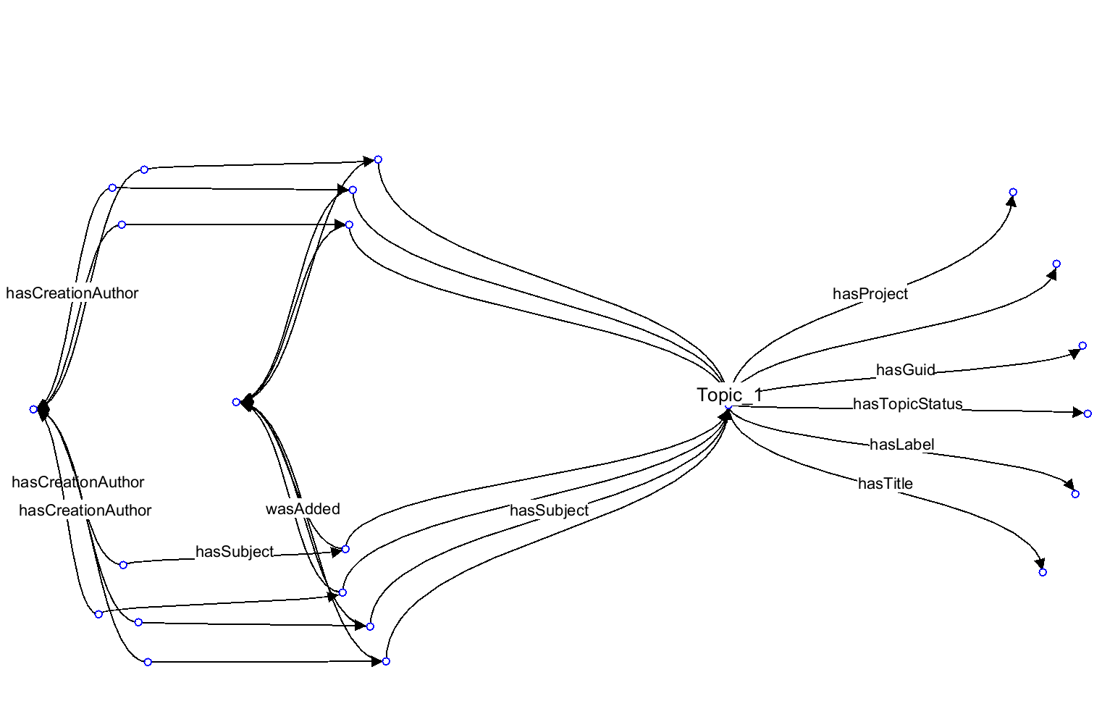
RDF-star Annotations. Statement of statement (reified)

Slide 2
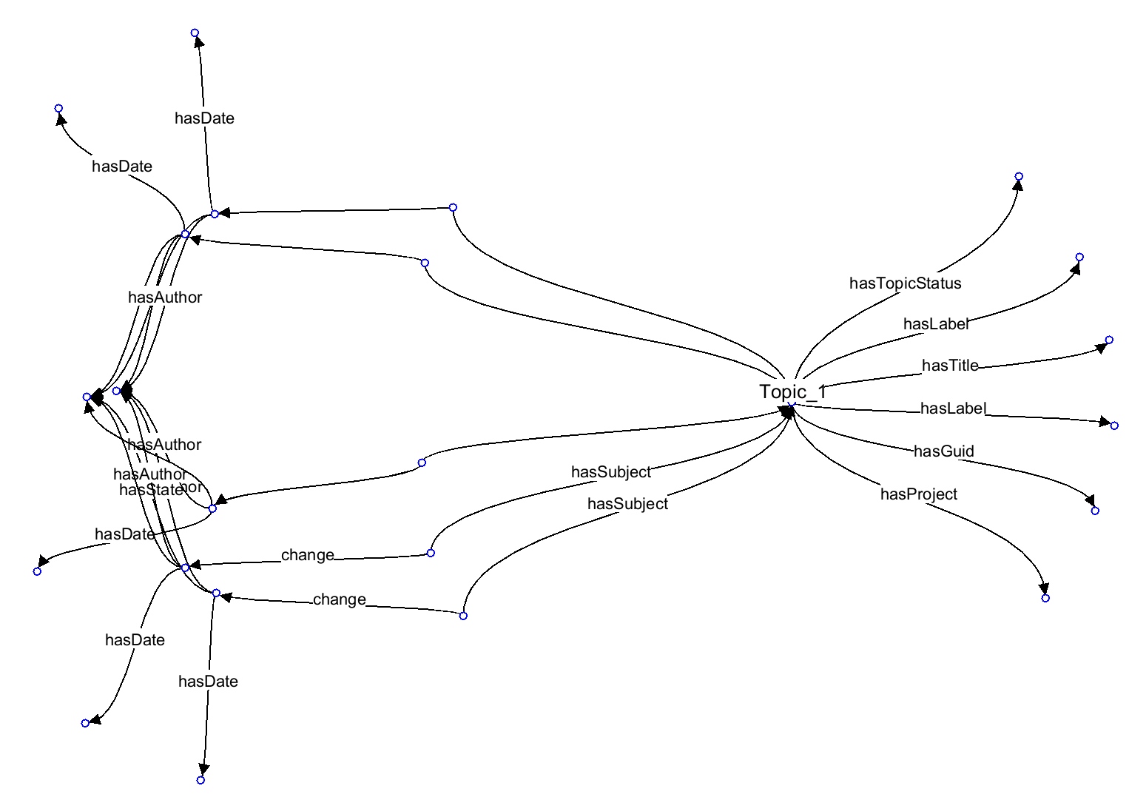
RDF-star: Object Property Annotation (reified)

Slide 3
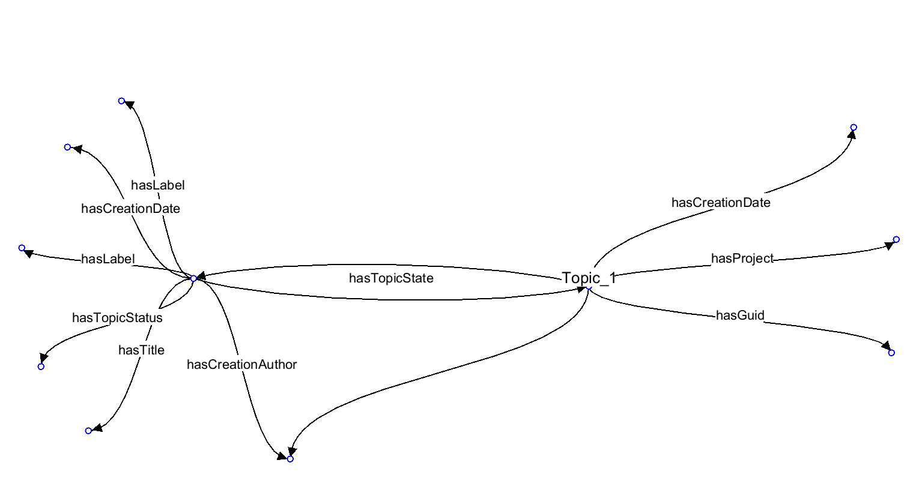
State

Slide 4
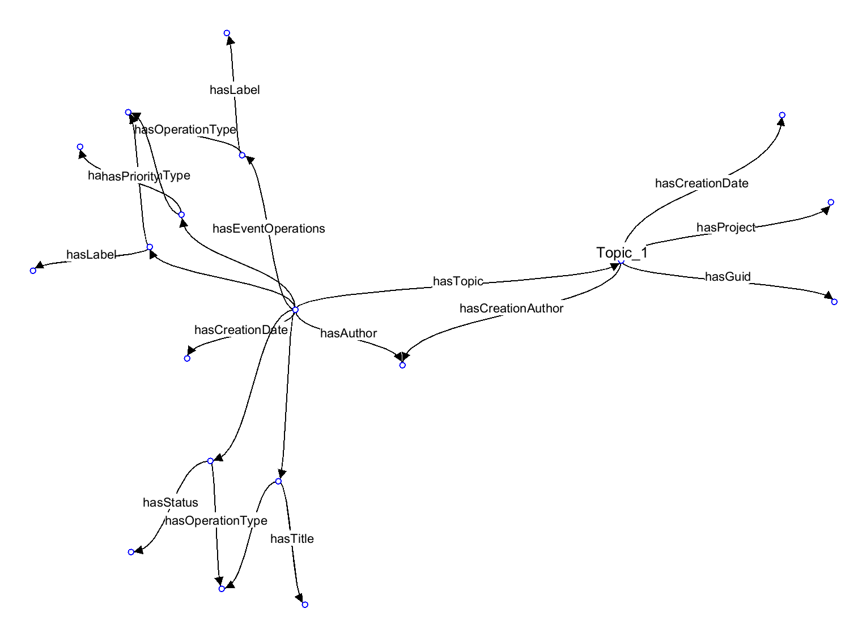
Events

Slide 6
