Slide 1
One Job
One task at a time — yours, or handed to you by an agent
Pre-seed · 2026
1

Slide 2

WHO'S BUILDING IT
Twenty years shipping products where attention was the scarce resource.
Appointed by Gov. Newsom to California's Office of Data and Innovation; later Acting Deputy Director for Service Innovation
Ran product for covid19.ca.gov — among the highest-traffic public health sites in the country
Led the Product chapter at 18F, the federal government's digital services team
Four books on product and design — O'Reilly, Rosenfeld Media, Wiley — including Designing Social Interfaces
Product leadership at Yahoo!, AOL, CloudOn (acq. Dropbox), and 7 Cups
2

Slide 3

Interrupted every two minutes. Then shown all 47 things at once.
Knowledge workers receive 117 emails and 153 chat messages every weekday, and are interrupted every two minutes during core hours (Microsoft, 2025).
Then they open a to-do app that renders the entire backlog at once, and spend the next ten minutes deciding instead of doing.
Forty-seven open items is not information. It's dread, delivered on schedule.
3

Slide 4

HOW IT'S SOLVED TODAY
Every tool solved storing the work. None of them solved choosing it.
Task databases — Asana, Jira, Linear, Todoist — are built for teams to track work, not for one person to pick the next thing
AI planners — Motion, Reclaim — auto-schedule your calendar, then hand you back the same crowded screen
The plain text file — where people land when the app got too opinionated. Infinitely flexible, and no help at all
4

Slide 5

What if the list weren't the interface?
What if the only thing you ever saw was the next thing — and everything else waited its turn, face down, out of mind.
5

Slide 6
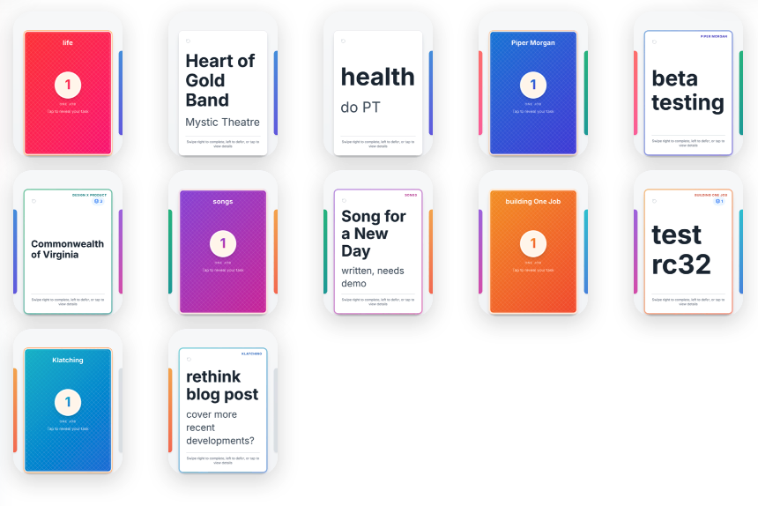

THE PRODUCT
A deck of cards. Right to finish it, left to send it back.
Swipe right to complete, left to defer — the card drops to the bottom and the next one is already up
Every card's interior is another deck, so subtasks work identically at any depth
Local-first: tasks live on your device. No account, no tracking, works offline
Multiple decks, one top card each
6

Slide 7

We are the inbox for work that needs a human.
TODAY
a standalone deck for your own tasks, on the phone in your hand
TOMORROW
a lens over the task systems you already pay for: your order, your interiors, sync that never flattens them
HORIZON
the client for MCP Tasks: where every agent you run queues work for you, and you answer it one card at a time
7

Slide 8
PROOF OF EXECUTION
Eleven months dead. Then thirty-three releases in eight weeks.
33 release candidates in 8 weeks, after an 11-month stall. The unlock was an agent, not more founder hours
167 tests passing, up 79 in 23 days. Every deploy verified against the live site, not against CI green
Lost the founder's own deck once — shipped the fix and a permanent protocol the same morning
Live on the web, build 32 on TestFlight, submission prepared. First tester, unprompted: "The experience is beautiful"
Not yet proven: that anyone beyond one founder and one tester wants this.
8

Slide 9

WHY WE WIN
Others compete to own your list. We own the moment you choose.
Others build a better database. We build a better decision.
The world's tasks already live in Asana, Jira, and Todoist — sunk cost, and not going anywhere. One Job doesn't compete with those systems, it faces them. The list stays exactly where it is; we become the surface where a person decides what to do right now, and the one place anything — a teammate, a system, an autonomous agent — can hand them a single thing at a time, with its provenance attached.
9

Slide 10



TAILWINDS
The waves we're riding.
Agent volume grew 15x year over year across Microsoft 365 — and 86% of AI users still treat every agent output as a starting point, not an answer
MCP went vendor-neutral under the Linux Foundation in December 2025; new servers published to its registry rose from 391 in January to 5,703 in August
DORA named the cost of reviewing AI output the "verification tax" — the human review queue is now a measured bottleneck, not a forecast
10

Slide 11

TIMING
The protocol shipped. Nobody built the client.
On 28 July 2026, MCP added Tasks as an official extension. Agent work can now halt in an input_required state, survive a dropped connection, and be answered later by a human. The specification's own documentation names the use cases: approval gates, review steps, any operation that pauses for user confirmation — and mobile clients on intermittent networks, whose task IDs survive disconnects. That is a deck of cards, described by a standards body. The community client-support matrix lists eleven clients and has no column for Tasks. The wire format for handing agent work to a person now exists. The human end of it does not.
11

Slide 12
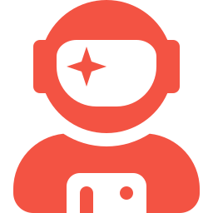
FOUNDER-MARKET FIT
Why this person builds this.
Christian Crumlish — thirty years building where attention is the scarce resource: Yahoo!'s design pattern library, AOL messaging, 7 Cups, covid19.ca.gov, the product chapter at 18F.
One Job began as the to-do app every product manager has in a drawer. It stalled in 2025 on a migration bug and on something harder — he could not put the feel of a gesture into words.
After a year learning to work with autonomous coding agents, he handed the entire wrecked history to one and asked it to finish the job. It did, including the gestural feel he had been unable to describe.
Every active project he runs turns out to be about the same thing: managing or focusing attention. This is the one you can hold in your hand.
12

Slide 13
THE ASK
With $750K, here's where we are in eighteen months:
1
1.0 live on both stores with a real retention curve — the first evidence anyone but us wants this
2
A first paying Pro cohort at $3.49/month, and an honest free-to-paid conversion number
3
The first MCP Tasks client shipped — agents queue work, a human answers one card at a time
4
Two named agent frameworks handing work into One Job in production
13

Slide 14

One more thing...
Our first beta tester, in his first hour with the app and knowing nothing about the roadmap, asked for the thing we are building: "a useful front end for all of my messaging inputs — email and Slack and WhatsApp, the unread stuff, with some indication of the source." He arrived at the agent-inbox thesis from the human side, unprompted. The appetite for one card at a time, from many sources, with provenance attached, is not something we have to go create.
14

Slide 15

We're raising $750K to ship 1.0, earn our first paying users, and build the human end of a protocol that already exists.
Christian Crumlish · xian@designinproduct.com · onejob.co
15

