Slide 1
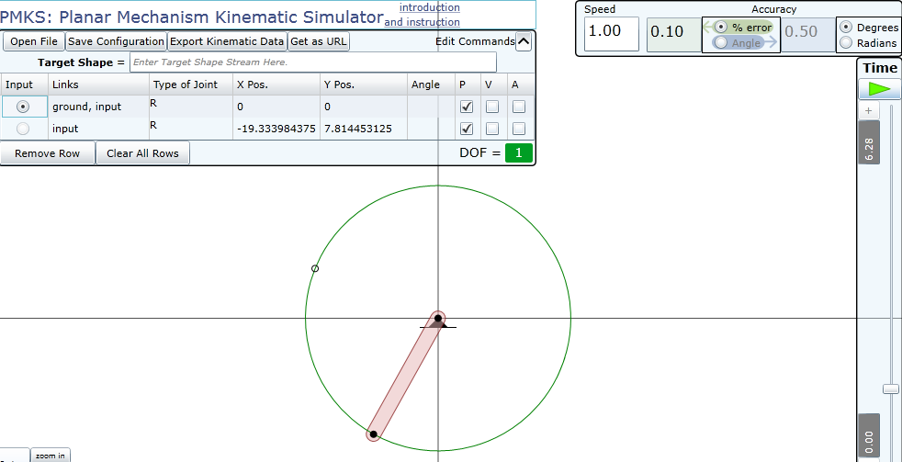
A link back to this page!
Simulation accuracy
Speed is in rad/s (use negative values for CW;
use positive values for CCW)
joint text editor
time slider

Slide 2
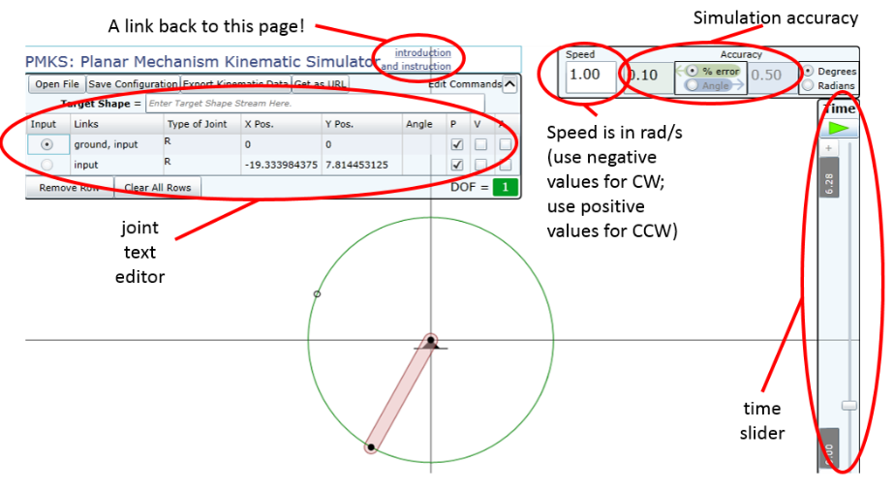

Slide 3
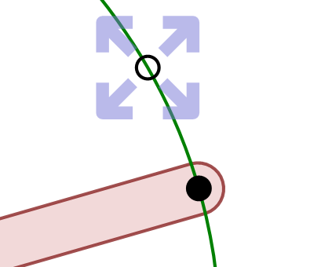
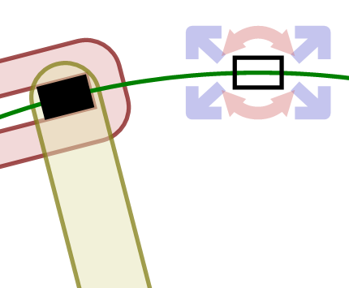

Slide 4
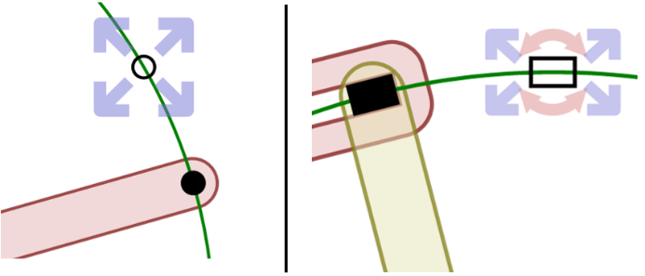

Slide 5
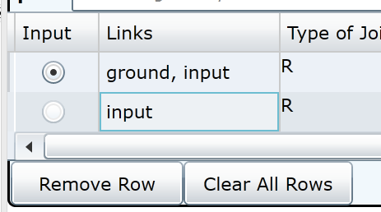
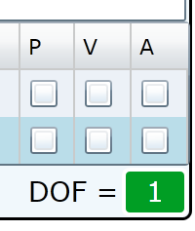


Slide 6
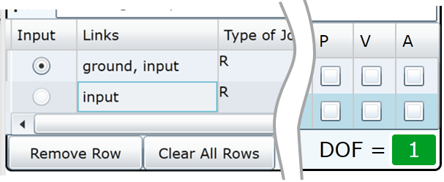

Slide 7
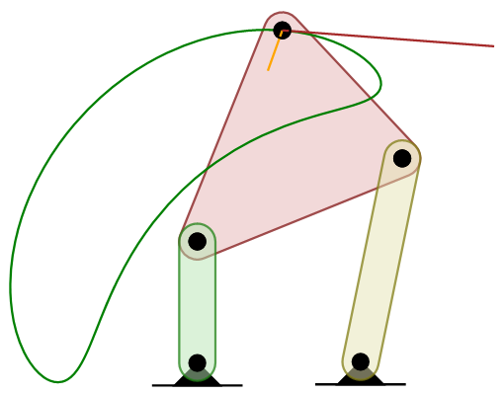

Slide 8
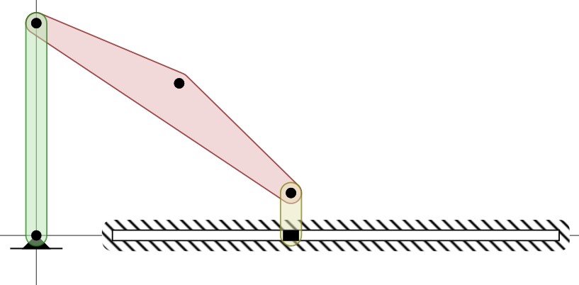

Slide 9
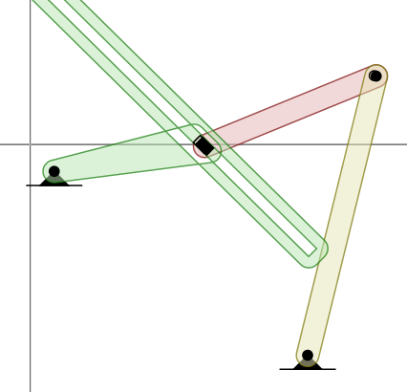
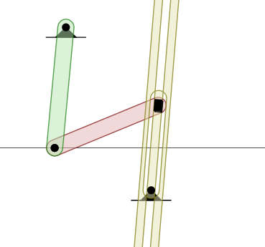
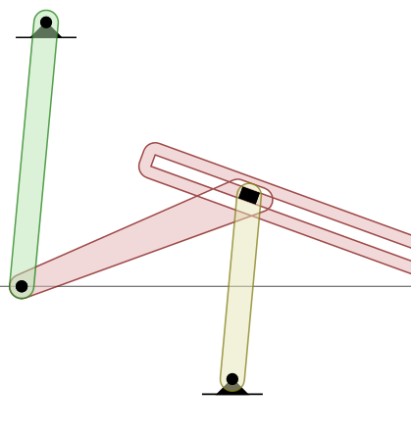

Slide 10
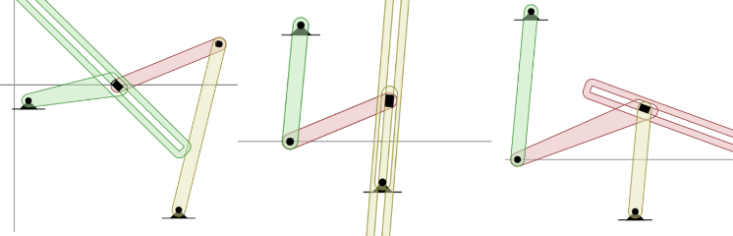

Slide 11
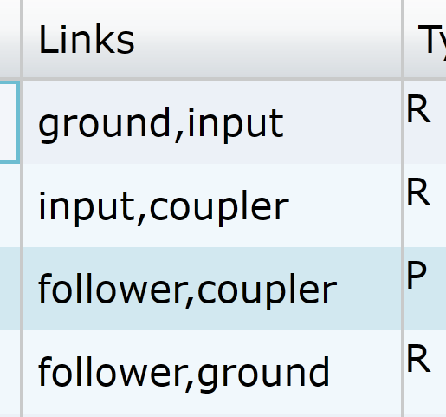
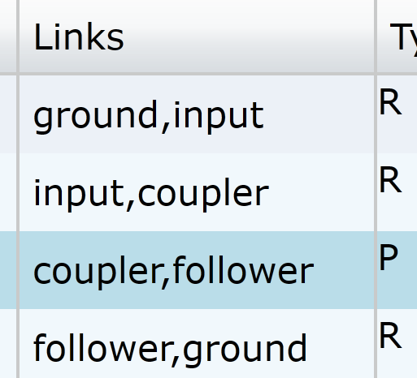

Slide 12
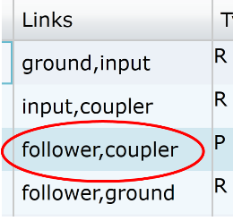
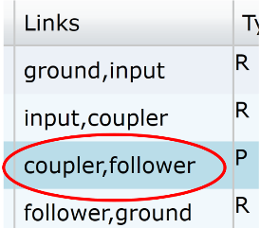

Slide 13
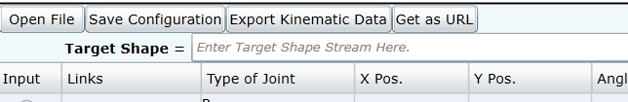
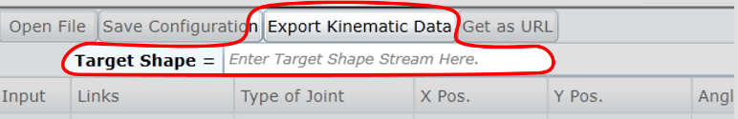

Slide 14
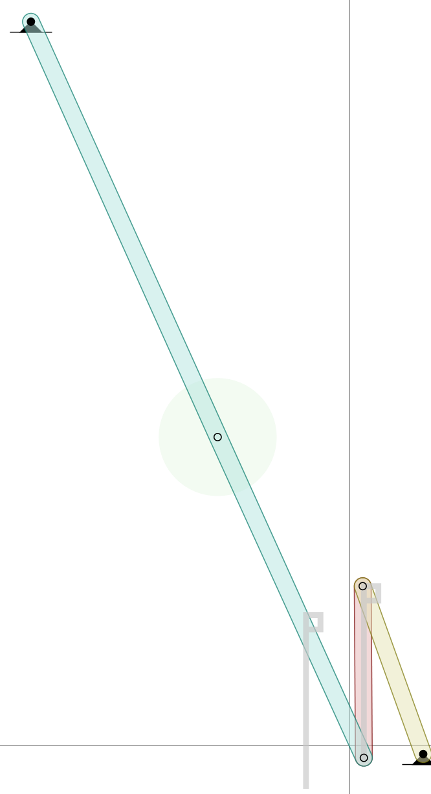
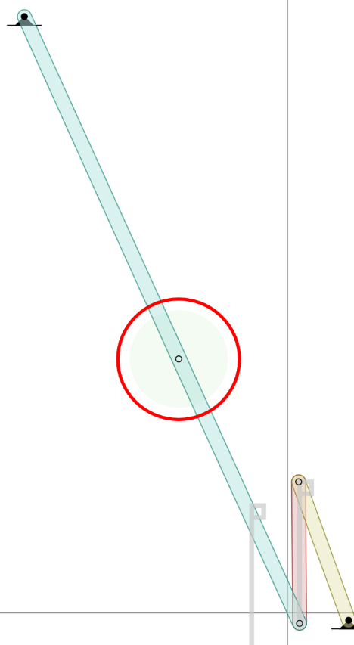

Slide 15
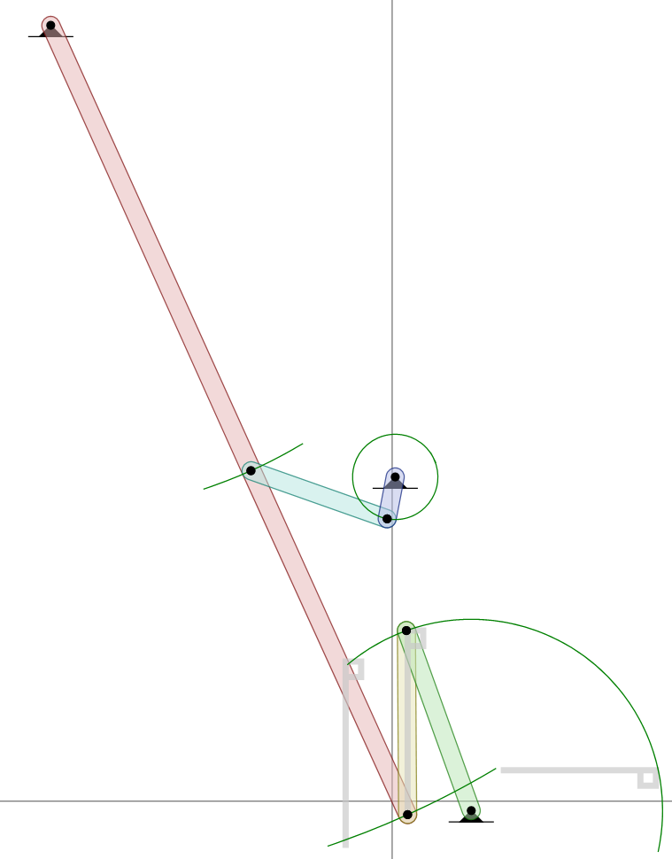
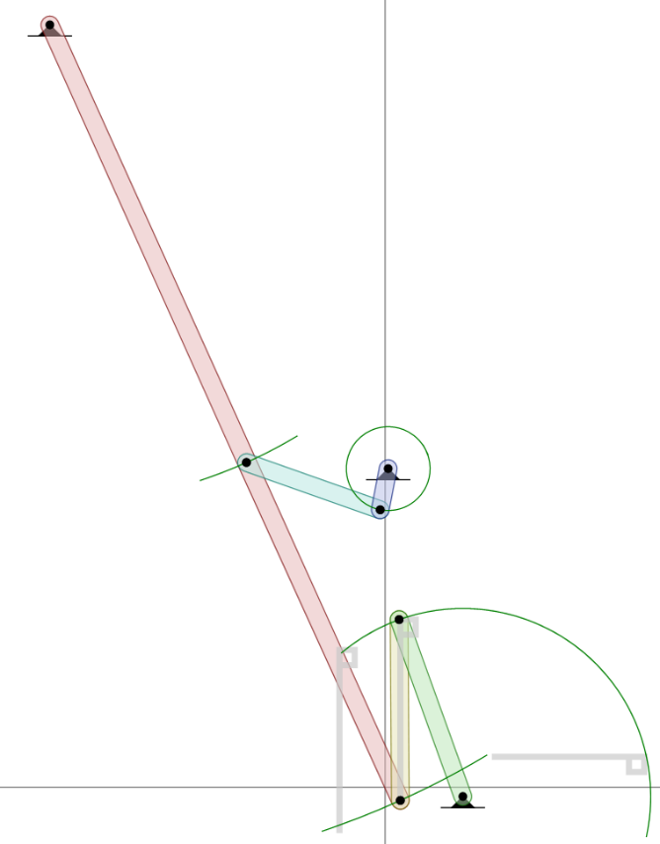
http://people.oregonstate.edu/~campmatt/pmks/pmks.html?ts=m5 5v50h5v-5h-5zm-20 -10v50h5v-5h-5zm50 15h50v-5h-5v5&mech=ground input R -110 250 0 tfff|input coupler R 5 -4.3 0 tfff|coupler output R 4.6 55 0 tfff|output ground R 25.5 -3 0 tfff|input c2 R -45.5 106.5 0 tfff|c2 crank R -1.6 91 0 tfff|crank ground R 1 104.5 0 tfft|
http://people.oregonstate.edu/~campmatt/pmks/pmks.html?ts=m5 5v50h5v-5h-5zm-20 -10v50h5v-5h-5zm50 15h50v-5h-5v5&mech=
ground input R -110 250 0 tfff|
input coupler R 5 -4.3 0 tfff|
coupler output R 4.6 55 0 tfff|output ground R 25.5 -3 0 tfff|input c2 R -45.5 106.5 0 tfff|c2 crank R -1.6 91 0 tfff|crank ground R 1 104.5 0 tfft|

Slide 16
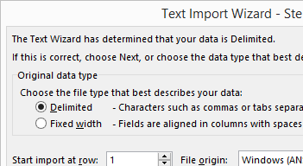
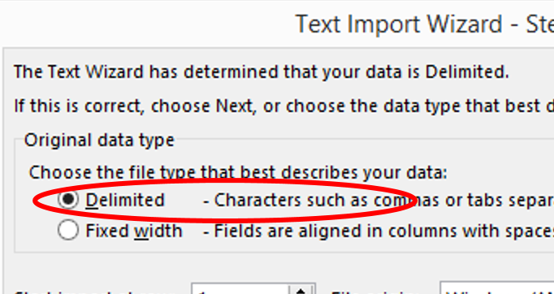

Slide 17
