Slide 1
#DOF=1,2
Element #1
nelx = 8
Node #1
Node #2
nely = 4
Node #5
y
Element #4
Node #45
x
Force = 1N
Fixed in x
Fixed in y

Slide 2
Nodes on this plane fixed in x and z directions
Element #1
#DOF=1,2,3
Node #1
Node #2
y
z
x
Node #5
Nodes with unit loads
Fixed in x, y, z
y
z
Element #4
Node #180
x
Node #45
Nodes on this plane fixed in x, y, z directions
y
z
x
Nodes with unit loads

Slide 3
Download the 3D code at https://top3dapp.com/
y
z
x
Nodes fixed in x, y, z
Nodes fixed in x, y, z

Slide 4
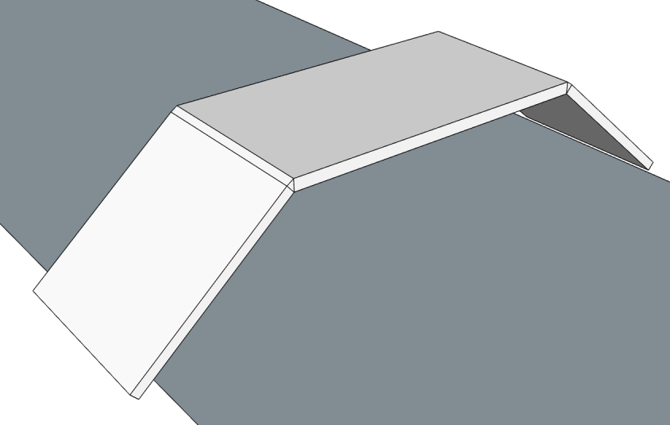
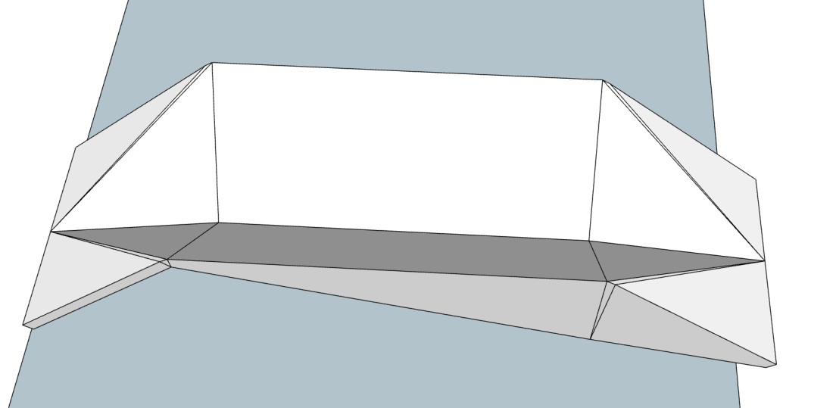
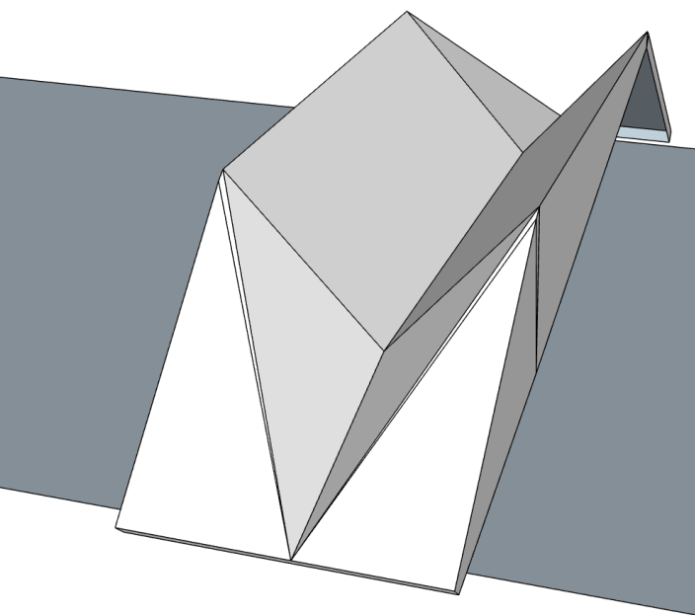
Large curvature makes the bridge less usable for pedestrians
Curvature = 0
OK
NOT OK

Slide 5
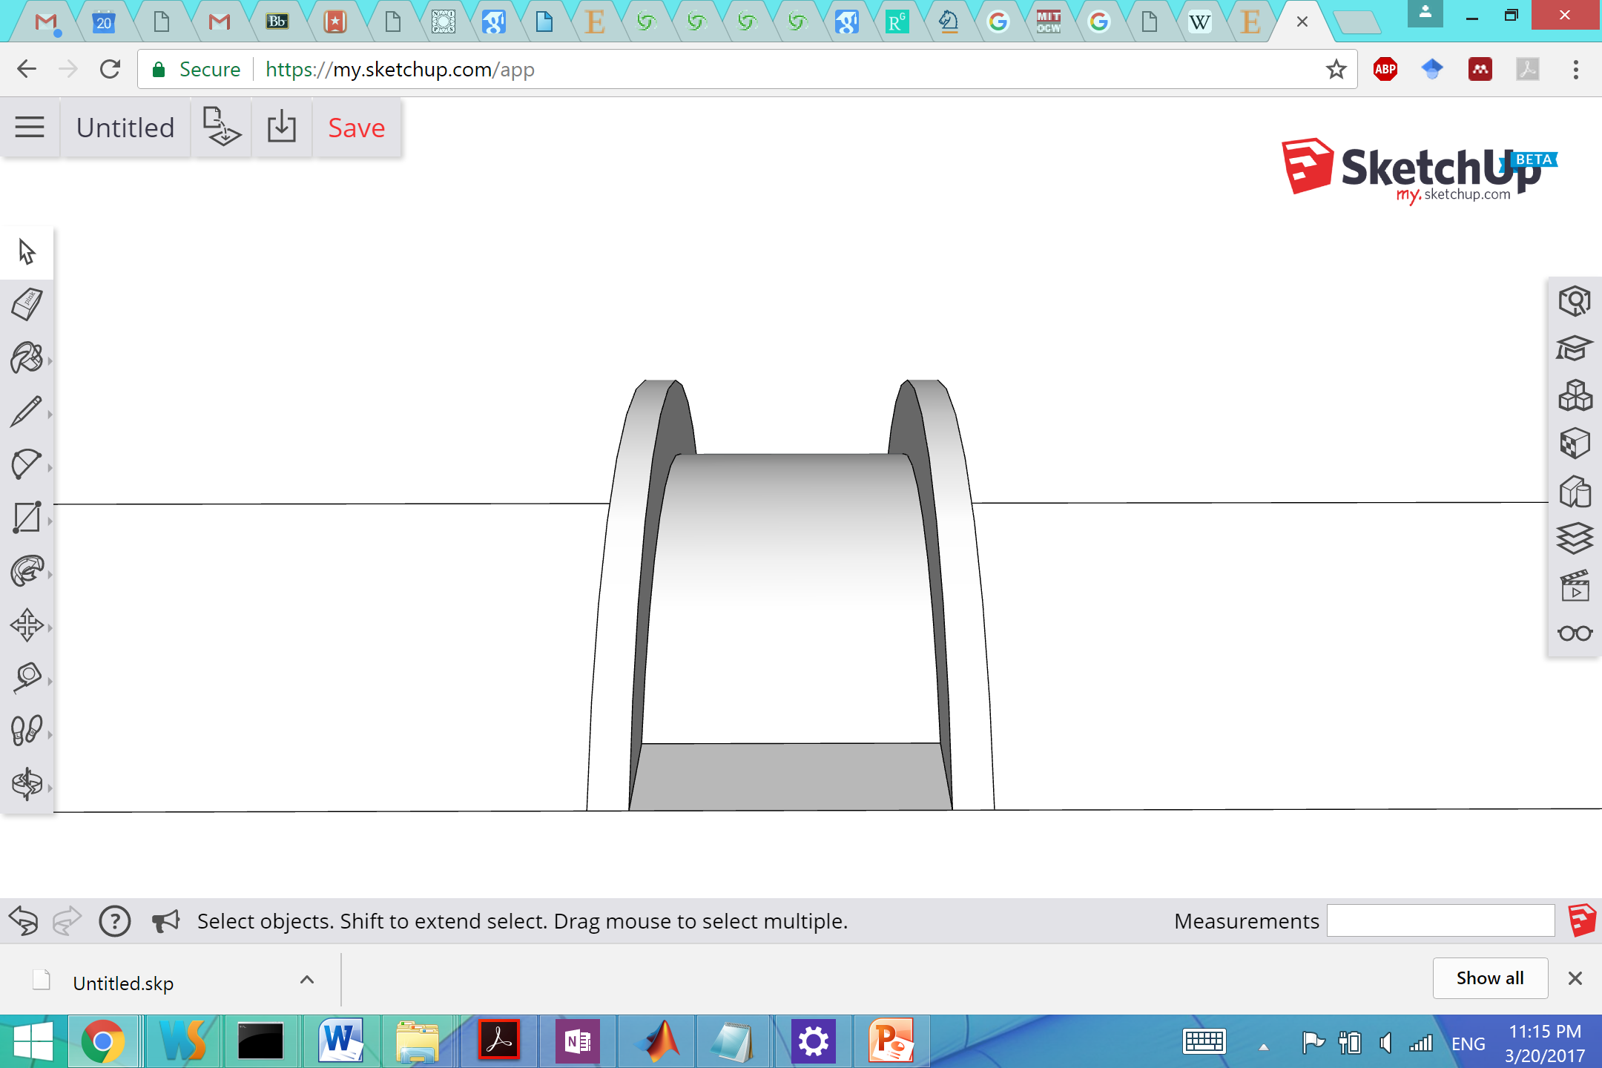
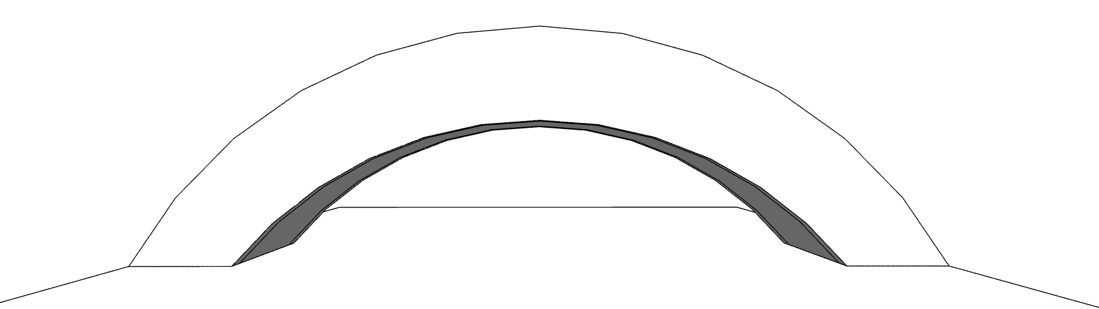
Force of 2500 lbf on the entire pavement
> 7 feet
> 50 feet
> 8 feet
Both ends are flat and fixed to the ground

