Slide 1
Preference learning
Max Yi Ren
MAE540 Advanced Product Design

Slide 2
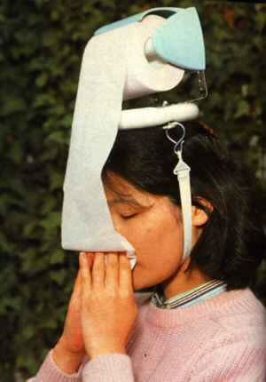
Understanding consumer preference is important for engineers!
Notes:
Maybe if you get info from potential users you will save yourself a lot of wasted effort in designing something people may not use or need

Slide 3
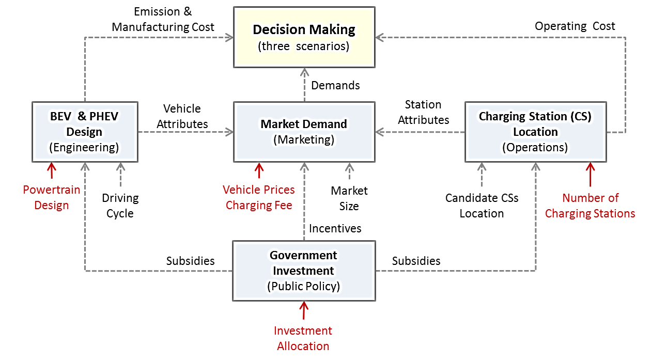
How will electric vehicle designs affect the market?
Kang et al., A Framework for Quantitative Analysis of Government Policy Influence on Electric Vehicle Market, 2015

Slide 4
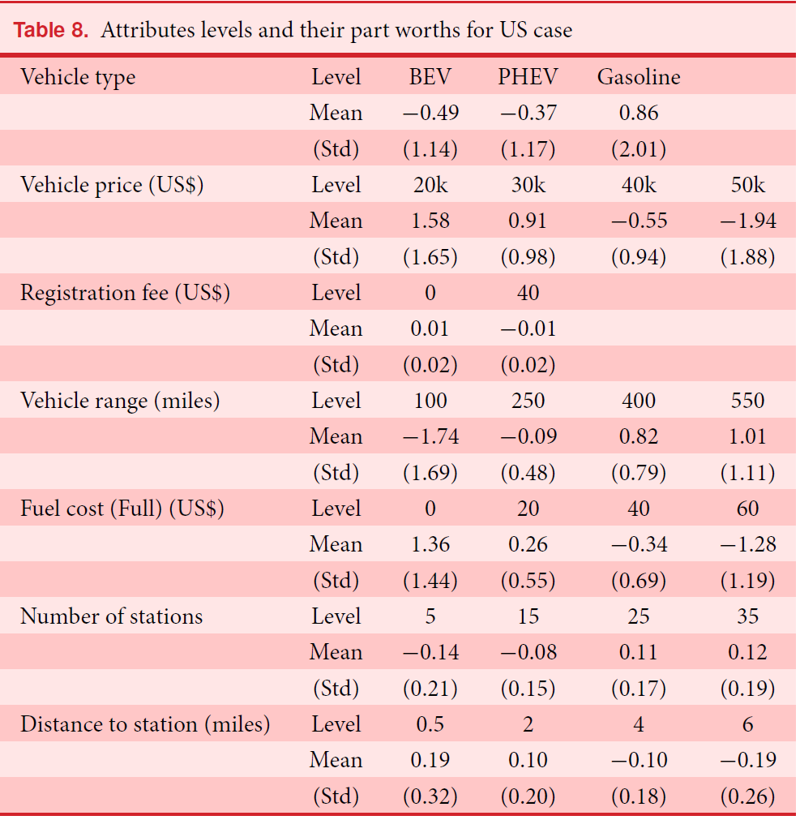
US consumer preference

Slide 5
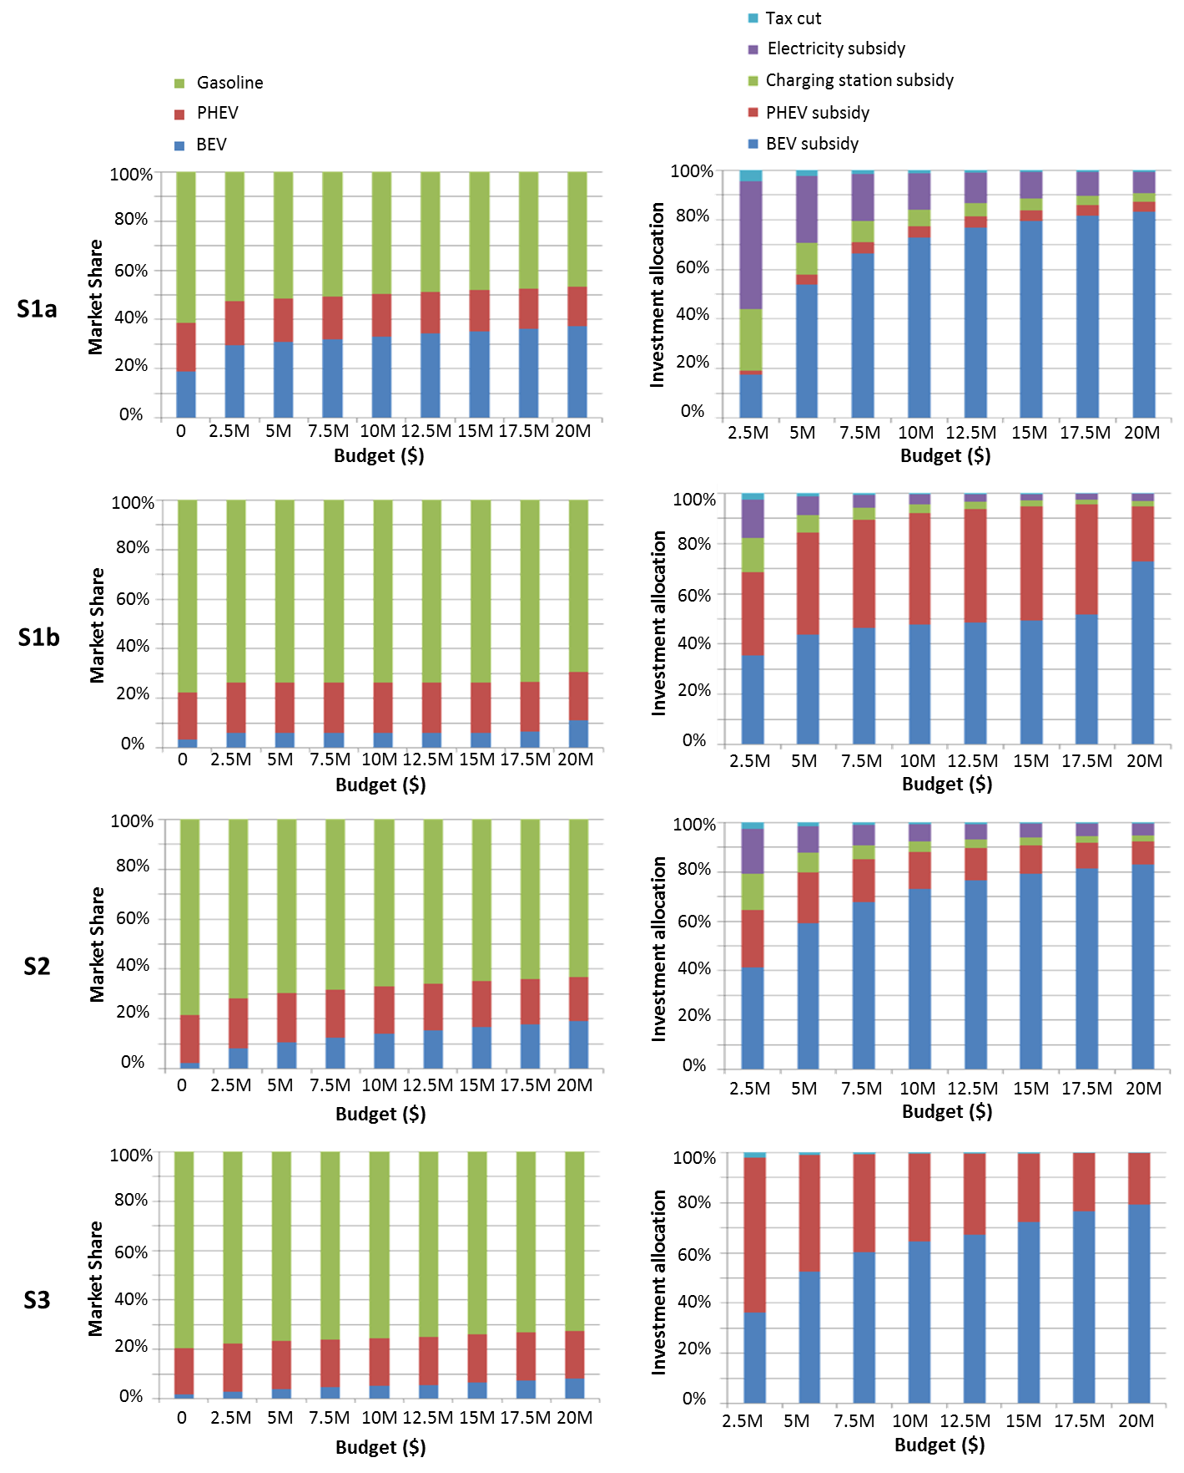
Policy design for energy security and emission reduction
Ann Arbor
Collaborative
Profit-driven

Slide 6
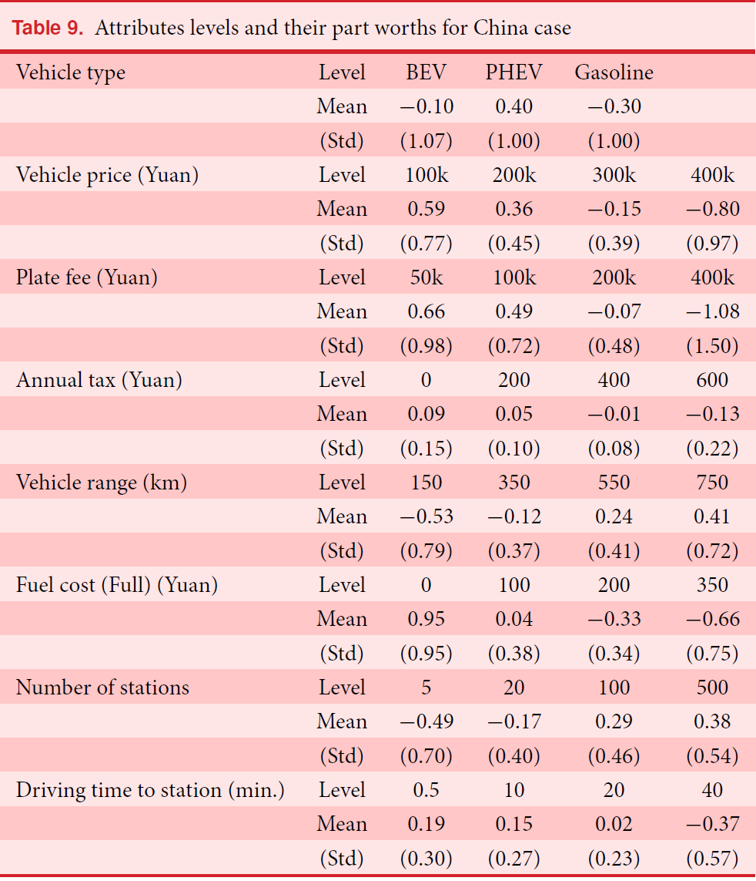
US consumer preference

Slide 7
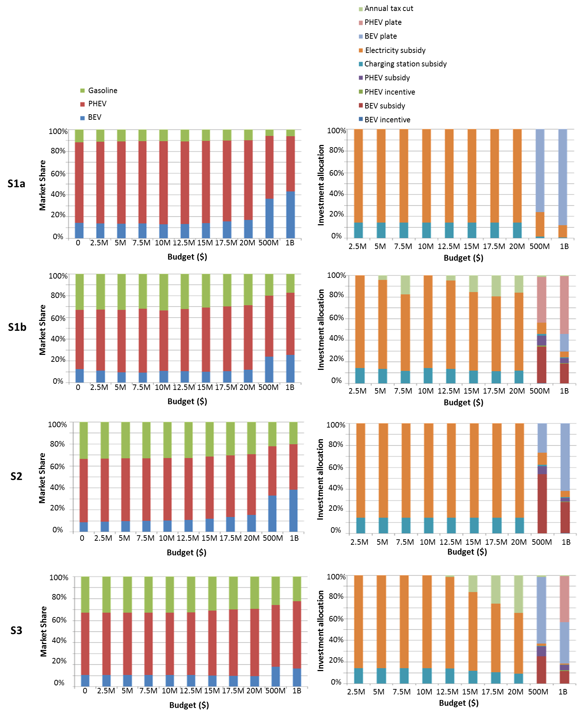
Policy design for energy security and emission reduction
Beijing
Collaborative
Profit-driven
Figure from: Kang et al., A Framework for Quantitative Analysis of Government Policy Influence on Electric Vehicle Market, 2015

Slide 8
Motivation
The design process should have some form of user input
How will the survey help you in the design process?
Notes:
The idea is that we want to put tools in your hands to help you be more user-driven in your design process.

Slide 9

Today’s Outline
What is the goal of the survey?
What are the best questions to ask to achieve those goals?
Common problems to avoid
Choice-Based Conjoint (CBC)
How do we prioritize our design objectives?

Slide 10

Goal: Understand consumers through data collection and analysis
Attitudes and Opinions/Beliefs
Awareness and Knowledge
Purchase Intentions
Usage Behavior (what people actually do)
Demographics
Notes:
1. Attitudes / Opinions about or towards a product
2. Awareness / Knowledge: about a product, features, availability (location, ease), price, manufacturer, possible uses, competitive products.
Testing:
Unaided Recall (no prompting)
Aided Recall (peripheral prompting)
Recognition (actual product / ad copy)
3. Purchase Intention: definitely will buy, probably will buy, possibly will buy, unlikely to buy, definitely will not buy, undecided
4. Purchase / Usage Behavior:
Who in the household is using it / purchasing it?
How / Where / When / In what situation are they using it?
How often / How much do they use it? Is it disposable or reusable?
What other complimentary / substitute products do they use?
Personal Information: demographic (age, sex, income, race, religion, etc.), psychographic (lifestyle, social class, personality), geographic (location)
TAKE A MOMENT AND SEE IF YOU’VE COVERED ALL OF THESE TYPES OF DATA IN YOUR GOALS

Slide 11
Types of Questions
Open Response
Closed Response
Itemized category
Comparative
Rank Order
Likert Scale
Semantic Differential
Constant Sum

Slide 12
Open Response
Example:
Why do you buy cellphone case? _________________
Notes:
Why would we want to use this type of question?
What are some drawbacks of open response questions?

Slide 13
Closed Response
Example:
How often do you have problem with low speaker volume in a class setting?
a) Very often
b) Sometimes
c) Rarely
d) Never
Notes:
What are the good and bad aspects of this type of question?

Slide 14
Itemized Category
What kind of food do you consume on a daily basis?
Milk
Egg
Kool-aid

Slide 15
Comparative
Compare to regular headphones, how much do you like bluetooth ones? _____.
(a) Better
(b) Worse
(c) The same
Notes:
Gives ORDINAL data

Slide 16
Rank Order
Please rank the following items in terms of importance to your daily life:
(1 = I feel most stressed if I lose it, 4 = I will live)
___ Wallet
___ Cellphone
___ Laptop
___ Lunch box

Slide 17
Likert Scale
Rate the following statement on a scale of 1 to 7:
1 = strongly agree, 7 = strongly disagree
It would be great if I can track how much water I use and when I use them
1 2 3 4 5 6 7
Notes:
You can decide how many numbers to put: consider carefully whether you want an odd or even number of options!

Slide 18
Semantic Differential
Please circle the number on the scale that best describes the difficulty in keeping your bike safe on campus:
For sure will get stole
1
2
3
4
5
Don’t need a lock
Notes:
Similar to likert, can choose number of choices

Slide 19
Constant Sum
How important are each of these when you choose a baby protection device?
Please assign 100 points among the following:
____ Easiness in installation
____ Maintenance cost
____ False positive rate
____ False negative rate
____ Price
15
35
15
5
30
Notes:
This is a tough one to administer because often people don’t understand, so an example might be good to include prior to the question.
Goal of this type of question is to get a sense of weights people assign to different attributes. There are better ways however.

Slide 20
Types of Questions
Open Response
Closed Response
Itemized category
Comparative
Rank Order
Likert Scale
Semantic Differential
Constant Sum
Notes:
LET’S TAKE A MOMENT TO COME UP WITH SOME QUESTIONS FROM EACH OF THESE CATEGORIES

Slide 21
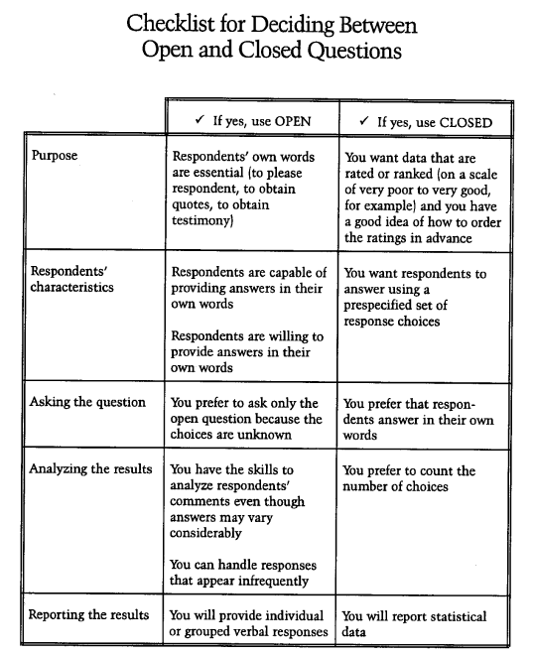
Taken from Fink, 1995

Slide 22
Common Problems to Avoid
Misunderstanding/misinterpretation of question
Specificity (too vague, too precise)
Bias
Inappropriate questions
Audience background/knowledge
Context (especially when questions may be out of order)
Offensiveness
Getting the right audience

Slide 23
Are the words understandable?
Complex word | Simpler substitute
Exhausted | Tired
Candid | Honest
Priority | Most important
Leisure | Free time
Employment | Work
Supervision | Care
Courageous | Brave
Assistance | Help
Preserve | Protect
Virtually | Nearly
Rectify | Correct
Notes:
Contempt is an intensely negative emotion regarding a person or group of people as inferior, base, or worthless—it is similar to scorn. It is also used when people are being sarcastic. Contempt is also defined as the state of being despised or dishonored; disgrace, and an open disrespect or willful disobedience of the authority of a court of law or legislative body.[1] One example of contempt could be seen in the character Ebenezer Scrooge from the Charles Dickens' book A Christmas Carol, who was cold-hearted, hating Christmas and poor people. The word originated in 1393, from the Latin word contemptus meaning "scorn." It is the past participle of contemnere and from com- intens. prefix + temnere "to slight, scorn." The origin is uncertain. Contemptuous appeared in 1529

Slide 24
Vague Questions
Example:
Do you work out regularly?
Yes
No
Improved:
Do you work out at least three times a week?
Yes
No
Even More Specific:
Physical activity can be defined as ________. Do you engage in physical activity at least 3 times a week?
Yes
No

Slide 25
What level of specificity is needed?
Example:
How many times did you use a treadmill last month? ________
Improved:
Over the last month, about how often did you use a treadmill?
Never
1 to 5 times
6 to 10 times
More than 10 times

Slide 26

Bias Problems
A question is biased if it influences people to
respond in a manner that does not
accurately reflect their position on the issue
under investigation (Dillman, 1978)
Notes:
How might you fix these problems?
Even in a multiple choice question, the order the answers appear in can make a big difference

Slide 27
Bias Problems
Order
Priming
Education/Information
Social Desirability
Wording/Connotations
Notes:
How might you fix these problems?
Even in a multiple choice question, the order the answers appear in can make a big difference

Slide 28
Bias - Order
1. How smart is the typical professional designer?
smart 1 2 3 4 very smart
2. How smart are you?
smart 1 2 3 4 very smart
Notes:
How might you fix these problems?
Even in a multiple choice question, the order the answers appear in can make a big difference

Slide 29
Bias - Priming
1. How are you feeling?
1. How is the weather?
2. How are you feeling?
Notes:
How might you fix these problems?
Even in a multiple choice question, the order the answers appear in can make a big difference

Slide 30
Bias – Education/Information
Read about our new product then answer the following questions…
Notes:
How might you fix these problems?

Slide 31
Bias – Social Desirability
conforms to dominant belief patterns
people often respond to make themselves sound or seem “better”
How often do you tell your significant other that you love them?
How much do you recycle?
Notes:
Social desirability bias - Answer a question in in a way that conforms to dominant belief patterns:
The answer may reflect more how they want to act or want to be perceived rather than how they actually act.

Slide 32
Bias Solutions
Randomization
Different versions
Careful wording
Think about potential bias when preparing surveys!

Slide 33
Wording Problems in Surveys (Dillman, 1978)
1. Will the words be uniformly understood?
2. Does the question contain abbreviations or unconventional phrases?
3. Is the question too vague?
4. Is the question too precise?
5. Is the question biased?
6. Is the question objectionable?
7. Is the question too demanding?
8. Is it a double question?
9. Does the question have a double negative?
10. Are the answers mutually exclusive?
11. Does the question assume too much about what the respondents know?
12. Is the question technically accurate?
13. Is an appropriate time referent provided?
14. Can the question be understood when taken out of order or context?
15. Can responses be compared to existing information?
Notes:
LET’S TAKE A MOMENT TO GO THROUGH THIS CHECKLIST WITH THE QUESTIONS WE HAVE

Slide 34
Today’s Outline
What is the goal of the survey?
What are the best questions to ask to achieve those goals?
Common problems to avoid
Choice-Based Conjoint (CBC)
How do we prioritize our design objectives?

Slide 35

Considerjointly Analysis
Systematic way to match product design with the needs and wants of customers, especially in the early stages of the New Product Development process
To understand how consumers make trade-offs
To help uncover customers’ most important product attributes
Measuring Utility
Design products to maximize market share

Slide 36

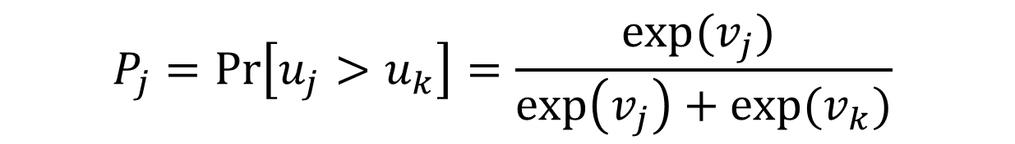
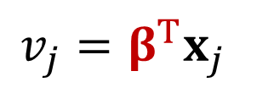
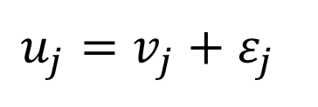
Utility model
Random utility model
Utility of
Product j
$$u_{j}=v_{j}+ε_{j}$$
Error
$$v_{j}=β^{T}x_{j}$$
Product
attributes
Deterministic
component
Part worths
In simple case: Product j vs. Product k
Utility of j
Utility of k
$$P_{j}=\operatorname{Pr}\left[u_{j}>u_{k}\right]=\frac{exp⁡(v_{j}) }{\exp\left(v_{j}\right)+exp⁡(v_{k})}$$
Multinomial Logit Model
Probability of choosing j = Probability that j has more utility than k

Slide 37
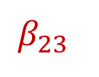
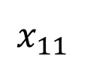
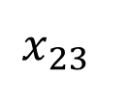
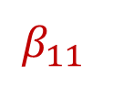
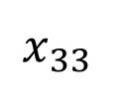
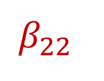
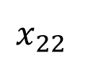
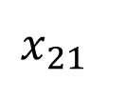
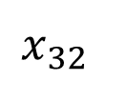



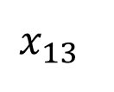
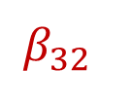
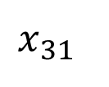
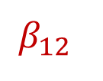
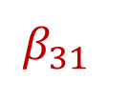
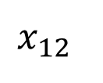
Utility model
Vehicle
Product
Utility
Attributes
Price
MPG
Acceleration
(0→60mph)
$$x_{11}$$
$$x_{12}$$
$$x_{13}$$
$$x_{21}$$
$$x_{22}$$
$$x_{23}$$
$$x_{31}$$
$$x_{32}$$
$$x_{33}$$
$15K
$20K
$25K
25
30
35
6sec
8sec
10sec
Levels
Part-
worth
$$β_{11}$$
$$β_{12}$$
$$β_{13}$$
$$β_{21}$$
$$β_{22}$$
$$β_{23}$$
$$β_{31}$$
$$β_{32}$$
$$β_{33}$$
Conjoint Analysis
$$U\left(x\right)=β_{11}x_{11}+β_{12}x_{12}+β_{13}x_{13}+β_{21}x_{21}+β_{22}x_{22}+β_{31}x_{31}+β_{32}x_{32}+β_{33}x_{33}$$
where x is binary variables (x = 0 or 1)

Slide 38
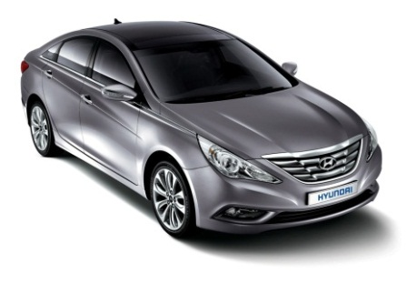
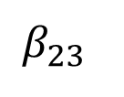
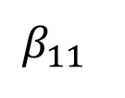
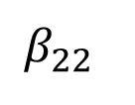
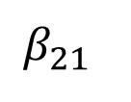
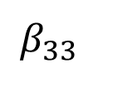
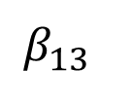
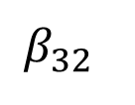
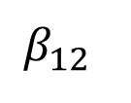
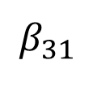
Utility model
Utility
of vehicle j
Vehicle
Product
Attributes
Price
MPG
Acceleration
(0→60mph)
$$x_{11}$$
$$x_{12}$$
$$x_{13}$$
$$x_{21}$$
$$x_{22}$$
$$x_{23}$$
$$x_{31}$$
$$x_{32}$$
$$x_{33}$$
$15K
$20K
$25K
25
30
35
6sec
8sec
10sec
Levels
Part-
worth
$$β_{11}$$
$$β_{12}$$
$$β_{13}$$
$$β_{21}$$
$$β_{22}$$
$$β_{23}$$
$$β_{31}$$
$$β_{32}$$
$$β_{33}$$
$25K
35MPG
8sec
<Vehicle j>

Slide 39
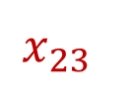
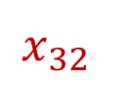
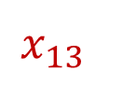
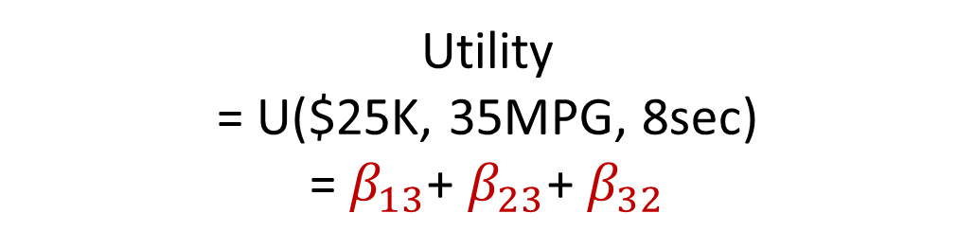
Utility model
Utility
of vehicle j
Vehicle
Product
Attributes
Price
MPG
Acceleration
(0→60mph)
$$x_{11}$$
$$x_{12}$$
$$x_{13}$$
$$x_{21}$$
$$x_{22}$$
$$x_{23}$$
$$x_{31}$$
$$x_{32}$$
$$x_{33}$$
$15K
$20K
$25K
25
30
35
6sec
8sec
10sec
Levels
Part-
worth
$$β_{11}$$
$$β_{12}$$
$$β_{13}$$
$$β_{21}$$
$$β_{22}$$
$$β_{23}$$
$$β_{31}$$
$$β_{32}$$
$$β_{33}$$
Utility
= U($25K, 35MPG, 8sec)
= $β_{13}$+ $β_{23}$+ $β_{32}$
$25K
35MPG
8sec
<Vehicle j>

Slide 40
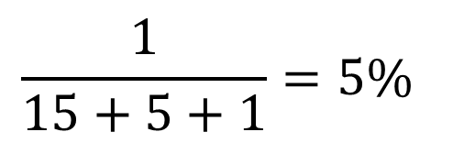
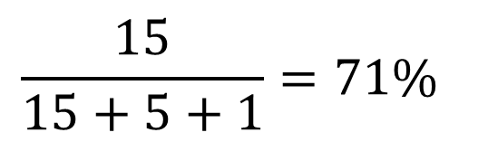
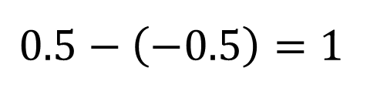
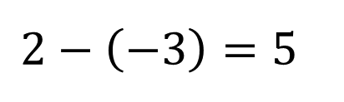
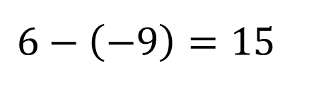
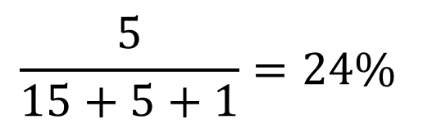
Utility Model
Compute relative importance for each product attribute
Attribute
Level
Part-worth
$15K
6
Price
$20K
3
$$\frac{15}{15+5+1}=71\%$$
$$6−\left(−9\right)=15$$
$25K
-9
Attribute
Level
Part-worth
35
2
$$\frac{5}{15+5+1}=24\%$$
MPG
30
1
$$2−\left(−3\right)=5$$
25
-3
Attribute
Level
Part-worth
6sec
0.5
$$\frac{1}{15+5+1}=5\%$$
0 to 60
8sec
0
$$0.5−\left(−0.5\right)=1$$
10sec
-0.5

Slide 41
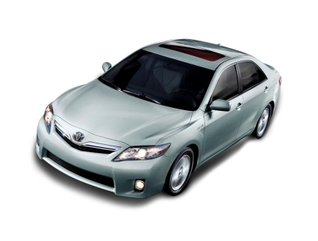
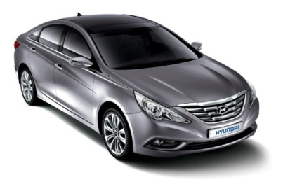
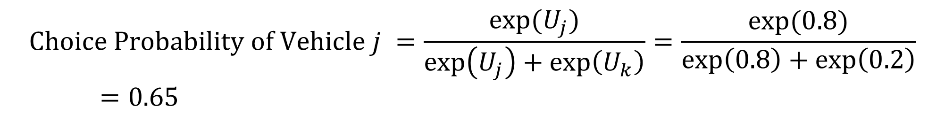
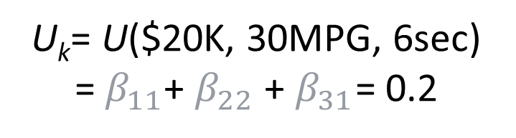
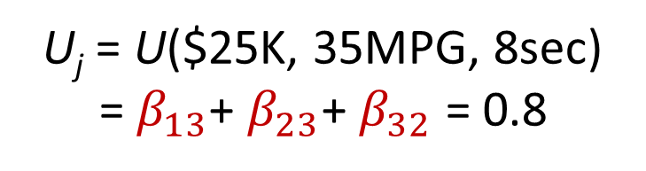
Utility model
Estimate market demand
<Vehicle j>
<Vehicle k>
VS
U_{j} = U($25K, 35MPG, 8sec)
= $β_{13}$+ $β_{23}$+ $β_{32}$ = 0.8
U_{k}= U($20K, 30MPG, 6sec)
= $β_{11}$+ $β_{22}$ + $β_{31}$= 0.2
$$Choice Probability of Vehicle j =\frac{exp⁡(U_{j})}{\exp\left(U_{j}\right)+\exp\left(U_{k}\right)}=\frac{exp⁡(0.8)}{\exp\left(0.8\right)+\exp\left(0.2\right)}=0.65$$
$$Demand of Vehicle j =s\frac{exp⁡(U_{j})}{\exp\left(U_{j}\right)+\exp\left(U_{k}\right)}=1milion×0.65=0.65milion$$
Potential Market Size

Slide 42

Conjoint survey design
1. Design the conjoint survey
1.1: Select attributes relevant to the product or service category
1.2: Select levels for each attribute
Attribute | Level
Price | $15K | $20K | $25K
MPG | 25 | 30 | 35
Acceleration (0→60mph) | 6sec | 8sec | 10sec
1.3: Develop “product bundles” to be evaluated
($15K, 25mpg, 10sec)
($20K, 30mpg, 8sec)
Design of experiment (DOE)
($25K, 35mpg, 6sec)
…

Slide 43
Conjoint survey design
Design of Experiment:
D-optimal design
Full factorial design
det(X^{T}X) = 0
det(X^{T}X) = 2
det(X^{T}X) = 3
X₁
X₂

Slide 44
Types of Conjoint survey
<Ranking conjoint>
<Metric/rating conjoint>
Please rank all the cars
Rank
Price: $15K
MPG: 25
Acceleration: 10sec
How likely would you be to buy this car?
3
Price: $25K
MPG: 35
Acceleration: 8sec
Price: $30K
MPG: 20
Acceleration: 6sec
5
Definitely Would
Not
Probably Would
Not
Might or Might Not
Probably
Would
Definitely
Would
Price: $25K
MPG: 35
Acceleration: 8sec
2
…
…

Slide 45
Types of Conjoint survey
<Pair-wise comparison conjoint>
<Choice-based conjoint>
Which car would you prefer?
If you were shopping for a car and these were your only option, which would you choose?
Price: $25K
MPG: 35
Acceleration: 8sec
Price: $15K
MPG: 25
Acceleration: 10sec
$15K
25 MPG
10sec
$30K
20 MPG
6sec
$25K
35 MPG
8sec
None: I wouldn’t choose any of these
Strongly
Prefer
Left
Somewhat
Prefer
Left
No
Preference
Somewhat
Prefer
Right
Strongly
Prefer
Right

Slide 46
Conjoint survey design
2. Conduct the conjoint survey and obtain data
Evaluate bundles using either ranking, rating, or choice
Choice based conjoint (CBC)
If these were your only options, which would you choose?
$15K MPG 25 Acceleration 6sec | $25K MPG 30 Acceleration 7sec | $15K MPG 35 Acceleration 8sec | NONE: I wouldn't choose any of these.
√
…

Slide 47



Estimate betas
3. Build the utility model
Use MLE(Maximum likelihood estimation)
Observed choice data
1: j is chosen
0: j is not chosen
Choice data
by survey
Train model
Estimate
betas (β)
$$v_{j}=β^{T}x_{j}$$
$$P_{j}=\frac{exp⁡(v_{j}) }{\sum_{j^{′}}{\exp\left(v_{j^{′}}\right)}}$$

Slide 48

Contents
1. Why Marketing Modeling?
2. Conjoint Analysis
2.1 Utility Model
2.2 Conjoint Survey
2.3. Spline Interpolation
3. Advanced Conjoint Analysis

Slide 49



Part-worth and Spline curve
Price | Level | 15K | 20K | 30K
 | Part-worth (Beta) | 0.64 | -0.03 | -0.61
MPG | Level | 25 | 30 | 35
 | Part-worth (Beta) | -0.67 | -0.07 | 0.74
Acceleration | Level | 6 | 8 | 10
 | Part-worth (Beta) | 0.74 | 0.57 | -1.32
Spline
Price
MPG
Acceleration
0.64
Part-worth
-0.03
-0.61

Slide 50

Compute interpolated values
Product A
 | Value | Part-worth
Price | $24.6 | -0.57
MPG | 34 | 0.56
Acceleration | 7.0 | 0.87
Product B
 | Value | Part-worth
Price | $23.9 | -0.49
MPG | 30 | -0.07
Acceleration | 6.2 | 0.80

