Slide 1
Gradient descent (GD) for unconstrained optimization
MAE598/494 Design Optimization
Yi Ren
ASU Fall 2025

Slide 2
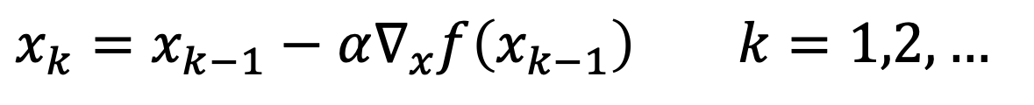
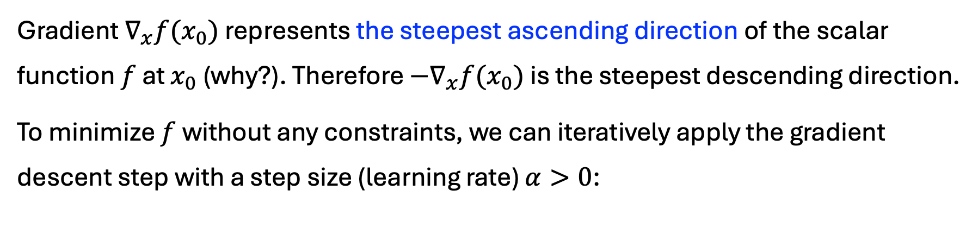
GD
Gradient $∇_{x}f(x_{0})$ represents the steepest ascending direction of the scalar function $f$ at $x_{0}$ (why?). Therefore $−∇_{x}f(x_{0})$ is the steepest descending direction.
To minimize $f$ without any constraints, we can iteratively apply the gradient descent step with a step size (learning rate) $α>0$:
$$x_{k}=x_{k−1}−α∇_{x}f\left(x_{k−1}\right) k=1,2,…$$

Slide 3
Gradient descent (GD)
$$x_{k}=x_{k−1}−α∇_{x}f\left(x_{k−1}\right) k=1,2,…$$

Slide 4
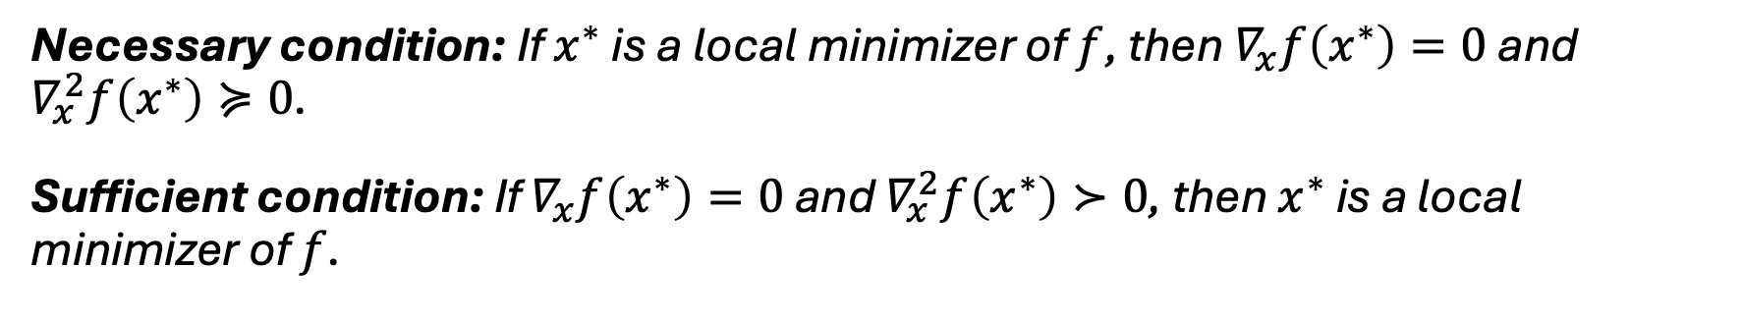
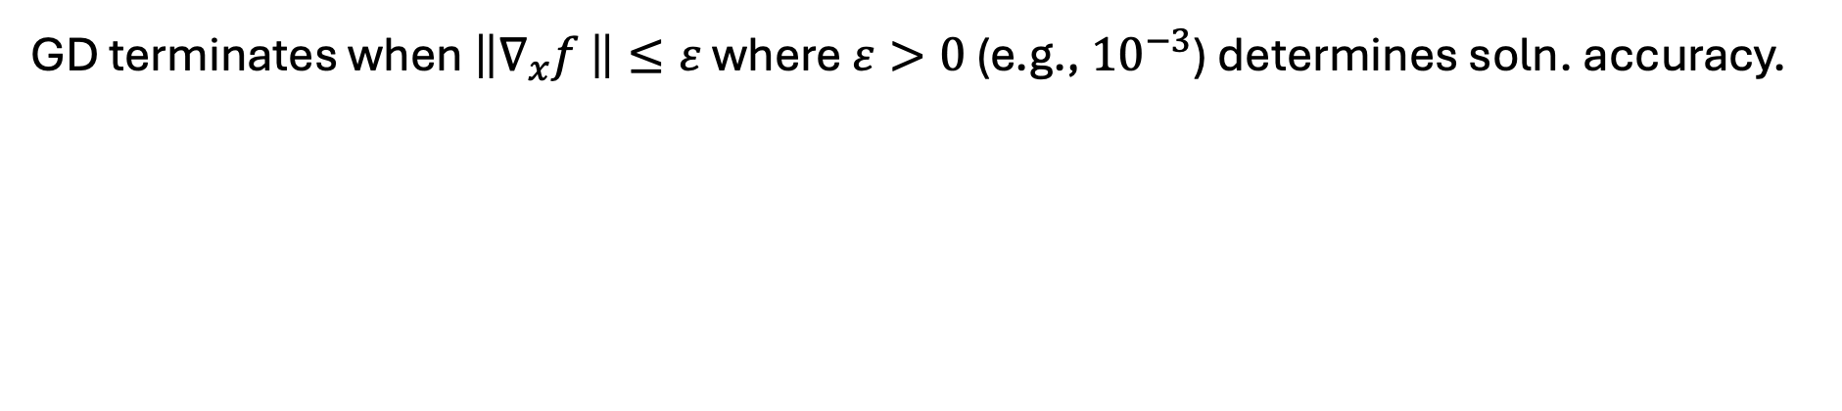
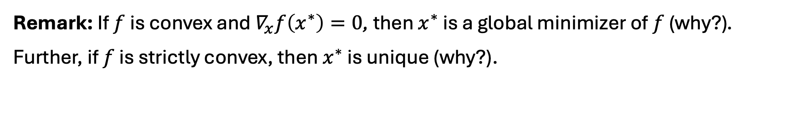
Termination criterion
GD terminates when $\left\|∇_{x}f \right\|≤ε$ where $ε>0$ (e.g., ${10}^{−3}$) determines soln. accuracy.
Necessary condition: If $x^{∗}$ is a local minimizer of $f$, then $∇_{x}f\left(x^{∗}\right)=0$ and $∇_{x}^{2}f\left(x^{∗}\right)≽0$.
Sufficient condition: If $∇_{x}f\left(x^{∗}\right)=0$ and $∇_{x}^{2}f\left(x^{∗}\right)≻0$, then $x^{∗}$ is a local minimizer of $f$.
Remark: If $f$ is convex and $∇_{x}f\left(x^{∗}\right)=0$, then $x^{∗}$ is a global minimizer of $f$ (why?). Further, if $f$ is strictly convex, then $x^{∗}$ is unique (why?).

Slide 5

Line search
GD with arbitrary step size $α$ is not guaranteed to converge (why?).
Line search: Choose $α_{k}>0$ so that
(Sufficient decrease) $f\left(x_{k}+α_{k}d_{k}\right)<f(x_{k})$ for descent direction $d_{k}$
(Efficiency) $α_{k}$ not too small

Slide 6
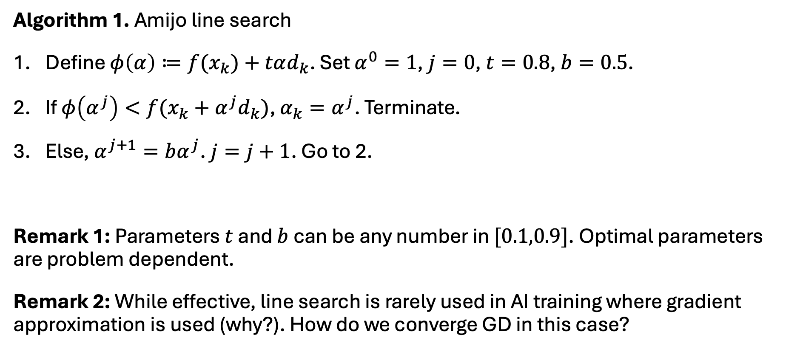
Amijo line search
Algorithm 1. Amijo line search
Define $φ\left(α\right)≔f(x_{k})+tαd_{k}$. Set $α^{0}=1$, $j=0$, $t=0.8$, $b=0.5$.
If $φ\left(α^{j}\right)<f(x_{k}+α^{j}d_{k})$, $α_{k}=α^{j}$. Terminate.
Else, $α^{j+1}=bα^{j}$. $j=j+1$. Go to 2.
Remark 1: Parameters $t$ and $b$ can be any number in $[0.1,0.9]$. Optimal parameters are problem dependent.
Remark 2: While effective, line search is rarely used in AI training where gradient approximation is used (why?). How do we converge GD in this case?

Slide 7
Amijo line search
Demo.

Slide 8
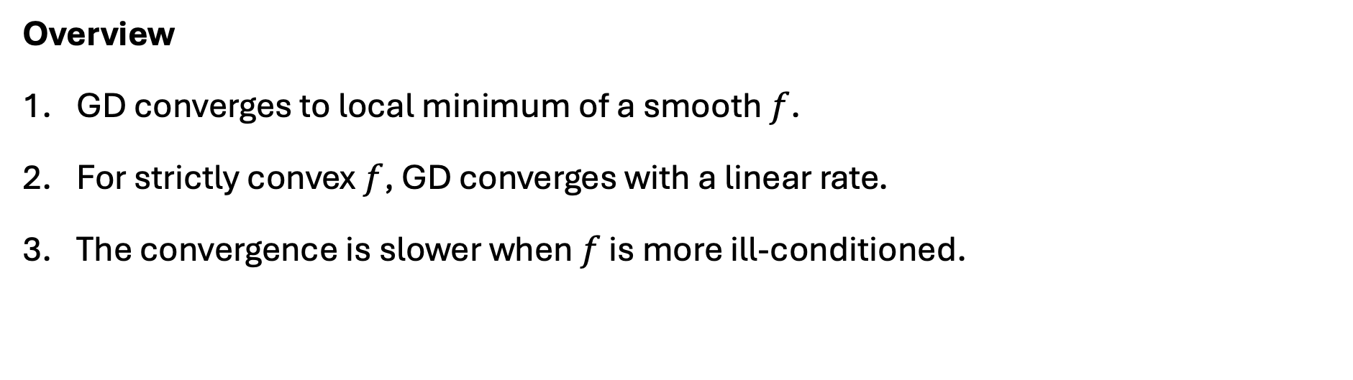
GD convergence properties
Overview
GD converges to local minimum of a smooth $f$.
For strictly convex $f$, GD converges with a linear rate.
The convergence is slower when $f$ is more ill-conditioned.

Slide 9
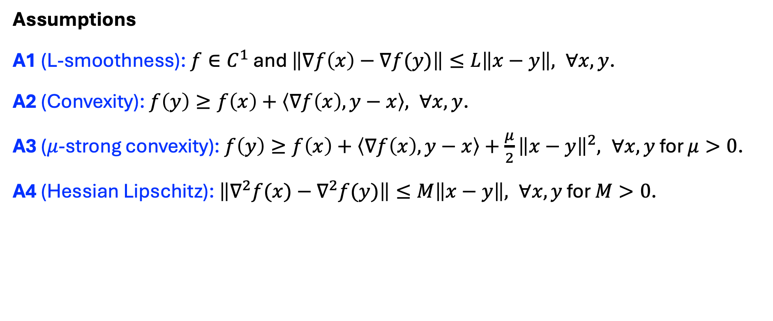
GD convergence properties
Assumptions
A1 (L-smoothness): $f∈C^{1}$ and $\left\|∇f\left(x\right)−∇f(y)\right\|≤L\left\|x−y\right\|, ∀x,y$.
A2 (Convexity): $f\left(y\right)≥f\left(x\right)+\left\langle ∇f\left(x\right),y−x\right\rangle , ∀x,y$.
A3 ($μ$-strong convexity): $f\left(y\right)≥f\left(x\right)+\left\langle ∇f\left(x\right),y−x\right\rangle +\frac{μ}{2}{\left\|x−y\right\|}^{2}, ∀x,y$ for $μ>0$.
A4 (Hessian Lipschitz): $\left\|∇^{2}f(x)−∇^{2}f(y)\right\|≤M\left\|x−y\right\|, ∀x,y$ for $M>0$.

Slide 10

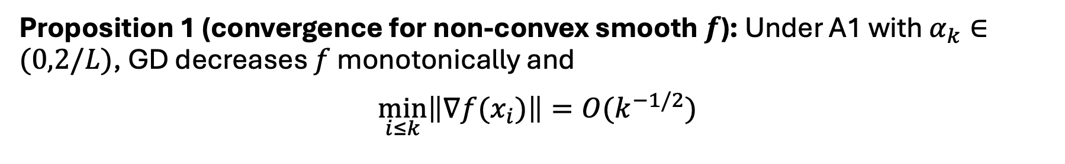
GD convergence properties
Proposition 1 (convergence for non-convex smooth $f$): Under A1 with $α_{k}∈(0,2/L)$, GD decreases $f$ monotonically and
$$\min_{i≤k}\left\|∇f(x_{i})\right\|=O(k^{−1/2})$$
Remark: Given $ε>0$, GD takes $ε^{−2}$ iterations. Problematic for engineering design when each iteration takes hours/days of simulations.

Slide 11

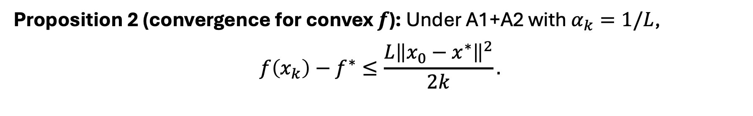
GD convergence properties
Proposition 2 (convergence for convex $f$): Under A1+A2 with $α_{k}=1/L$,
$$f\left(x_{k}\right)−f^{∗}≤\frac{L{\left\|x_{0}−x^{∗}\right\|}^{2}}{2k}.$$
Remark: Convergence rate for convex and L-smooth $f$ is at least sub-linear. Doubling accuracy doubles iterations.

Slide 12
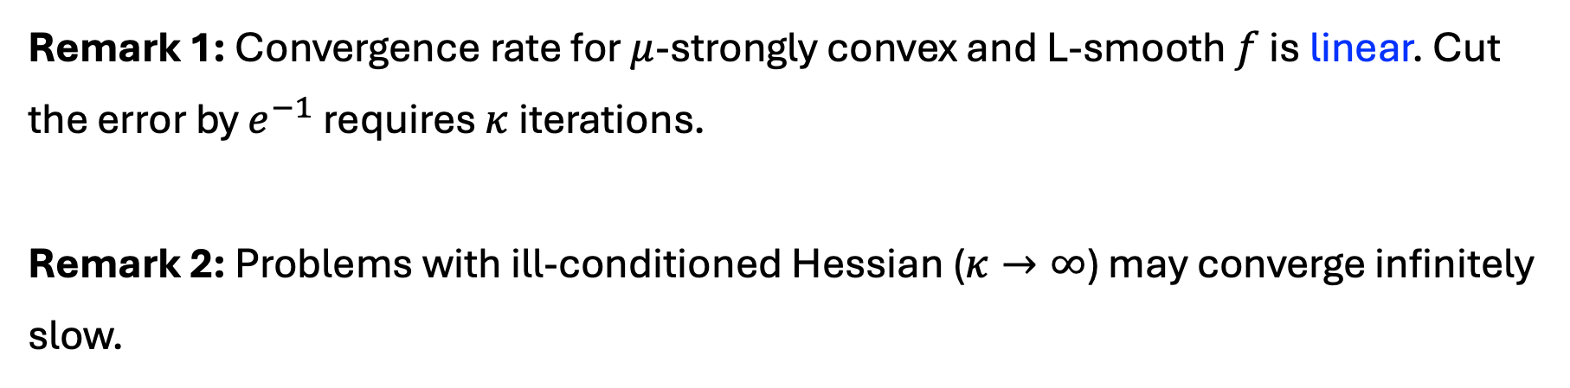
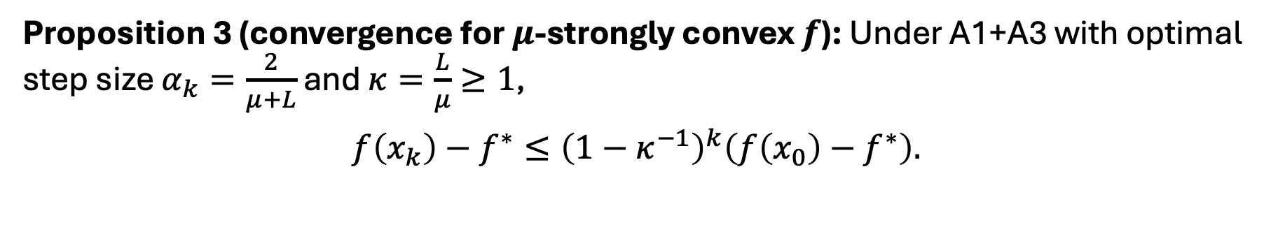
GD convergence properties
Proposition 3 (convergence for $μ$-strongly convex $f$): Under A1+A3 with optimal step size $α_{k}=\frac{2}{μ+L}$ and $κ=\frac{L}{μ}≥1$,
$$f\left(x_{k}\right)−f^{∗}≤{\left(1−κ^{−1}\right)}^{k}\left(f\left(x_{0}\right)−f^{∗}\right).$$
Remark 1: Convergence rate for $μ$-strongly convex and L-smooth $f$ is linear. Cut the error by $e^{−1}$ requires $κ$ iterations.
Remark 2: Problems with ill-conditioned Hessian ($κ→∞$) may converge infinitely slow.

Slide 13
GD convergence properties
Proof of Prop. 1

Slide 14
GD convergence properties
Proof of Prop. 2

Slide 15
GD convergence properties
Proof of Prop. 3

Slide 16

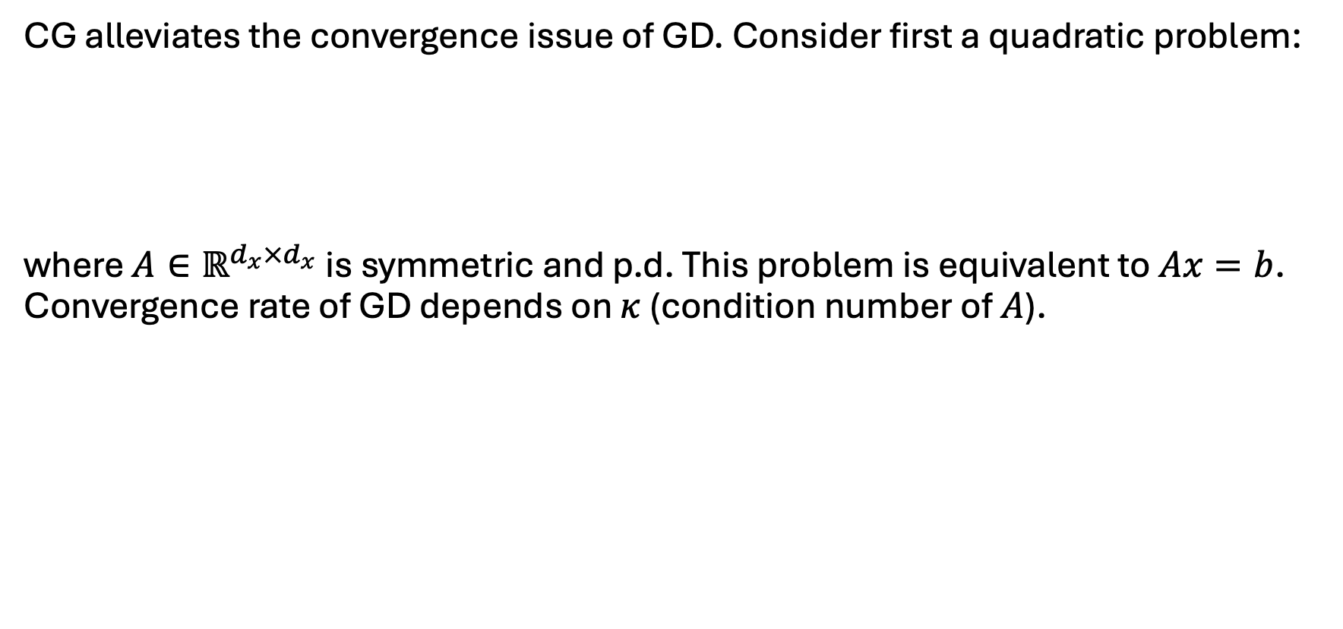
Conjugate gradient (CG)
CG alleviates the convergence issue of GD. Consider first a quadratic problem:
where $A∈ℝ^{d_{x}×d_{x}}$ is symmetric and p.d. This problem is equivalent to $Ax=b$. Convergence rate of GD depends on $κ$ (condition number of $A$).
$$\min_{x}$$ | $$f\left(x\right)=\frac{1}{2}x^{⊤}Ax−b^{⊤}x$$

Slide 17

Newton’s method
GD convergence rate affected by $∇^{2}f$. Thus, we should normalize the search using $∇^{2}f$:
$$x_{k}=x_{k−1}−α{\left(∇^{2}f\right)}^{−1}∇_{x}f\left(x_{k−1}\right) k=1,2,…$$

Slide 18
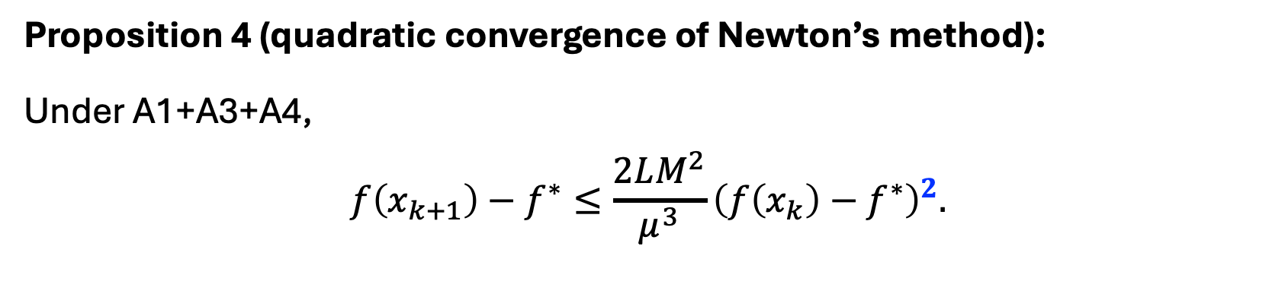
Newton’s method
Proposition 4 (quadratic convergence of Newton’s method):
Under A1+A3+A4,
$$f\left(x_{k+1}\right)−f^{∗}≤\frac{2LM^{2}}{μ^{3}}{\left(f\left(x_{k}\right)−f^{∗}\right)}^{2}.$$

Slide 19
Newton’s method
Proof of Prop. 4

Slide 20
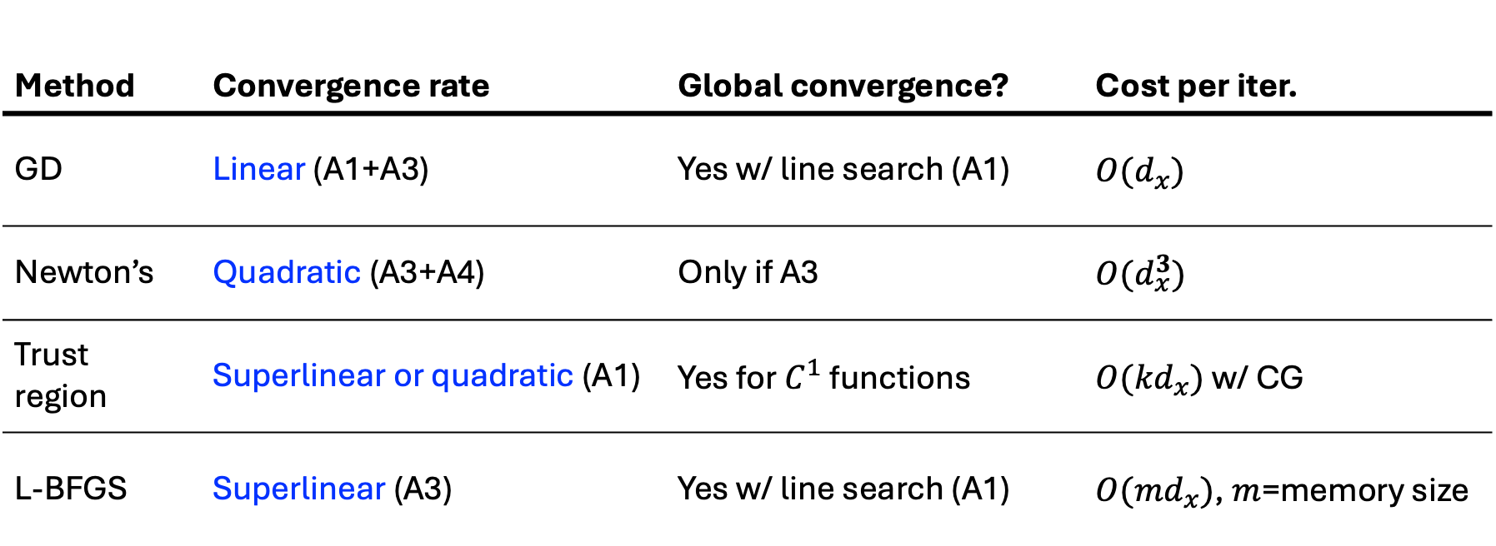
Summary of gradient-based algorithms
Method | Convergence rate | Global convergence? | Cost per iter.
GD | Linear (A1+A3) | Yes w/ line search (A1) | $$O(d_{x})$$
Newton’s | Quadratic (A3+A4) | Only if A3 | $$O(d_{x}^{3})$$
Trust region | Superlinear or quadratic (A1) | Yes for $C^{1}$ functions | $O({kd}_{x})$ w/ CG
L-BFGS | Superlinear (A3) | Yes w/ line search (A1) | $O({md}_{x})$, $m$=memory size

Slide 21


Trust region
At $x_{k}$, find a search step within a trust region $Δ$:
The solution is $s_{k}=$ $−{\left(∇^{2}f\left(x_{k}\right)+μI\right)}^{−1}∇_{x}f\left(x_{k}\right)$ where $μ≥0$ satisfies $||s_{k}||≤Δ_{k}$.
Remark: Trust region uses Newton’s step when $Δ$ is large ($f$ is approximately convex quadratic in a large neighborhood of $x_{k}$) and reduces to GD when $Δ$ is small.
$$\min_{s}$$ | $$∇f{\left(x_{k}\right)}^{⊤}s+\frac{1}{2}s^{⊤}∇^{2}f\left(x_{k}\right)s$$
$$s.t.$$ | $$||s||≤Δ_{k}$$

Slide 22
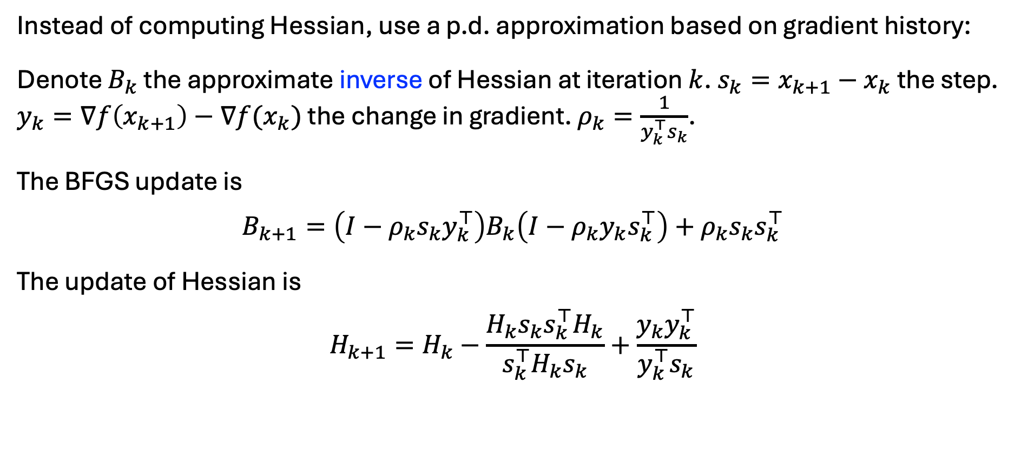
BFGS
Instead of computing Hessian, use a p.d. approximation based on gradient history:
Denote $B_{k}$ the approximate inverse of Hessian at iteration $k$. $s_{k}=x_{k+1}−x_{k}$ the step. $y_{k}=∇f\left(x_{k+1}\right)−∇f(x_{k})$ the change in gradient. $ρ_{k}=\frac{1}{y_{k}^{⊤}s_{k}}$.
The BFGS update is
$$B_{k+1}=\left(I−ρ_{k}s_{k}y_{k}^{⊤}\right)B_{k}\left(I−ρ_{k}y_{k}s_{k}^{⊤}\right)+ρ_{k}s_{k}s_{k}^{⊤}$$
The update of Hessian is
$$H_{k+1}=H_{k}−\frac{H_{k}s_{k}s_{k}^{⊤}H_{k}}{s_{k}^{⊤}H_{k}s_{k}}+\frac{y_{k}y_{k}^{⊤}}{y_{k}^{⊤}s_{k}}$$

Slide 23

L-BFGS
L-BFGS avoids storage of a dense (inverse) Hessian matrix, critical for large-scale optimization ($d_{x}∼{10}^{6}$).
L-BFGS stores the most recent $m∈[3,20]$ data $(s_{k}, y_{k})$. Approximates search direction $s_{k+1}$ by:
1. ***

