Slide 1
Gradient-based methods for unconstrained optimization (part 3)
MAE598/494 Design Optimization
Yi Ren
ASU Fall 2025

Slide 2
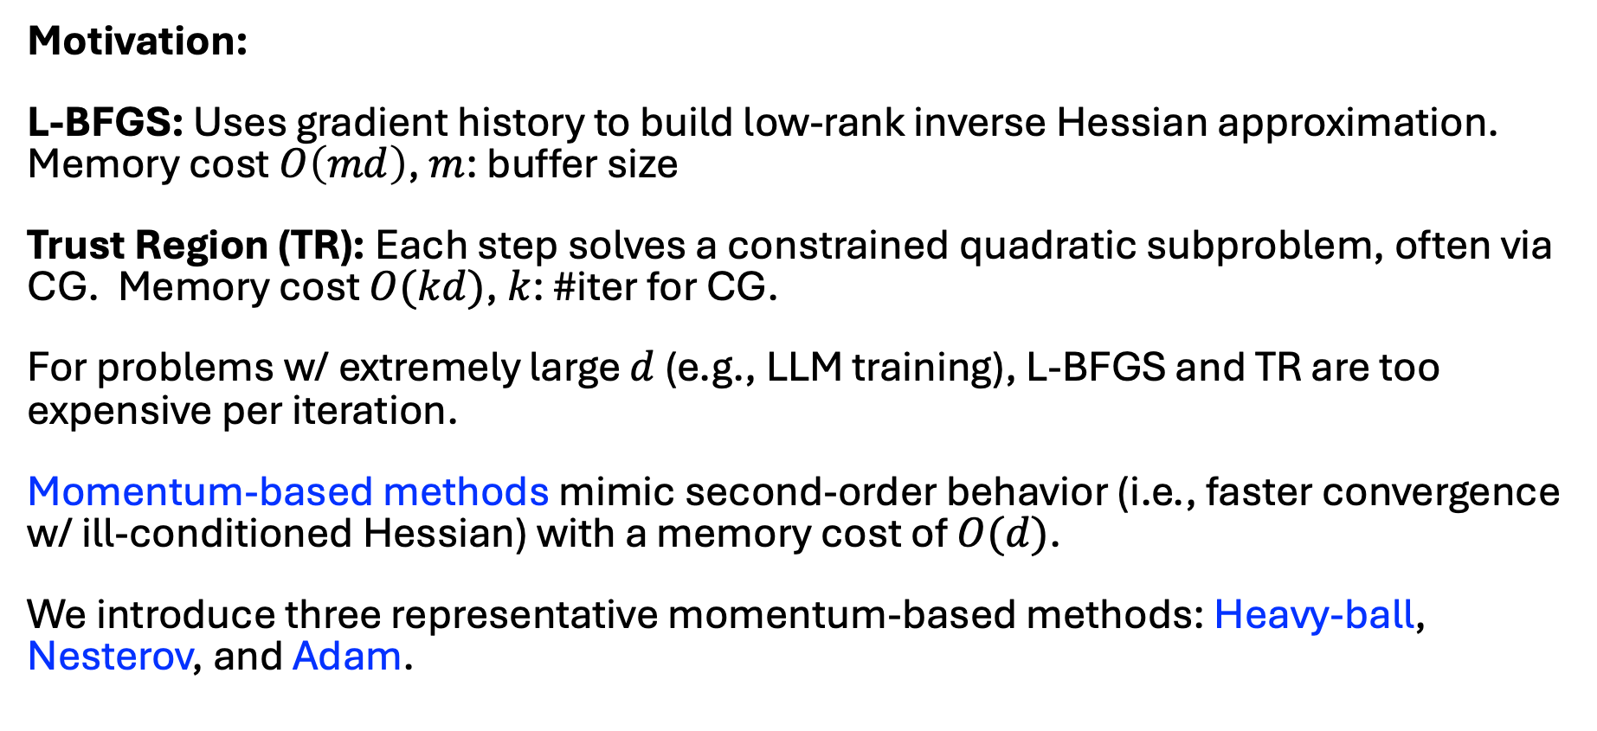
Momentum-based methods
Motivation:
L-BFGS: Uses gradient history to build low-rank inverse Hessian approximation. Memory cost $O\left(md\right)$, $m$: buffer size
Trust Region (TR): Each step solves a constrained quadratic subproblem, often via CG. Memory cost $O(kd)$, $k$: #iter for CG.
For problems w/ extremely large $d$ (e.g., LLM training), L-BFGS and TR are too expensive per iteration.
Momentum-based methods mimic second-order behavior (i.e., faster convergence w/ ill-conditioned Hessian) with a memory cost of $O(d)$.
We introduce three representative momentum-based methods: Heavy-ball, Nesterov, and Adam.

Slide 3
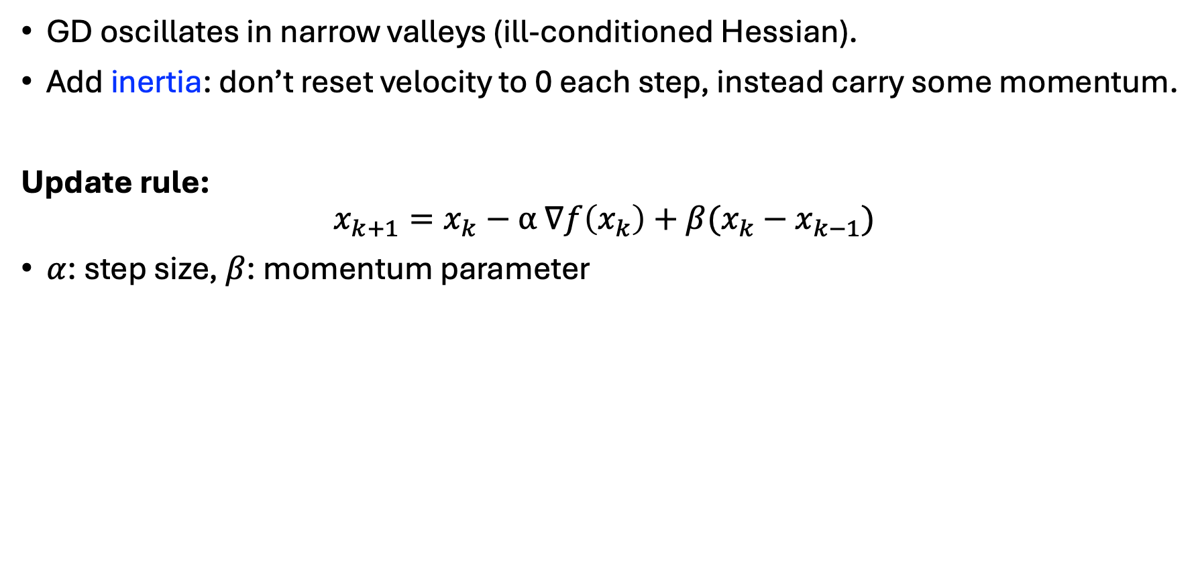
Heavy ball momentum (1964)
GD oscillates in narrow valleys (ill-conditioned Hessian).
Add inertia: don’t reset velocity to 0 each step, instead carry some momentum.
Update rule:
$$x_{k+1}=x_{k}−α ∇f\left(x_{k}\right)+β(x_{k}−x_{k−1})$$
$α$: step size, $β$: momentum parameter

Slide 4
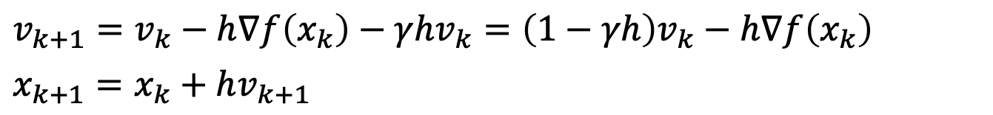
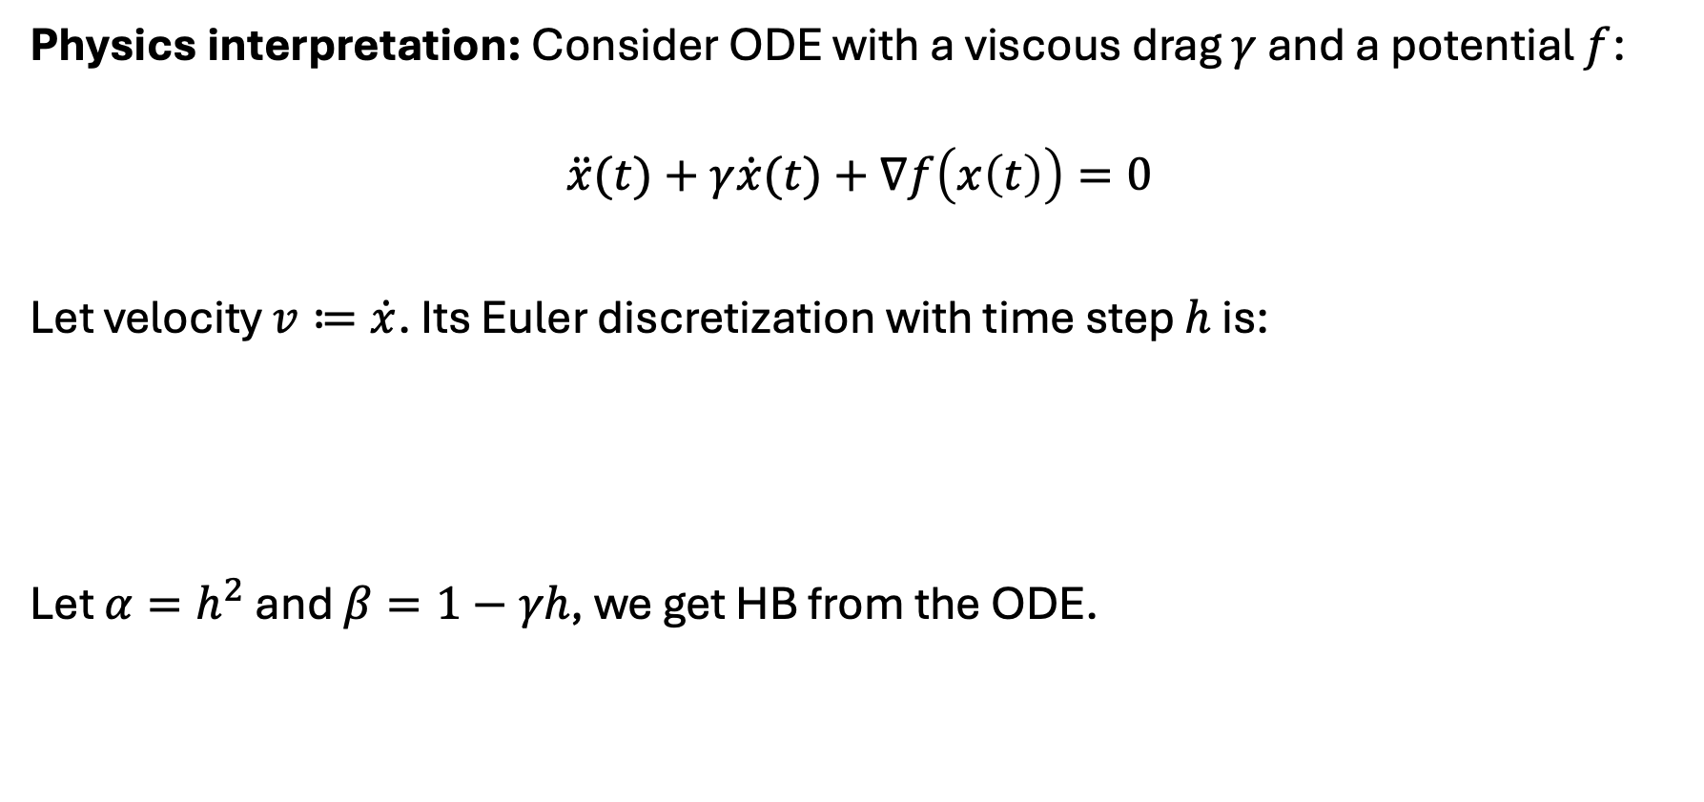
Heavy ball momentum
Physics interpretation: Consider ODE with a viscous drag $γ$ and a potential $f$:
$$\ddot{x}(t)+γ\dot{x}(t)+∇f\left(x\left(t\right)\right)=0$$
Let velocity $v≔\dot{x}$. Its Euler discretization with time step $h$ is:
Let $α=h^{2}$ and $β=1−γh$, we get HB from the ODE.
$$v_{k+1}=v_{k}−h∇f\left(x_{k}\right)−γhv_{k}=\left(1−γh\right)v_{k}−h∇f\left(x_{k}\right)$$
$$x_{k+1}=x_{k}+hv_{k+1}$$

Slide 5
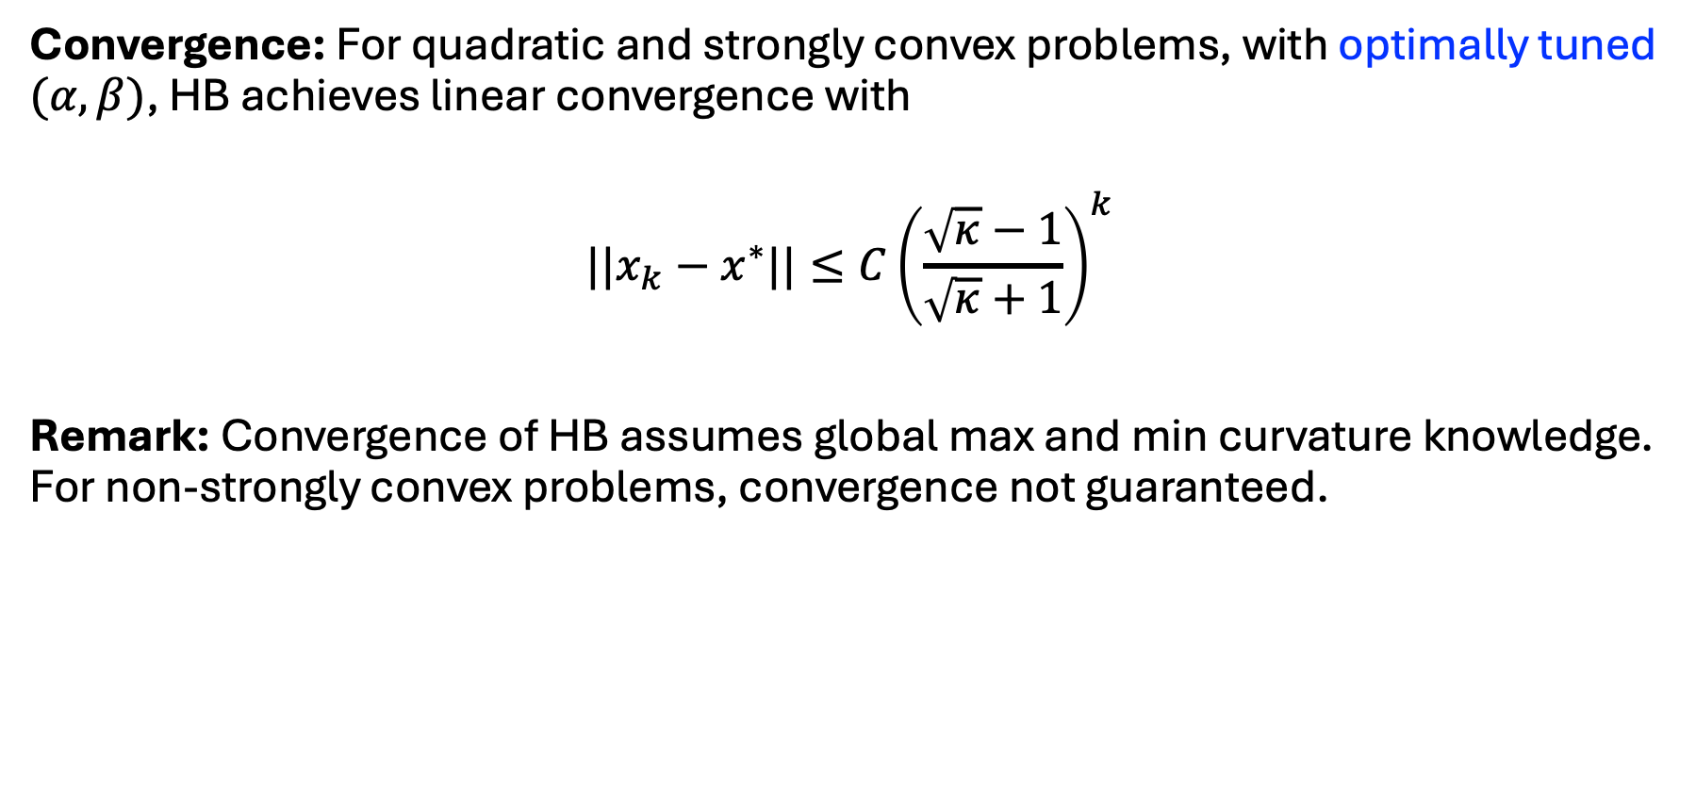
Heavy ball momentum
Convergence: For quadratic and strongly convex problems, with optimally tuned $(α,β)$, HB achieves linear convergence with
$$||x_{k}−x^{∗}||≤C{\left(\frac{\sqrt{κ}−1}{\sqrt{κ}+1}\right)}^{k}$$
Remark: Convergence of HB assumes global max and min curvature knowledge. For non-strongly convex problems, convergence not guaranteed.

Slide 6
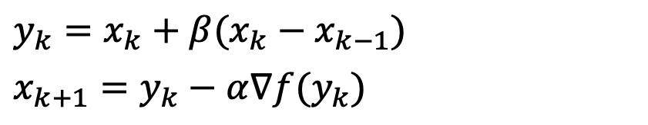
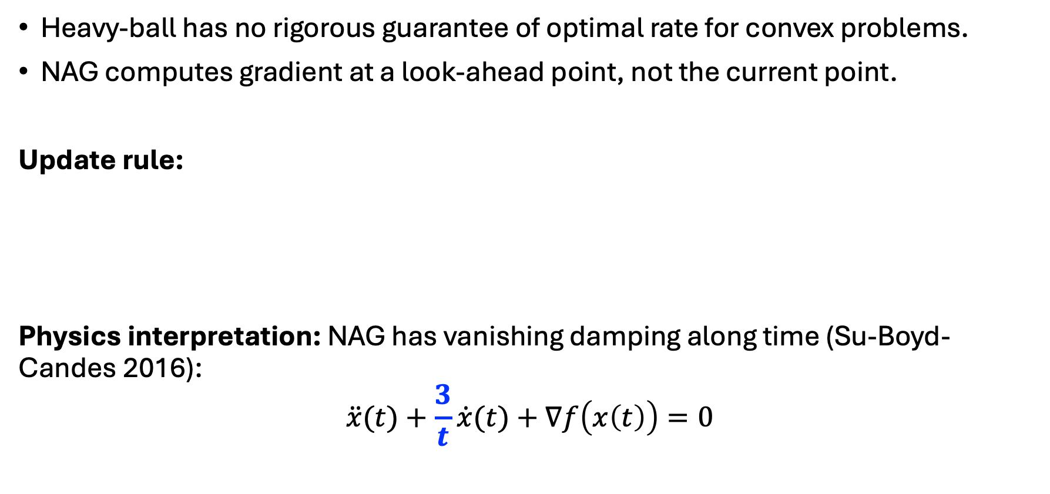
Nesterov’s accelerated gradient (NAG, 1983)
Heavy-ball has no rigorous guarantee of optimal rate for convex problems.
NAG computes gradient at a look-ahead point, not the current point.
Update rule:
Physics interpretation: NAG has vanishing damping along time (Su-Boyd-Candes 2016):
$$\ddot{x}(t)+\frac{3}{t}\dot{x}(t)+∇f\left(x\left(t\right)\right)=0$$
$$y_{k}=x_{k}+β(x_{k}−x_{k−1})$$
$$x_{k+1}=y_{k}−α∇f(y_{k})$$

Slide 7
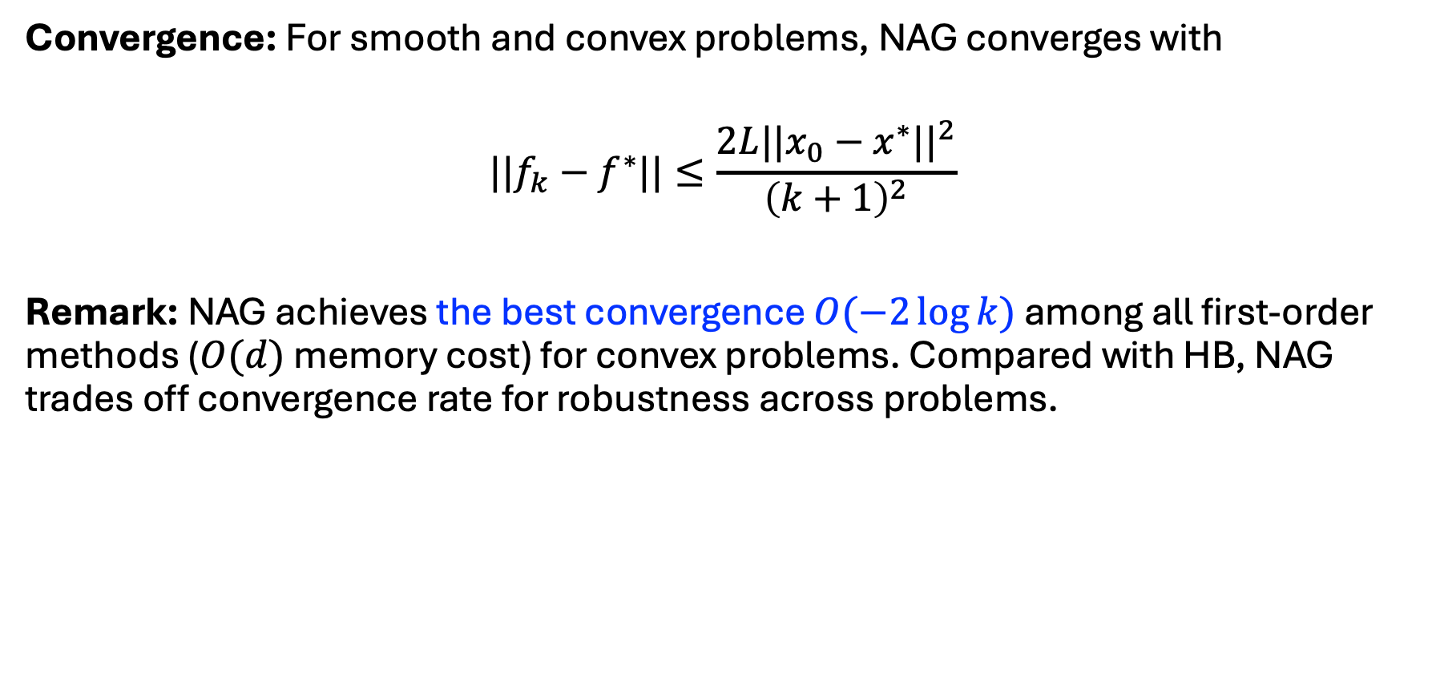
Nesterov’s accelerated gradient (NAG)
Convergence: For smooth and convex problems, NAG converges with
$$||f_{k}−f^{∗}||≤\frac{2L||x_{0}−x^{∗}||^{2}}{{\left(k+1\right)}^{2}}$$
Remark: NAG achieves the best convergence $O(−2\log{k})$ among all first-order methods ($O(d)$ memory cost) for convex problems. Compared with HB, NAG trades off convergence rate for robustness across problems.

Slide 8
Adam (2015)
Motivation: Deep learning needs optimizers robust to:
Nonconvex objectives
Stochastic gradients (due to random sampling)
Different scaling per coordinate
Adam combines momentum and adaptive step size.
Useful for stochastic gradient, but not when gradient changes rapidly.

Slide 9
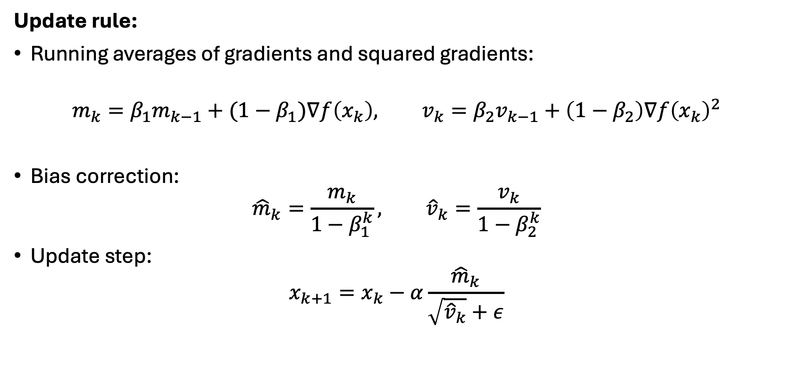
Adam
Update rule:
Running averages of gradients and squared gradients:
$$m_{k}=β_{1}m_{k−1}+{(1−β}_{1})∇f\left(x_{k}\right), v_{k}=β_{2}v_{k−1}+\left(1−β_{2}\right)∇f{\left(x_{k}\right)}^{2}$$
Bias correction:
$${\hat{m}}_{k}=\frac{m_{k}}{1−β_{1}^{k}}, {\hat{v}}_{k}=\frac{v_{k}}{1−β_{2}^{k}}$$
Update step:
$$x_{k+1}=x_{k}−α\frac{{\hat{m}}_{k}}{\sqrt{{\hat{v}}_{k}}+ε}$$

Slide 10
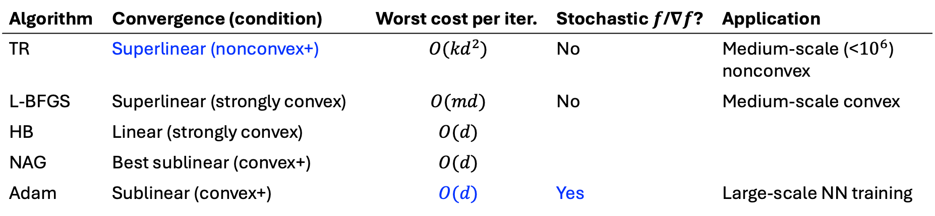
Summary
Algorithm | Convergence (condition) | Worst cost per iter. | Stochastic $f$/$∇f$? | Application
TR | Superlinear (nonconvex+) | $$O({kd}^{2})$$ | No | Medium-scale (<${10}^{6}$) nonconvex
L-BFGS | Superlinear (strongly convex) | $$O(md)$$ | No | Medium-scale convex
HB | Linear (strongly convex) | $$O(d)$$
NAG | Best sublinear (convex+) | $$O(d)$$
Adam | Sublinear (convex+) | $$O(d)$$ | Yes | Large-scale NN training

Slide 11
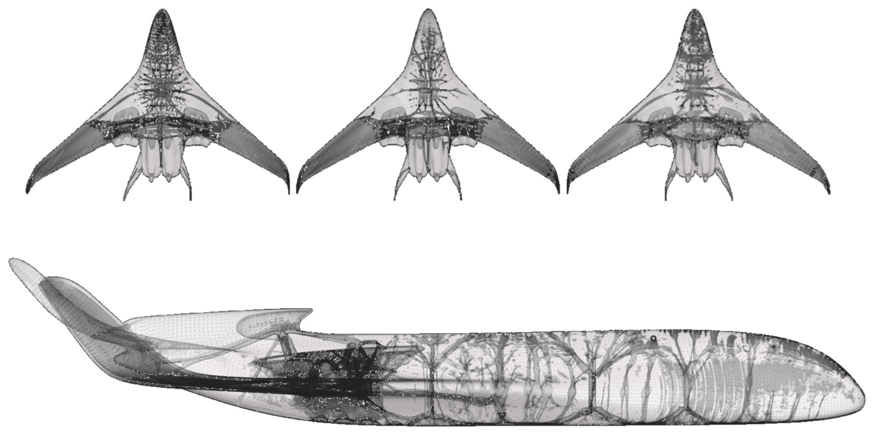
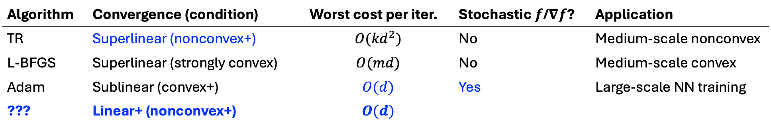
Open questions
Algorithm | Convergence (condition) | Worst cost per iter. | Stochastic $f$/$∇f$? | Application
TR | Superlinear (nonconvex+) | $$O({kd}^{2})$$ | No | Medium-scale nonconvex
L-BFGS | Superlinear (strongly convex) | $$O(md)$$ | No | Medium-scale convex
Adam | Sublinear (convex+) | $$O(d)$$ | Yes | Large-scale NN training
??? | Linear+ (nonconvex+) | $$O(d)$$
Curvature on the cheap: Recipe that (i) costs first-order per step and memory, (ii) uses curvature enough to beat momentum/Adam on hard problems, and (iii) stays stable in nonconvex regimes.
Applications: MPC w/ nonlinear dynamics (e.g., soft robotics), PDE-constrained optimization (e.g., engineering design), PINN/NO (e.g., climate prediction)
Van den Brink et al. (2024)

Slide 12
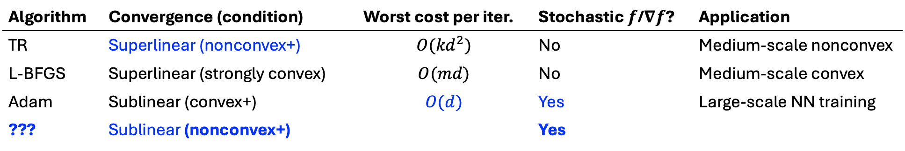
Open questions
Algorithm | Convergence (condition) | Worst cost per iter. | Stochastic $f$/$∇f$? | Application
TR | Superlinear (nonconvex+) | $$O({kd}^{2})$$ | No | Medium-scale nonconvex
L-BFGS | Superlinear (strongly convex) | $$O(md)$$ | No | Medium-scale convex
Adam | Sublinear (convex+) | $$O(d)$$ | Yes | Large-scale NN training
??? | Sublinear (nonconvex+) |  | Yes
Stochastic nonconvex optimization and games: Complexity results lack for noisy, structured, nonconvex engineering problems.
Applications: RL, learning dynamics from real-world data

Slide 13
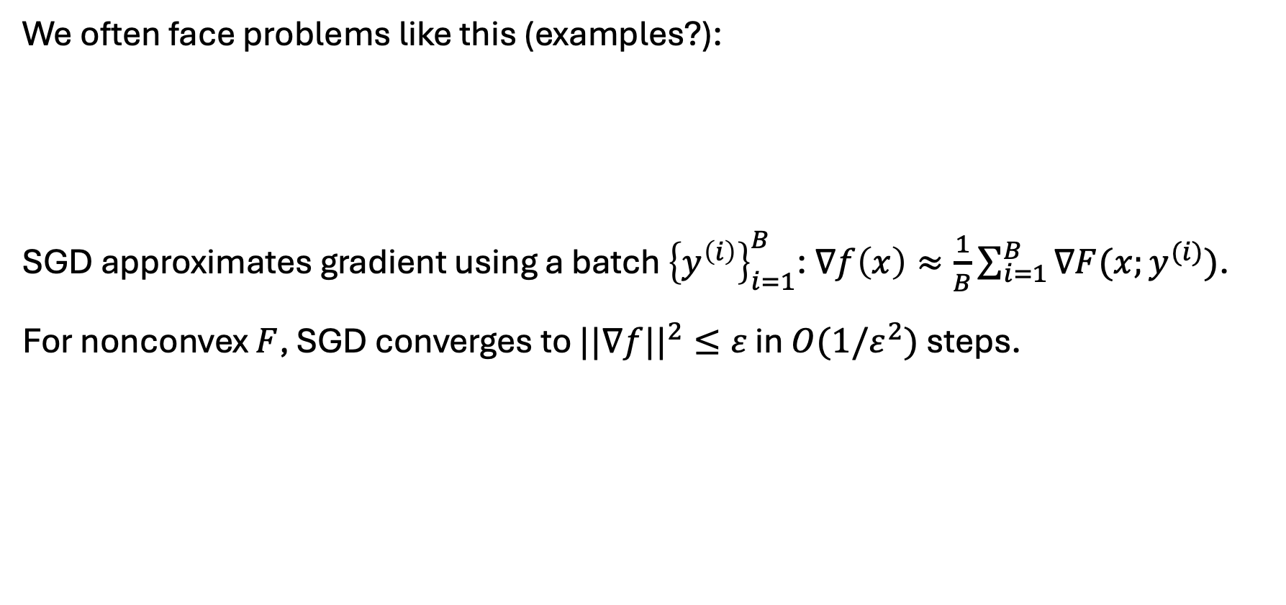
SGD
We often face problems like this (examples?):
SGD approximates gradient using a batch ${\left\{y^{\left(i\right)}\right\}}_{i=1}^{B}$: $∇f\left(x\right)≈\frac{1}{B}\sum_{i=1}^{B}{∇F(x;y^{(i)})}$.
For nonconvex $F$, SGD converges to $||∇f||^{2}≤ε$ in $O(1/ε^{2})$ steps.
$$\min_{x}$$ | $$f\left(x\right)≔𝔼_{y}[F(x;y)]$$

