Slide 1
Preliminaries: matrix calculus, convexity, Taylor’s expansion
MAE598/494 Design Optimization
Yi Ren
ASU Fall 2025

Slide 2
Matrix calculus
Overview
Gradient (first-order derivative) tells the slope and direction for going up hill.
Hessian (second-order derivative) tells the curvature of the hill.

Slide 3
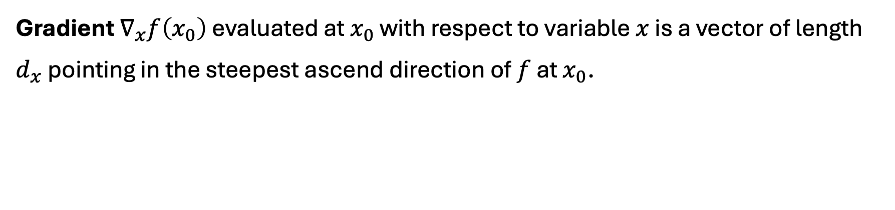
Matrix calculus
Gradient $∇_{x}f\left(x_{0}\right)$ evaluated at $x_{0}$ with respect to variable $x$ is a vector of length $d_{x}$ pointing in the steepest ascend direction of $f$ at $x_{0}$.

Slide 4

Matrix calculus
Hessian $∇_{x}^{2}f\left(x_{0}\right)$ evaluated at $x_{0}$ wrt $x$ is a symmetric matrix of size $d_{x}$-by-$d_{x}$.
Let its $i$th eigenvalue be $λ_{i}$, eigenvector $u_{i}$. $λ_{i}$ measures curvature of $f$along $u_{i}$ at $x_{0}$.

Slide 5
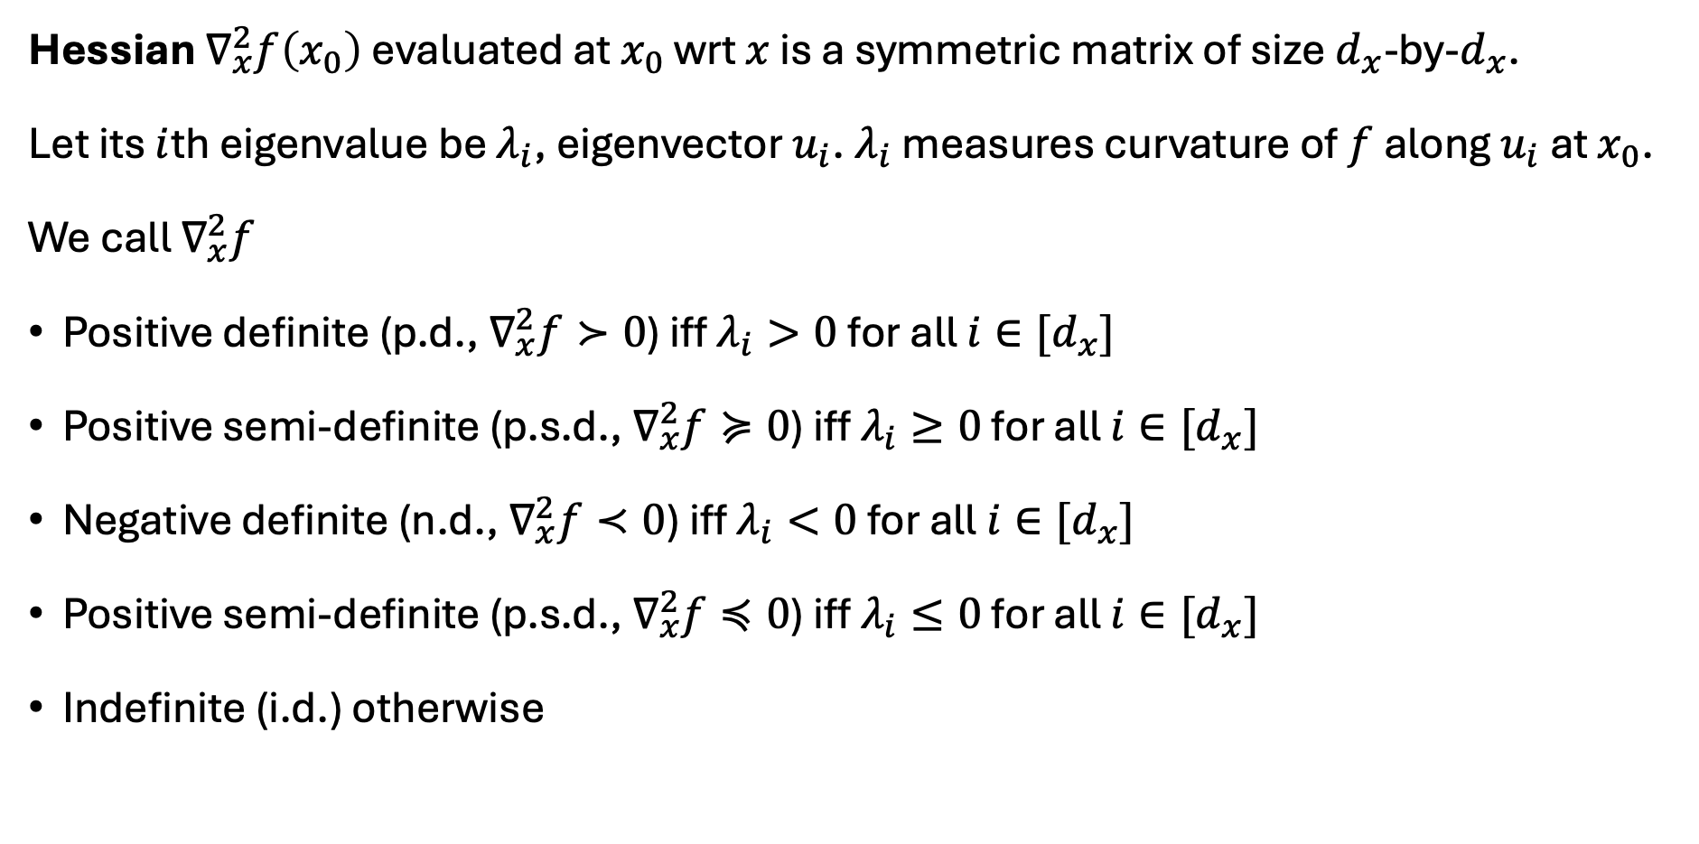
Matrix calculus
Hessian $∇_{x}^{2}f\left(x_{0}\right)$ evaluated at $x_{0}$ wrt $x$ is a symmetric matrix of size $d_{x}$-by-$d_{x}$.
Let its $i$th eigenvalue be $λ_{i}$, eigenvector $u_{i}$. $λ_{i}$ measures curvature of $f$along $u_{i}$ at $x_{0}$.
We call $∇_{x}^{2}f$
Positive definite (p.d., $∇_{x}^{2}f≻0$) iff $λ_{i}>0$ for all $i∈[d_{x}]$
Positive semi-definite (p.s.d., $∇_{x}^{2}f≽0$) iff $λ_{i}≥0$ for all $i∈[d_{x}]$
Negative definite (n.d., $∇_{x}^{2}f≺0$) iff $λ_{i}<0$ for all $i∈[d_{x}]$
Positive semi-definite (p.s.d., $∇_{x}^{2}f≼0$) iff $λ_{i}≤0$ for all $i∈[d_{x}]$
Indefinite (i.d.) otherwise

Slide 6
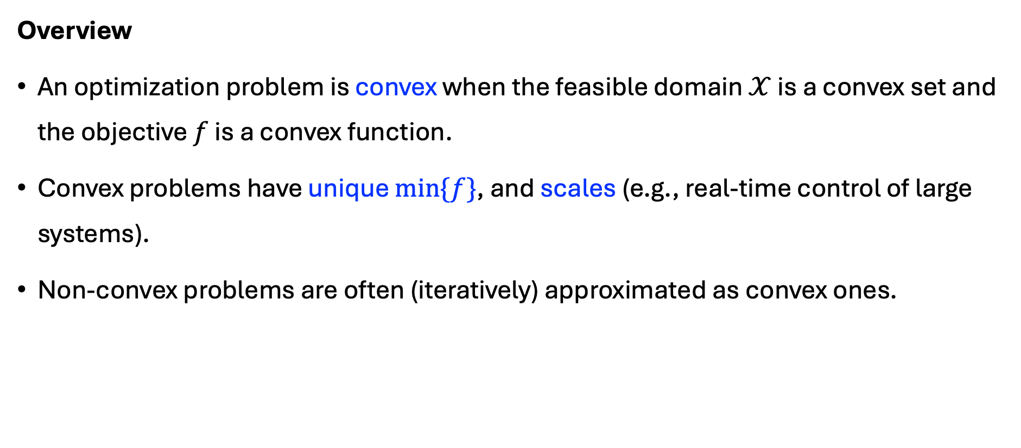
Convex set and function
Overview
An optimization problem is convex when the feasible domain $𝒳$ is a convex set and the objective $f$ is a convex function.
Convex problems have unique $min\{f\}$, and scales (e.g., real-time control of large systems).
Non-convex problems are often (iteratively) approximated as convex ones.

Slide 7
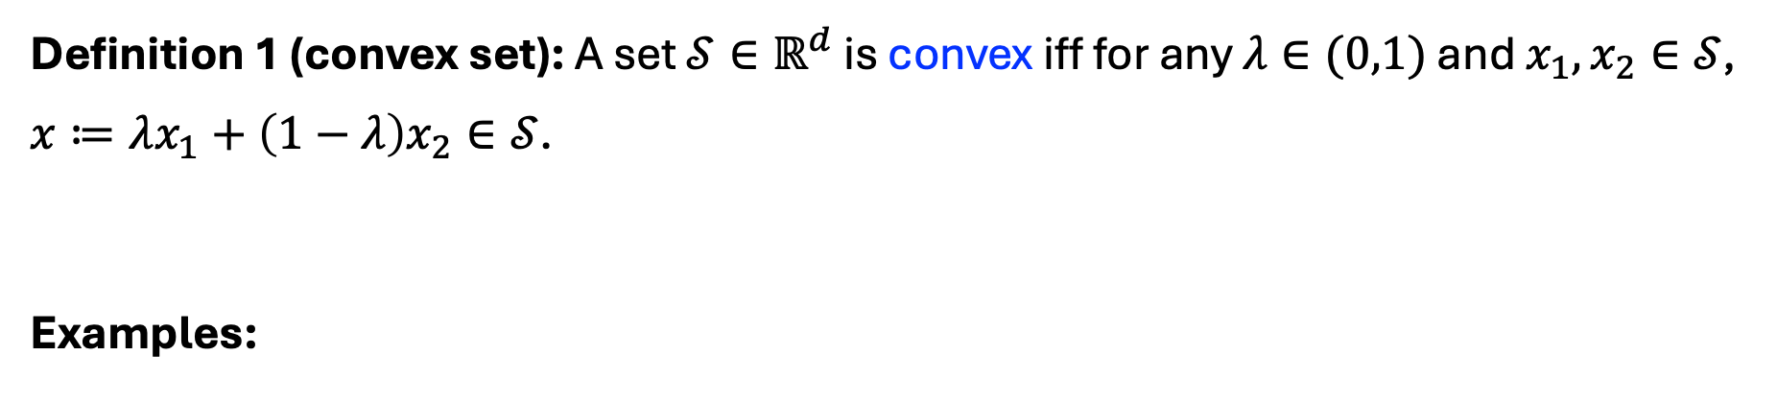
Convex set
Definition 1 (convex set): A set $𝒮∈ℝ^{d}$ is convex iff for any $λ∈(0,1)$ and $x_{1},x_{2}∈𝒮$, $x≔λx_{1}+\left(1−λ\right)x_{2}∈𝒮$.
Examples:

Slide 8
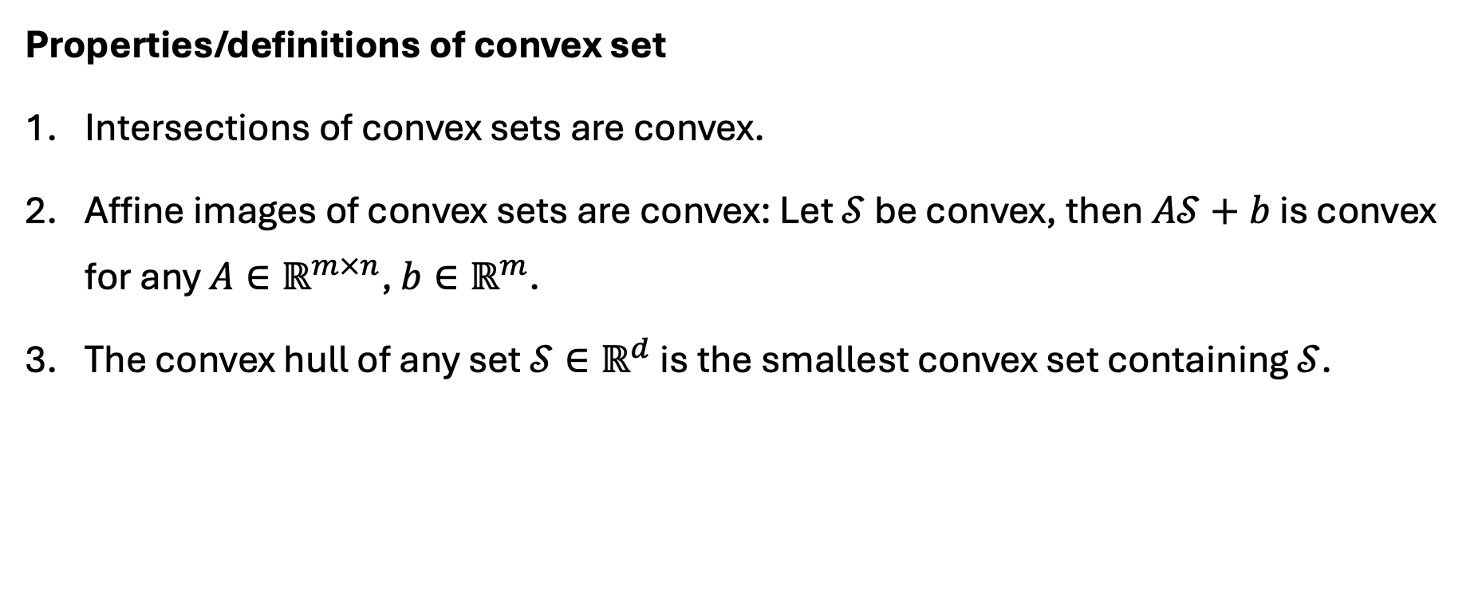
Convex set
Properties/definitions of convex set
Intersections of convex sets are convex.
Affine images of convex sets are convex: Let $𝒮$ be convex, then $A𝒮+b$ is convex for any $A∈ℝ^{m×n}$, ${b∈ℝ}^{m}$.
The convex hull of any set $𝒮∈ℝ^{d}$ is the smallest convex set containing $𝒮$.

Slide 9

Convex function
Definition 2 (convex function): A function $f:𝒳→ℝ$ is convex iff (1) $𝒳$is a convex set, and (2) for any $λ∈(0,1)$ and $x_{1},x_{2}∈𝒳$,
$λf\left(x_{1}\right)+\left(1−λ\right)f\left(x_{2}\right)≤f\left(λx_{1}+\left(1−λ\right)x_{2}\right)$.
Examples:

Slide 10
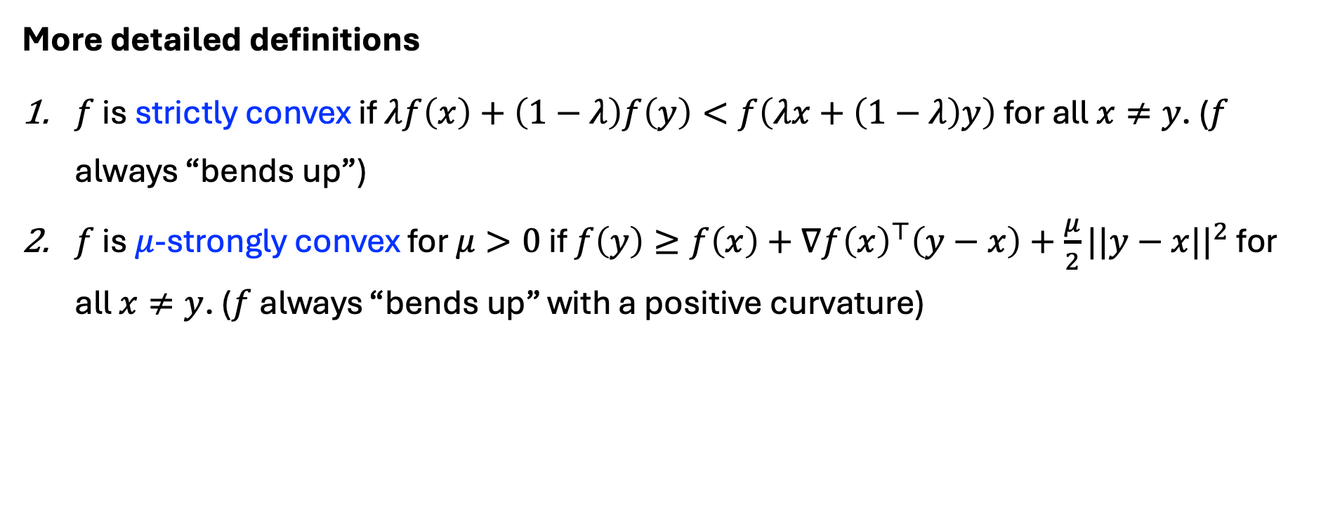
Convex function
More detailed definitions
$f$ is strictly convex if $λf\left(x\right)+\left(1−λ\right)f\left(y\right)<f\left(λx+\left(1−λ\right)y\right)$ for all $x≠y$. ($f$ always “bends up”)
$f$ is $μ$-strongly convex for $μ>0$ if $f\left(y\right)≥f\left(x\right)+∇f{\left(x\right)}^{⊤}\left(y−x\right)+\frac{μ}{2}||y−x||^{2}$ for all $x≠y$. ($f$ always “bends up” with a positive curvature)

Slide 11
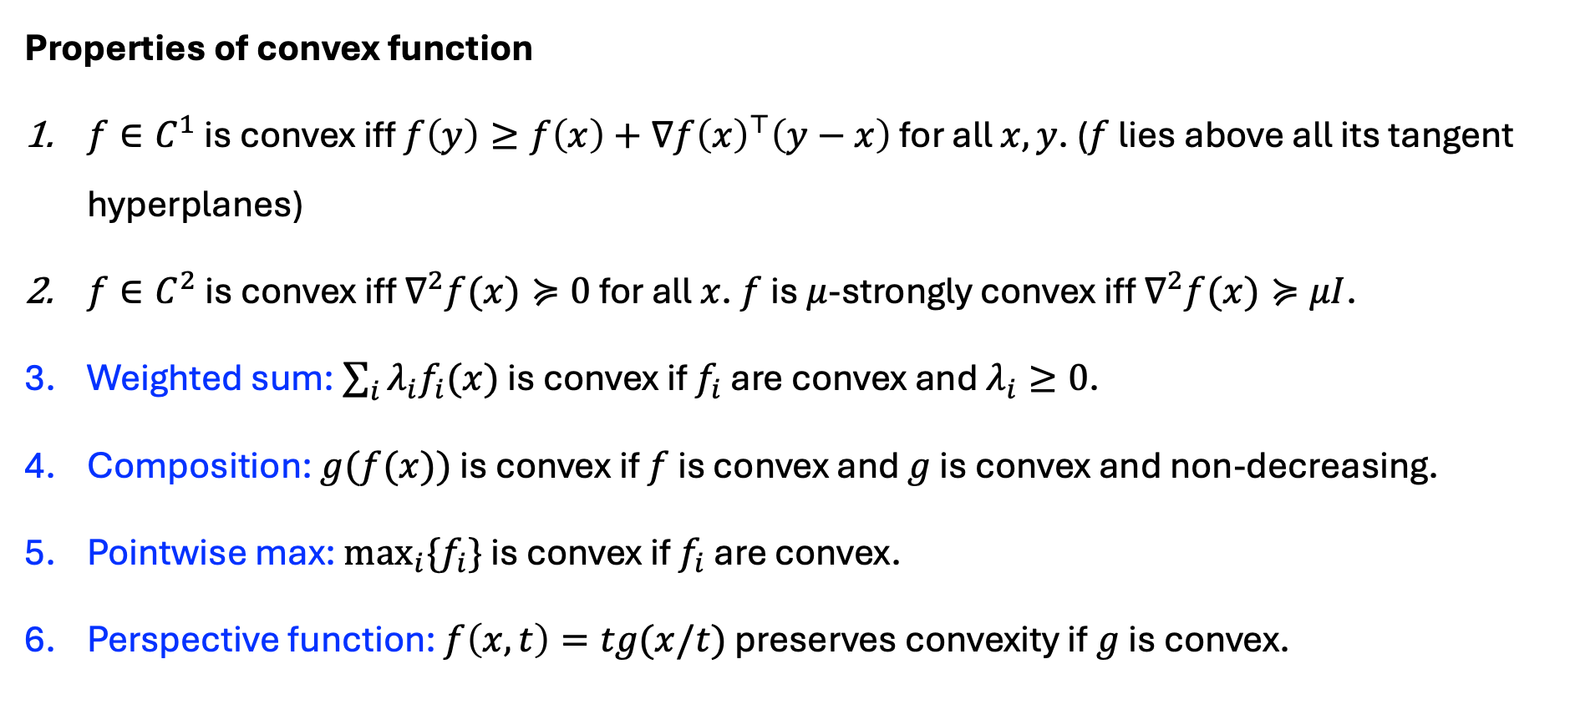
Convex function
Properties of convex function
$f∈C^{1}$ is convex iff $f\left(y\right)≥f\left(x\right)+∇f{\left(x\right)}^{⊤}\left(y−x\right)$ for all $x,y$. ($f$ lies above all its tangent hyperplanes)
$f∈C^{2}$ is convex iff $∇^{2}f(x)≽0$ for all $x$. $f$ is $μ$-strongly convex iff $∇^{2}f(x)≽μI$.
Weighted sum: $\sum_{i}{λ_{i}f_{i}(x)}$ is convex if $f_{i}$ are convex and $λ_{i}≥0$.
Composition: $g(f(x))$ is convex if $f$ is convex and $g$ is convex and non-decreasing.
Pointwise max: $\max_{i}{\{f_{i}\}}$ is convex if $f_{i}$ are convex.
Perspective function: $f\left(x,t\right)=tg⁡(x/t)$ preserves convexity if $g$ is convex.

Slide 12

Convex function
Proof of Property 1: $f∈C^{1}$ is convex iff $f\left(y\right)≥f\left(x\right)+∇f{\left(x\right)}^{⊤}\left(y−x\right)$ for all $x,y$. ($f$ lies above all its tangent hyperplanes)

Slide 13

Convex function
Proof of Property 2: $f∈C^{2}$ is convex iff $∇^{2}f(x)≽0$ for all $x$. $f$ is $μ$-strongly convex iff $∇^{2}f(x)≽μI$.

Slide 14

Convex function
Proof of Property 5: $\max_{i}{\{f_{i}\}}$ is convex if $f_{i}$ are convex

Slide 15

Convex function
Proof of Property 6: $f\left(x,t\right)=tg⁡(x/t)$ preserves convexity if $g$ is convex

Slide 16

Taylor expansion
Theorem 1 (Taylor expansion): Let $f\left(x\right)∈C^{2}$, $x_{0}∈dom(f)$, and $o\left(x\right)$ be a small term so that $\lim_{x→0}\frac{o\left(x\right)}{x}=0$, then
$$f\left(x\right)=f\left(x_{0}\right)+∇f\left(x_{0}\right)\left(x−x_{0}\right)+\frac{1}{2}{\left(x−x_{0}\right)}^{⊤}∇^{2}f\left(x_{0}\right)\left(x−x_{0}\right)+o(||x−x_{0}||^{2})$$
Examples:

Slide 17


Convex function in $C^{2}$
Theorem 2 (Convexity-Hessian): If $f\left(x\right)∈C^{2}$ and convex, then $∇^{2}f\left(x\right)≽0$ for all $x∈dom(f)$.
Examples:

Slide 18
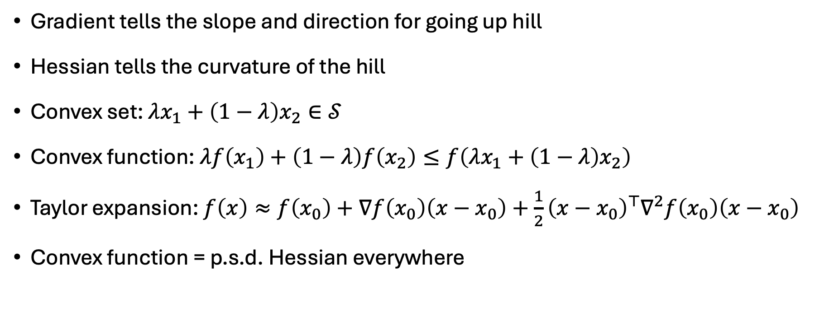
Summary
Gradient tells the slope and direction for going up hill
Hessian tells the curvature of the hill
Convex set: $λx_{1}+\left(1−λ\right)x_{2}∈𝒮$
Convex function: $λf\left(x_{1}\right)+\left(1−λ\right)f\left(x_{2}\right)≤f\left(λx_{1}+\left(1−λ\right)x_{2}\right)$
Taylor expansion: $f\left(x\right)≈f\left(x_{0}\right)+∇f\left(x_{0}\right)\left(x−x_{0}\right)+\frac{1}{2}{\left(x−x_{0}\right)}^{⊤}∇^{2}f\left(x_{0}\right)\left(x−x_{0}\right)$
Convex function = p.s.d. Hessian everywhere

